Slide 1
MOTIVATION

Slide 2
Motivation is originated from Latin word movere or Motum = motion,To Move
Something which moves, prompts, energize the organism
It is the process of arousing, directing, maintaining and controlling one’s interest in a particular activity

Slide 3
Motivation is an energy change that arouses, directs, and maintains behaviour of an organism to act for achieving a specific goal
It is a combination of forces which initiates , directs, and sustain behaviour towards specific goal
Motivation explains ‘why’ of the behaviour

Slide 4
MOTIVE: it is an inner state of mind or an aroused feeling generated through basic needs and drives which compel an individual to respond by creating a kind of tension or urge to act
Motive is an inclination or impulsion to action with a direction or orientation

Slide 5
Motives – two types:
- Primary Motive: linked with primary needs (biological or physiological needs)
Inborn and innate motives
- Secondary Motive: linked with socio-psychological needs
If motive is attached with a behaviour it is called as motivated behaviour

Slide 6
Motivation is the “ENERGY” in Learning Process
Initiate learning activity
Activate, direct, regulate, control the behaviour of the learner
Gives sustaining effect in the process
Reduce the tension and give satisfaction in the achievement

Slide 7
Types of Motivation
Intrinsic motivation:
- Natural motivation
- A force within the individual, work from within
- Activity carries its own reward
- Individual gets happiness and pleasure from within the activities - Genuine and real
- Create spontaneous attention and interest
- Sustains for a long time

Slide 8
2)Extrinsic Motivation:
- Artificial Motivation/incentive motivation
- The activity carries external reward
- Source of motivation is external to the activity
- Has no functional relationship with the task

Slide 9
Achievement Motivation
Desire to accomplish difficult task and meet standards of excellence
Related with competence, dominance, and pursuit of excellence
Motive to achieve something
Intense desire to perform with excellence for its own sake

Slide 10
Achievement Motivation and Learning
Perform well in learning
Higher the Achievement Motivation, higher the learning
Hard working, high aspirational level, excellent performance, satisfaction

Slide 11
Atkinson’s View on Achievement motivation
Achievement motivation is a function of the relative strength of the hope of success and the fear of failure
Achievement motivation determined by motivation towards success and motivation toward avoidance of failure

Slide 12
To develop motivation :
Make sure the students are ready to learn
Active participation in learning
Encourage Individual learning
Capture the attention of students
Proper organization of learning material
Maintain mild level of anxiety

Slide 13
To develop motivation :
Follow Child centered approach
Link with the past knowledge, life situations
Provide Different and direct learning experiences
Give Immediate feed back
Use proper reinforcement technique's
Provide Healthy classroom atmosphere and sources

Slide 14
To develop motivation :
Nurture Creativity, curiosity, construction, etc: among students
Set attainable goals
Provide rewards and punishments
Inspire students in all possible ways to have and fulfill their life goal/ aim
Provide examples of hero's
Teacher should be motivated enough, and have job satisfaction, enthusiastic..

Slide 15
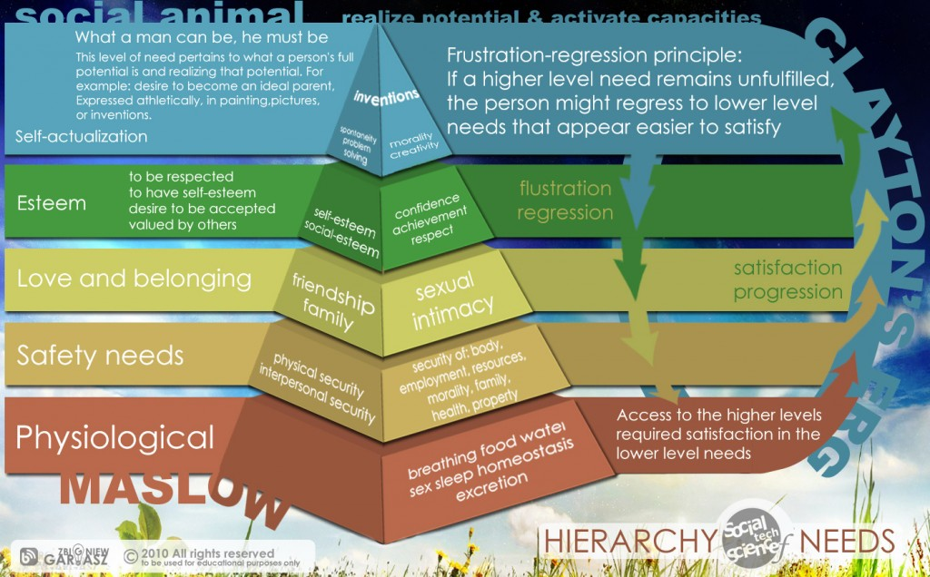
Maslow’s Hierarchical Structure of Needs

Slide 16
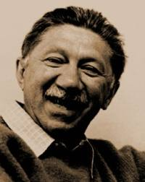
“Human has a
higher and
transcendent
nature.
Human being
is not a white rat”
Abraham Maslow

Slide 17
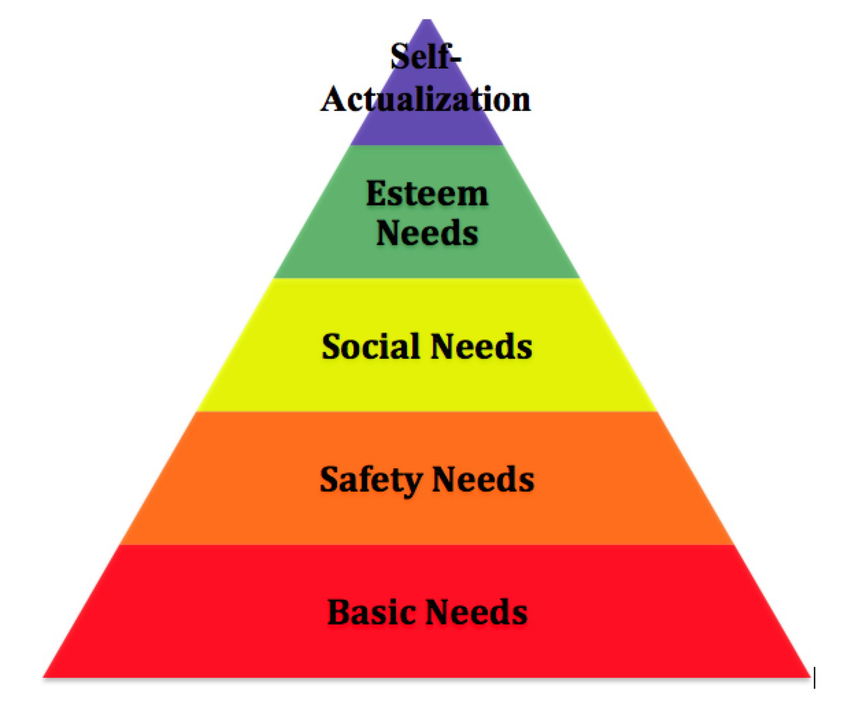

Slide 18
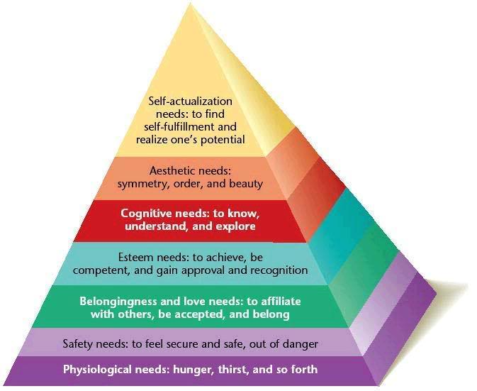

Slide 19
NEED DEPRIVATION: Deprived of some needs then motivated to do something.
NEED GRATIFICATION: more potent need emerges after gratify the less potent needs.

Slide 20
Physiological needs-most potent need, least significant for self actualized person
If deprived other needs disappear
All capacities are focusing on this
Philosophy changes

Slide 21
The Physiological needs:
They form the basic foundation of Maslow’s theory.
They are usually in the form of hunger, thirst and sex but there can be as many needs as one wishes.
The physiological needs are the most powerful of all needs.
If they remain unsatisfied the organism is dominated by them and all other needs go in the background. When they are satisfied, higher needs emerge and they predominate.

Slide 22
The Safety needs:
These are basically related to the security of a person.
They are most readily observable in the child because of his relative helplessness and dependence on adult.
Parental quarrels and threats of separation are particularly harmful to the child’s sense of security and wellbeing.
At adult level the individual seeks safety by establishing bank accounts, building a home and finding a job with an assurance.

Slide 23
Needs for love and belongingness:
When the individual seeks friends, longs for affectionate relationships and wishes to find a place in some group, these needs are said to be manifested.

Slide 24
Esteem needs:
These are represented in need for real self-respect and also a need for the esteem or recognition of others.
There are two types of esteem needs
- the desire for strength, achievement, confidence
- the desire for reputation, prestige, importance, attention and appreciation.
Lack of satisfaction of these needs results in discouragement, feelings of inferiority and inadequacy.

Slide 25
Self actualization
Fulfill one’s individual nature in all its aspects
Being what one can be
True to own nature
Ability to fulfill the basic potentialities of human nature
Reach to the life goal
Realize and actualize the aim of life

Slide 26
Characteristics of Self actualized Persons
Open to experiences
“Vividly, selflessly, with full concentration, and total absorption”
Tune with themselves, to inner being
Spontaneous, autonomous, fresh, un-stereotyped, appreciated by others
Devote total effort to life goal, wanting to be good or best as they could be

Slide 27
Appreciate “ basic goods of life”
Problem centered orientation
Dedicated, creative, unusual, responsible, balanced, simple, sence of humour
Related deeply with very few
They could detach and be personal
Demonstrate efficient perception of reality and acceptance
Accept themselves and others
Identity with mankind
Democratic out look
At times shows mysticism

