Slide 1
Module 5 - values
Meaning
Value comes from the Latin word ‘valere’ which means ‘to be of worth or to be strong.’
A value is what an individual desires, likes or prefers.
Moral ideas, general conceptions or orientations towards the world.
According to M. Haralambos (2000), “a value is a belief that something is good and desirable”.
For R.K. Mukerjee (1949 “values are socially approved desires and goals that are internalized through the process of conditioning, learning or socialization and that become subjective preferences, standards and aspirations”.

Slide 2
Common Human values
Brotherhood, friendship, empathy, compassion, and love.
Openness, listening, welcoming, acceptance, recognition, and appreciation.
Honesty, fairness, loyalty, sharing, and solidarity.
Civility, respect, and consideration.

Slide 3
Types of value
Intrinsic value is a value that one has of itself, independently of other things, including its context.
Extrinsic value is a property that depends on a thing’s relationship with other things. Extrinsic value is the value, which depends on how much it generates intrinsic value.
Personal values: values which are related with the development of human personality or individual norms of recognition and protection of the human personality such as honesty, loyalty, veracity and honor.

Slide 4
Social Values: values concerned with social aspects of human life. For example, truth, honesty, justice, kindness, generosity, tolerance, patriotism, perfection, excellence etc.
Spiritual values: The ultimate ethical value is called spiritual value. Spiritual values are piety, meditation, yoga, self-discipline, control, purity, and devotion to God etc.
Universal Values : Values that we link ourselves with humanity and the cosmos. Universal Values can be experienced as life, joy, brotherhood, love, compassion, service, bliss, truth and eternity.
Moral or Ethical value: It is also known as logical values- sensation, perception and thought.

Slide 5
Aesthetic value: appreciation of beauty from proportion and harmony, love for fine arts, drawing painting, music, dance etc.
Democratic value: Democratic value is characterized by respect for
individuality, absence of discrimination among persons on the basis of sex, language, religion, caste, color etc.
Environmental values: Environmental values have their contribution in disciplines like geography, sociology, anthropology, philosophy, economics, politics, ecology and other disciplines, which share the current and prospective environment of human beings and other species.

Slide 6
Characteristics
specific, such as honoring one’s parents or owning a home .
different from culture to culture.
extremely practical
provide standards of competence and morality.
relatively permanent.
more central to the core of a person.
loaded with effective thoughts about ideas, objects, behavior, etc.

Slide 7
integration and fulfillment of man’s basic impulses and desire stably and consistently appropriate for his living.
build up societies, integrate social relations.
mold the ideal dimensions of personality and depth of culture.
influence people’s behavior and serve as criteria for evaluating the actions of others.
great role to play in the conduct of social life.

Slide 8
Importance of values
Values Help in Decision Making
Values Can Give Direction to Our Life
Values Can Build Character
Values Can Help in Building a Society
Economic Progress
Social relations
Love, peace and happiness
Standard of living

Slide 9
bloom the children and achieve their goals by the means of
righteous paths.
Non-violence

Slide 10
Role of values in life
Values reflect our sense of right and wrong.
They help us grow and develop.
They help us create the future we want.
Individual values reflect how we live our life and what we consider important for our own self-interests.

Slide 11
Personal values
Beliefs we hold most dear.
Desirable goals that motivate our actions and guide us through our lives.
Values often weave into our personalities and define who we are.
Influence our decisions and actions.
Differ from person to person and are often affected by one’s culture, upbringing and life experiences.
Reflect on personality and behaviors
Expressed through actions, words and behaviors.

Slide 12
ROLE OF VALUES IN PERSONAL LIFE
Help you lead a more authentic and fulfilling life.
Increases self-awareness
Influences our outcomes
Improves quality of life
helps gain self-respect
helps be clear about your expectations
helps in decision-making
helps stay motivated, focused and engaged
Helps enjoy your life

Slide 13
IN SOCIAL LIFE
Help to progress
manage the common actions of individuals in a society
Expand the identity of a society and culture
Provide tools for self-realization
make society and people work better
Change human behavior
bring something positive to the common welfare
Provide personal satisfaction
Facilitate socialization

Slide 14
Aspects of values
Moral values
Moral values ​​serve to make decisions that are framed within ethics. Morality tells us how to act in specific situations, and allows us to respond to the question "what should we do?“ in the face of each situation.
Moral values ​​seek the happiness and self-realization through kindness, honesty and other human virtues, with preponderance of freedom directed by reason.

Slide 15
Ethical values
Ethics takes actions in function of the moral beliefs of the individual. Basically they are the same moral values, but if you will, in a more pragmatic field.
Moral values ​​act in a more philosophical field, more internal of the person , the decisions and actions taken as a result of their reflection, determine their ethical values.
All universal, human or personal values ​​are ethical values, since they have a strong moral burden.

Slide 16
Aesthetic values
They have the ultimate purpose of beauty, and to get it involved other aspects such as harmony and balance. It refers to physical properties that produce aesthetic enjoyment.
Spiritual and religious values
beliefs that are given by faith
associated with immaterial and intangible aspects
govern the behavior of the human being in the other aspects of his life. Here we find basically Faith and Holiness.

Slide 17
Material Values
values ​​are related to material goods that cover basic needs such as clothing, food, health and leisure.
Economic values
economic value, usually refers to the material, commercial or monetary value of some good or physical object.

Slide 18
Value and principle
Values are qualities or standards that govern the behavior of a person and principles are rules or beliefs that govern our actions.
difference between values and principles is that principles are based on a person’s values.
values act as the foundation for principles.
principles are sometimes equivalent to rules, they can be quite stern and unyielding.
For example, if a person values nonviolence, he’ll never get into fights with others or behave aggressively.

Slide 19
Customs and traditions
The word tradition derives from the Latin tradere literally meaning to transmit, to hand over, to give for safekeeping.
A tradition is a way of behaving, thinking or doing something that has been followed by people in a particular community, society, family, etc. for a long time.
Traditions may be adapted to suit the needs of the day, and the changes can become accepted as a part of the ancient tradition.
Tradition changes slowly, with changes from one generation to the next being seen as significant.

Slide 20
A custom is a usage or practice common to many or a particular place or group of people.
The commonly accepted way of behaving or doing something in a particular society, place or time.
EXAMPLE
In some countries you take your shoes off before entering the house.
In some places they sit on the floor and eat.

Slide 21
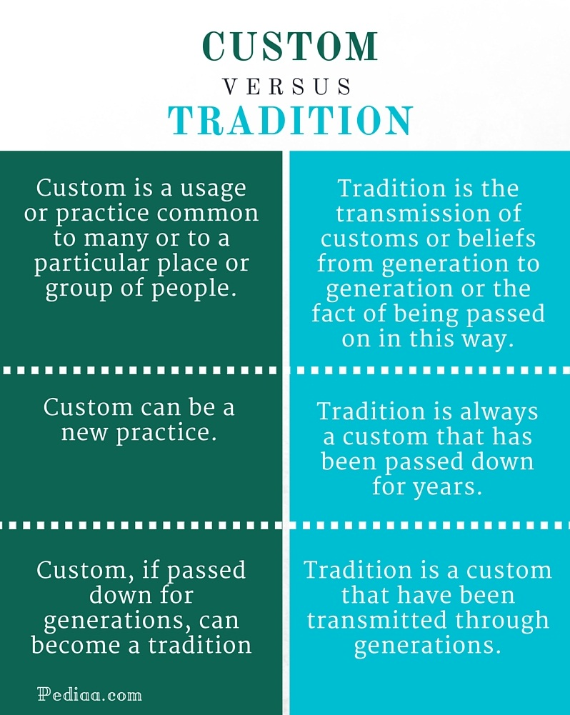

Slide 22
Difference between Customs and Traditions
Difference between a custom and a tradition seems to be the length of time and observance by a larger section of the society.
A tradition is a practice that has been passed down over generations and observed by most people of a society or culture while custom could be short lived and even observed at a family or individual level.
All traditions could qualify as customs, not all customs can be referred to as traditions.

Slide 23
LAWS AND RULES
For people to live together in this world in harmony, there must be certain rules and laws to regulate and justify proper behavior and functioning.
A rule is a set of guidelines to regulate a practice or procedure of any activity.
A law is a system of rules that help govern the members or citizens of a country or community.

Slide 24
Rules are applicable for any kind of society, institution, association or any activity.
Laws are generally applicable for an entire country or community.
Rules can be made by a secretary of the association, headmistress of an educational institution, etc.
Laws can be made only by the Legislature of India (or any other legislative body in their respective country)
Not following the rules can often lead to mild consequences such as the payment of an amount as fine, suspension, etc.
Not adhering to laws can lead to strict and severe consequences such as imprisonment.

Slide 25
Examples
Certain rules that are frequently found in academic institutions are: –
Mobile phones or any other electronic gadgets are not allowed.
Students are expected to follow the decorum of the institution.
Wear uniform daily
laws
. Marriage laws
Citizenship laws
Land laws

Slide 26
SOURCES OF VALUES
A significant portion of the values we hold is established in our early years from parents, teachers, friends, and others.
Family: Family is a great source of values. A child learn first value from his family.
Friends & peers: Friends and peers play a vital role in achieving values.
Community or society: As a part of society, a person learn values from society or different groups of society.

Slide 27
School: As a learner, school and teachers also play a very important role in introducing values.
Media: Media such as – Print media, Electronic media also play the role of increasing values in the mind of people.
Relatives: Relative also helps to create values in the minds of people.
Organization: Different organizations and institutions also play a vital role in creating value.
Religion.
History.
Books.
Others.

Slide 28
Educational implications of values
Helps the students to become more and more responsible and sensible.
Helps them to understand the perspective of life in a better way and lead a successful life as a responsible citizen.
Helps students to develop a strong relationship with family and friends.
Development of children's personality in its physical, mental, emotional and spiritual aspects.
Values education can show which morals are "bad" morals and which are "good".

Slide 29
Value conflict
Value conflict occurs when individuals or groups of people hold strong personal beliefs that are in disagreement within themselves or in disagreement with the institution’s/ organization’s values. These may include religious differences, cultural differences or differences in upbringing.
Examples of value conflict in the workplace can include employees who want to spend more time at home with family than in the office or employees who disagree on appropriate methods through which to complete a shared task.

Slide 30
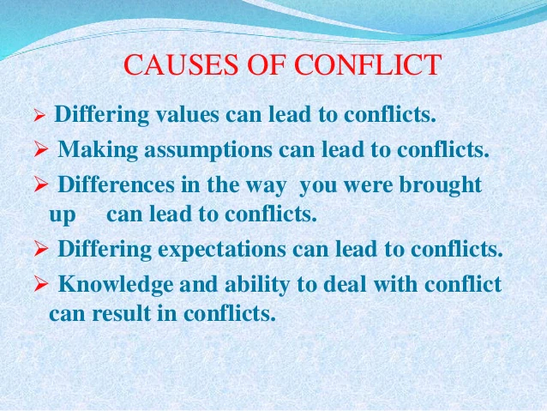

Slide 31
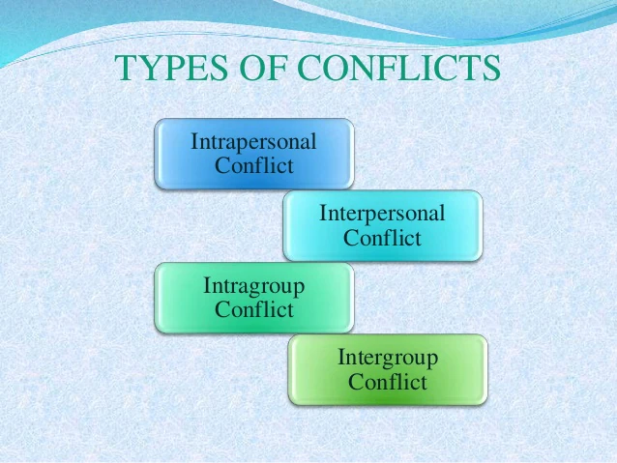

Slide 32
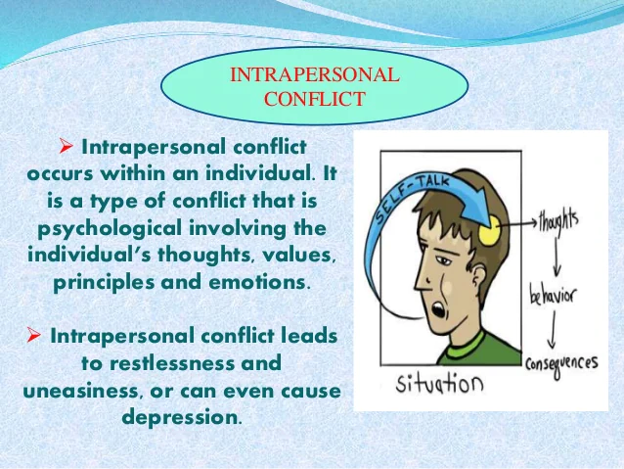

Slide 33
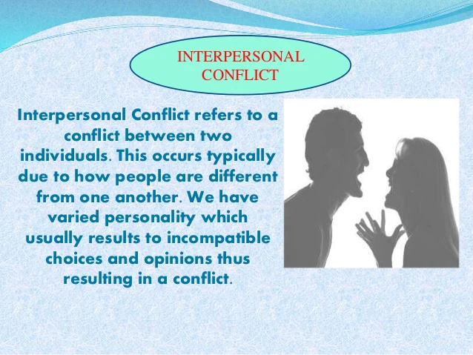

Slide 34
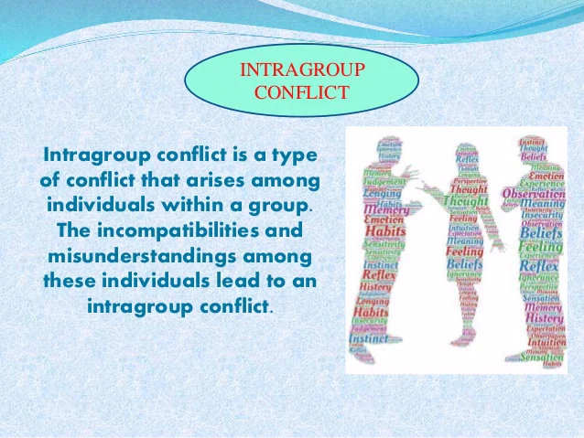

Slide 35
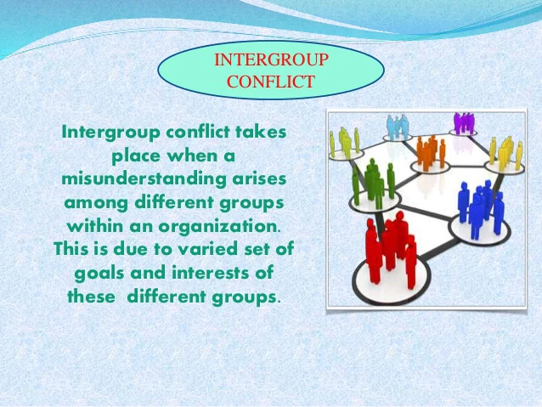

Slide 36
Conflict resolution
Conflict resolution is a way for two or more parties to find a peaceful solution to a disagreement among them. The disagreement may be personal, financial, political, or emotional. When a dispute arises, often the best course of action is negotiation to resolve the disagreement

Slide 37
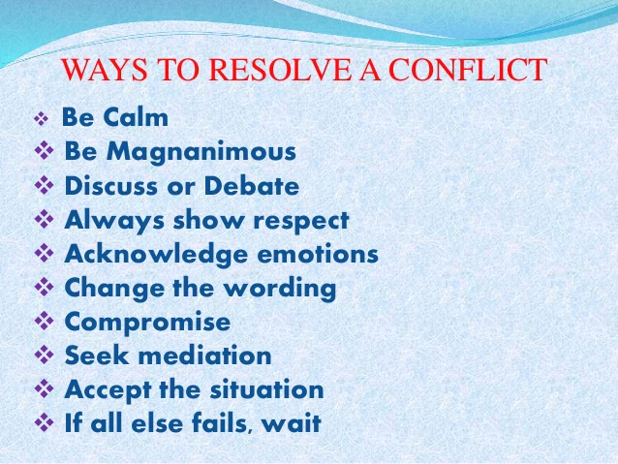

Slide 38
Methodology of teaching values
The methodology for teaching values in education includes several methods. One method is the ‘Direct Method’.
With this method a values lesson plan is taught to children as part of a dedicated class in character development.
The topics of Personal, Social and/or Health education
Five teaching methods included within the ‘Direct Method’.
1 ‘Theme for the Week’- theme is based on the value that is the focus for the week.
theme can be in the form of a quotation, short poem or universal prayer.

Slide 39
2.Silent Sitting. In silent sitting the teacher will goes through a simple relaxation exercise with the children where they follow the instructions given. Examples of these silent sitting exercises include:
Alternately tensing and relaxing muscles in different parts of the body.
Becoming aware through listening to different sounds and speech.
Self-awareness through being aware of one’s own breath.
Taking part in listening to a guided visualization exercise. An example of a guided visualization is an autumn leaf falling down into a stream, and then being gently carried out to a vast calm sea.

Slide 40
These exercises are done with the eyes closed for about five minutes
exercises quiet the minds of children
reducing stress.
3. Story Telling
Important way to teach children about:
1. Life
2. their own identity
3. their relationship to the world about them

Slide 41
4.Group singing is a powerful tool for enhancing the value being taught in the lesson.
5.Group activities. This covers a whole range of activities such as:
community service projects
drama
games
art
craft work
'Indirect Method' –through subjects like mathematics geography, language ,arts and writing.

Slide 42
OBJECTIVES OF VALUE BASED EDUCATION:
All aims of education are invariably rooted in values.
• To provide realistic and broad based understanding of human values and educate students to become responsible citizens in their personal and social life.
• To develop and promote the values such as truth, humility, honesty, perseverance, cooperation, compassion, love etc
• To enable students understand, appreciate, uphold, protect and promote the sovereignty, unity and integrity of India.

Slide 43
• To develop spirit of scientific inquiry and scientific temper and capacity for original and independent thinking.
• To offer science education conducive to the development of physical, intellectual , moral, social , spiritual and economic aspects of life.
• To enable students to distinguish between good and bad, right and wrong.
• To develop respect for the dignity of the individual and society.

Slide 44
Indian concept of values-Purusharthas
Purusharthas are the inherent values of the Universe: Artha (economic values), Kama (pleasure), Dharma (righteousness), and Moksha (liberation). The Purusharthas are the blueprint for human fulfillment. Purushatha means “for the purpose of the Self.
literally means an "object of human pursuit". It is a key concept in Hinduism, and refers to the four proper goals or aims of a human life.
Purusartha is a key concept in Hinduism, which holds that every human has four proper goals that are necessary and sufficient for a fulfilling and happy life.

Slide 45
Dharma –Hindu dharma includes the religious duties, moral rights and duties of each individual, as well as behaviors that enable social order, right conduct, and those that are virtuous.
Dharma, according to van Buitenen,is that which all existing beings must accept and respect to sustain harmony and order in the world.
The pursuit and execution of one's nature and true calling, thus playing one's role in cosmic concert.

Slide 46
Artha-signifies the "means of life", activities and resources that enables one to be in a state one wants to be in. Artha incorporates wealth, career, activity to make a living, financial security and economic prosperity.
Kama – signifies desire, wish, passion, emotions, pleasure of the senses, the aesthetic enjoyment of life, affection, or love, with or without sexual connotations. Gavin Flood explains kāma as "love" without violating dharma (moral responsibility), artha (material prosperity) and one's journey towards moksha (spiritual liberation).
Moksha – signifies emancipation, liberation or release. In some schools of Hinduism, moksha connotes freedom from saṃsāra, the cycle of death and rebirth, in other schools moksha connotes freedom, self-knowledge, self-realization and liberation in this life.

Slide 47
Constitutional values
Constitution means a set of fundamental-
principles, basic rules and established precedents (means standards/instances).
It identifies, defines and regulates various aspects of the State and the structure, powers and functions of the major institutions under the three organs of the Government – the executive, the legislature and the judiciary.
It also provides for rights and freedoms of citizens and spells out the relationships between individual citizen and the State and government.

Slide 48
The constitutional values are reflected in the entire Constitution of India, but its Preamble embodies ‘the fundamental values and the philosophy on which the Constitution is based’.
The Preamble to any Constitution is a brief introductory statement that conveys the guiding principles of the document.
The values expressed in the Preamble are expressed as objectives of the Constitution.
These are: sovereignty, socialism, secularism, democracy, republican character of Indian State, justice, liberty, equality, fraternity, human dignity and the unity and integrity of the Nation.

Slide 49
1. Sovereignty: India is “a sovereign socialist secular democratic republic”.
Being sovereign means having complete political freedom and being the supreme authority.
India is internally all powerful and externally free to determine for itself without any external interference (either by any country or individual) and nobody is there within to challenge its authority.
2.Socialism: socialism has been aimed at promoting social change and transformation to end all forms of inequalities.
to prevent concentration of wealth and power in a few hands.
provisions under the Directive Principles of State Policy promote
the value of socialism:

Slide 50
“The State shall, in particular, strive to minimise the inequalities in income, and endeavour to eliminate inequalities in status, facilities and opportunities, not only amongst individuals but also amongst groups of people residing in different areas or engaged in different vocations. “ (Article 38(2).
(a) the citizens, men and women equally, have the right to an adequate means of livelihood;
(b) the ownership and control of the material resources of the community are so distributed as best to subserve the common good;
(c) the operation of the economic system does not result in the concentration of wealth and means of production to the common detriment;
(d) there is equal pay for equal work for both men and women;…” (Article 39)

Slide 51
3. Secularism: Secularism implies that our country is not guided by any one religion or any religious considerations.
It allows all its citizens to profess, preach and practise any religion they follow.
it ensures that the state does not have any religion of its own.
Constitution strictly prohibits any discrimination on the ground of religion.
4. Democracy: The people elect the rulers of the country and the elected representatives remain accountable to the people.
The people of India elect them to be part of the government at different levels by a system of universal adult franchise, popularly known as ‘one man one vote’.
Democracy contributes to stability, continuous progress in the society and it secures peaceful political change.

Slide 52
5 Republic: India is not only a democratic nation but it is also a republic.
the office of the Head of the State is the President who is elected and not selected on the basis of heredity.
every citizen of India is equally eligible to be elected as the Head of the State.
Political equality is the chief message of this provision.
6 Justice: the constitution-makers have included social, economic and political justice as constitutional values.
a just and egalitarian society remains as one of the foremost values of the Indian Constitution.

Slide 53
7 Equality: The Constitution ensures equality of status and opportunity to every citizen for the development of the best in him/her.
8 Liberty: The Preamble prescribes liberty of thought, expression, belief, faith and worship as one of the core values. These have to be assured to every member of all the communities.
9 Fraternity: it stands for the spirit of common brotherhood among all the people of India. In the absence of fraternity, a plural society like India stands divided.
10 Dignity of the individual: equal participation of every individual in all the processes of democratic governance.

