Slide 1
The humanistic approach
Contribution of humanistic school of psychology.
It believes goodness of man & his positive nature.
Free will+freedom of choice +conscious
experience = Personality.
Potential (intellectual, emotional) for Self actualization

Slide 2
HUMANISTIC APPROACH TO PERSONALITY- CARL ROGER
Growth, development & appropriate adjustment to his environment-individual self
Carl Rogers (1902-1987)
HUMANISTIC PSYCHOLOGIST(1947)

Slide 3
Two basic systems:-
1.ORGANISM
Totality of one’s experience(conscious &unconscious).
-
2.THE SELF
Totality of ideas,feelings,and attitude about himself.
PHENOMINOLOGICAL FIELD
(A world of subjective experience, the personal and separate reality of each individual)

Slide 4
Acquisition of the concept of self is a long process.
Develop their self – interpersonal
social experiences
Two facets
SELF
REAL SELF
(self as it really is as a result of one’s experience)
IDEAL SELF
(self one would like to be)

Slide 5
False self image :-Unfortunate results in the development of personality.
Inconsistency between one’s actual image and a false image leads abnormality in behavior.
Development of an ideal self ,too unattainable,unreasonable,or
different from real self results
Maladjustment or
serious personality disorder.

Slide 6
An individual adjustment,happiness,growth and development all depend upon the unity and harmony between the image of his self and organism.
Self actualization lead to harmony between the concept of self and real life experiences .
The goal – bringing the individual in a unified way from WHAT HE / SHE IS NOT to WHAT HE / SHE REALLY IS.

Slide 7
ROGER’S VIEW OF PERSONALITY DEVELOPMENT
Poorly adjusted well adjusted
personality personality
Little overlap between experience and self concept
Much overlap between experience and self concept
The self(self concept)
The organism(experience)

Slide 8
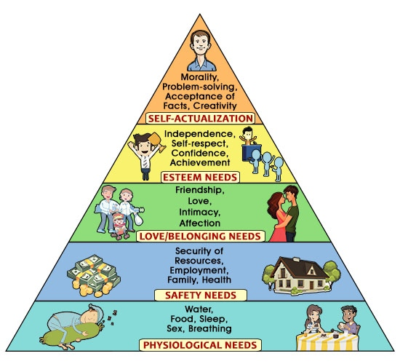
The self actualization theory of Maslow

Slide 9
Craving for the actualization of his inner potential continues till he reaches his ultimate goal of attaining fine humanistic values.
Maslow concluded that self actualized people have the following common characteristics which distinguish them the average person.
Ability to perceive reality accurately
Willingness to accept reality readily
Naturalness and spontaneity
Ability to focus on problems rather than on themselves
Need for privacy

Slide 10
6. Self sufficiency and independence
7. Capacity for fresh, spontaneous appreciation of events and people
8. Attain transcendence
9. Identification with humankind and shared social bonds
10. Deep relationship with some of friends
11. Democratic attitude
12. Strongly held values and clear distinction between means and ends.
13. A broad tolerant sense of humour

Slide 11
14. Inventiveness and creativity with the ability to see things in new ways
15. Resistance to confirm or give in to social pressures
16. Ability to go beyond and bring together opposites.
This theory is criticized because its not being objective and scientific in approach, especially subjective criteria of self actualisation.

Slide 12
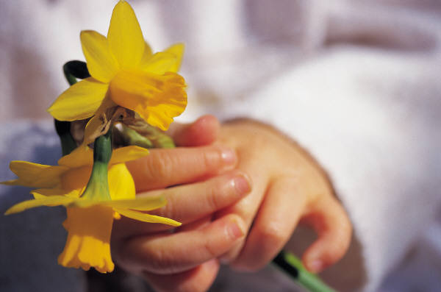
THANK YOU

