Slide 1
HUMANISTIC SCHOOL
Focused on the positive side of personality, the heights that each individual is capable of attaining.
The finer side of human nature- creativity,beauty,justice,uniqueness,self-actulisation, transcendence….
Positive approach to life
Sublimation of needs are possible
Abraham Maslow, Carl Roger

Slide 2
HUMANISTIC PSYCHOLOGY-
Emphasizes an optimistic view of human beings, as persons who have the ability to grow (human potential)
Though it does not deny the effect of the environment, it sees human beings as able to transcend it to some degree
It stresses - health and actualization
It is a reaction against a deterministic view of human beings

Slide 3
Study of Psychology that focuses on the study of the whole person.
Look at behavior not only through eyes of observer, but through eyes of person.
Study -the meanings, understandings, and experiences involved in growing, teaching, and learning

Slide 4
Study how people are influenced by their self-perceptions and the personal meanings attached to their experiences.
Focus on peoples responses to internal needs in shaping behavior.
They emphasize characteristics that are shared by all human beings such as love, grief, caring, and self-worth.

Slide 5
Humanistic Psychology: the Third Force
Psychoanalysis has sometimes been called the "first force" in psychology
Behaviorism was the second force
Both first and second forces are deterministic in their view of people
Humanistic psychology saw itself as the third force, stressing human freedom and human potential

Slide 6
Humanistic psychologists are not primarily concerned with instinctual drives, responses to external stimuli, or past experiences. Rather, they consider conscious choices, responses to internal needs, and current circumstances to be important in shaping human behavior.

Slide 7
Basic Assumptions
An individuals behavior is primarily determined by his/her perception of the world around him
  Perception: Allows us to organize, interpret, and act on outside stimuli based on past experiences
Individuals are not solely the product of their environment
Individuals are internally directed and motivated to fulfill their human potential

Slide 8
Humans have free will; not all behavior is determined.
All individuals are unique and have an innate (inborn) drive to achieve their maximum potential.
A proper understanding of human behavior can only be achieved by studying humans - not animals.
Psychology should study the individual case (idiographic) rather than the average performance of groups (nomothetic)

Slide 9
The Human Potential Movement
Both Maslow and Rogers were part of the "human potential movement"
Part of the 1960's mindset, emphasizing the realization of individual potential, was much more open to spiritual perspectives than classical psychoanalysis or behaviorism
In addition to individual therapy, this movement led to the use of encounter groups, team training etc..
It also fostered a holistic approach to health and was sympathetic to techniques like meditation, proper nutrition, exercise etc…

Slide 10

Abraham Maslow
1908-1970

Slide 11
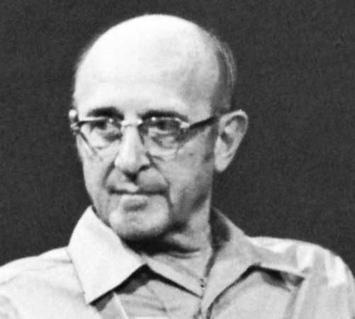
Carl Rogers (1902-1987)
Co-Founder of Humanistic Psychology with Abraham Maslow
Main contribution was in clinical therapy and applications of Humanism
Started Person-Centered Psychology

Slide 12
Humanistic Movement in Education
Emphasized the Idea that students have a need to become self-actualized adults.
  Need classroom freedom to be creative and gain a desire to learn.
Basic Objectives of Humanistic Education are to encourage students to:
  Be self-directed and independent
  Take responsibility for their learning
  Be creative and interested in the Arts
  Be Curious about the world around them
  Ask Questions - Why, What, Who says, Purpose?

Slide 13
Strengths
Emphasizes individual choice and responsibility
Satisfies most people’s idea of “the being human”
it values personal ideas and self-fulfillment
Provides researchers flexible framework for observing behavior
it considers the person

Slide 14
Weaknesses
Many concepts are too vague
Experiences can be taken different ways by different individuals
  Makes conclusions formed from experiences hard to verify
  Makes research unreliable
Not a true science : it involves too much common sense and not enough objectivity

