Slide 1
MODULE 2
COMPLEXITIES IN ADOLESCENCE

Slide 2
2.1: CHARACTERISTICS OF ADOLESCENCE
2.2:NEEDS OF ADOLESCENCE
2.3:PROBLEMS OF ADOLESCENCE
2.4:MANAGEENT OF ADOLESCENT PROBLEMS
2.5:HELPING ADOLESCENCE FOR BETTER ADJUSTMENT

Slide 3
Needs and problems of Adolescence

Slide 4
Needs and problems of Adolescence
Rapid physical development – for well balanced body –nutritive food, physical exercise, physical education, games
Extreme imagination & sentimentality – channelise to literature, music, painting
Development of mental abilities – thinking, problem solving, evaluating….-provide materials for thought and problem solving
Sexual development – sex education, clear their doubts, help them to overcome the anxieties and worries …develop interest in sports and games, cultivate good hobbies…

Slide 5
Needs and problems of Adolescence
Hero worship and idealisation – give good models through books, media….teacher should be a good model
Extroverts and introverts – group activities, social mildness, encourage to give service to the society
Peer group influence – encourage to mingle with good friends
Rationalization and critical - provision for value education, religious teachings

Slide 6
Needs and problems of Adolescence
Rebel against customs and traditions – help them to distinguish good and bad customs and traditions , spirit of nationality
Strong desire to achieve independence - make them to understand the meaning of freedom
Achieve a good career – career guidance, vocational guidance
Want to achieve self acceptance, Self esteem – psychological classes, awareness programmes, workshops, camps, be affectionate and sympathetic towards them

Slide 7
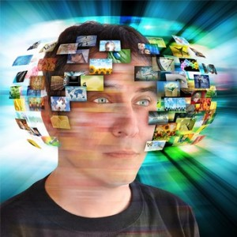
Information
Overloading

Slide 8
A situation in which you get more information
than you can deal with at one time and become tired and confused.
Stress induced by reception of more information than is necessary to make a decision (or that can be understood and digested in the time available) and by attempts to deal with it with outdated time management practices.
Information overload is a description given to the phenomenon where so much information is taken in by the human brain that it becomes nearly impossible to process it.

Slide 9
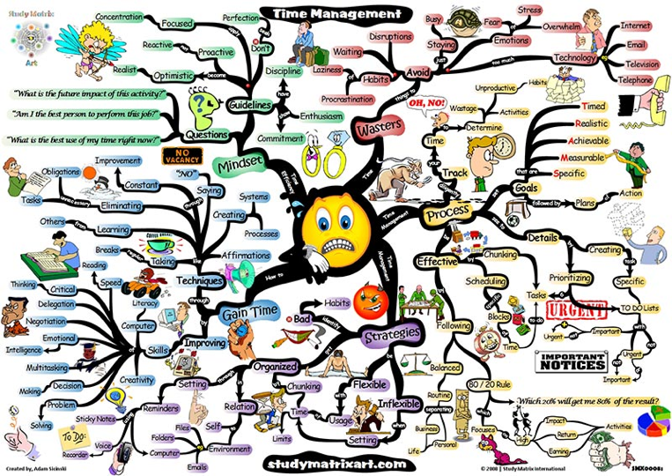

Slide 10
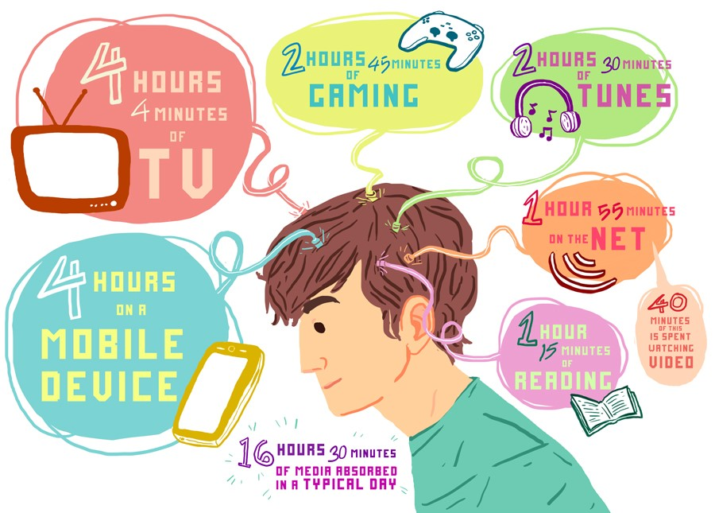

Slide 11
Teenagers are living in a world where they are constantly attached to headphones, and focused on multiple screens, resulting in their brains not having time to absorb anything and constantly doing two things poorly rather than one thing properly.

Slide 12
“We have become far more proficient in generating information than we are in managing it, and we have also built technology that easily allows us to create new information without human intervention.”
~Jonathan B. Spira

Slide 13
Information overload (also known as infobesity or infoxication) refers to the difficulty of a person can have understanding an issue and making decisions that can be caused by the presence of too much information.

Slide 14
The term is popularized by Alvin Toffler in his bestselling book ‘Future Shock’ (1970).

Slide 15

Speier et al. (1999) stated:
“Information overload occurs when the amount of input to a system exceeds its processing capacity.
Decision makers have fairly limited cognitive processing capacity. Consequently, when information overload occurs, it is likely that a reduction in decision quality will occur.”

Slide 16
In recent years, the term "information overload" has evolved into phrases such as "information glut" and "data smog" .
Information technology may be a primary reason for information overload due to its ability to produce more information more quickly and to disseminate this information to a wider audience than ever before .

Slide 17
In the modern information age, information overload is experienced as distracting and unmanageable information such as email spam, email notifications, instant message, tweets and Facebook updates in the context of the work environment.
Social media has resulted in "social information overload," which can occur on sites like Facebook, and technology. is changing to serve our social culture.

Slide 18
where does information overload come from?
the desire to know and to be a part of things.
18

Slide 19

As the variety of available communication systems has increased, so have concerns about information overload

Slide 20

Students and other individuals engaged in research intensive activities sometime experience information overload

Slide 21
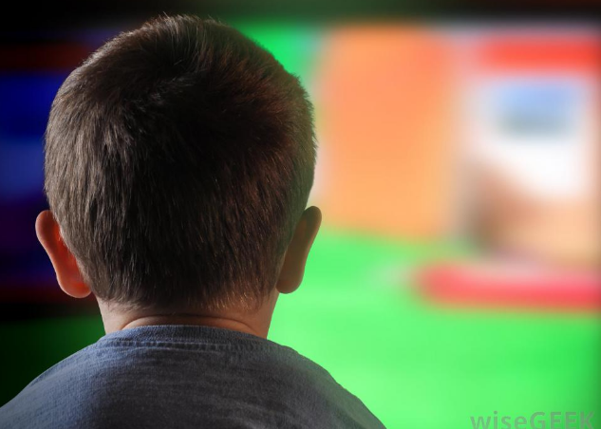
Watching television can cause information overload
  The U.S. Department of Health and Human services has published findings that TV might actually cause learning disorders, so try instating a
  family reading time instead.

Slide 22

The ease of information access online is contributing to information overload.

Slide 23

Many people believe cellphones with wireless internet access are contributing to information overload

Slide 24
GENERAL CAUSES OF INFORMATION OVERLOAD
A rapidly increasing rate of new information.
The ease of duplication and transmission of data across the Internet.
An increase in the available channels of incoming information (e.g. telephone, e-mail, instant messaging, RSS (Rich Site Summary: publish frequently updated information: Blog entries, news headlines, audio, video)
Ever-increasing amounts of historical information to dig through

Slide 25
Contradictions and inaccuracies in available information
A lack of a method for comparing and processing different kinds of information
The pieces of information are unrelated or do not have any overall structure to reveal their relationships

Slide 26
The widespread access to the Web
The ease of sending e-mail messages to large numbers of people
As information can be duplicated for free, there is no variable cost in producing more copies
Poorly created information sources (especially online), which:
  are not simplified or filtered to make them shorter
  are not written clearly, so people have to spend more time understanding them
  contain factual errors or inconsistencies – requiring further research

Slide 27
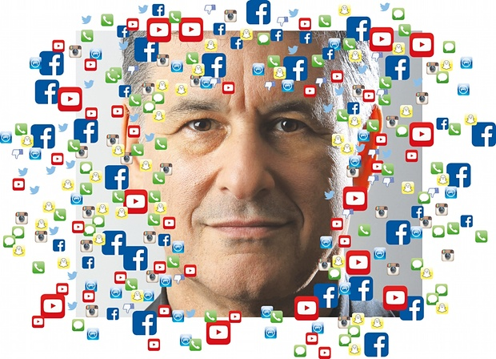
By constantly bombarding their brains with digital information
“people think they’re refreshing themselves, but they’re fatiguing themselves.
If brains need time to out to properly absorb and retain information, when do our teenagers get time to consolidate what they have learned?

Slide 28
after school, between the hours of 3-6pm that teens were most likely to be watching TV while surfing the Internet.
Teenagers are natural multi-taskers???.
  While they obviously do multi-task naturally, there are serious questions about how effective their efforts actually are.

Slide 29
Symptoms which accompany IOL
Increased cardiovascular stress, due to a rise in blood pressure,
Weakened vision (siting a Japanese study which predicts a nearly universal near-sightedness in the close future)
Confusion and frustration
Impaired judgment based upon overconfidence,
Decreased benevolence to others due to an environmental input glut

Slide 30
No relaxation time
Problems related with the memory and short attention span
Feel tired constantly
No regular exercise
“Unconscious back up” of information loaded
Discomfort in body, problems related with borne and spinal cord

Slide 31
Solutions
Spending less time on gaining information that is nice to know and more time on things that we need to know now.
Focusing on quality of information, rather than quantity. A short concise e-mail is more valuable than a long e-mail.

Slide 32
Learning how to create better information (this is what Infogineering is about). Be direct in what you ask people, so that they can provide short precise answers.
Single-tasking, and keeping the mind focused on one issue at a time.
Spending parts of the day disconnected from interruptions (e.g. switch off e-mail, telephones, Web, etc.) so you can fully concentrate for a significant period of time on one thing.

Slide 33
Schedule breaks. Take a break away from the computer. This gives your brain a breather, and helps you regain perspective. The quiet time can help you zero in on making a good decision.
Set limits. Because the Internet is available 24/7, can consume information for hours. Limit how long you scan for information. Filter your sources, focusing only on the high-quality ones.
Keep your virtual and physical spaces clutter-free. Make sure your computer files and desk are ‘clear, well-organized and ready to handle overflow.’

Slide 34
Set the goal.
Decide whether really need the information.
Consume only the minimal effective dose.
Don’t procrastinate by consuming too much information

Slide 35
Information overload is a plague. There’s no vaccine, there’s no cure. The only thing you have is SELF-CONTROL.

