Slide 1

WHEN ?
WHERE ???
WHO?
HOW ???

Slide 2
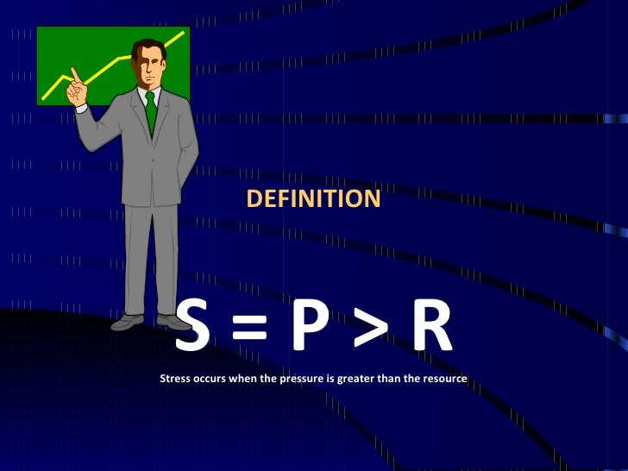


Slide 3
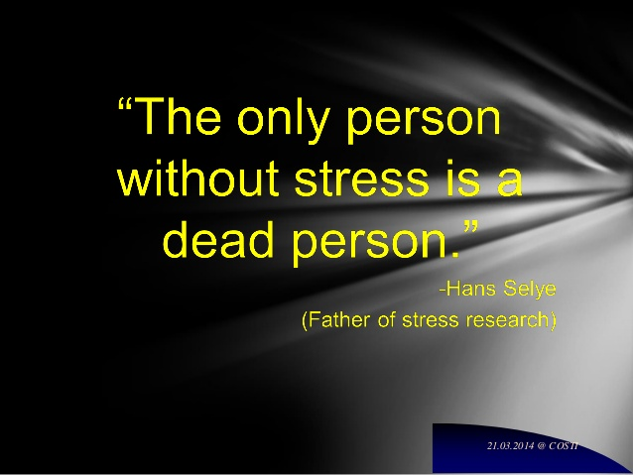

Slide 4
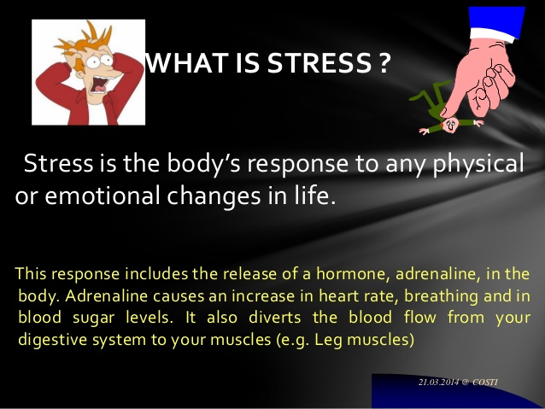

Slide 5
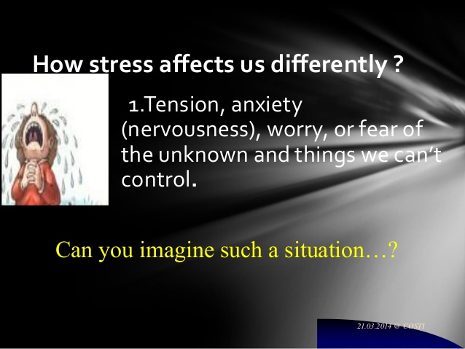

Slide 6
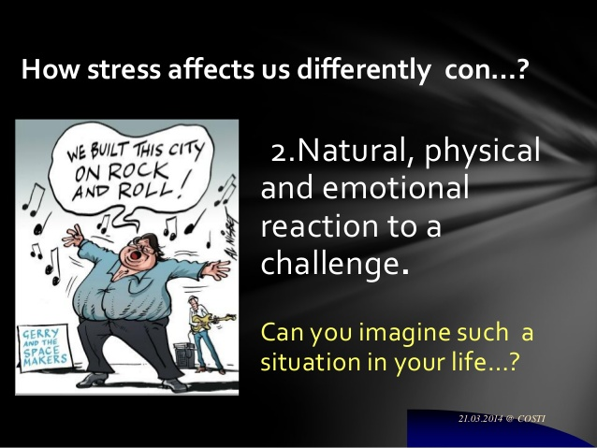

Slide 7
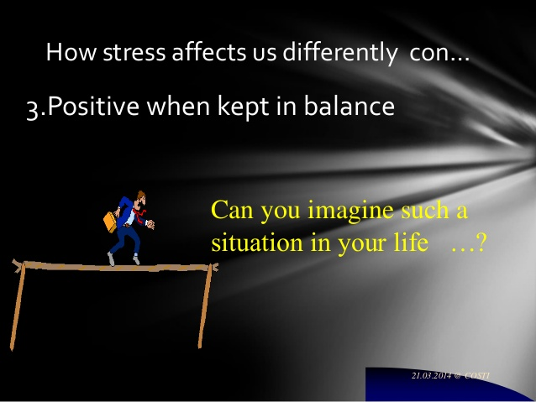

Slide 8
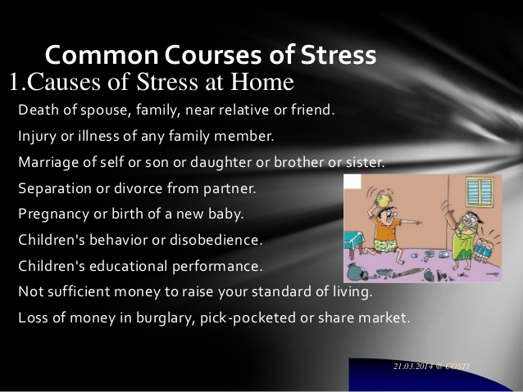

Slide 9
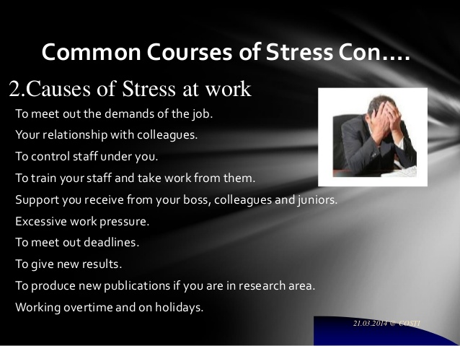

Slide 10
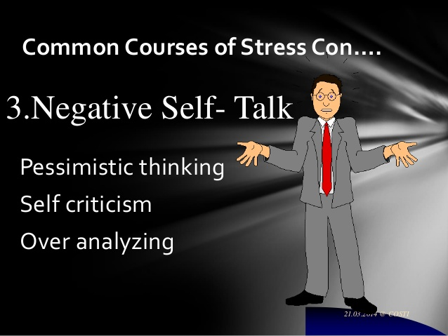

Slide 11
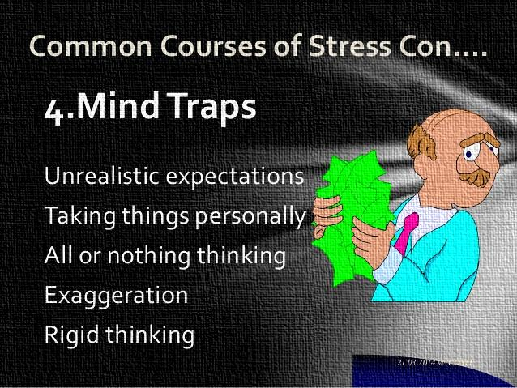

Slide 12
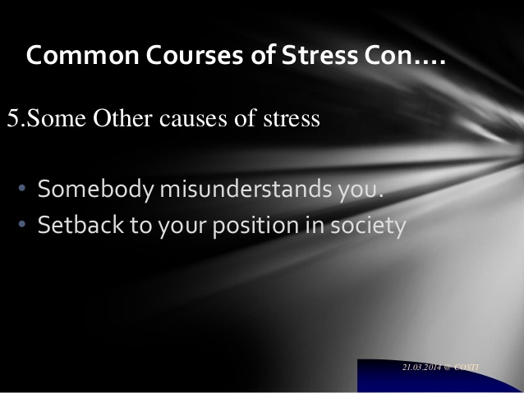

Slide 13


Slide 14


Slide 15
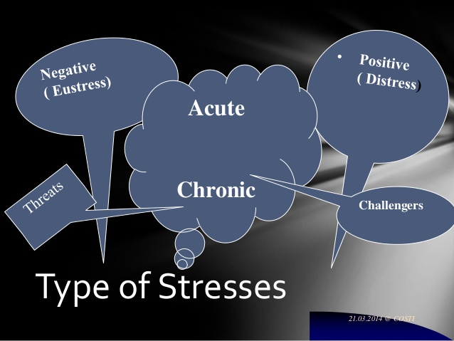

Slide 16
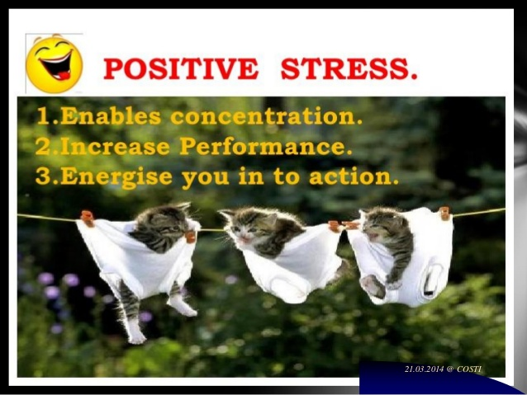

Slide 17
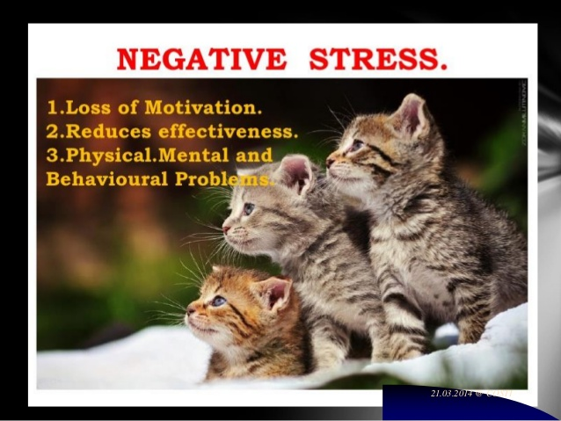

Slide 18


Slide 19
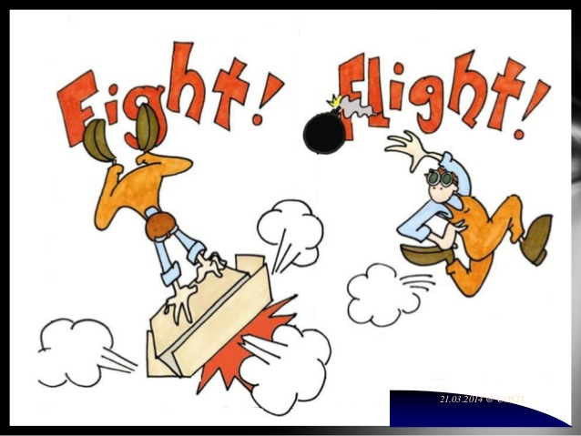

Slide 20


Slide 21


Slide 22
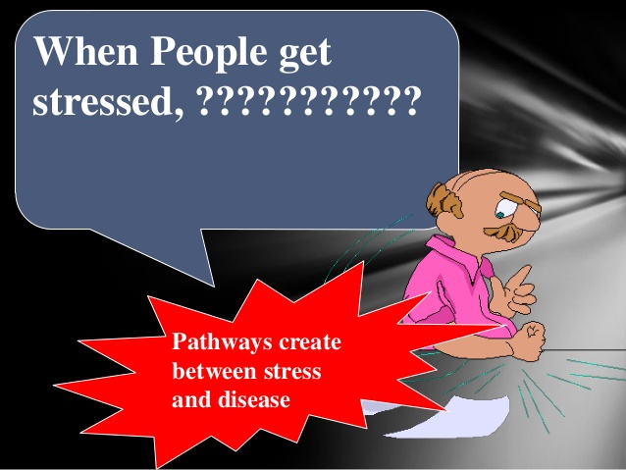

Slide 23
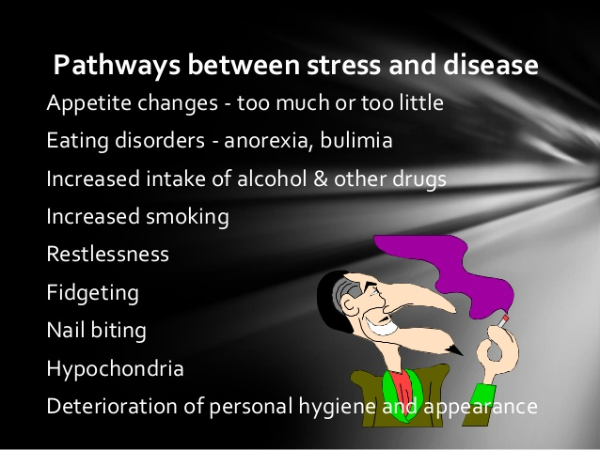

Slide 24
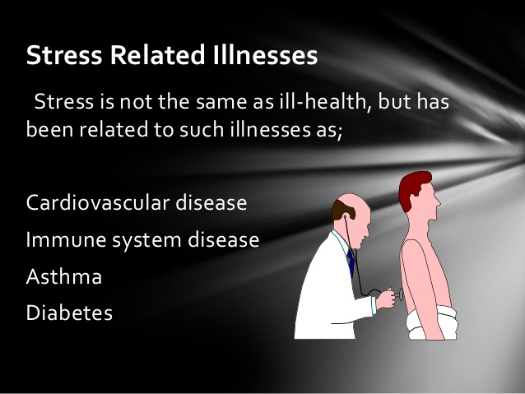

Slide 25


Slide 26
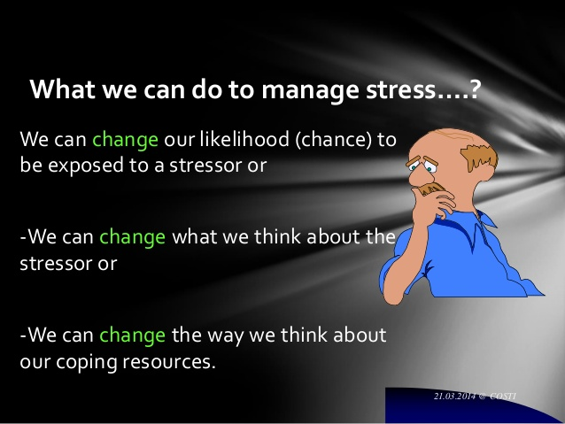

Slide 27
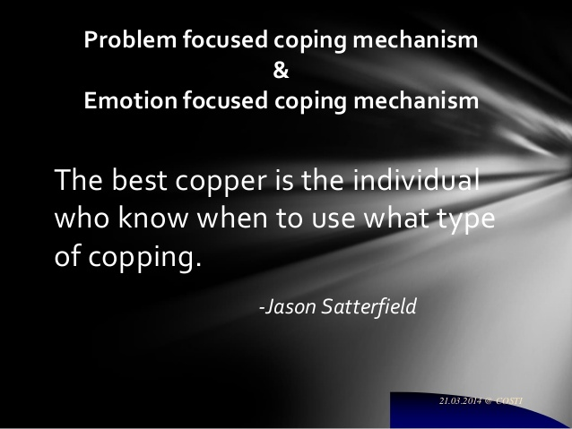

Slide 28


Slide 29
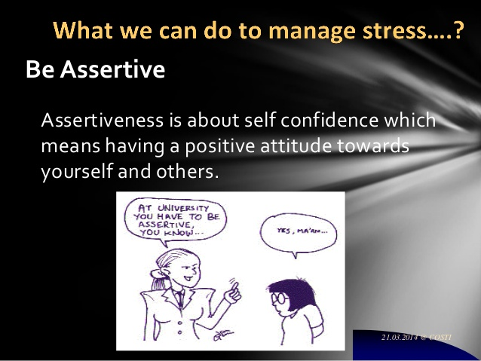

Slide 30
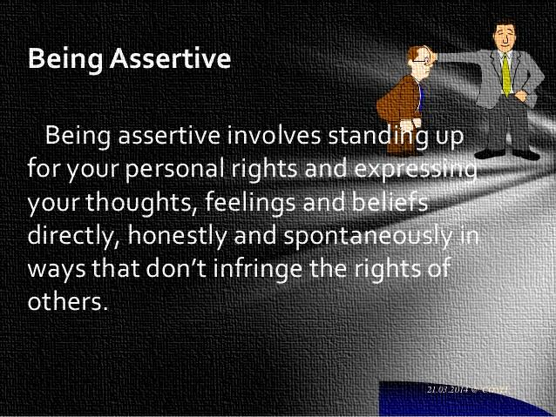

Slide 31


Slide 32
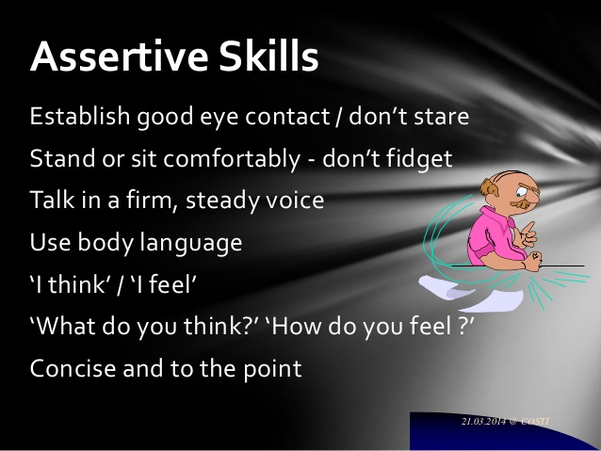

Slide 33
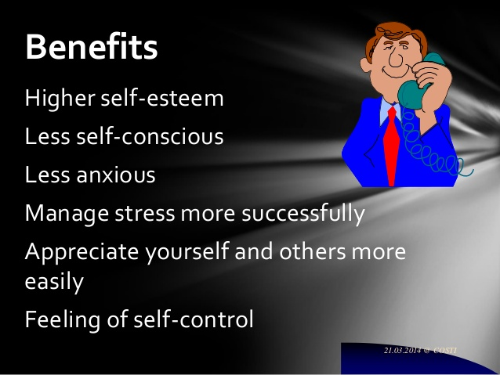

Slide 34
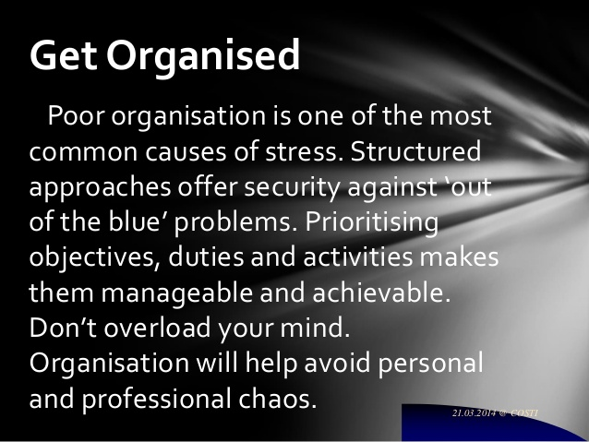

Slide 35

Focus on your strengths

Slide 36

Engage in
physical activity

Slide 37

Do things that make you happy

Slide 38

Talk to someone

Slide 39
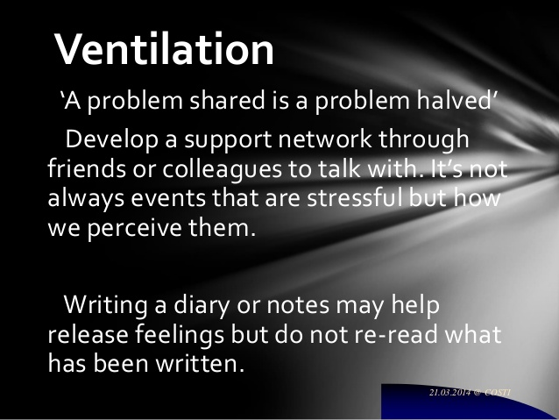

Slide 40

PRAY REGULARLY…

Slide 41



Slide 42
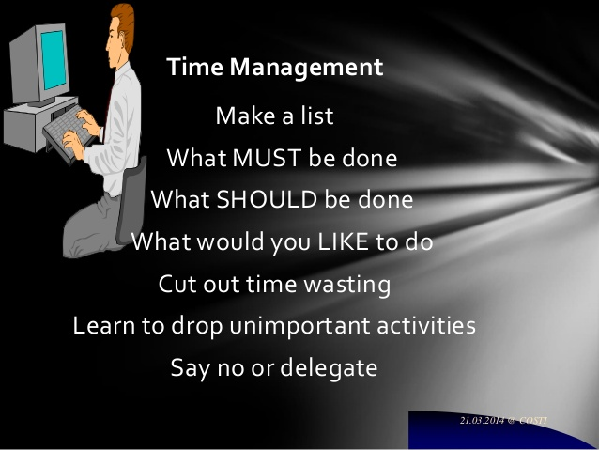

Slide 43
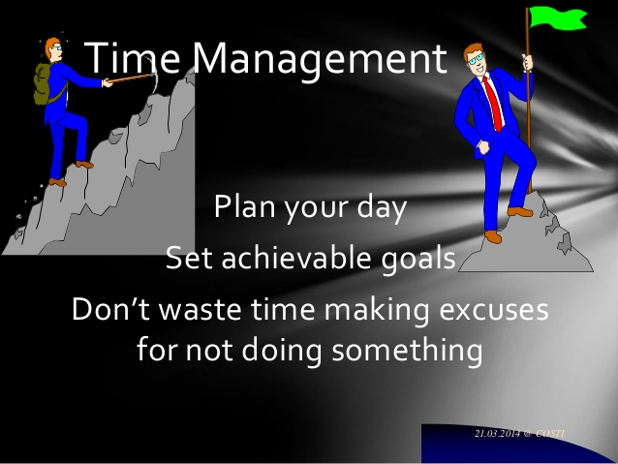

Slide 44

Laugh Out Loud…..

Slide 45
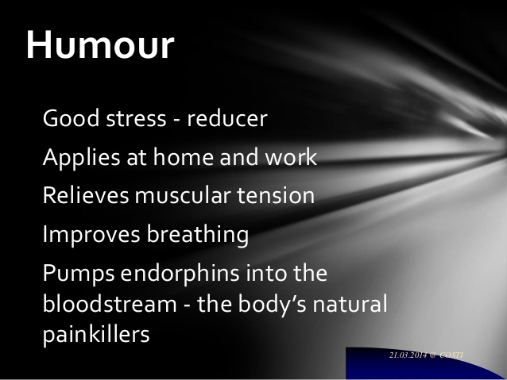

Slide 46


SING AND DANCE

Slide 47
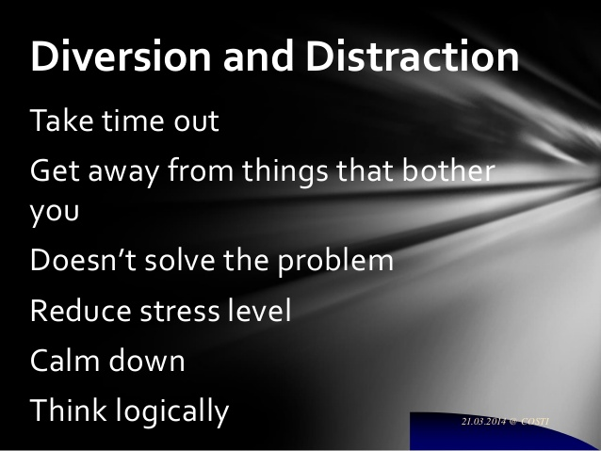

Slide 48

Involve yourself in hobbies
- Spent time with your pets..
-Do gardening…

Slide 49

ARRANGE & CLEAN
YOUR ROOM ..

Slide 50

Drink Some Fruit Juice

Slide 51

Take a Walk

Slide 52

DO SOME YOGA

Slide 53
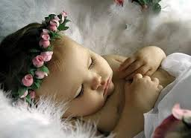
GET SLEEP

Slide 54
GOOD
PLANNING
Concretely identifying a problem
List the problem solving options
Select one of the options
Write out a plan of action

Slide 55
CLEARING
SPACE
Technique of Clearing Space to turn off and to quiet the ruminative mind
Sit quietly with eyes closed
Focus upon open container ready to receive every issue on your mind
See & name each issue and imagine placing into the container
Mentally put a lid on the container and put it away until you need to get something from it!

Slide 56
PLAN- NOT WORRY
If worrying starts, say to your self
STOP! I have a Plan!
AUTOSUGGESTION

Slide 57



Slide 58

WITH GOD
NOTHING IS IMPOSSIBLE

Slide 59

DESTINY IS FAR….
BUT VOYAGE BEGINS….

