Slide 1
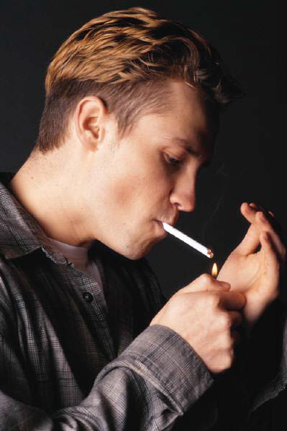
Substance
Abuse

Slide 2
Substance abuse, also known as drug abuse and substance use disorder, is a patterned use of a drug in which the user consumes the substance in amounts or with methods which are harmful to themselves or others.
Widely differing definitions of drug abuse are used in public health, medical and criminal justice contexts.

Slide 3
Substance abuse is widespread
  120 million users of hard drugs such as cocaine, heroin, and other synthetic drugs.
  In 2013 drug use disorders resulted in 1,27,000 deaths up from 53,000 in 1990.
  The highest number of deaths are from opioid use disorders at 51,000.
  Cocaine use disorder resulted in 4,300 deaths
  Amphetamine use disorder resulted in 3,800 deaths.
  Alcohol use disorders resulted in an additional 139,000 deaths.

Slide 4
Drugs most often associated with this term include:
alcohol
substituted amphetamines,
barbiturates
benzodiazepines (alprazolam, lorazepam, diazepam and clonazepam)
cocaine
methaqualone
cannabis
opioids

Slide 5
Commonly abused substances by children
Tobacco
Alcohol : (Beer, Whisky, Country Liquor)
Cannabis : (Bhang, Ganja)
Inhalants : (Ink Eraser /Correction Fluid, Glue, Petrol)
Opioids : (Street Heroin, Pharmaceutical Opioids, Including Propoxyphene, Pentazocine, Buprenorphine)
Sedatives : Diazepam, Nitrazepam, Alprazolam
Anesthetic medicines

Slide 6
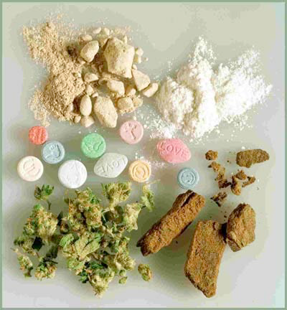
Drug use becomes more widespread from about 10-25 years of age.
Drug use before 18 is the best predictor of later drug abuse

Slide 7
HOW?????
A genetic disposition
Learned from others
Imitation
A habit which if addiction develops
Social factors: Age,Culture,Gender

Slide 8
Top Reasons Why Teens Abuse Substances
1) Stress
2) Social Acceptance and/or Low Self-Esteem
3) Self-Medication
4) Misinformation
5) Easy Access
6) Media Influence
7) Peer group pressure
8)Broken Family conditions
9) Environmental influence
10)Curiosity

Slide 9
PROBLEMS
Health problems
Social problems
Morbidity
Injuries
Sexual problems and deviations
Violence
Deaths
Motor vehicle accidents
Homicides
Suicides
Physical Dependence
Mental problems and illness
Criminal offences
Economic problems
Poverty
Problems with the law
Loss of interest in favorite activities
Violent behavior
Withdrawal
Depression
Poor hygiene
Missing money

Slide 10
There is a high rate of suicide in alcoholics and other drug abusers
Suicide is also very common in adolescent alcohol abusers, with 1 in 4 suicides in adolescents being related to alcohol abuse
Alcohol abuse is also associated with increased risks of committing criminal offences including child abuse, domestic violence, rapes,burglaries and assaults.

Slide 11
Substance induced psychiatric disorders:
Hallucinogens can trigger delusional and other psychotic phenomena long after cessation of use.
cannabis may trigger panic attacks during intoxication.
Severe anxiety and depression are commonly induced by sustained alcohol abuse.

Slide 12
Drug abuse and CNS
  produce changes in mood
  Affects the levels of awareness or perceptions and sensations
  Affects Co-ordination
  Cognitive capacity of the person
  Effect the activity of neuro transmitters: block the passage, overdose releasing, mimic the natural NT, block receptors, prevent neuronal messages.

Slide 13
  The fatty tissues protecting the nerve cells in the brain are destroyed by inhalant vapors. This slows down or even stops neural transmissions .This can have adverse effects on learning ability, memory, and problem solving.

Slide 14
LSD causes an increase in the receptor of serotonin. This can induce mood swings, altered perception, delusions, and hallucinations.
Ecstasy can damage neurons containing serotonin, which can cause confusion, depression, sleep problems, drug cravings, and anxiety .
Steroids also produce violent behavior, impaired judgment, and even psychosis. It can also produce changes in sexual characteristics and stunt the growth of teens

Slide 16
Dopamine is a neurotransmitter present in regions of the brain that regulate movement, emotion, cognition, motivation, and feelings of pleasure.
When drugs of abuse are taken, they can release 2 to 10 times the amount of dopamine than natural rewards. The resulting effects on the brain's pleasure circuit dwarfs those produced by naturally rewarding behaviors such as eating and sex. The effect are so strong that it motivates people to take drugs repeatedly .

Slide 17
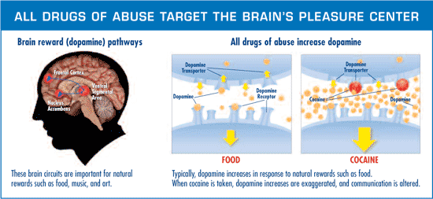

Slide 18
Substance abuse affects teen brain development by:
Interfering with neurotransmitters and damaging connections within the brain
Reducing the ability to experience pleasure
Creating problems with memory
Causing missed opportunities during a period of heightened learning potential
Ingraining expectations of unhealthy habits into brain circuitry
Inhibiting development of perceptual abilities

Slide 19
IMPULSIVITY: It is characterized by actions based on sudden desires, whims, or inclinations rather than careful thought. Individuals with substance abuse have higher levels of impulsivity and individuals who use multiple drugs tend to be more impulsive.

Slide 20
In addition to addiction risks, alcohol poses a serious risk to the physical health and growth of teens.
Excessive drinking in teens can result in:
Delayed puberty and/or negative effects on the reproductive system
Lower bone mineral density
Higher levels of liver enzymes that indicate liver damage
Shorter limbs and reduced growth potential

Slide 21
Criminal records that cannot be expunged
Accidents
Sexually transmitted diseases
Unplanned pregnancies
Wasted academic opportunities
Late start in chosen career path
Damaged relationships with friends and family

Slide 22
It’s no secret that teenagers can be risk-takers who don’t always recognize the consequences of their actions. Drug and alcohol experimentation is often highest during these critical formative years. Teens are more likely to perceive social benefits of drug use (such as being accepted among peers or feeling more social) than they are to evaluate the negative effects.

Slide 23
Consequences of youth substance abuse
Academics
Declining grades, absenteeism from school and other activities, and increased potential for dropping out of school are problems associated with adolescent substance abuse.

Slide 24
Physical health
Injuries due to accidents, physical disabilities and diseases
Increased risk of death through suicide, homicide, accident, and illness.

Slide 25
Many substance-abusing youth engage in behavior that places them at risk of contracting HIV/AIDS or other sexually transmitted diseases.

Slide 26
Peers
Substance-abusing youth often are alienated from and stigmatized by their peers. Adolescents using alcohol and other drugs also often disengage from school and community activities, depriving their peers and communities of the positive contributions they might otherwise have made.

Slide 27
Families
Family crises and jeopardize many aspects of family life, sometimes resulting in family dysfunction.
Family's financial and emotional resources become affected.

Slide 28
Social and Economic consequences
They result from the financial losses and distress suffered by alcohol- and drug-related crime victims, increased burdens for the support of adolescents and young adults who are not able to become self-supporting, and greater demands for medical and other treatment services for these youth.

Slide 29
Delinquency
There is an undeniable link between substance abuse and delinquency.
Arrest, adjudication, and intervention by the juvenile justice system are eventual consequences for many youth engaged in alcohol and other drug use.
school and family problems, involvement with negative peer groups, a lack of neighborhood social controls, and physical or sexual abuse.

Slide 30
Substance abuse is associated with both violent and income-generating crimes by youth
Association with gangs, drug trafficking, prostitution, and growing numbers of youth homicides are among the social and criminal justice problems often linked to adolescent substance abuse.

Slide 31
What to Look for…
Absenteeism
Change in Behavior
Change in Academic Performance
Problems controlling mood and behavior
Neglected Physical Appearance
Weight loss
Peer concern
Some Physical Signs: bruises and other marks on arms or other vein-laden areas (neck, behind knees), bloodshot eyes, sniffling nose, dilated pupils, etc

Slide 32
● Substance use appear to be increasing among children and adolescents, with an upward trend seen in recent surveys.
● Substance use is high in street children, but also found in the school and community surveys.
● Substance use is seen in both rural and urban areas
● There are likely to be regional variations in the prevalence and pattern of substance use

Slide 33
● Tobacco followed by alcohol and cannabis appear to be common substances of abuse in these age groups
● Inhalant are emerging as a common substance of use in younger children, especially among those who are vulnerable and under-privileged.
• Treatment seeking is low in adolescents. Those who seek treatment are likely to be cannabis, inhalant or opioid users, including injecting drug users.

Slide 34
SAVE THEM… BY
PHARMACHOLOGICAL ASSISTANCE
SOCIAL SERVICES
BEHAVIORAL THERAPIES
MEDICAL SERVICES

Slide 35
Protect them….
Individual care
Counselling
Involvement in co-curricular activities
Involvement in community activities
Social support from community members
Strong attachments to family
All lead to higher self esteem and less risk taking behaviors
Get the help from authorities & law
Conduct awareness programme

Slide 36
Train them to have real faith
Develop self esteem
Give awareness programmes
Educate parents & elders
Help them to keep up a value system and better relations
Give media awareness

