Slide 1
SENSATION AND PERCEPTION
SENSATION:
Sensation is the starting point for all our psychological experiences.
Sensation is the stimulation of sensory receptors by a stimulus from the environment.
It is mere impressions just conveying information
The process of sensing using sense organs.
The process by which our senses gather information and send it to the brain.

Slide 2
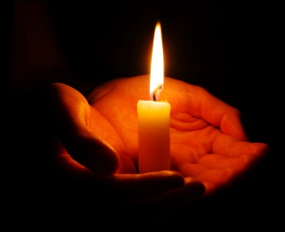

STIMULATION
  Stimuli from environment
Exiting sensory receptors

Slide 3



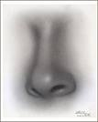
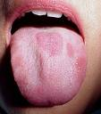

Sensation
Sense organs –eyes, ears, nose, tongue, skin
Gather basic informations about the surrounding.
Process of sensing – Sensation.

Slide 4
Steps involved in sensation
Stimulation ( internal or external)
Stimulus activates the receptors cells
Neural impulses forms and travel to brain
Brain recognise and produce conscious sensations

Slide 5
Principles of sensetion
Sensation begins with stimulus
Continuous stimulation of receptors leads to sensory adaptation
Prolonged stimulation diminishes sensory firing
Sensory capabilities can be measured

Slide 6
Types of sensation
Human body’s senses are divided into 8 types:
          Visual (seeing)
          Auditory (hearing)
          Gustatory(taste)
          Olfactory(smell)
          Cutaneous(touch)
          Kinesthetic
          Vestibular
          Organic

Slide 7
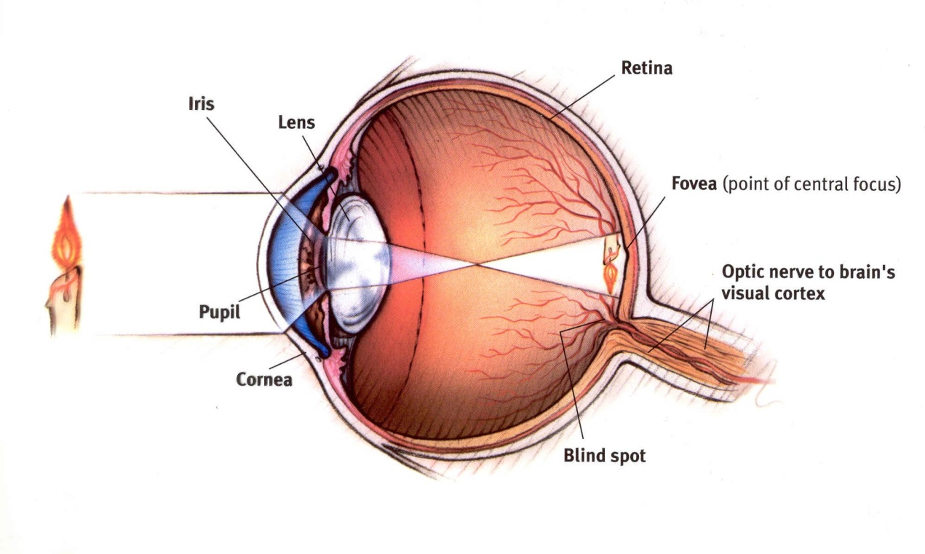
          Visual Sence(seeing)

Slide 8
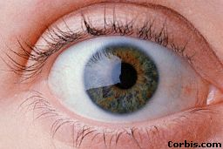
eyes
Rods and cones – sensory receptor cells
Transform the light impulses to neural impulses
Pass through optical nerve to brain
Brain recognize the image

Slide 9
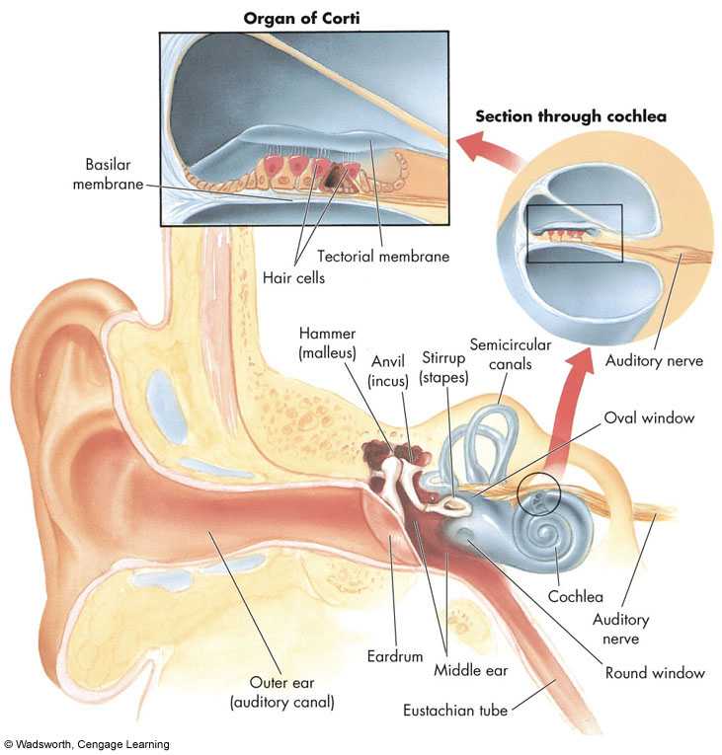
          Auditory (hearing)

Slide 10
          Gustatory(taste)
(Vdeo)

Slide 11
Olfactory(smell)
(Vdeo)

Slide 12
Cutaneous(touch)
(Vdeo)

Slide 13
Kinesthetic
Sense of posture and movement

Slide 14
Vestibular
Sense of balance
Awareness of the position, movement of the head

Slide 15
Organic
The sensation only from the internal organs
By which certain physiological process
Hunger, thirst, drowsiness etc:

Slide 16

See the pictures..
Where he stands ? ????

Slide 17
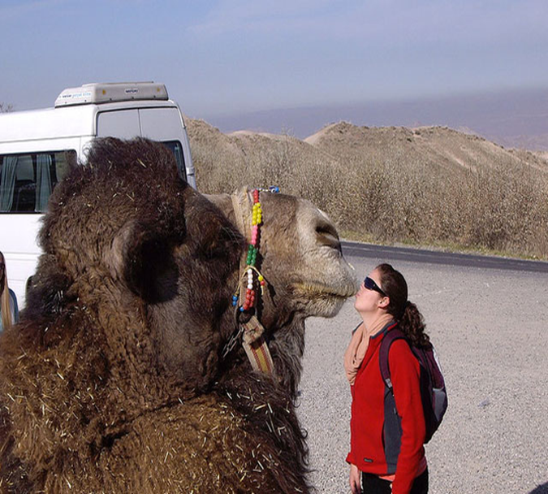
Oh!...what a kiss????

Slide 18

FROM WHERE IT IS ???

Slide 19
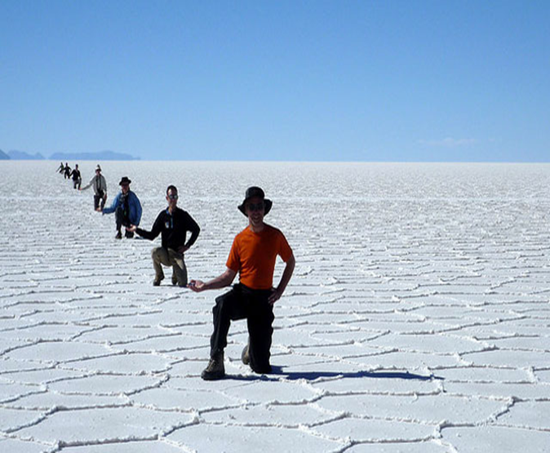
YAH! GOOD POSTURE…

Slide 20
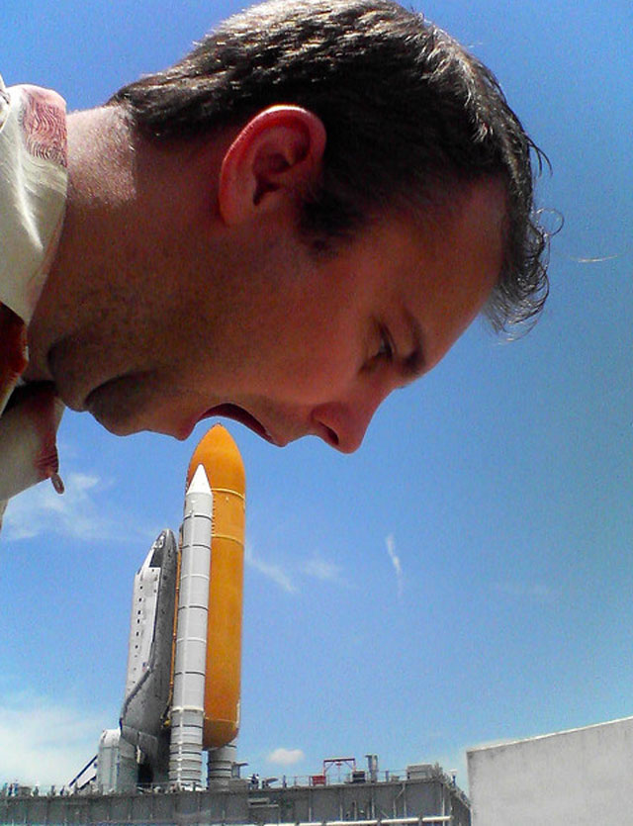
HUNGRY MAN !!!

Slide 21

TRY TO COVER IT ….!!!!

Slide 22
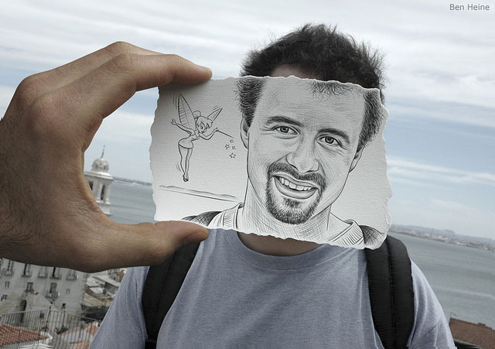

Slide 23
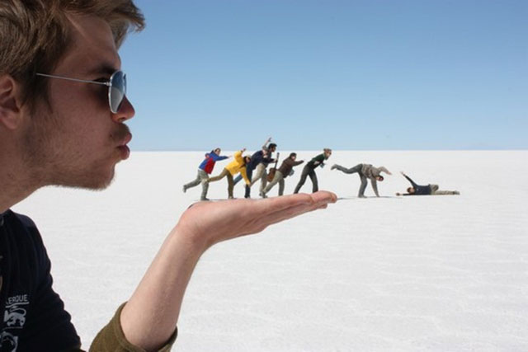


Slide 24
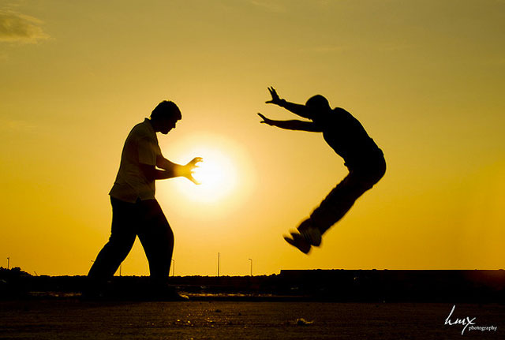
POWERFUL ……

Slide 25

EVEN WITH SUN….

Slide 26
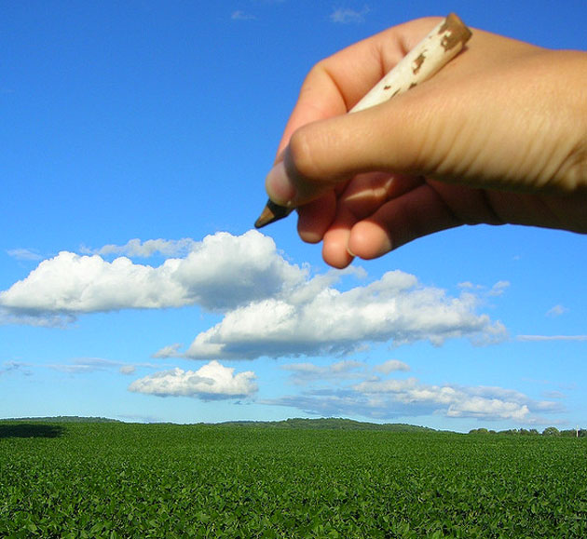

BEAUTIFUL ART………

Slide 27
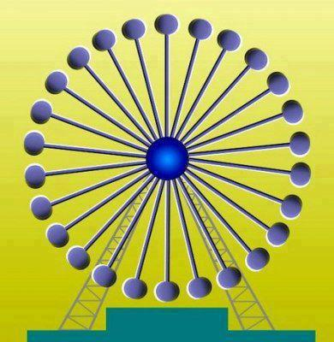

Slide 28
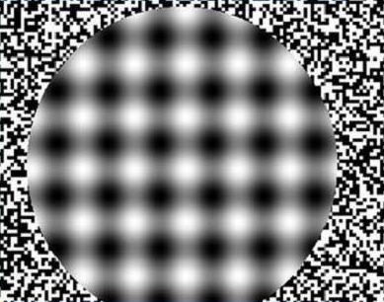

Slide 29



Slide 30

If you said "a hamburger," go get some lunch and come back.
If you said "three Pac Man-looking things chomping on a triangle," then you’re on target.
Except where’s the triangle?
The triangle is implied. It isn’t there, except as white space.
But look at it and tell me the triangle isn’t there. Yes, it is.

Slide 31
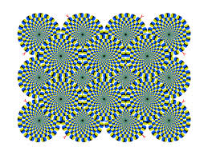

Slide 32
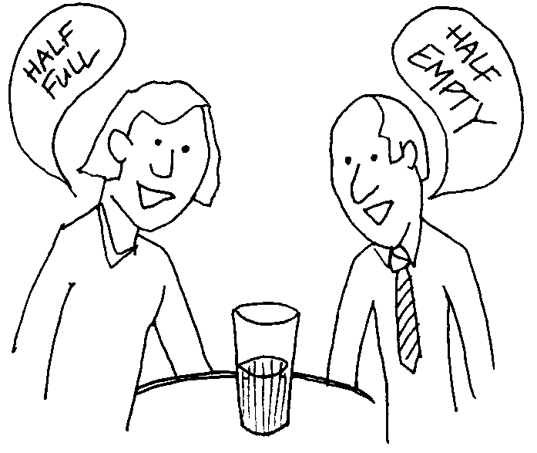

Slide 33
Perception
Processing of sensory inputs in mind
The process by which we organise, integrate and recognize the various patterns of stimuli.
Interpretation of what we take in through our senses
Complex and active process

Slide 34
Perception
Process of acquiring, interpreting, selecting and organizing sensory information
“PERCEPTION”(From Latin word-Perception or percepio –receiving, collecting..
The ability of perception get developed gradually
Sensation + Meaning = Perception

Slide 35
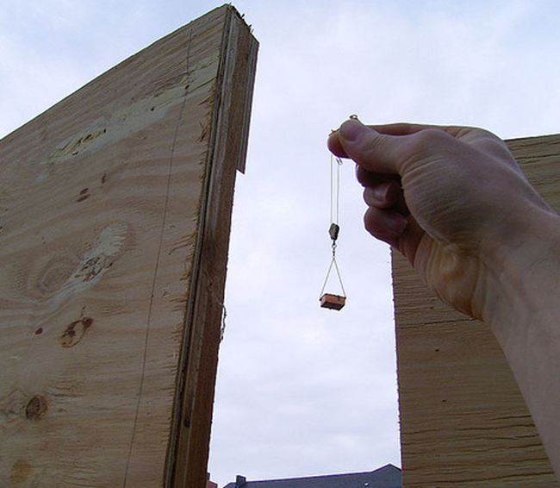
Characteristics of Perception
Perception is selective
Objects are perceived as whole
Perception involves an organizing activity

Slide 36
Gestalt Psychology and Perception
Focused on how people interpret the world.
Developed a set of principles to explain perception.
While perceiving an object we look for patterns.
We make patterns if they are missing.

Slide 37

Figure Ground Relationship
Law of Pragnanz

Slide 38
Figure Ground Relationship
“To a large extent the nature of the object perceived is determined according to the background against which it is perceived.
Objects which are outstanding in terms of colour, shape or size are prominent.
Prominent object is the figure and background is referred as ground

Slide 39


Slide 40


Slide 41


Slide 42
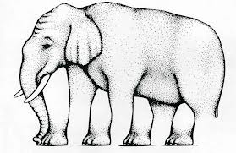

Slide 43
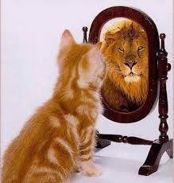

Slide 44
Law of Pragnanz
Pragnanz - German word – “good figure”
Good figure means symmetrical, simple, regular,complete.
When we see a visual, people will attempt to organize that information into the simplest form possible.
People will mentally organize that visual to create a good figure.

Slide 45
Law of Pragnanz
Law of Similarity
Law of Proximity
Law of Continuity
Law of Closure
Law of Inclusiveness
Law of Common fate
Law of Familiarity

Slide 46
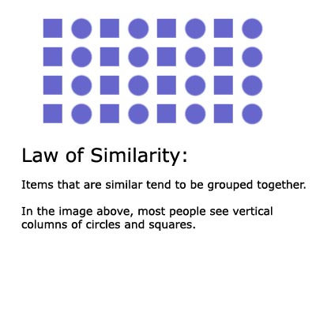

Slide 47
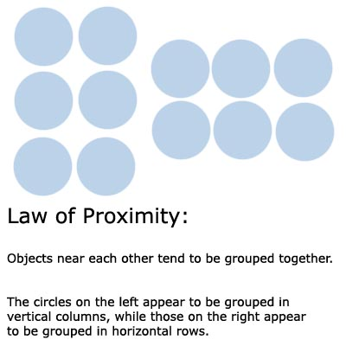
Law of Proximity

Slide 48
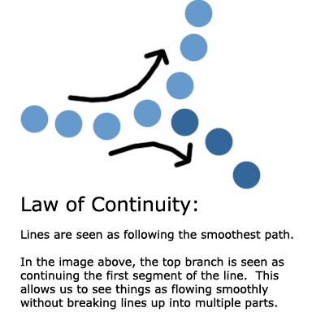
Law of Continuity

Slide 49

Law of Closure
Our minds often ignores contradictory informations and fills in the gap to complete the figure.
Things are often grouped together if they seem to complete some entity.

Slide 50
Law of Familiarity
Previous experience or familiarity determines the pattern of object being perceived.

Slide 51

Law of Common fate
Objects which move in same direction or function in a similar manner will be perceived as a collective unit.

Slide 52
Law of Inclusivenss
A pattern that includes all the elements in the field is more outstanding than other patterns that are less inclusive in nature.
Inclusive figures are perceived easily
Has more advantage than other pictures

Slide 53
Factors influencing perception
Past experiences
Learning
Motives and emotions
Maturation of sense organs
Characteristics of the objects
Beliefs, attitudes, interest, self-concept, expectations, etc:

Slide 54
Types of perception
Amodal Perception: the full perception of a physical structure when it is only partially perceived.
Colour vision: the capacity of a organism or machine to distinguish objects based on the wavelength of the light they reflect
Depth Perception: the visual ability to perceive the world in three dimension
Speech Perception: the process by which humans are able to interpret and understand the sound used in language.

Slide 55
ILLUSION AND HALLUCINATION
Illusion is wrong perception,
- inaccurate perception of an existing sensory stimulus
Hallucinations are distortions of sensory perceptions in which we perceive something without any appropriate stimulus or without any actual stimulus,
- perception without stimulation

Slide 56
Perception and education
It is the basis for learning through observation and imitation.
It initiates and sustains activity in reasoning and problem solving.
Memory and imaginations are not possible without perception.
Observation is regulated perception, it is the core of scientific investigation and basis for systematic knowledge formation.

Slide 57
ATTENTION
“Your ATTENTION Please”
“Attention”
ATTENTION – an act, a process, a function
- act of listening, looking at, concentration on…

Slide 58
Definitions:
“Attention is the concentration of consciousness upon one object rather than upon another.”
- Dumvile
“Attention is the process of getting an object or thought clearly before the mind”.
-Ross et al
“Attention can be defined as a process which compels the individual to select some particular stimulus according to the interest and attitude out of the multiplicity of stimuli present in the environment.” -Sharma R.N.

Slide 59
NATURE OF ATTENTION
Attention is focusing of consciousness on a particular object
Attention is constantly shifting/flexible/
dynamic: consciousness:- central &marginal attention
: subject & object of attention also changes
Attention is selective: based on interest, attitude, usefulness…
Attention is a state of preparedness or alertness:
physical, mental, emotional..

Slide 60
ATTENTION is
A process carried out through cognitive abilities and helped by emotional and conditional factors to select something out of various stimuli present in one’s environment and then bring it in the center of one’s consciousness in order to perceive it clearly for deriving the desired ends.

Slide 61
TYPES OF ATTENTION
ATTENTION
Non-Volitional
(no involvement of will)
Enforced
(sustained by instinct)
Sponta-
neous
(by sentiment)
Volitional
(by the exercise of will)
Implicit
(by single act of will)
Explicit
(by repeated act of will)

Slide 62
FACTORS AFFECTING ATTENTION
EXTERNAL FACTORS:
  NATURE OF STIMULUS
  INTENCITY AND SIZE OF THE STIMULUS
  CONTRAST, CHANGE AND VARIETY
  REPETITION OF STIMULUS
  MOVEMNT OF THE STIMULUS

Slide 63
INTERNAL FACTORS:
  INTEREST
  MOTIVES
  MENTAL SET-UP
  ATTITUDE
  MENTAL AND PHYSICAL STATE
  VALUE AND PURPOSEFULNESS OF THE STIMULIS
  PRIOR EXPERINENCE AND TRAINING
  HABITS AND TEMPERAMENT
  INSTINCTS AND EMOTIONS

Slide 64
SPAN OF ATTENTION
One Object at a Time or Not ????
Span of Attention: defined in terms of quality, size or extent to which the perceptual field of an individual can be effectively organized in order to enable him/her to attend a number of things in a given spell of short duration.

Slide 65
Span of attention for adults: seconds exposure- 6-8 dots, letters, digits(for children 4-5)
Arrangements in groups or shapes increases span of attention
Simplicity, meaningfulness, familiarity, high intensity of stimulus and purposefulness/ value increases span of attention
Time of exposure effect the span of attention
Favorable and unfavorable environmental conditions affects span of attention.

Slide 66
Concept Formation
Concept
Basic unit of all types of learning
Generalized idea about things, persons or events
A class of stimuli (objects, events or ideas) which have common characteristics
An idea or understanding of what a thing is.
Mental disposition that helps in understanding the meaning of the objects of our thinking.

Slide 67
Concept
Concepts are founded on our sensory and perceptual experiences
Sensation + Perception Concept
It is a collection of experiences or ideas that are grouped together based on some common properties
Language acquisition, experience, examples, environmental stimulations are helpful to form concept.

Slide 68
Components of a Concept
Two parts
  Prototype
  -properties that describe the best example of the concept
  - imaginary mental image
  Core – properties that are more important for being a member of the concept

Slide 69
Concepts????
A cuckoo is a bird
A bat is a bird
An Aeroplain is a bird
A book is a bird
A crow is a bird

Slide 70
Process of Concept formation
Important phases are:
Perception
Abstraction
Generalization
Naming

Slide 71
Perception
The process of interpreting or giving meaning to sensation
Our perceptions provide opportunities for getting mental images of things, persons or events

Slide 72
2. Abstraction
Process of observing similarities and commonness
The mind analyses the images formed by perception and synthesizes what is common to all, neglecting the particular

Slide 73
3. Generalization
After abstraction, the individual is able to generalize the common properties of the object or event. On account of this generalization ,the concept is developed.

Slide 74
4. Naming
Last step in concept formation
The concept is given a name

Slide 75
Elements of concept (bruner)
Five elements:
A name / label
Examples
Attributes
Attribute value (essential & non-essential)
Rule / definition

Slide 76
TYPES OF Concepts
Concrete and Abstract Concepts
Classical or Definite and Probabilistic Concept
Concepts about concrete things
Concepts about
Abstract things
Traditional,classical,
Universal, uniform
Non-Traditional,classical,
Universal, uniform

Slide 77
TYPES OF Concepts
Simple and Complex Concepts
Two or more common features,
attributes,
properties
Single feature,
attribute,
property
Eg: READ,GREEN
Eg: READ SHIRT

Slide 78
Complex Concepts divided as:-
Conjunctive concepts: appropriate values of several attributes are jointly present. Eg:Read Fort
Disjunctive concept: the appropriate values of one attribute or of another attribute or both are present. Eg: Pencil, news paper
Relational Concept: has a specified relationship between attributes Eg: Boys hostel, milky white

Slide 79
Educational implications
Direct experiences should be provided to children wherever possible.
Use inductive-deductive methods for effective concept formation.
Encourage students to express their ideas.
Rote memorization should be discouraged
Encourage discovery learning.
New concepts should be given in relation with old concepts
Encourage discovery learning.

Slide 80
Thinking
Is a process of internal representation of external events.
Cognitive rearrangement of both information from environment and symbols stored in memory for the solution of some specific purposeful problem.
Thinking is a pattern of behaviour in which we make use of internal representations of the things and events for the solution of some specific purposeful problem.

Slide 81
Definitions
Valentine (1965)
“ Thinking is an activity which consists essentially of a connected flow of ideas which are directed towards some end or purpose”.
Gilmer (1970)
“Thinking is a problem solving process in which we use ideas or symbols in place of overt activity”.

Slide 82
Nature of Thinking
It is essentially a cognitive activity
It is a purposeful and goal directed behaviour
It is a problem solving behaviour
It involves mental exploration of images
It is a symbolic activity
It can shift over a span of time & space

Slide 83
Thinking is-
- An inner cognitive process
- Has a definite end or purpose
- Initiated to solve some difficulty or problem and ends in its solution
- There is only mental manipulation

Slide 84
Tools of Thinking ( Elements of Thought)
Images -mental picture
Concepts -general idea
Symbols & Signs
Language
Brain functions

Slide 85
Types of Thinking
Perceptual or Concrete thinking
Simplest form of thinking
Perception (interpretation of sensation according to one’s experience) is the basis of this thinking
Also called concrete thinking as it is carried out on the perception of actual or concrete objects and events

Slide 86
Conceptual or Abstract thinking
Does not require the perception of actual objects or events
In abstract thinking one make use of concepts, symbols and language for solving problems
Superior to perceptual thinking

Slide 87
Concrete thinking & abstract thinking
Concrete thinking does not have any depth. It just refers to thinking in the periphery. On the other hand, abstract thinking goes under the surface.
Concrete thinking is just regarding the facts. On the other hand abstract thinking goes down below the facts.
Unlike the concrete thinking, abstract thinking involves some mental process.
Concrete thinkers only have a generalized concept for all things. On the other hand, abstract thinkers have a very specific concept of things.

Slide 88
To develop abstract thinking
  search for explanations (e.g., why and how questions)
  search for analogies to make the subject matter more understandable (e.g., “Let’s think about what this might be like in your life; what are other examples of this?”)
  search for alternative perspectives (e.g., “Are there other ways to think about this? How might other people think about this?”)

Slide 89
To develop abstract thinking
  ways to organize the topic and make connections (e.g., “I think there are three separate issues here that we should consider in order”; “Let’s try to think about what this might be connected to”)
  ways to evaluate (e.g., “How can we decide if this is a good thing or not?”)
  ways to draw inferences (e.g., “If this is true, then what else must be true?”)

Slide 90
Convergent Thinking
Type of thinking that focuses on coming up with the single, well-established answer to a problem
Appropriate in science, maths and technology
Convergent thinking emphasizes speed, accuracy, and logic and focuses on recognizing the familiar, reapplying techniques, and accumulating stored information.

Slide 91
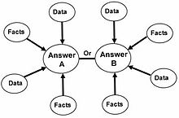
Convergent Thinking

Slide 92
Convergent Thinking
most effective in situations where an answer readily exists and simply needs to be either recalled or worked out through decision making strategies
It is oriented toward deriving the single best, or most often correct answer to a question.
Multiple choice questions requiring convergent thinking

Slide 93
Divergent Thinking
Thinking to generate creative ideas by exploring many possible solutions.
More suited to artistic pursuits
Divergent thinking typically occurs in a spontaneous, free-flowing manner, where many creative ideas are generated and evaluated.

Slide 94
Divergent Thinking
Multiple possible solutions are explored in a short amount of time, and unexpected connections are drawn.
Examples of divergent thinking include using brainstorming, free writing and creative thinking.

Slide 95
Divergent Thinking
After the process of divergent thinking has been completed, ideas and information are organized and structured using convergent thinking.
Divergent thinking is found among people with personality traits such as nonconformity, curiosity, willingness to take risks, and persistence.

Slide 96
To promote divergent thinking
Activities which promote divergent thinking include
-creating lists of questions
- setting aside time for thinking
- meditation
-brainstorming
- subject mapping
        - keeping a journal
        - creating art work
        -free writing

Slide 97
Critical Thinking
Type of thinking that helps a person in stepping aside from his own personal belief, prejudices and opinion to sort out the facts and discover the truth at the expense of his basic belief system
Challenging (higher order and well disciplined) thought process which involves the use of cognitive skills for arriving at unbiased and reliable judgment

Slide 98
Reflective Thinking or Logical Thinking
Higher form of thinking aiming at solving complex problems
In this thinking all relevant experience are reorganized to find new ways of reacting to a situation
Insightful approach is needed
Relevant facts are arranged in logical order in order to get the solution

Slide 99
Creative Thinking
Associate with one’s ability to create something new or unusual.
Involves manipulating mental representation to solve problems in a novel way
Ability to discover new solution to problem or to produce new ideas, invention or works of art
It is a search of new relationship and associations to describe and interpret the nature of things, events and situations
Thinking pattern of scientists or inventors

Slide 100
Characteristics of Creative Thinking
Internal mental process
Results in the production of something new
Creative expression – source of joy and satisfaction for the creator
Can be nurtured by training
Involves divergent thinking
Presence of various factors – originality, flexibility, divergent thinking, self confidence and the ability to see and build relationships

Slide 101
Stages of Creative Thinking
5 stages
Preparation – preparatory work on the problem. The problem is defined, the facts and material relevant to the solution are collected and examined
Incubation – the problem is internalized and nothing appears externally to be happening
Intimation - the creative person gets a feeling that a solution is own its way

Slide 102
4. Illumination or insight – the sudden appearance of the solution to the problem
5. Verification – the idea is verified, elaborated and applied

Slide 103
Promotion of Creativity
Encourage self expression
Encourage originality and flexibility
Removal of hesitation and fear
Provide appropriate opportunities for creative expression
Avoids blocks in creative thinking
Use creative resources of the community

Slide 104
Promotion of Creativity
Proper organization of curriculum
Use special techniques for fostering creativity – brain storming , models of teaching and gaming technique
Teachers be the model for creativity

Slide 105
Problem Solving
Highest level of learning in the learning process
Deliberate act on the part of the individual to overcome the difficulty in the path of attainment of his goal
Skinner (1968) “problem solving is a process of overcoming difficulties that appear to interfere with the attainment of a goal

Slide 106
Steps in problem Solving
Recognizing the problem
Defining the problem
Collection of relevant data
Evaluating and organising
Formulation of hypotheses
Evaluation of the hypotheses
Applying the solution

Slide 107
Developing problem solving ability in the learner
Encourage active participation in problem solving process
Teacher should help the pupils to locate and select the problem
Create moderate motivation in learner
Encourage divergent thinking
Present the problem as a whole
Guide the pupils

Slide 108
Level of difficulty
Active manipulation
Give practice
Fosters new and different learning experiences

