Slide 1
WELCOME
NARCOTICS CONTROL BUREAU
COCHIN

Slide 2
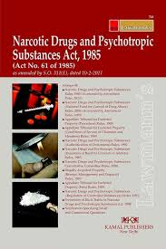

Slide 3
NARCOTICS CONTROL BUREAU
Drug Law Enforcement Organisation
Formed according to UN mandate
Apex body of Central Government for Preventing Drug Abuse
Nodel agency for Preventing Illegal Trafficking of Preventive Drugs and Enforcement of NDPS Act 1985
Duties – Suppy Control & Demand Reduction

Slide 4
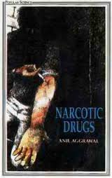
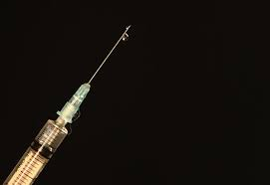
TYPE OF SUBSTANCES THAT CAN BE ABUSED
NARCOTIC DRUGS
PHSYCHOTROPIC SUBSTANCES
CONTROLLED SUBSTANCES
OTHER SUBSTANCES
Drugs are smoked, snorted, consumed
orally or injected depending on the
nature of drug.

Slide 5
NARCOTIC DRUGS
Drugs that reduce the user's perception of pain and induce euphoria (a feeling of exaggerated and unrealistic well-being).
The English word narcotic is derived from the Greek narkotikos , which means "numbing" or "deadening".
In short, it refers to any drug that deadens sensation or produces stupor, or affects the central nervous system.

Slide 6
PHSYCHOTROPIC SUBSTANCES
A chemical substance that changes brain function and results in alterations in:-
Perception
mood
emotions or
consciousness.

Slide 7
CONTROLLED CHEMICALS &PRECURSORS
Mainly used in the pharmaceutical industries in the manufacturing of medicines.
Precursors are chemicals which can also be used to manufacture narcotic drugs and psychotropic substances.
Considering the legitimate use of precursors, these chemicals are classified as controlled substances under NDPS Act 1985.

Slide 8
TYPES OF COMMONLY ABUSED DRUGS
NATURAL DRUGS
Cannabis @ Ganja @ Marijuana
Opium @ Afeem
Coca leaves
SEMI-SYNTHETIC DRUGS
Heroin @ Brown Sugar @ Smack
Cocaine
SYNTHETIC DRUGS
Ketamine
Methamphetamine
LSD – Lysergic Acid Diethylmide etc.

Slide 9
PSYCHOTROPIC SUBSTANCES
Mandrax @ Methaqualone
Ketamine
Methamphetamine
MDMA @ Ecstasy
LSD – Lysergic Acid Diethylamide
Rophynol ( Date rape drug)
Buprenorphine @ Bunogesic @ Tidigesic @ Lupigesic
Mephodrone @ Meow Meow

Slide 10
PRESCRIBED MEDICINAL DRUGS
Some prescribed drugs are also abused as psychotropic substances such as :–
Nitrazepam
Diazepam
Clorozapam
Lorazapam

Slide 11
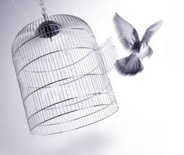
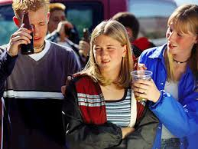
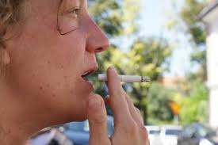
REASONS
Escapism.
Idea - medicines may address complications.
Peer pressure.
Experiment, Pleasure of the effects.

Slide 12
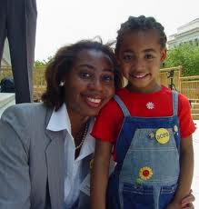
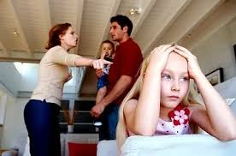
REASONS
Single Parents
Quarrelling Parents

Slide 13
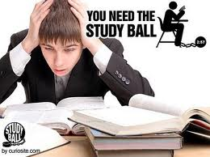
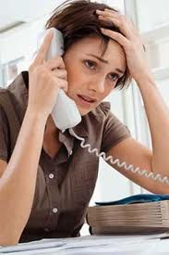
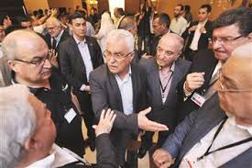
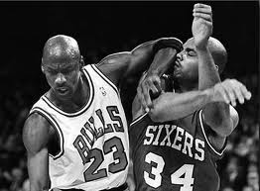
REASONS
Pressure of
Study
Job
Business
Competitive mentality

Slide 14
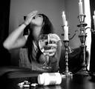
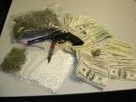
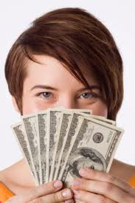
REASONS
Un-necessary comparisons between children
Anti-social elements in the family itself : involvement in drug trafficking or drug addiction
Plenty of earning at young age &
lack of wisdom to spend it

Slide 15
TO SUM UP WE CAN SAY
The disintegration of the old joint family system
Absence of parental love and care in modern families where both parents are working
Decline of old religious and moral values
Drug use also depends upon the personality of the individual and the addict’s immediate environment.
The processes of industrialization, urbanization and migration have led to individual vulnerable to the stresses and strains of modern life.

Slide 16
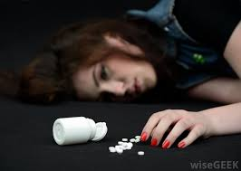
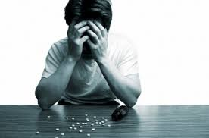
PHSYCHOLOGICAL EFFECTS
Depression
Mood swings
Anxiety
Paranoia
Violence
Decrease in pleasure in everyday life
Hallucinations
Confusion
Desire to engage in risky behavior
Increasing tolerance to drugs

Slide 17
PHYSICAL EFFECTS
Drug addiction changes the way the brain functions- drug repeatedly floods the brain with the chemicals such as dopamine and serotonin during drug use.
The brain adapts and comes to expect, and depend on, these drug-induces highs.
Children born to drug addicted mothers can be cognitively affected throughout life.

Slide 18
PHYSICAL EFFECTS
Contraction of HIV, hepatitis
Heart rate irregularities such as heart attack
Respiratory problems such as lung cancer
Abdominal pain, vomiting, constipation, diarrhea
Kidney and liver damage
Seizures, stroke, brain damage
Changes in appetite, body temperature

Slide 19
BEHAVIOURAL EFFECTS
Easily getting annoyed or nervous
Often appearing angry
Putting blame on others
Refusing to follow rules or questioning authority
Arguing and throwing temper tantrums
Having difficulty in handling frustration
Getting jealous or giving self importance
Action on instincts

Slide 20
SOCIAL EFFECTS
Detrimental impact on the society.
Increase in the crime rate.
Remove inhibition and impair judgment egging one on to commit offences.
Untold emotional pain for every member of the family.
Loss in terms of human potential is incalculable.
Damage to the physical, psychological, moral and intellectual growth of the youth.

Slide 21
OTHER EFFECTS OF DRUG ABUSE
Individual - Addict cannot sustain his life without drugs
Family - Creates all sorts of problems, which in turns effects the whole family members
Friends - An addict is cut off from his real friends but he becomes more close to persons who were influential in developing this addiction
Society - An addict invites negative response from the society, whereby he and his family members get discarded from the society
Economy - The money generated through drug sales is again pumped into legal channels, which disturbs the whole economy.

Slide 22
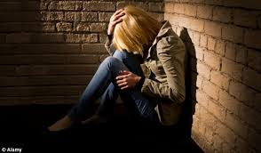
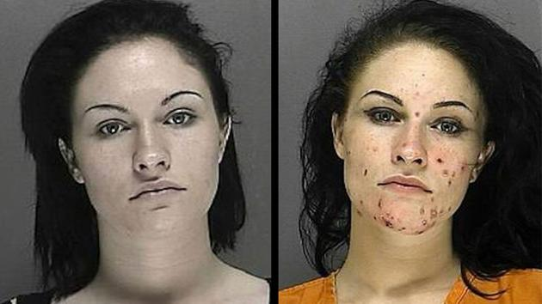
SIGNS OF DRUG ABUSE
Depression
Change in
appearance

Slide 23
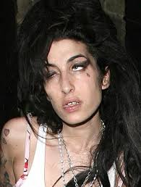
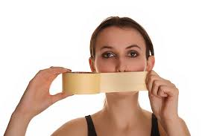
SIGNS OF DRUG ABUSE
Shabby dressing sense
Lack of Communication

Slide 24
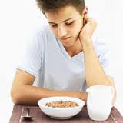
SIGNS OF DRUG ABUSE
Priority for Privacy
Lack of Appetite

Slide 25
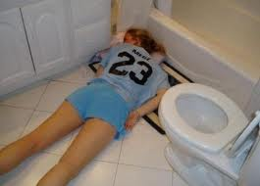
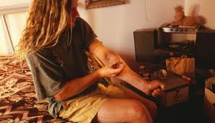
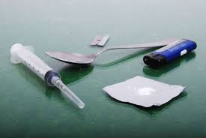
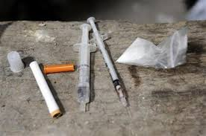
SIGNS OF DRUG ABUSE
Usage of toilets
Poor Hygiene/
Drug paraphernalia

Slide 26
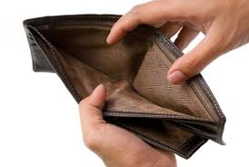
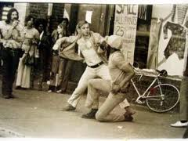
SIGNS OF DRUG ABUSE
Missing Money/Increase in demand for money
Indulgence in unlawful activities/
Violent behaviour

Slide 27
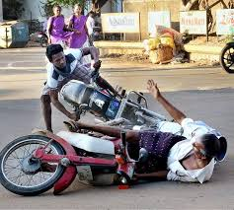
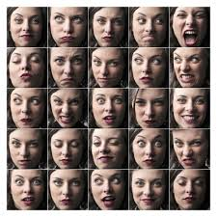
SIGNS OF DRUG ABUSE
Rash driving
Mood swings

Slide 28
OTHER SIGNS
Tendency to tell lie
Odd hour phone calls
Absence in schools/colleges/work places
Desire to complete the work hastily
Loss of interest in favourite activities
In schools/colleges, the persons addicted will mostly be found near the exit gates
May be seen at odd hours at odd places

Slide 29
RESULT:- DEATH FOLLOWS

Slide 30
CHANGE IN APPEARENCE

Slide 31
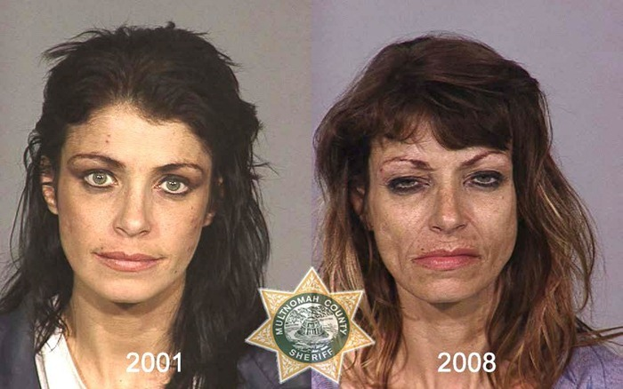
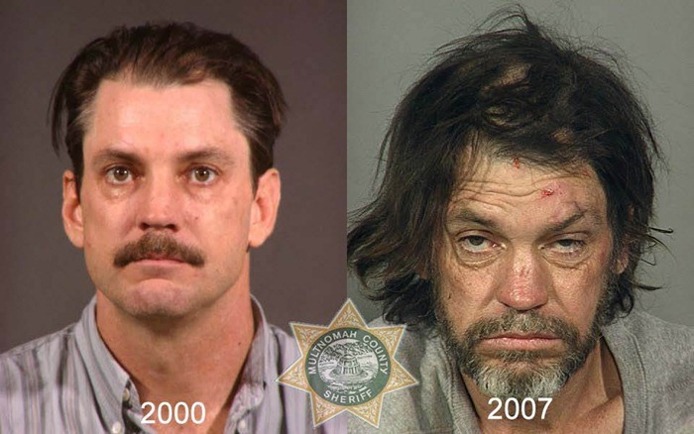
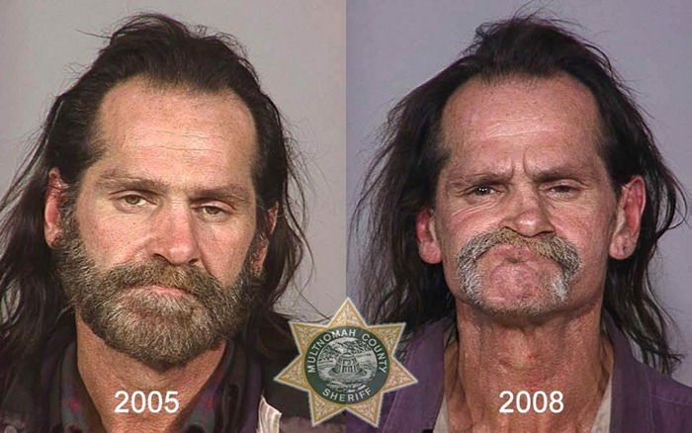
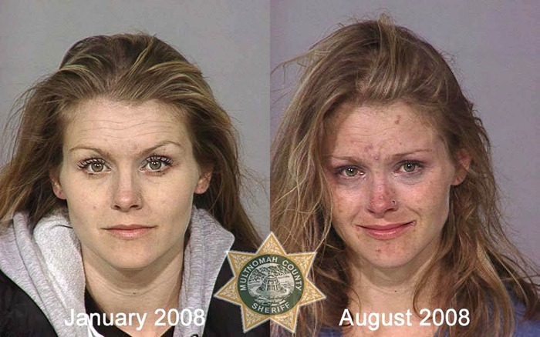

Slide 32
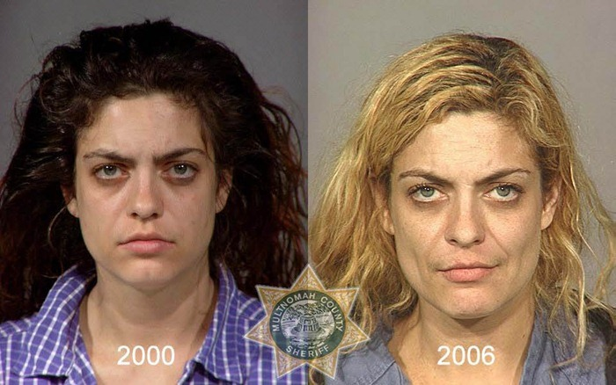
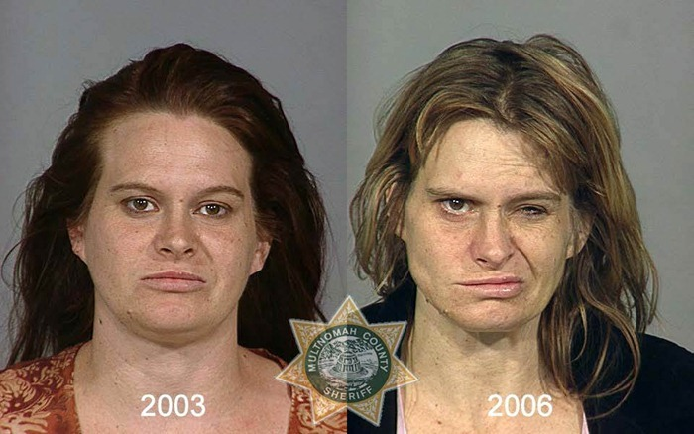
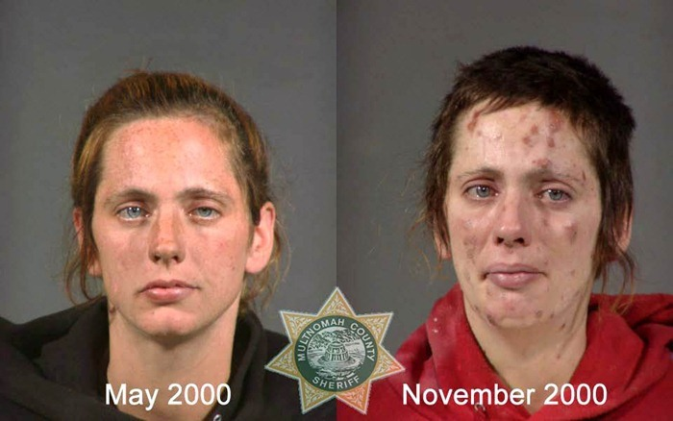
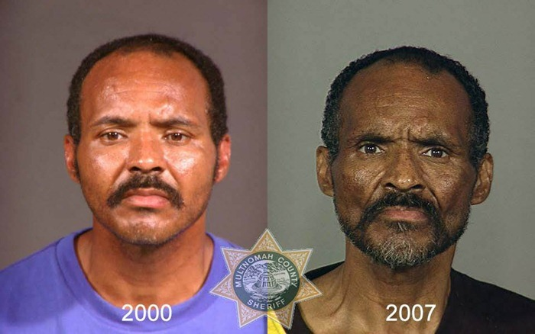

Slide 33
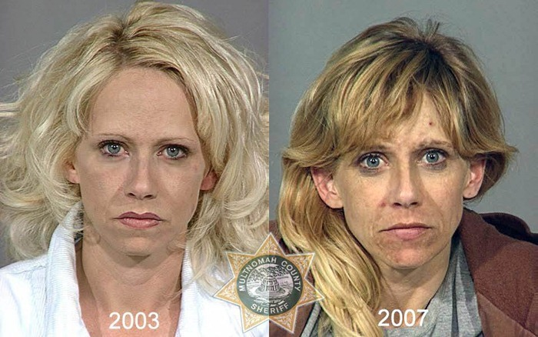
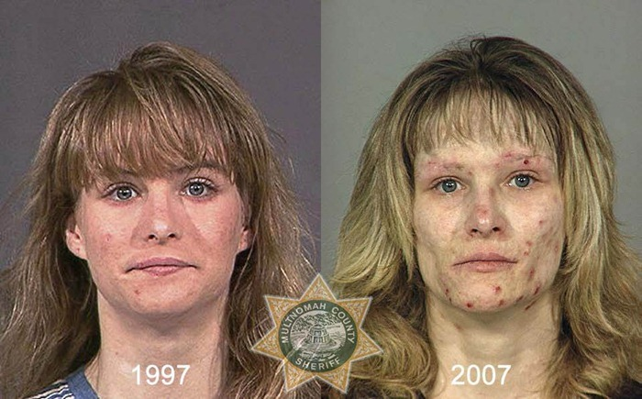
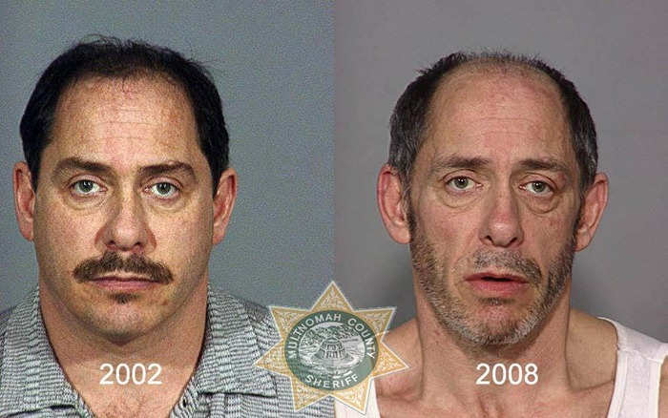
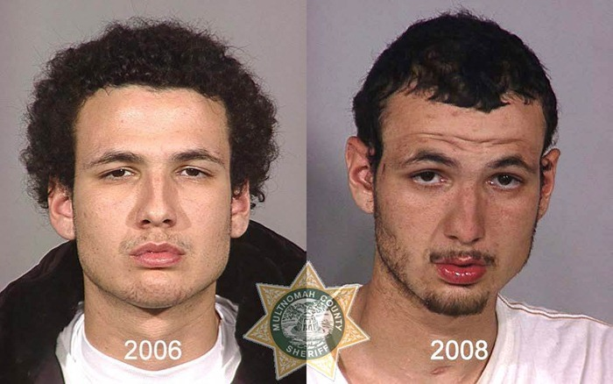

Slide 35
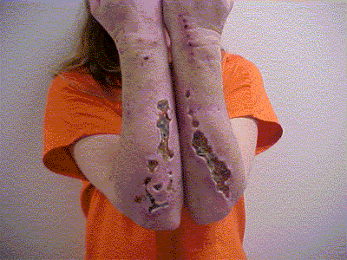
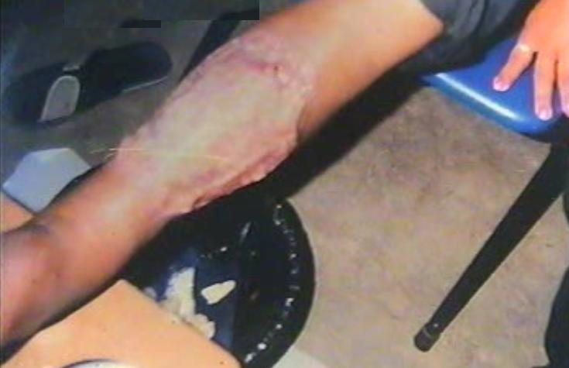
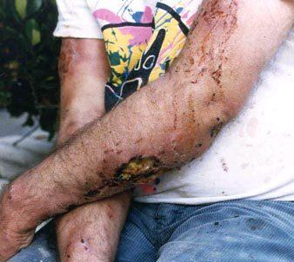
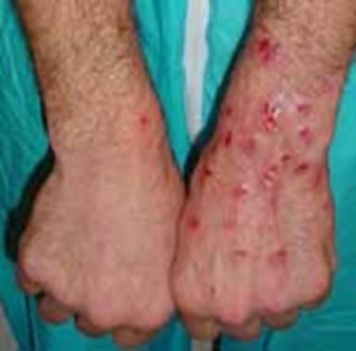

Slide 37
KROKODIL Emergence of new Drug
"In the last three to five years Russia, Ukraine and other countries are no longer using poppies or raw opium as their starting material, but turning over to medications that contain codeine .The drug is called Russian Magic, more common, to its street name, krokodil. Excessive harms reported, such as the scale-like and discolored (green, black) skin of its users, resulting from large area skin infections and ulcers.

Slide 38
CHOOSE YOUR SIDE

Slide 39
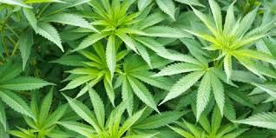
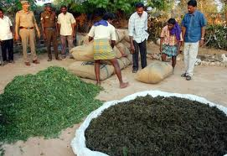
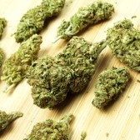
PICTURES OF DRUGS
CANABIS/GANJA @ MARIJUANA

Slide 40
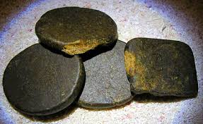
PICTURES OF DRUGS
CHARAS/ HASHIS

Slide 41
PICTURES OF DRUGS Semi sythetic
White Heroin
Brown Heroin
Cocaine
White Heroin

Slide 42
PICTURES OF DRUGS Synthetic
Ketamine Tablets
Ketalar
PCP
LSD

Slide 43
PICTURES OF DRUGS Synthetic
Amphetamine Type Stimulants (ATS)
Ritalin
Metha Ice

Slide 44
PICTURES OF DRUGS Synthetic
Ketamine Powder
Metha Powder
Metha Crystals

Slide 45
PICTURES OF DRUGS
MDMA / ECSTASY
The psychoactive drug MDMA or Ecstasy, an amphetamine that produce entactogenic and stimulant effects

Slide 46
PICTURES OF DRUGS-PRESCRIPTION DRUGS
DIAZEPAM
NITRAZEPAM
CLOROZAPAM
A minor tranquillizer, with sedative effects taken to reduce anxiety. Used in mental patients for treatments

Slide 47
PICTURES OF DRUGS
PCP - PHENCYCLIDINE
A veterinary anaesthetic, used illegally in humans as a hallucinogen

Slide 48
PICTURES OF DRUGS
Abuse of Buprenorphine
Buprenorphine is a semi-synthetic opioid that is used to treat opioid addiction.
Ampoules

Slide 49
CONTROLLED CHEMICALS@PRECURSORS
Ephedrine Powder
Ephedrine Tablets
Pseudoephedrine

Slide 50
PUNISHMENTS
OFFENCE | PUNISHMENT
Cultivation of opium, cannabis or coca plants without license | Rigorous imprisonment-up to 10 years + fine up to Rs.1 lakh
Production, manufacture, possession, sale, purchase, transport, import inter- state, export inter-state or use of narcotic drugs and psychotropic substances | Small Qty - Rigourous imprisonment upto 6 months or Rs 10000 fine or both Intermediate Qty- 10 years + 1 lakh Commercial Qty - 10 to 20 years + 1-2 lkhs fine
Knowingly allowing one's premises to be used for committing an offence under NDPS Act | 10-20 years + 1-2 lakhs fine regardless of quantity
Violations pertaining to controlled substances (precursors) | 10-20 years + 1-2 lakhs fine
Attempts, abetment and criminal conspiracy | Same as for the offence
Preparation to commit an offence | Half the punishment for the offence
Repeat offence | One and half times the punishment for the offence. Death penalty in some cases.

Slide 51
THE END

Slide 52
DRUGS
D – Death
R – Regularized
U – Under
G – Guise
S – Solace
DEATH REGULARIZED UNDER GUISE OF SOLACE

Slide 53
NARCOTIC CONTROL BUREAU
KOCHI OFFICE
Landline : 0484-2425321
Venugopal G Kurup, Superintendent- 9495823751
Samson K Samuel, Int.Officer - 9497696139
Kumar Manohar M, Int.Officer - 8129778960
Mathews Varghese, Int.Officer - 8989859604
S.Rajesh Jayakrishnan, Int.Officer - 9495823337

