Slide 1
Emotional Intelligence questionnaire
Assessment and Development

Slide 2
Contents
Purpose
Definition and Model of Emotional Intelligence
What the Test Measures
Psychometrics
Feedback Report and Scoring Approach
Impression Management
Improvement Tips
Improvement Planning
Conclusion and Discussion

Slide 3
Purpose
Increase self-awareness and awareness of others
Use emotions in relationship management, work performance, creativity, decision making etc
Understand current competency and determine key improvement areas
Improve emotional competencies, raise performance, realize potential

Slide 4
Emotional Intelligence Definitions
John Mayer and Peter Salovey
“The ability to perceive emotions, to access and generate emotions so as to assist thought, to understand emotions and emotional knowledge, and to reflectively regulate emotions so as to promote emotional and intellectual growth.”
Daniel Goleman
“Managing feelings so that they are expressed appropriately and effectively, enabling people to work together smoothly toward their common goals.”

Slide 5
Model of Emotional Intelligence
4 Branch Concept Model
John Mayer and Peter Salovey (2002)
Perceiving Emotions/Reading People. The ability to perceive emotions in oneself and others as well as in objects, art, stories, music, and other stimuli
Facilitating Thought/Using Emotions. The ability to generate, use, and feel emotion as necessary to communicate feelings or employ them in other cognitive processes
Understanding Emotions. The ability to understand emotional information, to understand how emotions combine and progress through relationship transitions, and to appreciate such emotional meanings
Managing Emotions. The ability to be open to feelings, and to modulate them in oneself and others so as to promote personal understanding and growth

Slide 6
Branch 1: Reading People
Scale | Measures
Self-analysis | The degree to which you are in touch with your feelings and emotions and notice when your mood changes.
Analysis of others | The extent to which you pay attention to and identify other people’s feelings and emotions.
Self-expression | How far you are able to describe and communicate your feelings and emotions.
Discrimination | How far you pick up on emotional cues and can tell when something is wrong or when someone is trying to deceive you.

Slide 7
Branch 2: Using Emotions
Scale | Measures
Thinking | The degree to which you follow your hunches and feelings and let your feelings guide your thinking.
Judgment | The extent to which you allow your instincts and intuition to influence your judgments and decisions.
Sensitivity | The extent to which you are able to capitalize on mood changes in a positive way to explore and analyze things.
Problem solving | The extent to which you use your own and other people’s feelings and emotions to help solve problems.

Slide 8
Branch 3: Understanding Emotions
Scale | Measures
Symptoms | Your ability to recognize a range of common emotions – for example, happiness, anger, fear, surprise, interest etc.
Causes | How far you understand the factors that lead people to experience different feelings and emotions.
Complexity | The extent to which you understand complex feelings, emotional blends and contradictory states.
Transitions | The degree to which you are aware of and can anticipate how emotions progress and change.

Slide 9
Branch 4: Managing Emotions
Scale | Measures
Openness | The extent to which you stay open to pleasant and unpleasant feelings to help manage situations and events.
Monitoring | How far you are able to reflectively engage or ignore your feelings and emotions to help guide your actions.
Self-control | Your ability to stay in control of your feelings and emotions when you are under pressure and stress.
Managing others | The degree to which you are able to manage other people’s feelings and emotions in a sympathetic manner.

Slide 10
Test Psychometrics
International comparison group of 6,000 respondents
Majority of respondents from USA (50%), UK (18%), Australia (10%), Canada (7%)
Average age of 38, 50/50 gender balance
Scale reliabilities within accepted benchmark
Median correlation between scale scores and job performance is 0.21 (consistent with 2010 meta-analysis conducted at Virginia Commonwealth University)
Only minor variations due to gender, age, ethnicity and nationality

Slide 11
Feedback Report Contents
Introduction
Profile Summary
Reading Emotions
Using Emotions
Understand Emotions
Managing Emotions
Next Steps
Development Tips

Slide 12
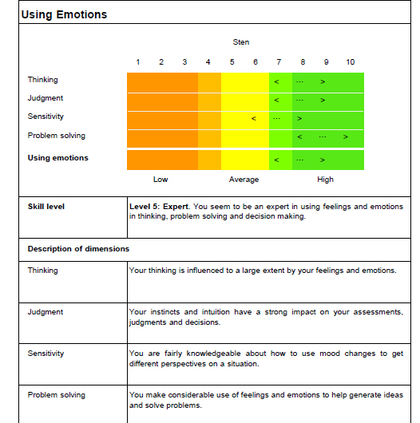
Graphic Profile

Slide 13
Scoring Approach
Standard Ten (sten) scores used frequently in personality assessment tests
Sten Range | RAG Rating | Skill Level | Development
8-10 | Green | 5 Very high | Capitalize on
7 | Amber Green | 4 High | Round off
5-6 | Amber | 3 Average | Work on
4 | Amber Red | 2 Low | Develop
1-3 | Red | 1 Very low | Improve

Slide 14
Stens and Percentiles
Sten | Higher Than % of Comparison Group
10 | 99
9 | 95
8 | 90
7 | 75
6 | 60
5 | 40
4 | 25
3 | 10
2 | 5
1 | 1

Slide 15
Links with Management Competencies
EI Key Area | SHL Universal Competency
Reading people | Interacting and presenting
 | Supporting and cooperating
Using emotions | Leading and deciding
 | Creating and conceptualizing
Understanding emotions | Organizing and executing
 | Analyzing and interpreting
Managing emotions | Adapting and coping
 | Enterprising and performing

Slide 16
Impression Management
Average score in 4-7 range
Low score indicates person who is very self-critical
High score indicates either that person has high opinion of abilities or set out to convey a positive profile
In case of low or high score, EI true score likely to be 1-2 stens different

Slide 17
Improvement Tips
Try to understand what motivates and satisfies you and what people and situations push your buttons
Get to know people on a personal level and try to understand their perspectives
In difficult situations, put your immediate needs on hold in favour of achieving larger goals
Displaying positive emotions such as enthusiasm and optimism can be a huge motivator
Encourage people to think about new ways of doing things and come to you with ideas and suggestions
Personally thank subordinates for their efforts

Slide 18
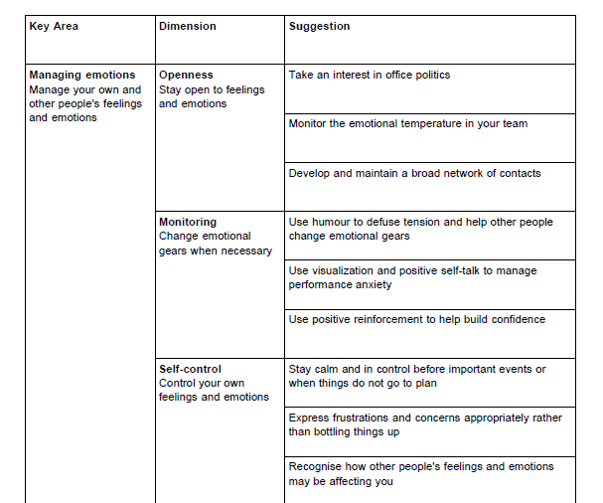
Improvement Tips (cont)

Slide 19
Improvement Planning
Reading Emotions
Strengths | Weaknesses | Improvement Actions
Using Emotions
Strengths | Weaknesses | Improvement Actions

Slide 20
Conclusion and Discussion
Purpose is to provide a framework for self-development
EIQ16 designed to help you pinpoint what you are good at and where you need to improve
Scores don’t matter--what matters is what you have learned about yourself
Questions

