Slide 1
INTELLIGENT TESTS
FOR Assessing intelligence of the individual

Slide 2
INTELLIGENCE TESTS
INDIVIDUAL TEST
GROUP TEST
NON-VERBAL
VERBAL TEST
PERFORMANCE TEST
VERBAL TEST

Slide 3
VERBAL TEST
VOCABULARY TESTS
MEMORY TESTS
COMPREHENSION TESTS
INFORMATION TESTS
REASONING TESTS
ASSOCIATION TESTS

Slide 4
PERFORMANCE TEST
GIVEN IN THE FORM OF MATERIAL OBJECTS
ASSESS THE REACTION OF THE INDIVIDUAL
INSRUCTIONS ARE GIVEN BY THE TESTER

Slide 5
INDIVIDUAL PERFORMANCE TEST
BLOCK BUILDING OR CUBE CONSTRUCTION: Eg: Koh’s Block Design Test
TO FIT BLOCK IN HOLES Eg: Goddard Bord Test
TRACING A MAZE Eg: Porteus Maze Test
PICTURE ARRANGEMENT OR PICTURE COPLETION Eg: Healy test

Slide 6
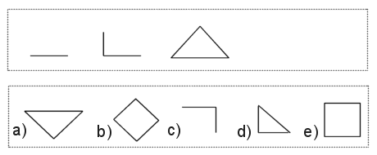
NON VERBAL TEST
a) | b) | c) | d) | e)

Slide 7
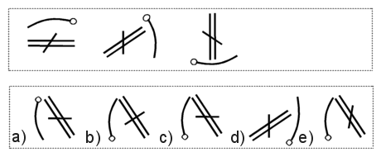
a) | b) | c) | d) | e)

Slide 8
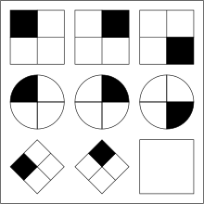
Intelligence quotient Diagnostics
An example of one kind of IQ test item, modeled after items in the Raven's Progressive Matrices test.

Slide 9

USES OF INTELLIGENCE TEST
1.SELECTION:-Admission
- for scholarship of gifted sts.
-for assessing responsibilities
- trainees for a job
2.CLASSIFICATION
3.PROMOTION
4.PROVIDE GUIDENCE
5. IMPROVING TEACHING LEARNING PROCESS
6.IN SETTING PROPER LEVEL OF ASPIRATION
7. IN DIAGNOSIS:-Exceptional children , MR, problems of behaviour
8.Arranging suitable educational programme to meet individual differences

Slide 10

LIMITATIONS
1. Labeling and classification
2. Permanent idea about the person
3. Segregation and Conflict
*not free from practice or coaching effects
*touches only the cognitive domain
*cannot depend only on this result

