Slide 1
SPIRITUAL INTELLIGENCE
DANA ZOHAR & IAN MARSHALL(2000) introduced SI
-the intelligence to solve problems of meaning and VALUE OF LIFE

Slide 2
What is my aim???
Am I happy in my life or make others happy???
Am I really live my life????
Is my job really give the fulfillment what I want????
…………IQ &EQ ARE INADEQUATE
IN THESE CONDITIONS…
…...WE NEED SQ

Slide 3
SI = THE ULTIMATE INTELLIGENCE
It is about the growth of human being;
it is about moving on in life, about having an aim, healing ourselves, discovering freedom, understanding ourselves as the manifestations of the ultimate reality
It is the ability and behaviour to develop & maintain a relationship with the ultimate

Slide 4
SPIRITUAL INTELLIGENCE
Gives meaning in life
Help us to find a moral & ethical path in life
Gives the real values and its meaning
Help us to relate with the Creator and live accordingly Thy will…

Slide 5
Signs of high SQ
FLEXIBILITY
SELF-AWRENESS
ABILITY TO FACE, USE,FIND MEANING IN SUFFERINGS
THINKING HOLISTICALLY
DO NOT BECOME A CAUSE OF HARM TO OTHERS
ABILITY TO ASK FUNDAMENTL QUESTIONS
ABILITY TO WORK AGAINST CONVENTION

Slide 6
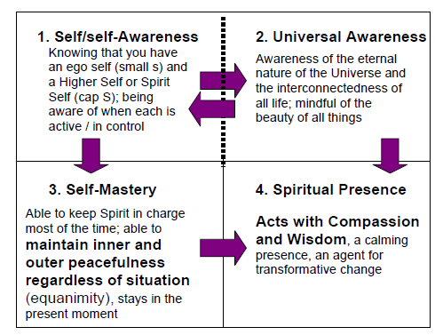
SQ COMPETENCIES

Slide 7
SQ
EQ
IQ
INNER WISDOM GUIDED BY COMPASSION, EQUANIMTY
(INNER &OUTER PEACE)
MANAGING OURSELVES OUR RELATIONSHIPS WELL
RATIONAL & REASONING INTELLIGENCE
PQ
BODY AWARENESS & SKILLFUL USE

Slide 8
