Slide 1
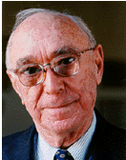
Gerome S Bruner
-Educational thinker
-Process of learning is more important than the material learned
- “Learning to learn” is most important
- Any subject can be taught at any age, provided the material is converted to a form appropriate to the child

Slide 2
Constructivist Theory
Learning is an active process in which learners discover and construct new ideas/concepts based on their current/prior knowledge.
The issues that guide this process must be personally or socially relevant.
Bruner believed that the learner selects information, constructs ideas based on that information and makes decisions by relying on their own cognitive structure of information.

Slide 3
Constructivist Theory
Instruction should allow the learner to discover principles for themselves through active dialog or interaction.
Instructors should become information facilitators instead of information transmitters.

Slide 4
Constructivist Theory
Instruction should address four Major Aspects:
  Predisposition toward learning
  The ways in which knowledge can be structured so that it is readily grasped by the learner
  Effective sequencing of the material
  The nature and pacing of rewards

Slide 5
3 SEQUENTIAL STAGES IN COGNITIVE DEVELOPMENT
The ENACTIVE Stage:
Stage of action
0-2 years
Objects are directly manipulated and facts are gathered
Major learning experience is direct perception through physical activities
Direct experience

Slide 6
THE ICONIC STAGE
Stage of imagery(2-4 years)
Through the formation of images and organization of learning
So that the individual could recall these objects and think about them even when physically they are absent

Slide 7
THE SYMBOLIC STAGE:
Through words and symbols.
Stage of language ( 4 years onwards)
Thinks about an idea in the absence of the specific object and its image
Images are transformed in to the level of pure concept
Conceptualization will be completed –pure reasoning

Slide 8
Spiral Curriculum
CURRICULUM : It is meaningful sequential organisation of learning material appropriate to the cognitive level of a child belonging to a particular chronological age-level

Slide 9
The fundamental structure of all the subjects students are likely to encounter through out school years, would be presented very clearly in very simplified form and then in successively more complex forms in the grades.

Slide 10
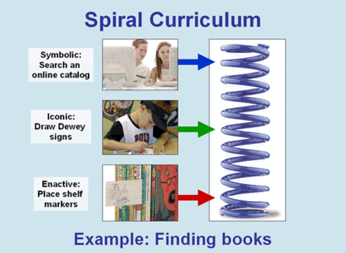

Slide 11
Spiral curriculum is a curriculum which stipulates that students should repeat the study of a subject at different grade levels, each at a higher level of difficulty and in greater depth. It is a curriculum which goals are to improve the quality of education and graduates .

Slide 12
Advantages
The student revisits a topic, theme or subject several times throughout their school career.
• The complexity of the topic or theme increases with each revisit.
• New learning has a relationship with old learning and is put in context with the old information.
• The information is reinforced and solidified each time the student revisits the subject matter.
• The spiral curriculum also allows a logical progression from simplistic ideas to complicated ideas.
• Students are encouraged to apply the early knowledge to later course objectives.

Slide 13
INDUCTIVE LEARNING:
Learning should be inductive(simple to complex, concrete to abstract, specific to general)
Pupils are active
It start s with the specific experience of the pupils which is then consolidated with more and more ideas until a general idea or concept is formed.

Slide 14
DISCOVERY LEARNING
Teacher –facilitator
Teacher organise the class so that the students learn through their own active involvement
Leading or Intriguing questions, baffling situations, interesting problems are presented to students

Slide 15
Not teaching how to solve the problem , but provide appropriate materials for observations, formulate hypothesis, test solutions.
Intuitive and analytic thinking
Teacher should give proper feedback at correct time

Slide 16
Discovery learning is a technique of inquiry- based instruction
Discovery learning can occur whenever the student is not provided with an exact answer but rather the materials in order to find the answer themselves.
Discovery learning takes place in problem solving situations
Students interact with their environment by exploring and manipulating objects, wrestling with questions and controversies, or performing experiments.

Slide 17
GUIDELINES
Emphasis the basic structure of new material
Present many examples of the concept
Help students to build a coding system
Apply new learning to many different situations and kinds of problem
Pause a problem to students and let them try to find out the answer
Encourage students to make intuitive guesses

Slide 18
ADVANTAGES
Help students to learn how to learn
Produce sense of excitement and self motivation
It allows students to proceed in ways that fit their own abilities
Strengthen the students self-concept
Students become accountable to themselves for their learning
It aids students in effective memory and transfer to new learning situations
Encourage students to think intuitively, logically, formulate hypothesis and test it
Give inner satisfaction

Slide 19
Educational implications
  Instruction must be concerned with the experiences and contexts that make the student willing and able to learn.
  Instruction must be structured so that it can be easily grasped by the student (spiral organization).
  Instruction should be designed to facilitate extrapolation and/or fill in the gaps (going beyond the information given).

Slide 20
Spiral curriculum: same basic idea revisited till the student get complete details
3 developmental stages are applicable to adults learning unfamiliar materials
Discovery learning
Building and maintaining predispositions required of learners
Learners become active in learning process
Importance of Inductive method
Intuitive and analytical method of learning

