Slide 1
Cognitive field theories
Gestalt- learning by insight
Learning by perceptual organisation

Slide 2
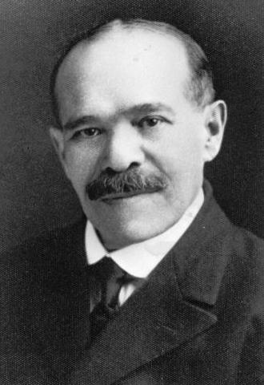
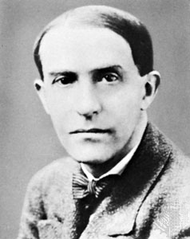
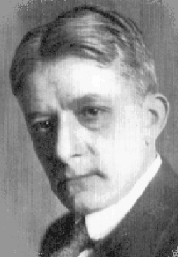
G
E
S
T
A
L
T
P
S
Y
C
H
O
L
O
G
I
S
T
S
Max Wertheimer
Kurt Koffka
Wolfgang Kohler

Slide 3
Gestalt psychologists consider the process of learning as an organized whole.
A thing cannot be understood by the study of its constituent parts but only by the study of it as a totality.

Slide 4
Gestalt psychology used the term ‘insight’ to describe the perception of the whole situation by the learner and his intelligence in responding to the proper relationships.
This theory stresses the importance of motivation, previous knowledge, thinking, action etc.

Slide 5
THE INSIGHT LEARNING THEORY
Wolfgang Kohler
Learning is the development of insight
Basic Concepts of Insight learning
Total situation is taken into account
Learning situation is a problem situation – solution by insight
Perceives situation as a whole- takes proper decision intelligently
Learner responds to proper relationship

Slide 6
INSIGHT
Sudden grasping of the solution for a problematic situation.
A flash of understanding comes to us all on a sudden.
Sudden awareness or perception of the essential relationship in a total situation.
A sudden coherent pattern of solution appears at once.

Slide 7
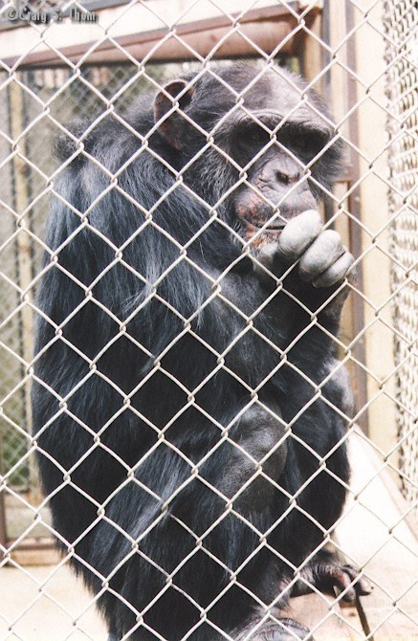
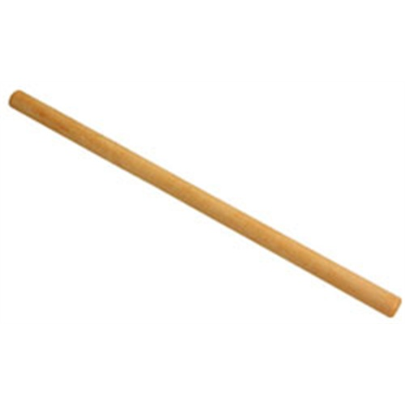

Chimpanzee - Sultan

Slide 10
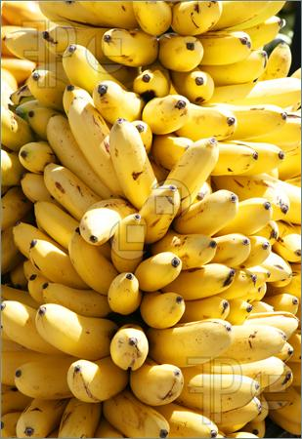
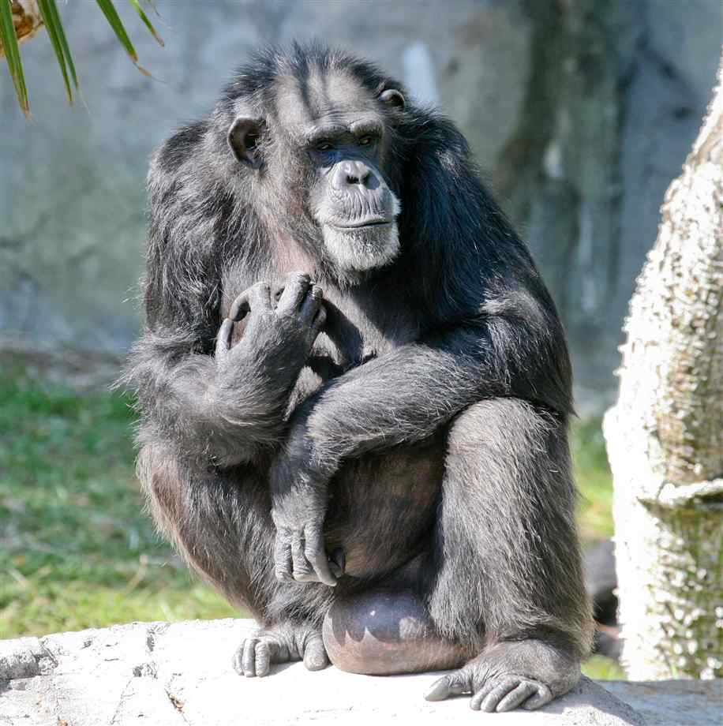
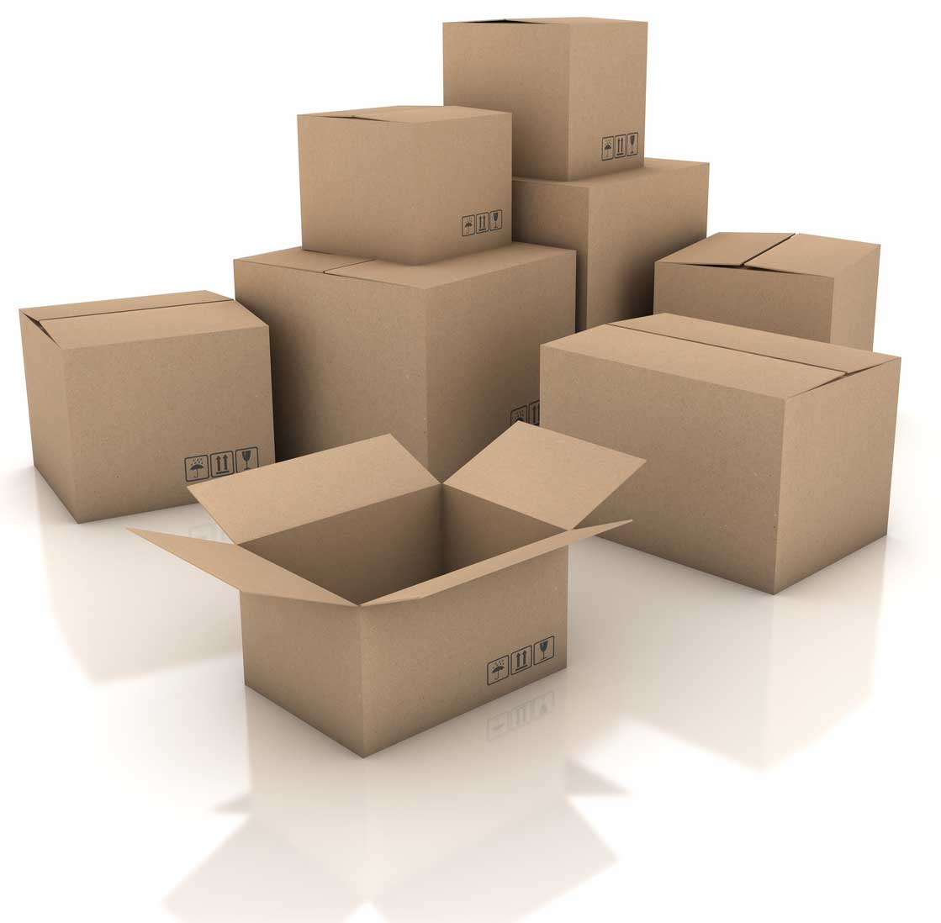

Slide 11
Steps in Insight learning
Identifying the problem
Understanding the problem
Incubation of ideas
Trail & error mode of response
Sustained attention
Insight development
Steady repetition of adaptive behavior
Comprehension of ability

Slide 12
Factors Affecting Insight Learning
Experience
Intelligence
Learning situation
Initial efforts
Repetition & generalization

Slide 13
Gestalt laws of Learning
Learning takes place when the learner organize the separate parts of his perceptual field into a meaningful whole
Organization of the stimuli takes place according to four laws
Law of similarity
Law of proximity
Law of closure
Law of continuity

Slide 14
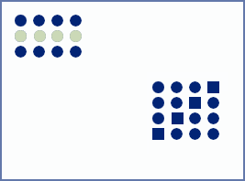
Law of Similarity
This law states that elements of a stimulus configuration will be grouped together perceptually if they are similar to each other.
We tend to group objects with similar properties (color, shape, texture).

Slide 15
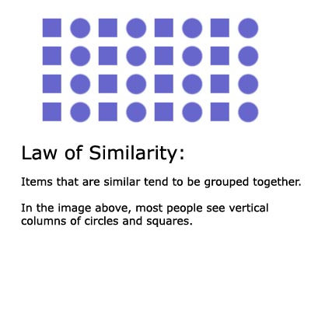

Slide 16
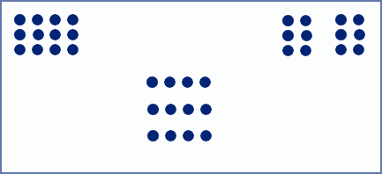
Law of proximity
This law states that elements nearer to each other are perceived as part of the same configuration.
We tend to group nearby objects.

Slide 17
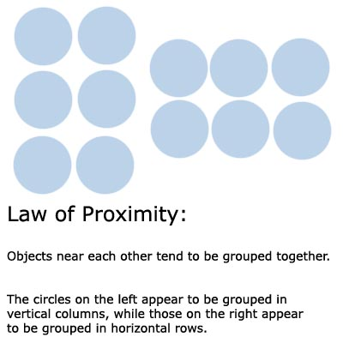
Law of Proximity

Slide 18

Law of closure
This law states that we tend to close the open edges of a figure to make the stimulus configuration complete
We are so accustomed to seeing closure that we sometimes close things that aren't

Slide 19
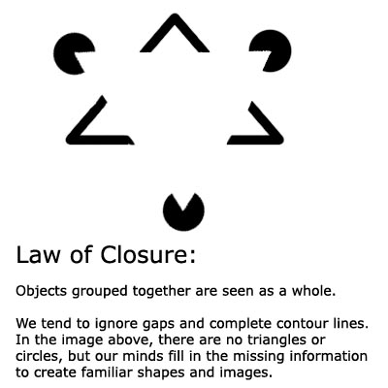
Law of Closure

Slide 20
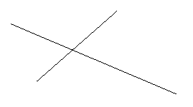
Law of continuity
The law states that we link individual elements of a configuration so that they form continuous pattern that makes sense to us.

Slide 21
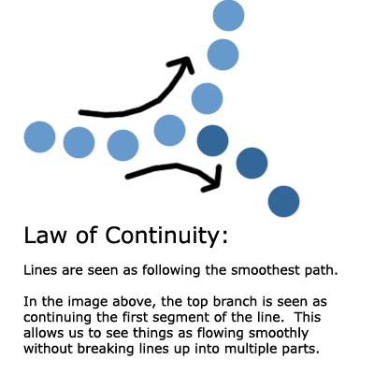
Law of Continuity

Slide 22
Educational Implications
        1.The whole is greater than the parts and therefore the situation should be viewed as a whole.
        2. The use of blind fumbling and mechanical trial and error should be minimised. The learner should try to see relevant relationships and act intelligently.
        3. The purpose or motive plays the central role in the learning process.

Slide 23
4. Subject matter should be presented in gestalt form.
5. Organization of syllabus and curriculum - use gestalt principle
6. Give opportunities for using mental abilities.
7. Emphasizes discovery learning, scientific method, heuristic method and problem solving.

Slide 24
8. Importance of motivation.
9. Grade learning task according to the intellectual development of the learner.
10. Relate new learning to previous one.

