Slide 1
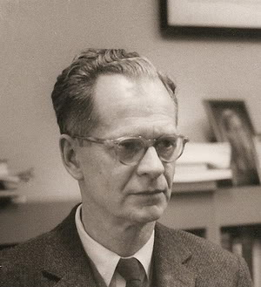
Burrhus Frederic Skinner
Born March 20, 1904
Died August 18, 1990
Born in Susquehanna, Pennsylvania
American psychologist, author, inventor, advocate for social reform and poet.
Innovated his own philosophy of science called Radical Behaviorism

Slide 2
Operant conditioning / Instrumental conditioning
Included in the category of conditioning
Differs from classical conditioning
Classical conditioning – stimulus essential for response
Operant conditioning – Organism itself initiate the behaviour
Behaviour is shaped and maintained by its consequences

Slide 3
Operant conditioning is a process of learning through which organisms learn to repeat behaviours that yield positive outcomes or permit them to avoid or escape from negative outcomes.

Slide 4
Respondent behaviour – elicited responses( classical conditioning )
Operant behaviour- emitted responses
Operant behavior: operated by the organism and maintained by its results. It is an emitted behaviour. It occurs without an observable external stimulus which operates on the organism’s environment
The response emitted by the organism is instrumental in bringing about reinforcement. Hence it become instrumental conditioning.

Slide 5
Laboratory Examples
Operant Conditioning
Exploring
Scratching
Key-pecking
Grooming
Defecating
Urinating
Pigeon
Reinforcement
(in a Skinner box)
(food pellet)

Slide 6
Skinner’s Theory
“All we need to know in order to describe and explain behavior is this: actions followed by good outcomes are likely to recur, and actions followed by bad outcomes are less likely to recur.” (Skinner, 1953)

Slide 7
  In Skinner’s Experiment : CR produces UCS
  Disc – Conditioned Stimulus (CS)
  Pecking – Conditioned Response (CR)
  Food - Unconditioned Stimulus (UCS)
  Eats -Unconditioned Response (UCR)

Slide 8
Central Human Motive in Skinner’s Theory
Environmental consequences shape behavior

Slide 9
OPERANT CONDITIONING TECHNIQUES
POSITIVE REINFORCEMENT = increasing a behavior by administering a reward
“Do something to get something done”
NEGATIVE REINFORCEMENT = increasing a behavior by removing an aversive stimulus when a behavior occurs
“Do something to avoid something”

Slide 10
PUNISHMENT = decreasing a behavior by administering an aversive stimulus following a behavior or by removing a positive stimulus
EXTINCTION = decreasing a behavior by not rewarding it

Slide 11
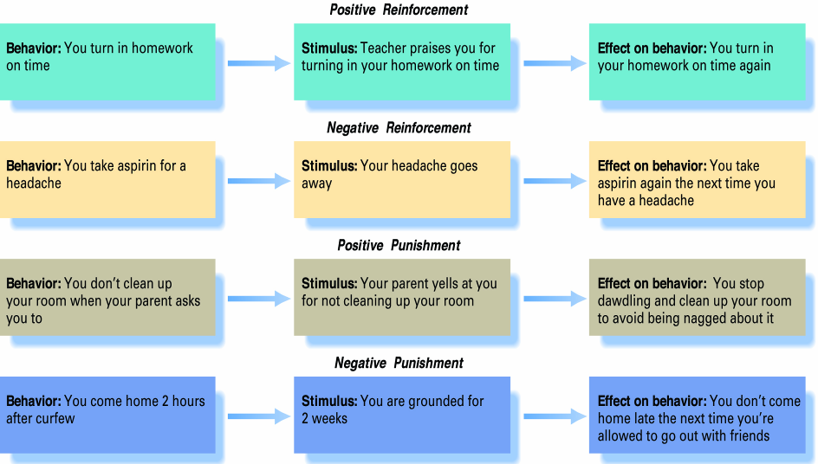
Positive and Negative Reinforcement, Positive and Negative Punishment

Slide 12
The schedule of reinforcement
1. Continuous reinforcement schedule: Provision is made to reinforce every correct response of the organism during learning (Ex: student may be rewarded through praise or approval for every correct response)

Slide 13
2. Fixed interval reinforcement schedule
The organism is rewarded only after a fixed interval of time. (Ex: in animal training the trainer may reinforce the response of the animal after every 5 minutes by providing some food)

Slide 14
3. Fixed ratio reinforcement schedule
The reinforcement is given after a fixed number of correct responses.
( In classroom quiz, a student is rewarded with a pen after every 5 correct answers)

Slide 15
4. Variable reinforcement schedule
When reinforcement is given at varying intervals of time or after varying number of responses, it is called a variable reinforcement schedule(in classroom teacher may give compliments to students occasionally when he feels so)

Slide 16
Classical & Operant Conditioning
Classical Conditioning
Learning of elicited response (respondent behavior)
S-type conditioning – emphasis to stimulus
CR & UCR are same
Pairing of UCS and CS
Stimulus substitution
Stimulus oriented
Reinforcement is correlated with stimulus
Controlled by autonomous nervous system
Operant Conditioning
Learning of emitted response ( operant behavior)
R-type conditioning – emphasis to response
CR & UCR are different
No pairing of UCS & CS
Response modification
Response oriented
Reinforcement is correlated with response
Controlled by central nervous system

Slide 17
Educational contributions
Significance of reinforcement
Positive reinforcement in the schools
Programmed learning

