Slide 1
Theory of Classical Conditioning (Ivan Pavlov)
(Learning by conditioning)
Learning – Habit formation – By Association & Substitution
Conditioning
response to a natural stimulus is transferred to a substitute stimulus

Slide 2
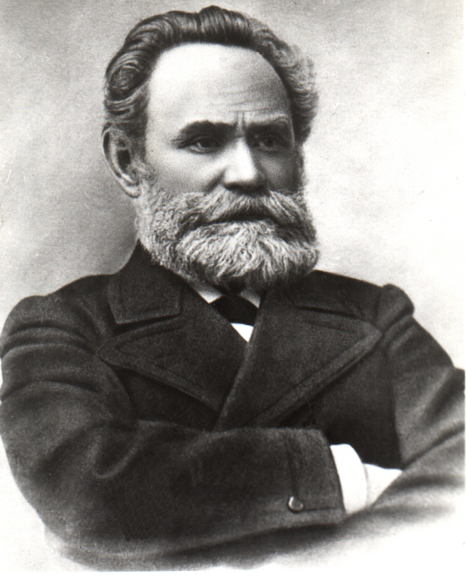
Ivan Petrovich Pavlov
Born Sept 14, 1849
Died Feb 27, 1936
Born in Ryazan, Russia
Physiologist, Psychologist, and Physician
Awarded the Nobel Prize in Physiology in 1904 for research on the digestive system

Slide 3
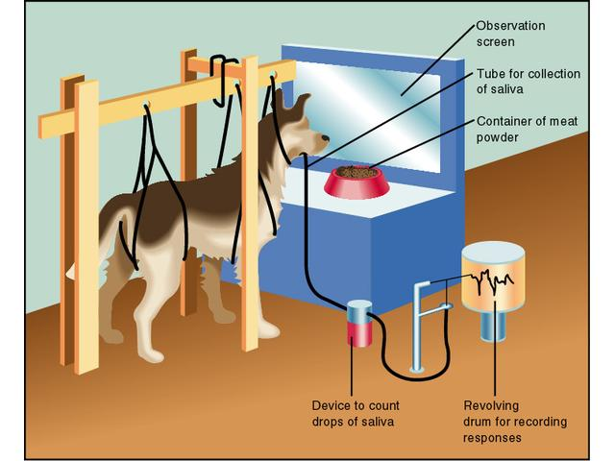

Slide 4
Four essential elements of conditioning process
Unconditioned Stimulus (US)
the natural stimulus – food
2. Unconditioned response (UR)
natural response - Salivation
3. Conditioned Stimulus (CS)
artificial Stimulus – ringing of bell
4. Conditioned Response (CR)
  Salivation

Slide 5
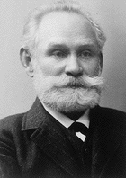



Classical Conditioning:
Definitions
Unconditioned Stimulus (US): a stimulus that has the ability to produce a specified response before conditioning begins.
(FOOD)
Unconditioned Response (UR): the response produced by the US.
(SALIVATION PRODUCED BY FOOD)
Conditioned Stimulus (CS): an initially neutral stimulus that comes to produce a new response because it is associated with the US.
(BELL)
Conditioned Response (CR): the response produced by the CS.
(SALIVATION PRODUCED BY THE BELL)

Slide 6
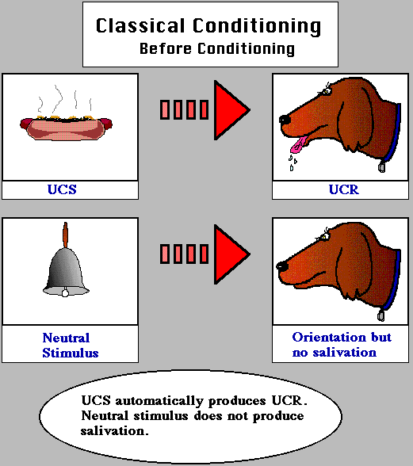

Slide 7
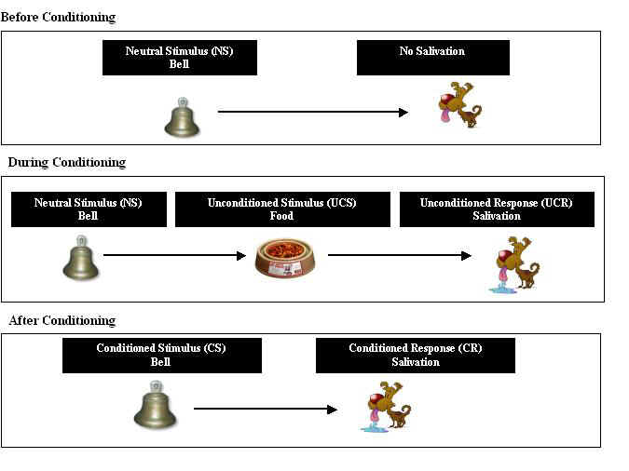

Slide 8
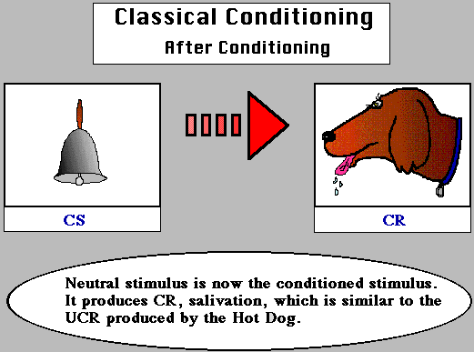

Slide 9
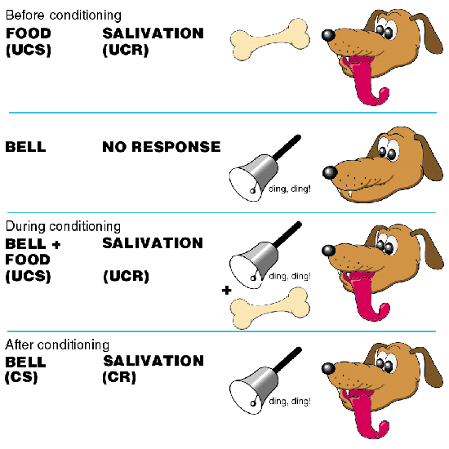
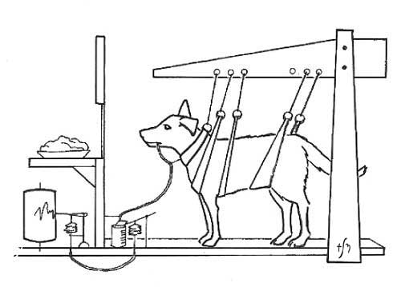
UCS = unconditioned stimulus
UCR = unconditioned response
CS = conditioned stimulus
CR = conditioned response

Slide 10
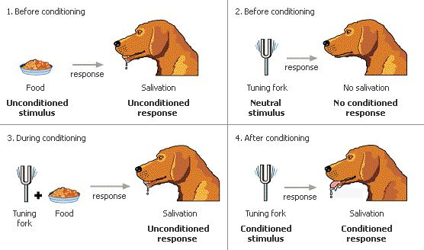

Slide 11
Classical Conditioning
A form of learning in which two stimuli are presented together and the response originally elicited by one of them comes to be elicited by other.
A process in which conditioned stimulus comes to elicit a response after having been paired with an unconditioned stimulus.

Slide 12
Formation of an association between a conditioned stimulus & a response through the repeated presentation of the conditioned stimulus in a controlled relationship with an unconditioned stimulus that originally elicits that response.

Slide 13
Principles of Classical Conditioning
Acquisition
Extinction
Spontaneous recovery
Stimulus generalization
Stimulus discrimination

Slide 14

Classical Conditioning: Basic Principles
Acquisition
Repeatedly pairing a
CS with a US will produce a CR.

Slide 15
Extinction
After conditioning has taken place,
repeatedly presenting the CS without the US will make the CR weaker
and eventually make it disappear.-no reinforcement
X

Slide 16
Spontaneous Recovery
Following extinction, the CR reappears at reduced strength if the CS is presented again with the US, after a rest period.

Slide 17
Stimulus Generalization
After a CR has been trained to a CS,
that same CR will tend to occur to
similar stimuli without further training.
The greater the similarity,
the stronger the response will be.
Conditioning:
Test for Generalization:

Slide 18
Stimulus Discrimination
A subject responds to the CS but not to a similar stimulus
because
the CS was paired with a US
but
the similar stimulus was presented without the US.
X

Slide 19
Educational Implications
Developing good habits by conditioning
De-conditioning of desired habits for behaviour modification
Developing positive attitude towards learning
Use of A-V aids (association)
Teaching of alphabets and fundamental principles of arithmetic
Importance of reinforcement-conditioned with reward.
Affectionate and sympathetic treatment by teachers

