Slide 1
JEAN PIAGET
Swiss biologist
‘Genetic Epistemology’ = origin and growth of knowledge
How does knowledge originates? How it develops?...
By Naturalistic observation

Slide 2
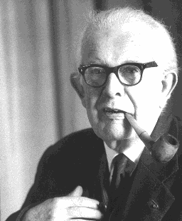
JEAN PIAGET

Slide 3
CONSTRUCTIVISM
Children are active thinkers who are constantly trying to construct more accurate and advanced knowledge or understanding of the world /environment.
Children construct the knowledge by interacting with the environment.

Slide 4
Piaget believed that the development of qualitatively different cognitive structures occurred through the processes of assimilation and accommodation.
When a qualitative change occurs, the infant/child enters a new stage of development.

Slide 5
Cognitive development
“SCHEMA” - Basic unit of cognitive structure
Enable an organism to be ‘aware of’ or ‘act up on’ the environment
Mental representation of an experience
The basic building block of the knowledge
It undergoes modification with interaction

Slide 6
Operation: mental manipulation of schemas
(acting on, changing, comparing, relating….)

Slide 7
ADAPTATION OR ORGANISATION
The mental process of extension and modification of schemas by the interaction with the environment
Assimilation
ADAPTAION
Accommodation

Slide 8
Assimilation
The process of fitting/incorporation of new knowledge in the established cognitive structure
It is a kind of absorption without resistance

Slide 9
Accommodation
Process of modification or expansion of existing cognitive structure to adjust to the integration of new experience
Equilibration – organism moves from the state of disequilibrium to equilibrium by adaptation

Slide 10
ASSIMILATION
Existing Knowledge Structure
New Knowledge
Is incorporated in to
ACCOMMODATION
Existing Knowledge Structure
New Knowledge
Produces changes in

Slide 11
STAGES IN COGNITIVE DEVELOPMENT
4 Stages With Distinctive Learning Capabilities Connected With Age Span

Slide 12
1.SESORY MOTOR STAGE
BIRTH – 2 YEARS
The baby use sensory and motor apparatus to adapt her/himself to the environment
‘Action Schema’-no thinking-no symbols
Object permanence -concept formation
  Objects continue to exist when they pass from view
    Absence of Object Permanence
(1st yr.)- anything out of sight is out of mind
    Object Permanence (2nd yr.)

Slide 13
Co-ordinate space
Objectified Causality
Objectification of time

Slide 14
2.Pre operational Stage
2- 7 years ( Preconceptual stage 2-4), Intuitive stage(4-7)
Egocentric
No logic reasoning
Centration(concentrate on one feature of the object)
Concentrates on– superficial features, static states
Capable of symbolic representations ( symbolic function)-language develops

Slide 15
Animism
Use of language
Irreversible
Do not possess the schema to assimilate concepts of number, length, volume etc:
Provide stimulating home environment

Slide 16
Lack of understanding of relational terms such as lighter,,larger, softer….
Lack of SERIATION: The ability to arrange objects in order along some dimension
Lack the ability of CONSERVATION
    Knowledge that certain physical attributes of an object remain unchanged even though the outward appearance of the object is altered

Slide 17
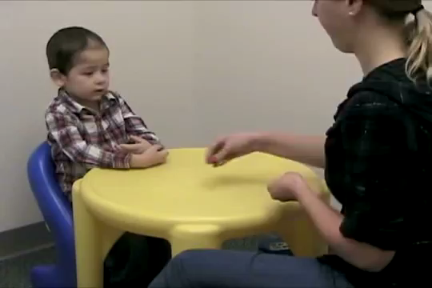

Slide 18


Slide 19
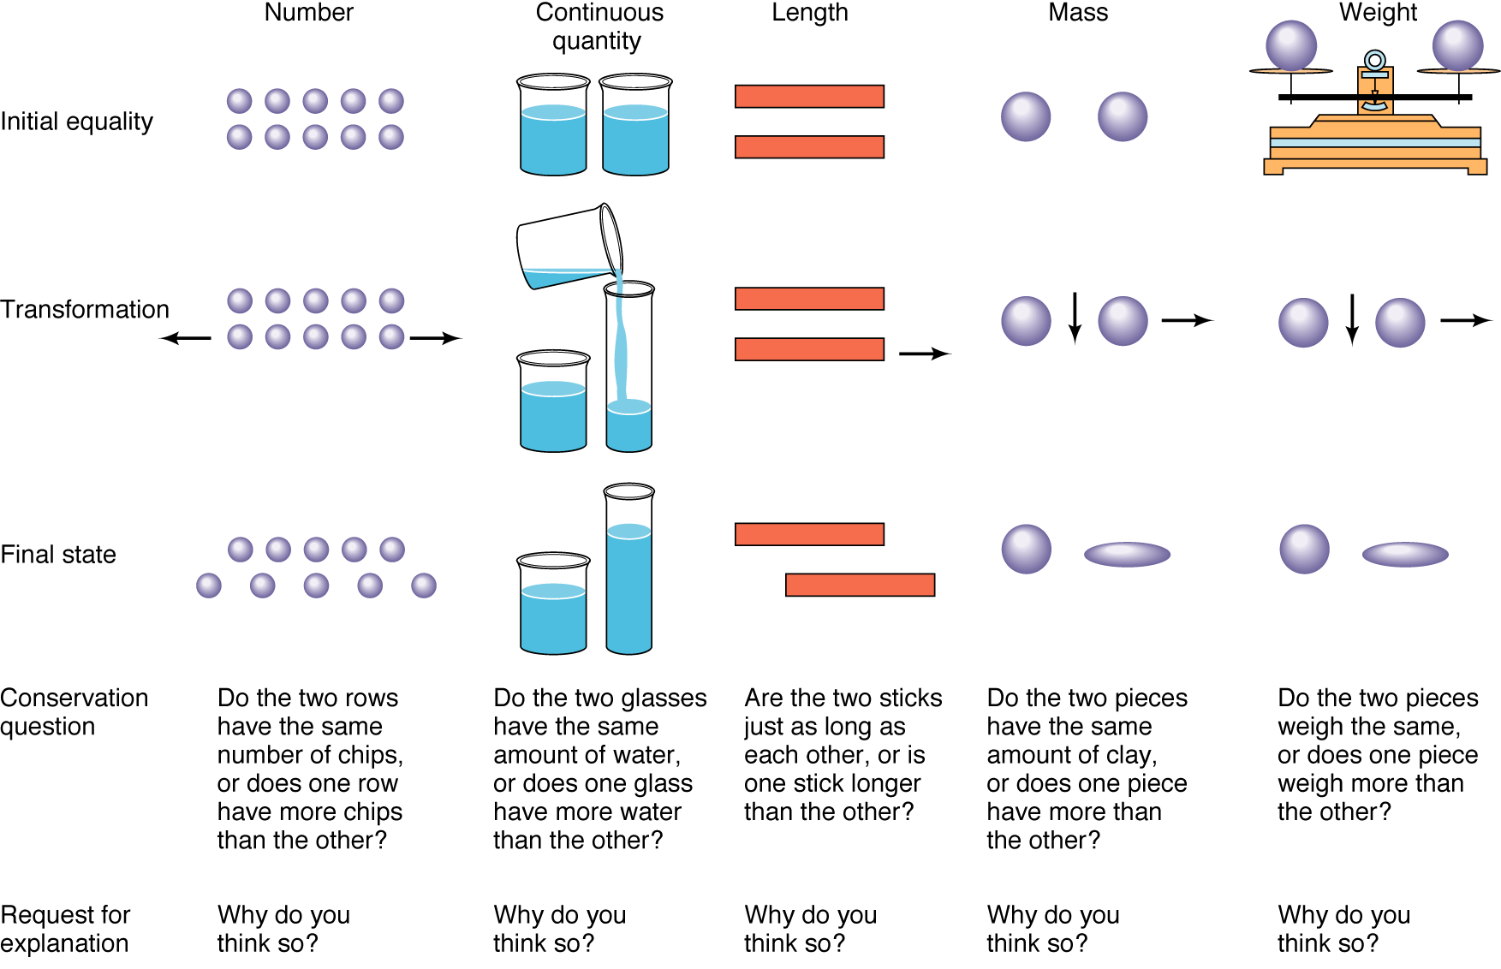
Conservation Examples

Slide 20
3. CONCRETE OPERATIONAL STAGE
7- 11 YRS
Operation = mental activity that transform or manipulates information for some specific purpose
Stability and integration of cognitive system
Reversible in thinking process

Slide 21
Can focus on successive changes in a process
Capable of classification of concrete objects
Can do Simple logical operations
Decentration
Transitivity-ability to recognize relation among elements in a series. eg: A < B < C

Slide 22
4.FORMAL OPERATIONAL STAGE
11-15 YRS
Time for ideas, beginning of theories
Handling hypothesis, reasoning, logical thinking
Ability for abstract thinking
Hypothetical- deductive reasoning
Spontaneous development of experimental spirit

Slide 23
Educational Implications
Arrangement of subject matter in the curriculum –ability based curriculum
Organisation of various activities in learning
Provide direct experience then to abstract ideas
We should not expect the children to work at the level of formal operations when the child is still at pre- operational level

Slide 24
Learning experience according to the developmental stage
Learning is an active process
Students should interact with environment
Teacher – ensure that the child remains as active participant in learning process for intelligent adaptation
Child centered education

Slide 25
Problems with Piaget’s Theory
Children often grasp ideas earlier than what Piaget found
Cognitive development across domains is inconsistent (e.g. better at reading than math)
Studies have shown that development can to some degree be accelerated

