Slide 1
Hereditarians claim that heredity is all in all. No amount of education can change the individual from what s/he is.

Slide 2
Experimental studies - in Favour of Heredity,
Kallikak family:
- H.H. Goddard studied Kallikak family.
Kallikak (soldier who married two women). First was a feeble minded girl and the other was a normal one.
THE family line established by the feeble minded woman contained 480 direct descendants, among which only 46 normal individuals were found, the others were criminals, drunkards, feeble minded patients, sexually perverted and illegitimate etc.
Whereas among 496 direct descendants of the line established by the normal women, all were normal with the exception of five.

Slide 3


Slide 4
Juke family study:
This study was conducted by Dugdale. Juke was a corrupt fisherman. His wife was also corrupt. About 1200 descendance the family line established by them were studied. It was found that most of these descendants were paupers and prostitutes. Only a few of them were found normal.

Slide 5
Galton Francis in 1869, prepared a list of 977 genius and well-to-do persons and investigated about their relatives. They were found to have 535 eminent relatives. For comparison he prepared another list of 977 average men and similarly investigated about their relatives. These 977 average men had but four relatives who were eminent.

Slide 6
It is not heredity : it is environment

Slide 7
Newman, Freeman and Holzinger in 1937, reported a case study of 19 pairs of identical twins.
They found that whereas the I.Q. difference of the identical twins reared together was 5.9 points, it was 8.2 for the twins reared apart.

Slide 8
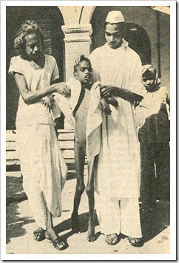
Ramu known as the wolf-boy.

Slide 9
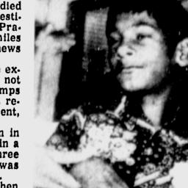
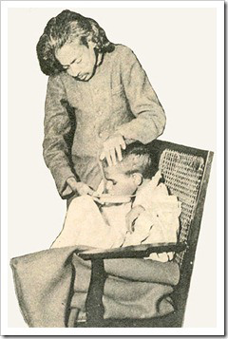

Slide 10
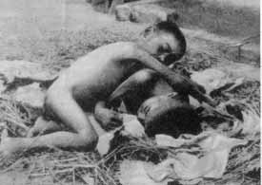
Amala and Kamla, aged 2 and 9 years. They are found in the forest of Bengali in 1920 from the den of a wolf.

Slide 11
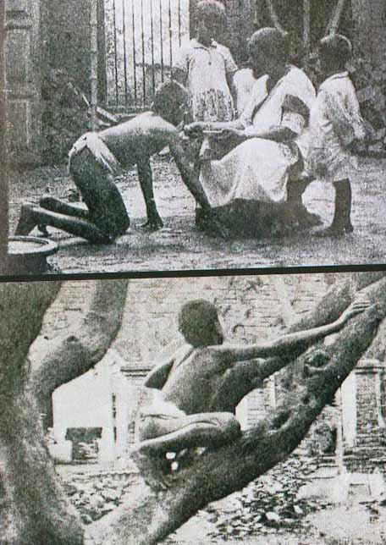
Amala and Kamala

Slide 12
A child’s development is conditioned by heredity and environment both of which are correlated factors. Heredity provides whatever potentialities we possess, while environment or nurture determines whether they shall be actualized or not. In other words, children are born with a biological heritage and a social heritage. Both must be good for good results.

Slide 13
General Provisions for the Individual Difference in the classroom.
1. To know about the abilities, capacities, interests, aptitudes and other personality traits of the individual pupils.

Slide 14
2. Ability grouping: The students in a class can be divided into homogenous groups in order to adjust instruction to varying individual differences.

Slide 15
3. Adjusting the curriculum: The curriculum must be as flexible and differentiated as possible in order to meet the requirement of varying individual differences among the pupils.

Slide 16
4. Adjusting the methods of teaching: Every teacher should be some-what free to formulate his/her own plan and strategy and adopt instructional procedure which s/he finds most suited to the particular types of pupils under him/her.

Slide 17
5. Adopting special programme or methods for individualizing instruction: Schools may adopt some special programme or methods of teaching like Dalton Plan, Project Plan or use Programmed learning material for enabling the students to learn at their own individual rate.

Slide 18
6. Other measures of individualizing instruction:
a) The size of the class should be as small as possible.
b) The teacher should try to pay individual attention to the group.
c) The teacher should keep in view the individual difference of her/his students while engaging them in drill or practice work.
d) Special coaching and guidance programme for both the dull and the gifted children is most helpful.

