Slide 1
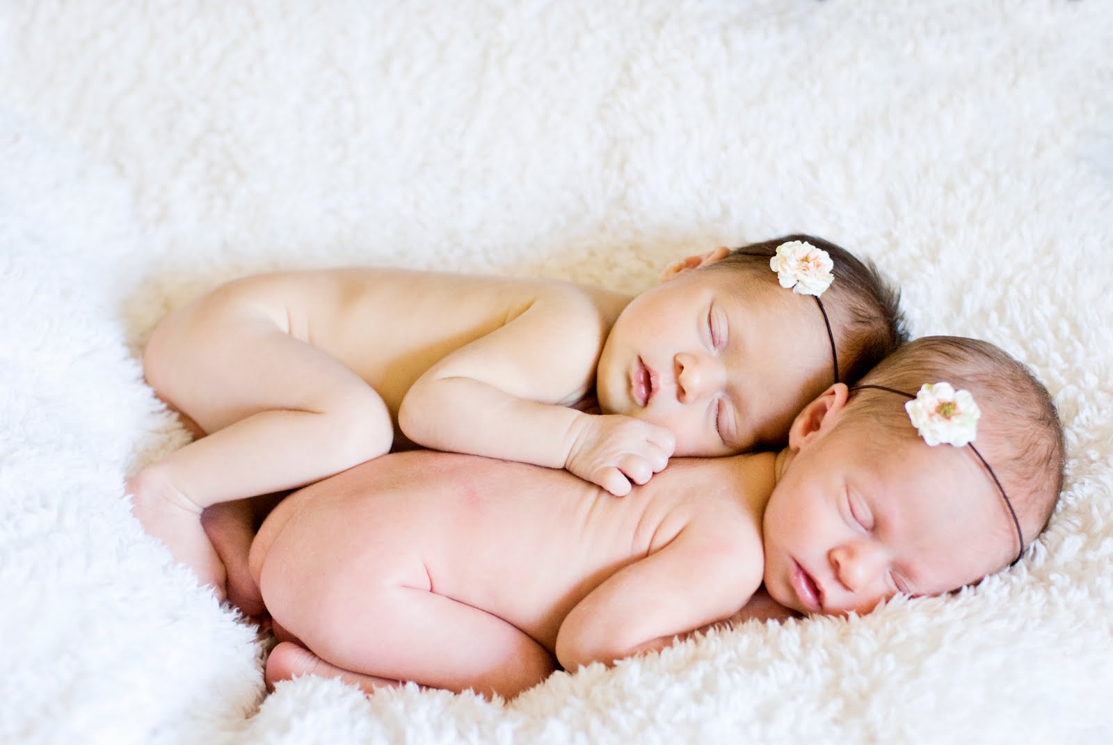
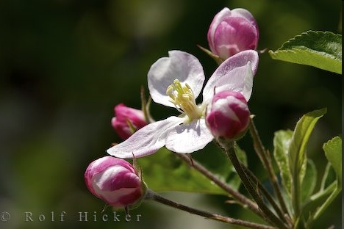
DITERMINANTS OF INDIVIDUAL DIFFERENCE
HEREDITY
AND
ENVIRONMENT

Slide 2
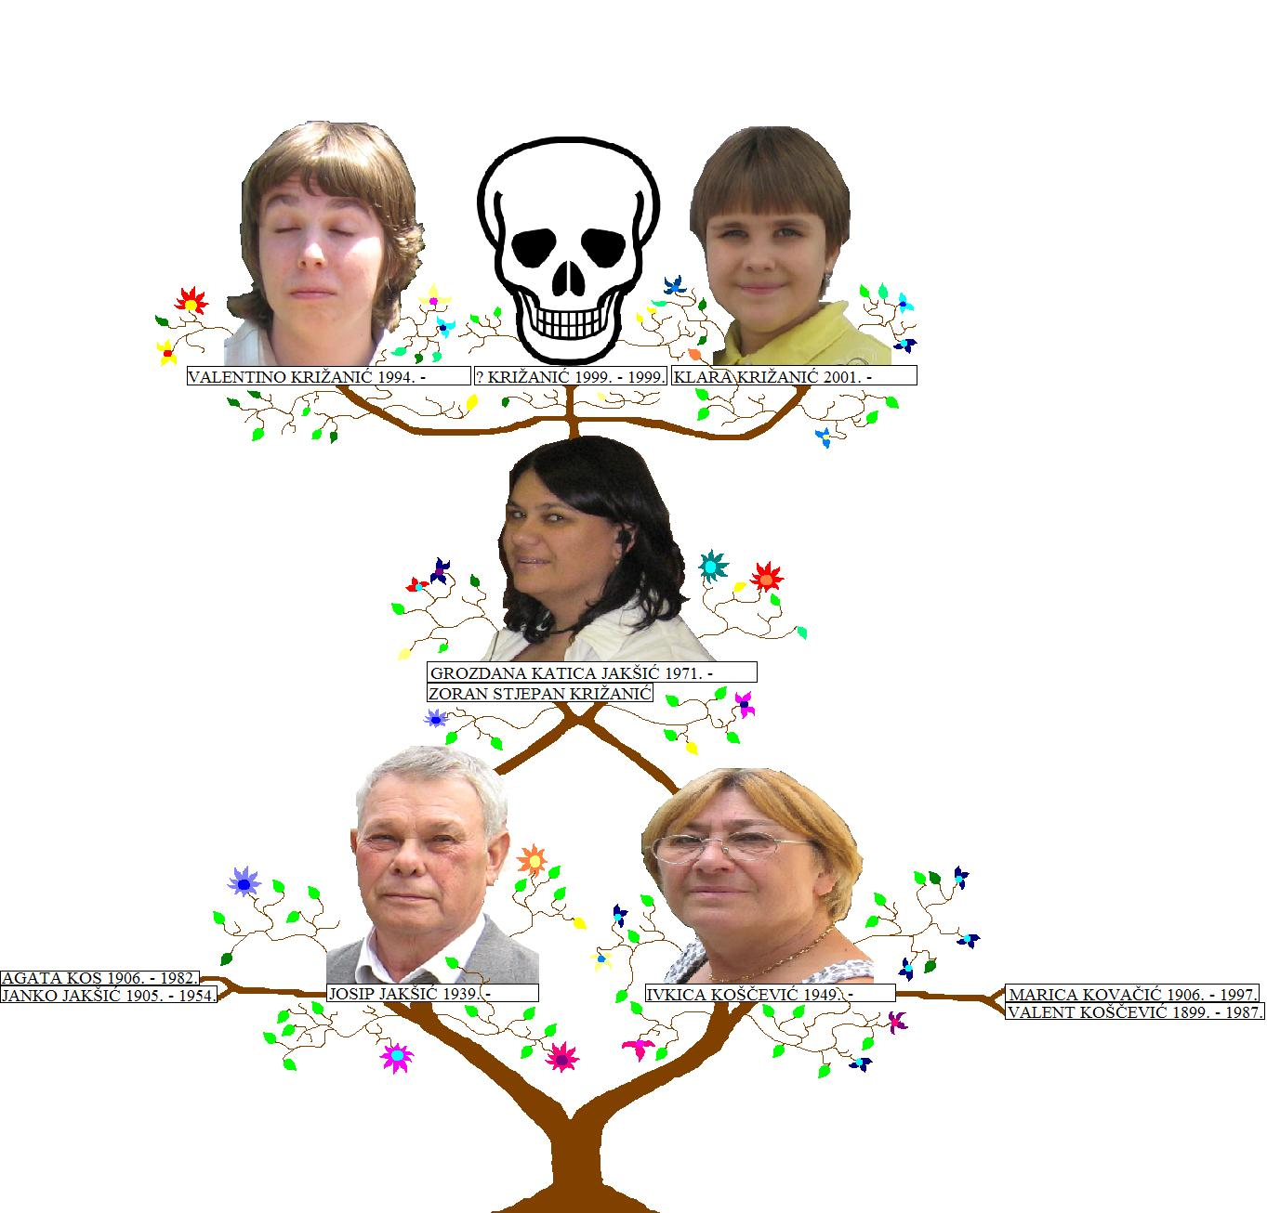
HERIDITY
Heredity is the passing of traits to offspring from its parents or ancestor.
This is the process by which an offspring cell or organism acquires or becomes predisposed to the characteristics of its parent cell or organism.
Through heredity, variations exhibited by individuals can accumulate and cause some species to evolve.

Slide 3

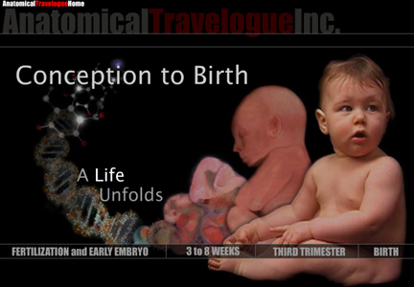
HOW AND WHEN OF HEREDITY

Slide 4
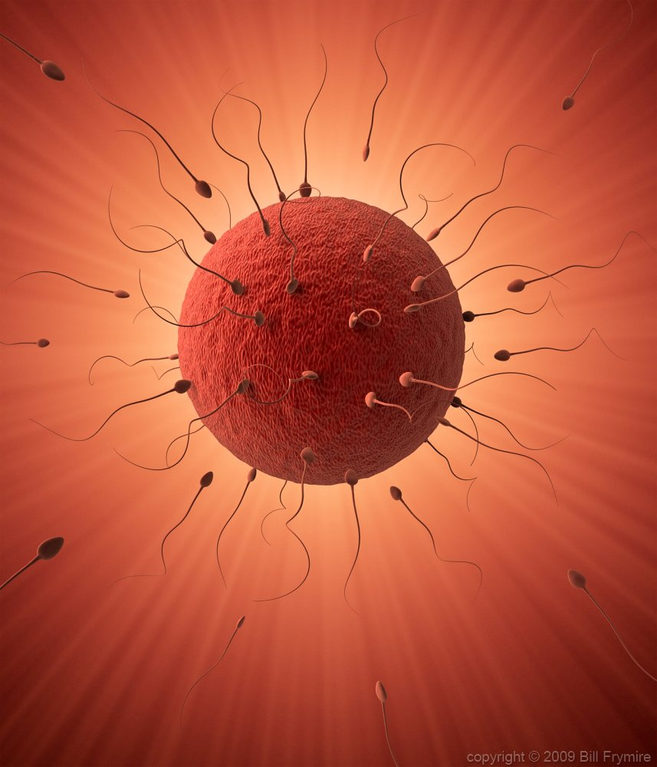
CONCEPTION
MATING WITH MALE AND FEMALE
SPERM X EGG = FERTILIZATION

Slide 5
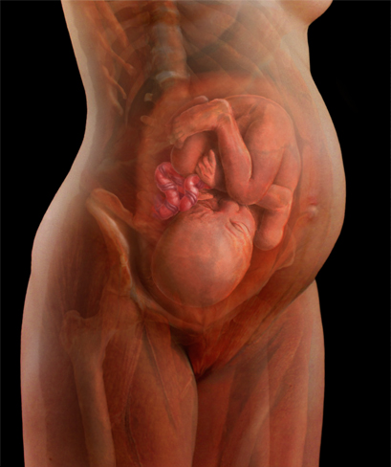
9 MONTHS IN MOTHERS WOMB

Slide 6
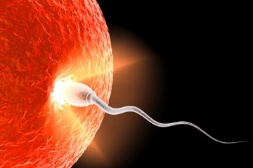
FERTILIZATION
ZYGOT
  BEGINS A NEW LIFE

Slide 7
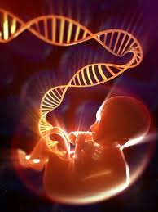
WHAT HAPPENS IN FERTILIZATION
GENETIC MATERIAL IS TRANSFERRED FROM PARENTS TO OFFSPRING

Slide 8
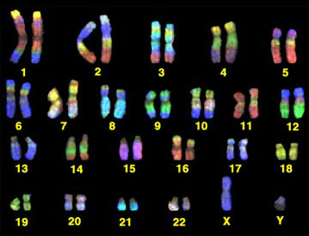
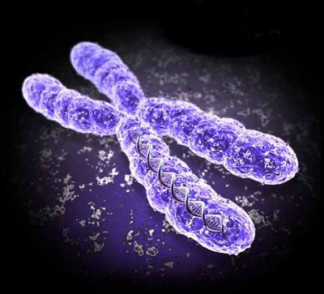
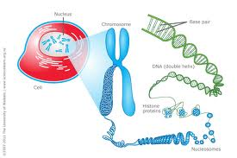
CHROMOSOMES ARE THE GENETIC MATERIAL
CELL
NUCLEUS
CHROMOSOMES (46)
23(FATHER) + 23(MOTHER) = 46(CHILD)

Slide 9
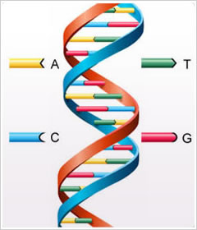
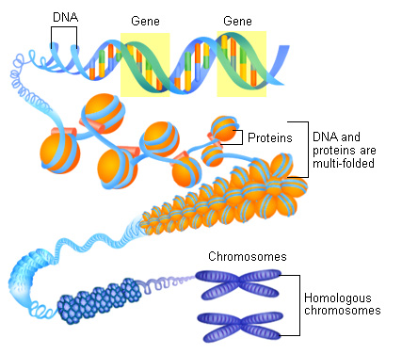
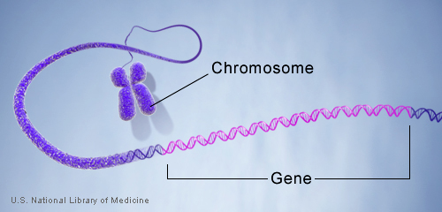
23(FATHER) + 23(MOTHER) =46(CHILD)

Slide 10
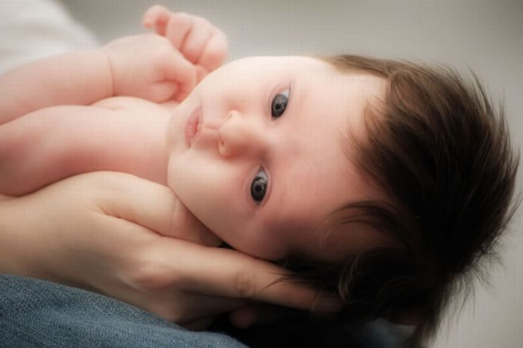
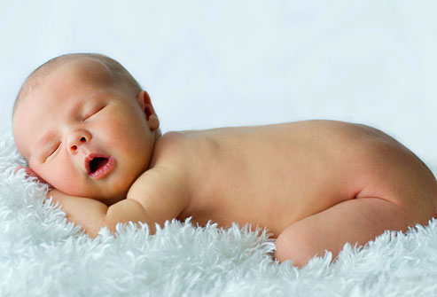
GENES-
CODED WITH THE GENETIC INFORMATION
RECESSIVE
AND
DOMINANT GENES

Slide 11
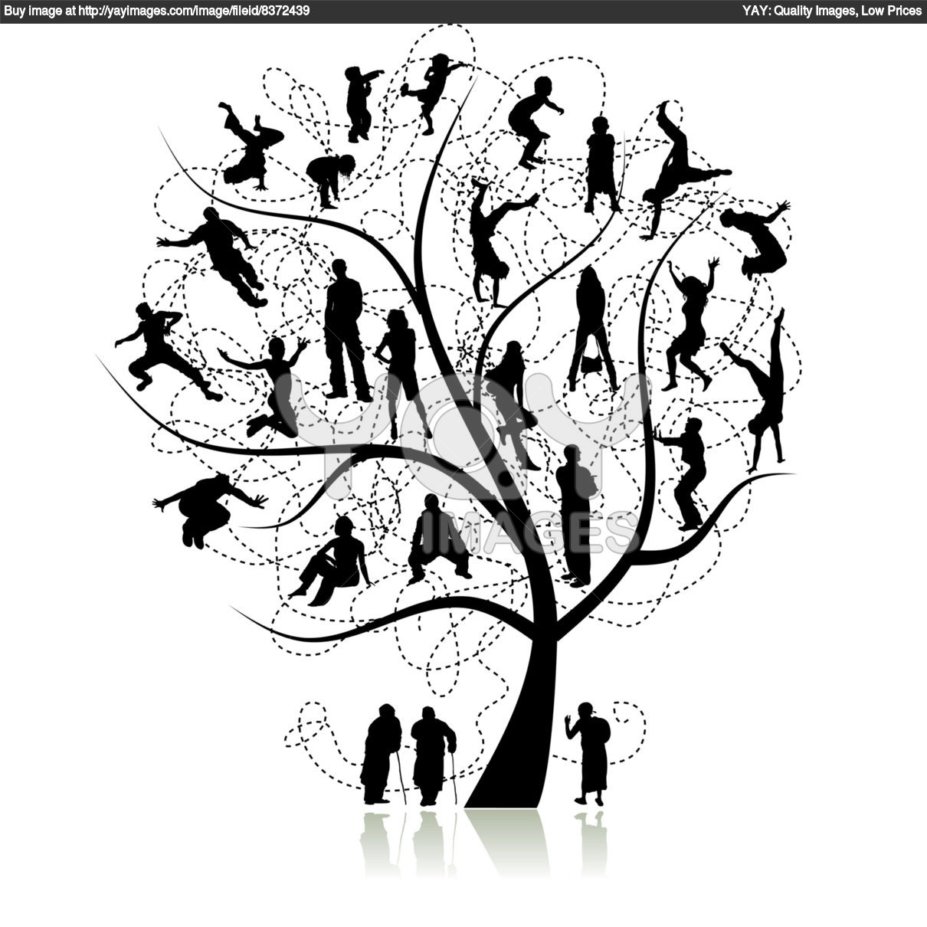
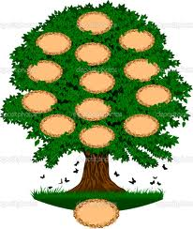
WHERE R MY ROOTS????
FIND OUT
YOUR
FAMILY
TREE…

Slide 12
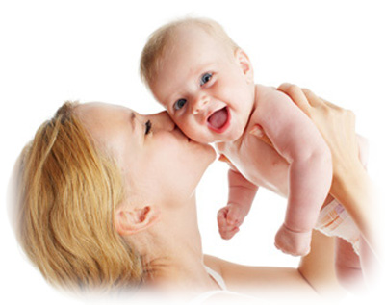
YES, LIFE IS A GIFT FROM GOD
HOW WE MAKE OUR LIFE IS OUR GIFT TO GOD

Slide 13
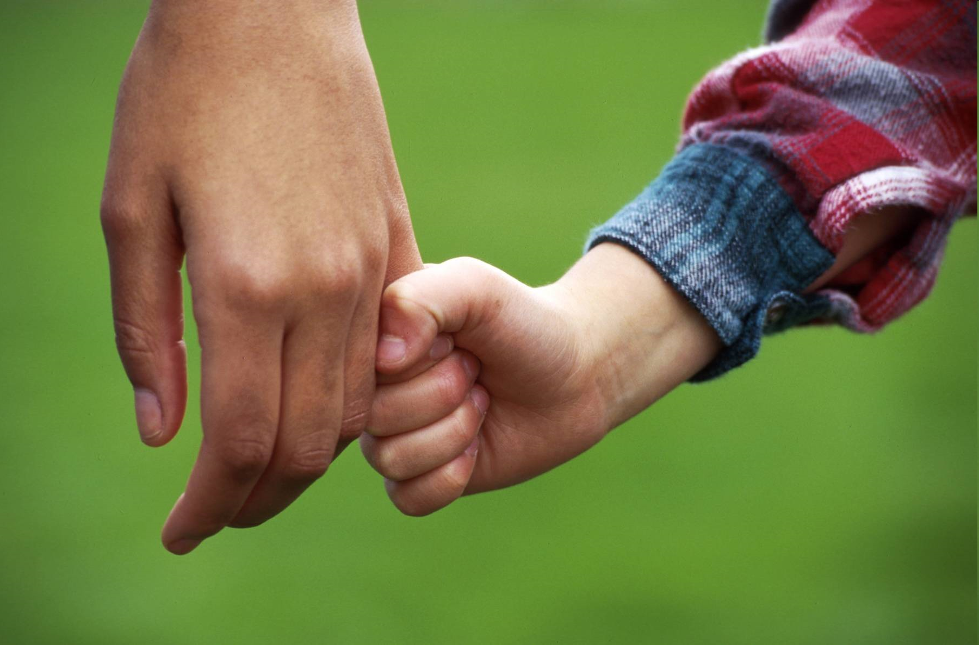

THANKS TO PARENTS…..
…….&….FOR ALL….
…..MADE ME …..

