Slide 1
INDIVIDUAL DIFFERENCES
- ALL ARE UNIQUE.
- ALL ARE SPECIAL….
- ALL ARE PRECIOUS…….
ALL ARE WONDERFUL…
- NO ONE IS ALIKE..

Slide 2
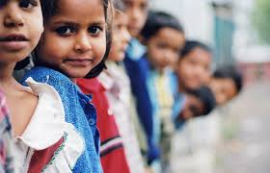
The differences between individuals that distinguish or separate them from one another and make one as a unique individual in oneself are named as individual differences

Slide 3
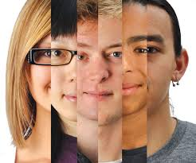
DIFFERENT DIMENTIONS OF A PERSON
PHYSICAL
MENTAL
EMOTIONAL
SOCIAL
SPIRITUAL

Slide 4
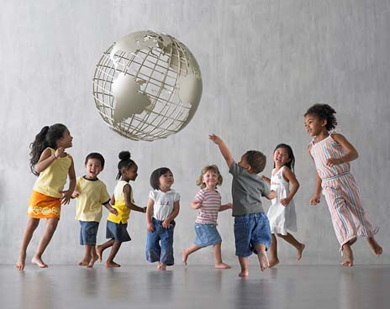
DIFFERENT AREAS OF INDIVIDUAL DIFFERENCES
1.PHYSICAL DIFFERENCES---
HEIGHT
WEIGHT
COLOUR
SIZE
STRUCTURE
EXPRESSIONS
SPEECH
WALK……… ETC:

Slide 5
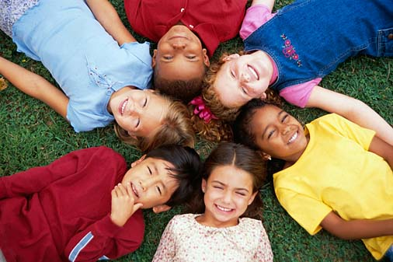
2.MENTAL DIFFERENCES
INTELLECTUAL ABILITIES
REASONING
THINKING CAPACITIES
CREATIVITY
UNDERSTANDING………..ETC:

Slide 6
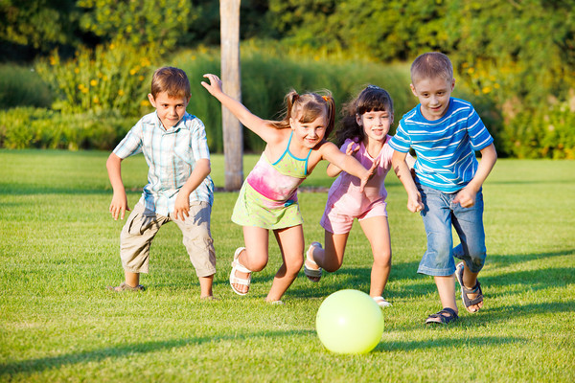
3.MOTOR ABILITIES (PHYSICAL SKILLS)
SPEED OF ACTION
MUSCULAR MOVEMENTS
RESISTANCE TO FATIGUE
WAY OF DOING ACTIVITIES……ETC

Slide 7
4.DIFFERENCES IN ACHIEVEMENT
SAME SCHOOLING AND INPUT BUT THEIR ACHIVEMENT IS DIFFERENT

Slide 8
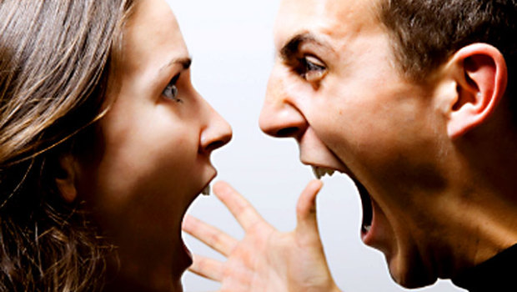
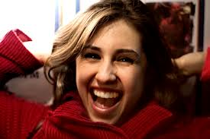
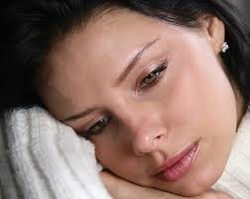
5.EMOTIONAL DIFFERENCES
POWERFUL POSITIVE/ NEGATIVE EMOTIONS
MODE OF EXPRESSION
WAY OF SUPRESSION
METHODS TO OVERCOME OR SUBLIMATE….ETC:

Slide 9
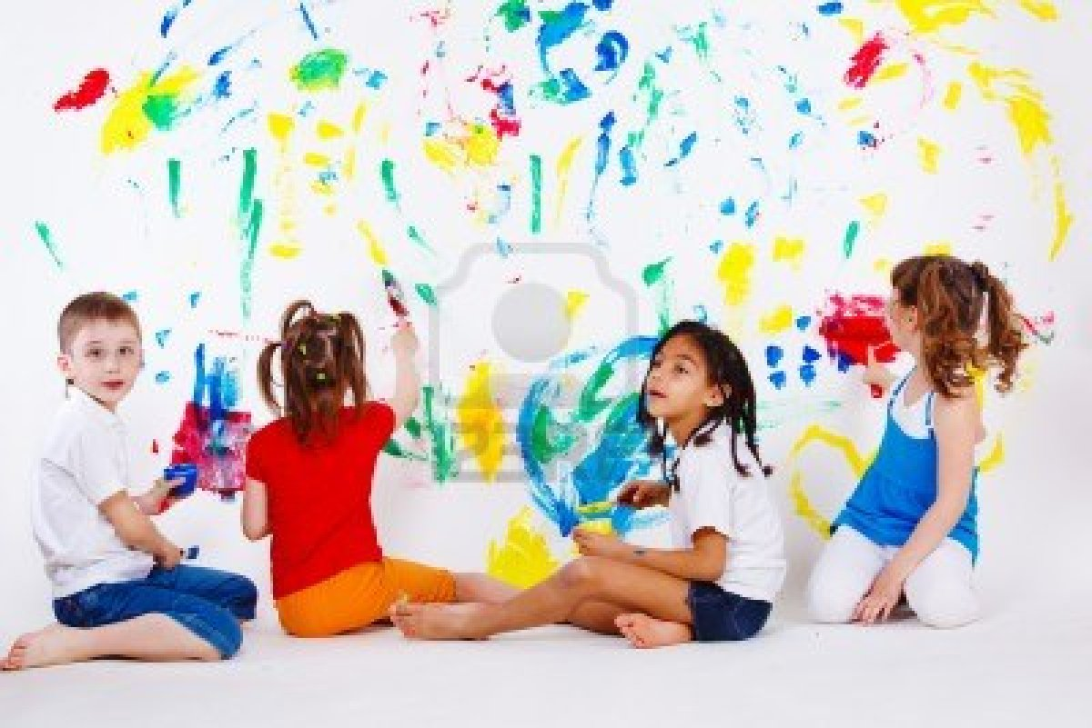
6.INTERESTS AND APTITUDES
EXTROVERT /INTROVERT
EXPRESSIVE /NON-EXPRESSIVE
MECHANICAL,TECHNOLOGICAL,
MATHEMATICAL.ARTISTICAL………..APTIUTDE.

Slide 10
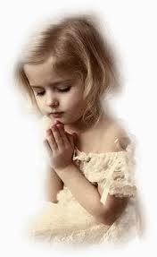
7.ATTITUDES,BELIEFS,OPINIONS
# POSITIVE OR NEGATIVE OR NEUTRAL ATT ITUDES
# HAVE OR NOT… BELIEFS
# FOR OR AGAINST OPINIONS

Slide 11
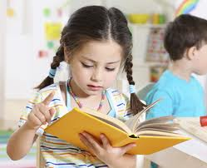
8.LEARNING DIFFERENCES
EASY OR DIFFICULT TO LEARN
EASY TO LEARN ART / SCIENCE
DIFFERENT METHODS………… ETC:

Slide 12
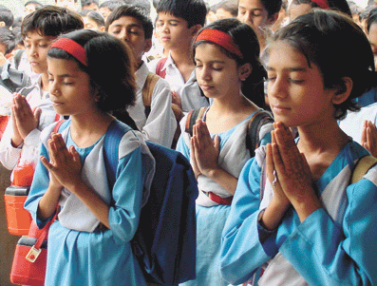
9.Social and Moral Development
Socially- happy /handicapped
Unsocial or antisocial
Different in moral and ethical sense

Slide 13
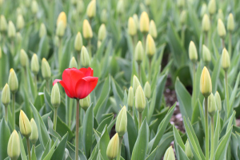
I AM UNIQUE………
I AM SPECIAL
I AM WONDERFUL
I AM VALUABLE
I AM WORTH
I AM PRECIOUS………..
HOW DO I SEE MYSELF….???

Slide 14
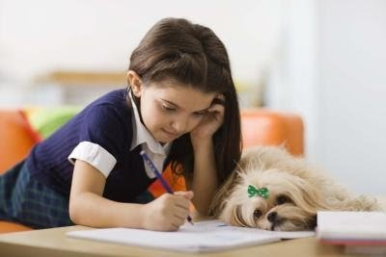
A POEM ABOUT ME
I AM…………………………..
I FEEL…………………………..
I VALUE………………………………
I HOPE …………………………………..
I TRY…………………………………………….
I CRY…………………………………………………..
I DREAM……………………………………………………
I LAUGH…………………………………………………………..

Slide 15
I FEAR……………
I SEE…………………….
I TRUST…………………..
I PRAY……………………….
I GIVE…………………………….
I SHARE………………………………………
I ENJOY………………………………………………
I DOUBT…………………………………………….ETC:

Slide 16
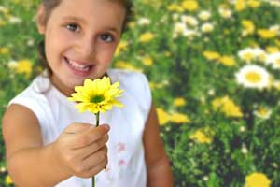
YES, U R SPECIAL………!!!!…
UNIQUE……!!!!!….
WONDERFUL…………!!!!!
KEEP THE SPIRIT,
SHARE THE SPIRIT…..!!

