Slide 1
MODULE 4
AIMS AND VALUES OF TEACHING NATURAL SCIENCE

Slide 2
AIMS :-
A distant goal, not immediately attained or reachable
Broad goals of education
Cannot achieve in a classroom
Like ideals / high expectations
May be realised by certain planned activities
Need long term planning

Slide 3
VALUES
Values – in terms of usefulness / importance
Moral principles and beliefs that they think are important
Important or noticeable feature about something
Value from “Valoir” (French) – be worth and “Valere” (Latin) – be strong, be well

Slide 4
OBJECTIVES :-
Immediate goal
Can be realised –planned activities
Specific – attained by classroom teaching
Terminal behaviour expected from pupils – end of learning

Slide 5
Difference between Aims & Objectives
AIMS
Distant goal
Directional - broad & general
Achieved by long term planning
Include objectives
All-round development & is beyond school
OBJECTIVES
Short term goal
Specific- clear & precise
Endpoint of the possible achievement
Come from aim -- achievement of aims
Immediate, change – after an instructional hour

Slide 6
Answer to the question of ‘why’ a subject is taught.
Close to the ‘ideals’ - not be fully achieved.
School & society – responsible
Can’t change from subject to subject
Eg : Self realisation
Answer to the question ‘what’ - achieved after the teaching of that topic.
Achievable completely.
School only
May be changed from subject to subject
Eg : Uderstanding a formula
Objectives originate from aims and attainment of each objective – achievement of aim

Slide 7
Aims of Teaching Natural Science
Knowledge aim
Practical aim
Development of scientific attitude
Cultural aim
Social aim
Vocational aim
Utilization of leisure time
Psychological aim
Helpful in the study of other subjects
Skill aim

Slide 8
Knowledge aim
  Increase span of one’s knowledge
  Simple facts & principles – complex
Practical aim
  Practical application of sciences
  Teaching practical aspects of scientific principles and knowledge
Social aim
  Development of social virtues – help to adjust & contribute towards progress of society
  Awareness that welfare of self linked with society
  Preparation for responsible citizen
  Education regarding evils of misuse- destructive ends

Slide 9
Cultural aim
  Development of culture & civilization – linking progress and improvement of science
  Scientific development & cultural improvement –closely related
  So science teaching aims to
    Grasp scientific progress
    Apply science for enhancing cultural heritage and development of civilization
    Appreciate the progress of science
Psychological aim
  Satisfaction of psychological needs
  Curiosity, interest, use of scientific method

Slide 10
Vocational aim
  Prepare to earn livelihood by
    study relevant courses of study
    Learn essential facts & principles of science
    Preparation for choosing, entering & successful in various occupations – for earning & prosperity of nation
  Opportunities for scientific hobbies - livelihood
Skill aim
  Develop useful skills - Observation, experimentation
  Independent learning
  Manipulate & explore
  Infer & draw conclusions

Slide 11
Utilisation of leisure time
  Fruitful utilistion of leisure time by
    Spending time with nature
    Scientific hobbies – gardening, agricultural practices, manufacturing (soap, lotion), repairing gadgets
Interdisciplinary aim / helpful in the study of other subjects
  Correlate science with other subjects

Slide 12
Values of Teaching Natural Science
  Intellectual values
  Utilitarian values
  Cultural values
  Vocational values
  Psychological values
  Moral values
  Aesthetic values
  Training in scientific method
  Development of scientific attitude

Slide 13
General Objectives of Teaching Science
The following objectives were recommended by All India Science Seminar which was held at Simla.
Arousing and maintaining interest in nature and arousing love for nature
Developing habits of observation, exploration, classification & systematic way of thinking
Developing powers of manipulation & creative faculties
Development of neat & orderly habits
Inculcation of the habit of healthful living

Slide 14
6. Acquisition of a fund of information concerning
nature
7. Developing ability to generalize & apply
knowledge in everyday life
8. Understanding the impact of science upon our
way of living
9. Developing interest in scientific hobbies
10. Inspiring children with stories of inventions &
discoveries

Slide 15
The following objectives also should be kept in mind while teaching science
Better understanding of the nature of science
Acquisition of skills
Development of scientific attitude
Training in scientific method
Development of interest & appreciation
Helping the students to fit to their society
Helping students develop suitable career interests

Slide 16
Objectives of teaching natural science at different stages
Primary
Secondary
Higher secondary

Slide 17
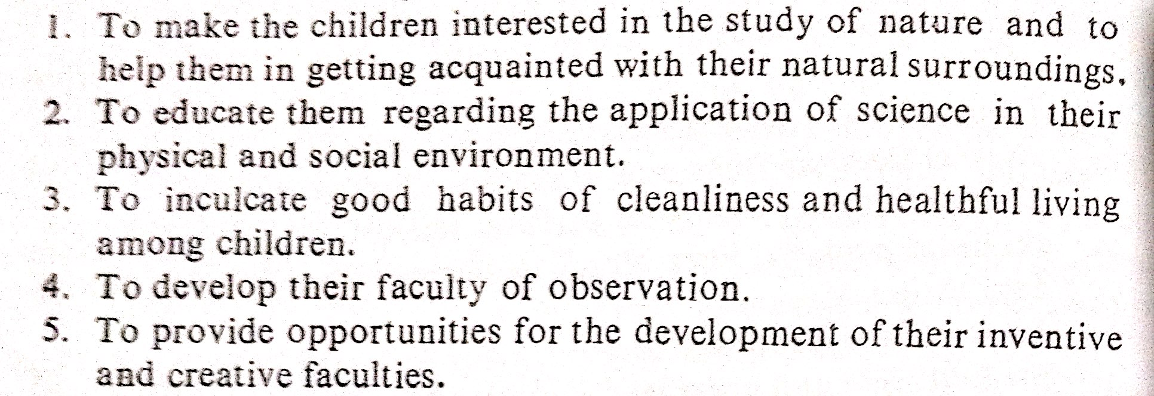
Lower primary (class 1 to 4)

Slide 18
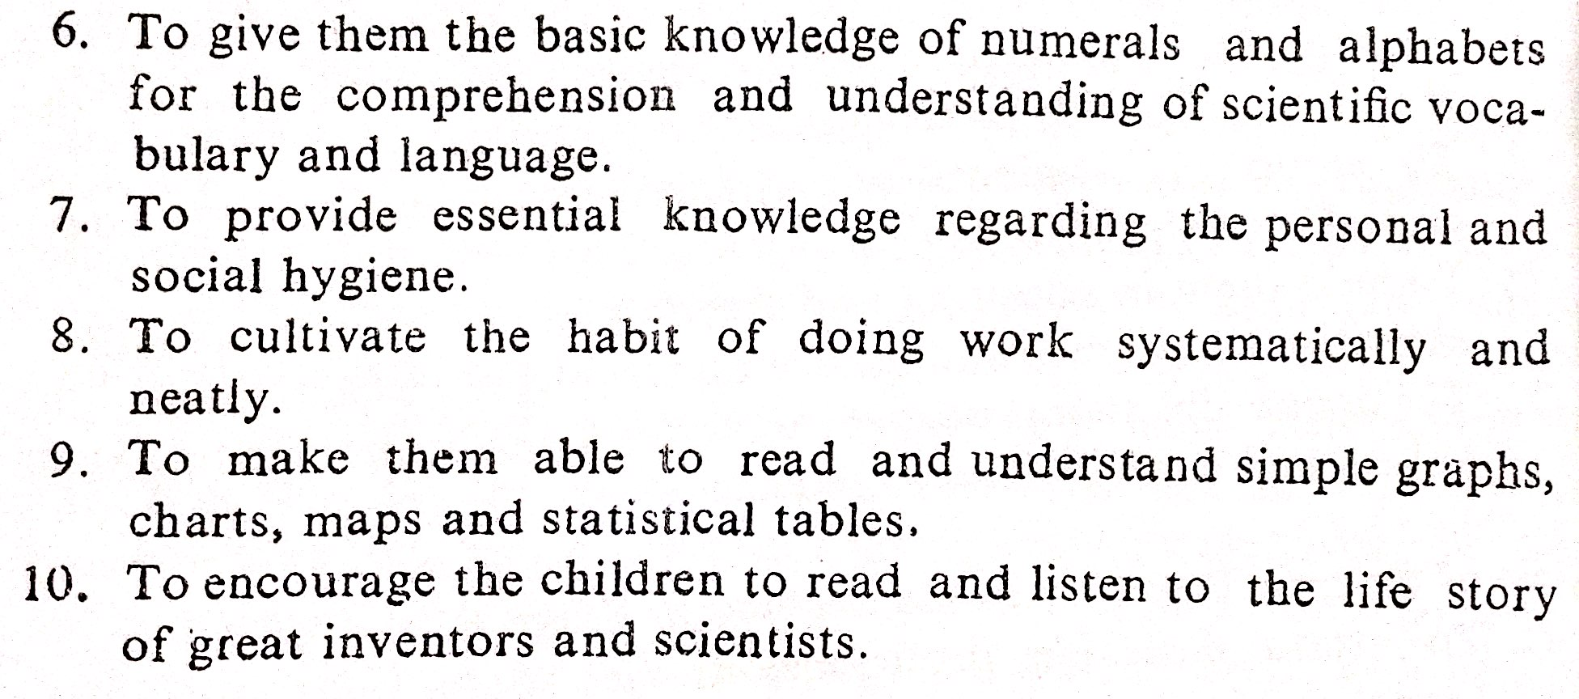

Slide 19
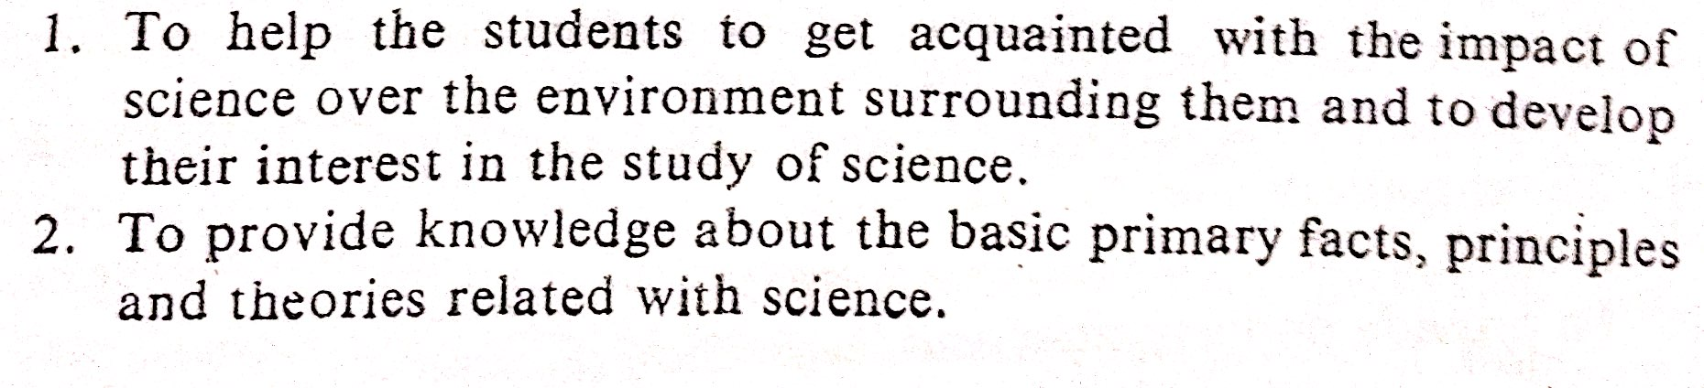
Upper Primary ( class 5 to 7)

Slide 20
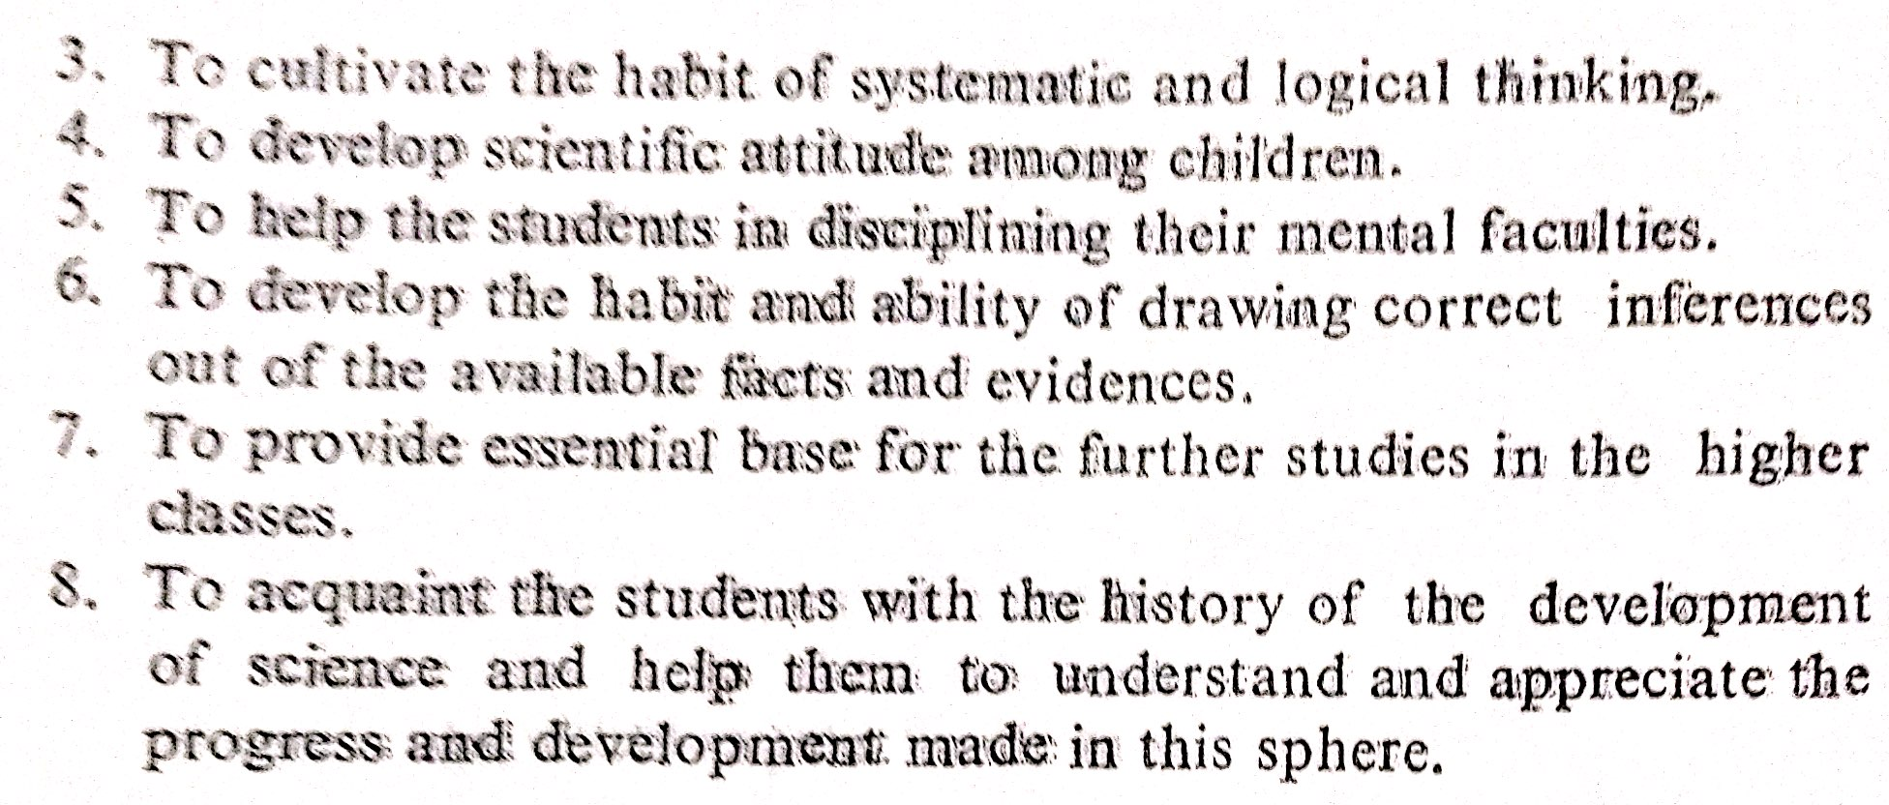

Slide 21
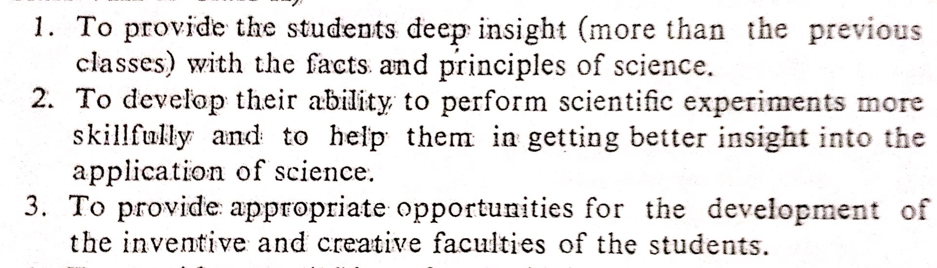
Secondary (class 8 to 10)

Slide 22
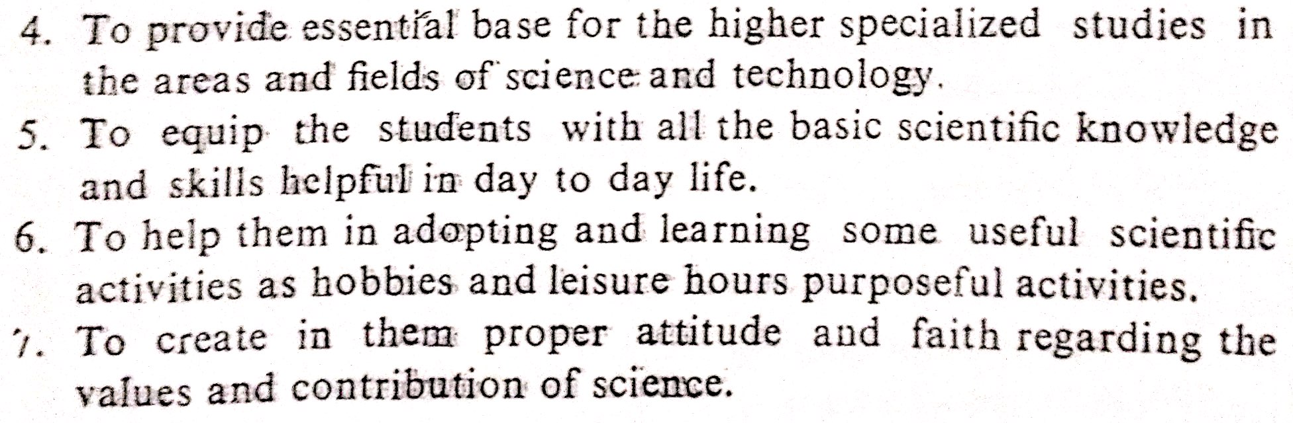

Slide 23
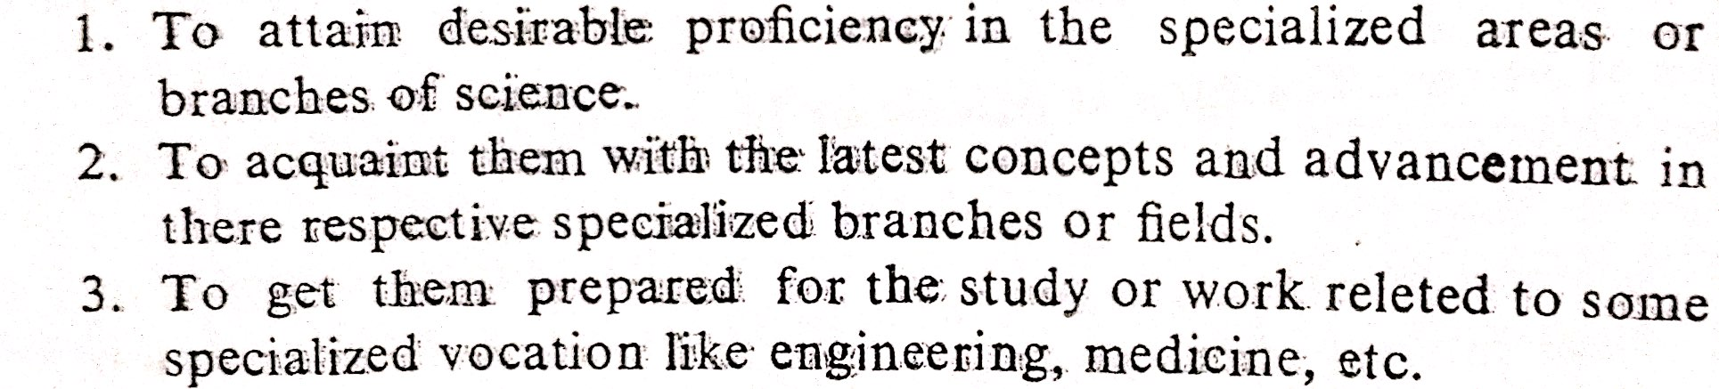
Higher secondary

Slide 24
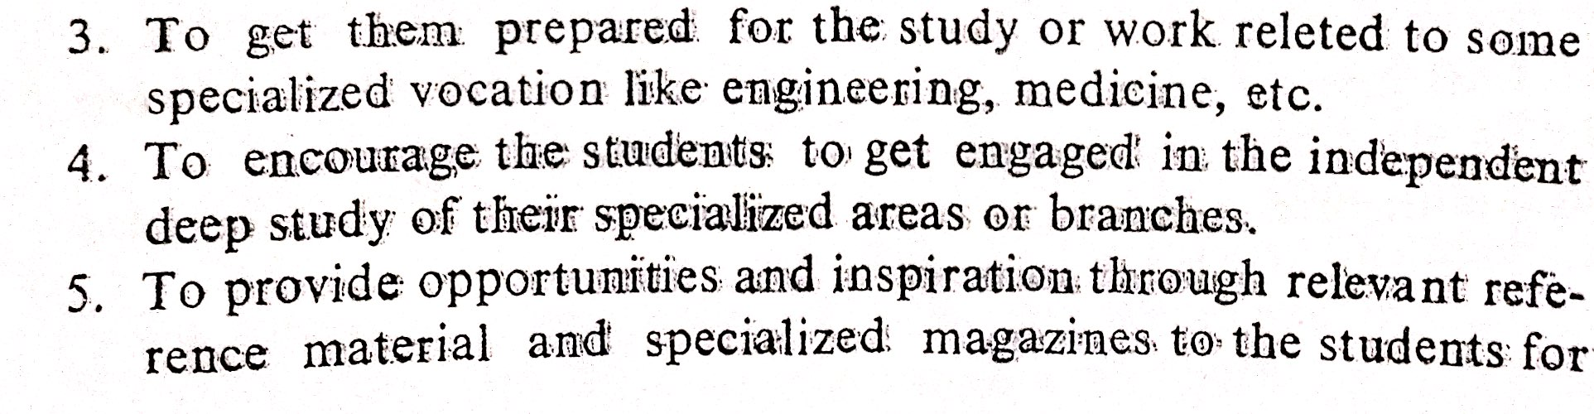


Slide 25
Scientific Literacy
Means -firm understanding of the nature of science and its interrelationship with technology and society .
Knowledge and understanding of scientific concepts and processes required for personal decision making, participation in civic and cultural affairs and economic productivity.(National Academy of Sciences, 1995)
Combination of scientific attitude, skills & knowledge.

Slide 26
Attributes of a scientifically literate person
A good science background knowledge of related facts concepts, theories etc. with the ability to apply them.
A clear understanding of the ever changing nature of science
A positive attitude towards science and technology
Ability to make value judgment and decision in issues related to science based on social needs
Ability to use scientific method to solve problems
Sufficient process skills in science
Appreciation of values of science and technology

Slide 27
Scientific Temper
A way of life that calls for scientific attitude and scientific approach
It calls for a particular outlook and way of behaviour
It becomes a part of culture, a philosophy
Considers knowledge as open-ended & ever evolving
Emphasis on verifiability & repeatability
Compatible with observation and insight, reasoning & intuition, systematic work & creative impulse

Slide 28
Has deep emotional content & a sense of beauty
A system of value judgments
Social justice, wide spread education and unrestricted communication – prerequisites for spread of scientific temper
Jawaharlal Nehru (1946) use this phrase first in India ( Discovery of India)
“The scientific approach & temper are, or should be, a way of life, a process of thinking, a method of acting and associating with our fellow men”
‘Fostering scientific temper’ – theme chosen for National Science Day – 2014
“It is the temper of a free man.”

Slide 29
Scientific Creativity
Creativity:-
Use of imagination or original ideas to create something
Scientific creativity
Capacity to have novel-original & useful ideas in natural and social sciences (Feist, 1998)

Slide 30
Nourishment of creativity
Freedom to respond
Opportunity for ego involvement
Encouraging originality and flexibility
Appropriate physical environment
Healthy habits among children
Using creative resources of the community
Providing good example

