Slide 1
Development of Education in India
Educational heritage of India

Slide 2
Ancient –Vedic , Buddhist
Medieval -Islamic
Colonial – western education
Post Independence – various education commissions

Slide 3
background
Buddhism emerged in 6th century B.C(1500 B.C-1200A.D)
As a reaction against Vedic religion
Islam reached India by 1000 A.D
Europeans -1498 A.D

Slide 4
Vedic Education

Slide 5
Social System
Varna system –
Brahmins –head of the society-Priestly class – acquisition ,preservation and transmission of knowledge
Kshatriysa – arms of the society-warrior class
Vyasyas – thigh – agriculturalists and traders
Shudras –feet – servants to upper class

Slide 6
Ashramas – Brahmacharya
Grahasthashrama
Vanaprastha
Sanyasa

Slide 7
Period
Early Vedic period B.C 2000- B.C 1000
Later Vedic period B.C 1000- B.C 600
Vedas governs the Personal and social life of the people – Vedic Age
Veda- Sanskrit term – Vid- to Know
Etymological meaning of Veda –Knowledge
Vedic – pertaining to veda
Vedas – earliest literary record of Indo- Aryan civilisation

Slide 8
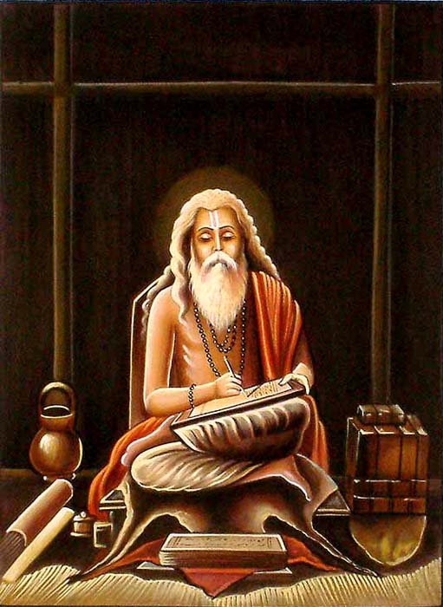
In compiling the vedic mantras, VED VYASA edited them into four books, the Rig-Veda, the Yajur-Veda, the Sama-Veda, and the Atharva-Veda.

Slide 9
The education system prevailed in Vedic age is called Vedic Education
Gurukula system of education
Dominated by religion
Important tool for self-realisation

Slide 10
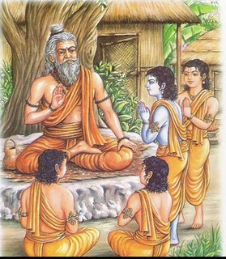
THE GURUKUL SYSTEM

Slide 11
Gurukul (ashram) the household of the teacher was the centre of education. The students lived with their Guru as members of his own family (Gurukula). The Guru looked after the child as guardian and protector.
In a gurukul, students would reside together as equals, irrespective of their social standing, learnt from the guru and distribute work in themselves to help the guru in his day-to-day life.
At the end of studies, pupil would be ready to offer gurudakshina (one time fees) to the guru. The gurudakshina is a traditional gesture of acknowledgment, respect and thanks

Slide 12
2 stages :
Primary- equip the learner with basic competencies and knowledge – enable him to enter higher learning
Secondary ; equip the learner to conduct sacrifices
Subject taught are- Vedas and subject related to the requirements of conduct of sacrifice

Slide 13
Important ceremonies
Vidhayarambha – at the age of 5 – start the learning of alphabets
Upanayana – to bring in touch with
Formal admission ceremony when child become the shishya (disciple) of the guru (teacher)
Child is only an animal before Upanayana ,and after it he becomes a soul
Reborn -dwija

Slide 14
8,11 and 12 years for Brahmins, Kshatriyas and vaishyas
Brahmachary

Slide 15
Upakarma –or sravana –commencement of new year programme
Upasarjansa- close of each year programme
Samavarthana- -convocation ceremony

Slide 16
features
Gurukula system
Education for all sectors
Autonomy of Educational Institutions
Educational ceremonies
Compulsory Brahmacharya
Begging alms –
Individualistic education- depending upon his interest and ability

Slide 17
Ideal teacher- great respect and devotion to teachers – model for students
Ideal teacher –student relationship: Father and son
Prominence of religious ideals : spiritual and religious ideals
Promotion of vocational efficiency
Duties of disciples : The pupils performed household duties for the teacher, in addition to their academic studies.

Slide 18
Aims
Attainment of moksha (salvation) or self –realisation
Education for other world lines.
∗ Character formation.
∗ All round development for Personality.
∗ Intellectual Development
∗ Spiritual Development

Slide 19
. Infusion of Piety & Religiousness
Preparation for living
Preserving and Transmitting Culture
Education only a means and not an end in itself
Stress on Social duties
Promotion of Social Efficiency and Welfare – vocational efficiency

Slide 20
Curriculum
Spiritual ,materialistic and vocational subject
Vedas
Military Science
Agriculture , trade
Anthropology
Astronomy
Economics
Mathematics
handicrafts, Ayurveda

Slide 21
Process of Instruction
There were three steps in instruction:
1. Sravana 2. Manana 3. Nididhyasana.
Sravana is listening to words texts as they uttered by the teacher.
Manana is the process of deliberation or reflection of the topic taught.
Nididhyasana represents the highest stage.

Slide 22
Method of teaching
lecturing
Discussion and recitation
Listening
Dialogue
Meditation
Illustration
Project Method

Slide 23
Medium of instruction
Sanskrit

Slide 24
Education of Women
The Vedas give a very honorable & respectable status to women.
They were eligible for higher education for the study of the Vedas and the performance of administrative and other important jobs .
Girls should go to the schools where there are women teachers(Rishikas ).

Slide 25
Role of teacher
1.Teachers as Spiritual as well as Intellectual Guide
2.Teacher occupied a pivotal position in the Vedic System of education.
3.The teacher was a (Parent Substitute),
4. A facilitator of learning, exemplar and inspirer, confident, detector ,friend and philosopher moral educator, reformer, evaluator, character and personality builder,
5.Teacher was the spiritual father of his pupils.

Slide 26
Discipline
Self-discipline
Compulsory Brahmacharya
Physical and spiritual Punishment for indiscipline

Slide 27
Merits
The system of education was well-organized.
It was suited to the needs of the society
It was aimed at the development of personality of an individual to his maximum extent.
Education helped in the realization of spiritual & moral values,
Preservation and propagation of national culture

Slide 28
preparing for worldly pursuits
. Education was free
Ideal teachers – pupils relation
Development Social Skills

Slide 29
Demerits
Undue importance to spiritual life
Based on caste system

