Slide 1
Meaning of Philosophy
Philosophy literally means “the love of wisdom” from the Greek words ‘philo’ and ‘sofia’ , meaning love and wisdom.
It is the art of reasoning or ‘reasoning upon reasoning’. Philosophy involves questions and answers but more questions than answers.

Slide 2
Philosophy historically is about the dialectical or debate: one man says something and another one refutes it. It often involves thesis, antithesis and sometimes synthesis.
Philosophy is the study of almost every area of our lives, from morality to reality to death to self.

Slide 3
Physics, biology, chemistry, cosmology, psychology, all were branches of philosophy, these are still frequently discussed in philosophical terms. Maths was a huge branch of philosophy.

Slide 4
DEFINITION OF PHILOSOPHY
“Philosophy is the successful love of thinking.” John Armstrong.
Aristotle considers philosophy as "the first and last science"—the first science because it is
logically presupposed by every other science, the last because deals with reality in its ultimate principles and causes. .

Slide 5
Plato gives a few characteristics of philosophical wisdom, such as ability to enter into critical discussion, having direct access to "true reality," knowledge of the purpose of life, etc.
Descartes' distinction between mind and matter made it appear that there could be an inquiry into "the inner world" which would be wholly distinct from inquiries into "the outer world.“

Slide 6
Oxford Dictionary defines philosophy as "that department of knowledge which deals with
ultimate reality, or with the most general causes and principles of things.“
It is presumed here that science, inheriting the cosmological tradition, does not offer us the knowledge of ultimate reality; only philosophy can do this.
Science can only tell us how, whereas philosophy can tell us why, things happen as they do.

Slide 7
Philosophy investigates the principles and rules of language, and attempts to clarify the meaning of vague words and concepts.
Philosophy examines the role of language in communication and thought, and the problem of how to identify or ensure the presence of meaning in our use of language.

Slide 8
4 Branches of philosophy
Metaphysics…called “first philosophy” because it involves questions about being and existence .
Questions that come up in metaphysics are: what is the meaning of life? What are being and substance? Is time real? Why am I here?

Slide 9
Ethics…this are social moral codes that people agree upon and is linked to moral philosophy which is more personal and individual.
Ethics asks questions about the right and wrongness of actions and choices; and what are good or bad choices and actions?. Why are there good and bad choices and actions and how can we develop good habits?

Slide 10
Epistemology…the theory of knowledge from the Greek words “episteme” and “logos” meaning ‘knowledge’ and ‘study’.
It asks questions like how do we know? What are some sure foundations for knowing? Is there any such thing as indubitable knowledge?

Slide 11
Logic…the art of reasoning and using syllogism; how to identify fallacies or crooked reasoning and reason properly. Questions include: What is crooked reasoning and how do I identity and eliminate it? How can I develop a method or rules for proper reasoning?

Slide 12
NATURE OF PHILOSOPHY
Philosophy seeks to integrate the knowledge of the sciences with that of other fields of study to achieve some kind of consistent and coherent world view. Philosophers do not want to confine their attention to a fragment of human experience or knowledge, but rather, want to reflect upon life as a totality.
It is an attempt to arrive at a rational conception of the reality as a whole. It enquires into the nature of matter, time, space, causality, evolution, life, and mind, and their relation to one another.

Slide 13
Why do we do what we do? Should we be doing that? - Ethics/Morals
Do we have a creator? - Ontology
Is there an after life? - Metaphysics
What is the meaning of life? - Existentialism
What is knowledge? - Epistemology

Slide 14
All sciences were once a philosophy before they branched into the method of scientific reasoning(psychology being the last to join) now philosophy is the residual of the sciences.
Philosophy is an activity people undertake when they seek to understand fundamental truths about themselves, the world in which they live, and their relationships to the world and to each other.

Slide 15
Importance to understand the nature of philosophy
The study of philosophy helps us to enhance our ability to solve problems, our communication skills, our persuasive powers, and our writing skills.

Slide 16
Need of philosophy
Every human being has a philosophy of life; it gives shape to his/her life.
Philosophy of life moulds one’s attitudes and convictions.
Study of philosophy is not for intellectual consumption, it is primarily for oneself to develop a philosophy of life.

Slide 17
Philosophy enables a person to have the clarity of concepts and precision of expressions. Such a precision and clarity will be seen in thinking, speaking and acting.
Study of philosophy gives a depth in one’s thinking and acting.

Slide 18
It vibrates as a constant ‘echo’ in our life.
Philosophy disturbs and awakens from their life of mediocrity and stagnation, and spurs them to dynamic action and moral living.
In short, philosophy enables people to live a life of existential depth, moral integrity and religious conviction.

Slide 19
Purpose of philosophy
It teaches critical thinking, close reading, clear writing, and logical analysis; it uses these to understand the language we use to describe the world, and our place within it.
Philosophy is a natural tendency to understand myself, my life, and the world around me. Everyone is a philosopher.

Slide 20
Philosophy on the other hand is the attempt to change the world by thinking and talking about it..
Philosophy help us to correct our desires that will activate a corrected mind and perceive a corrected world.

Slide 21
Philosophy courses give you more than just knowledge of the world; they give you a deep understanding of how the world works, even how it should work.
Studying philosophy, help us to analyse the world closely and critically, to question thoroughly, and to write and think rigorously.

Slide 22
Five Reasons to Study Philosophy
1. Fascinating subject matter
2. Wide variety of interesting classes taught by outstanding professors
3. Skill development
4. Great preparation for any career or graduate study
5. Personal development

Slide 23
1. Fascinating subject matter
Philosophy seeks not simply knowledge, but deep understanding and wisdom.
People seek to understand themselves, the world they live in, and the relations to the world and each other.
Those who study philosophy are engaged in asking, answering, evaluating, and reasoning about some of life’s most basic, meaningful, and difficult questions.

Slide 24
Questions are:
What is it to be a human?
What is the human mind?
Is there a God?
What is the best sort of life to live?
What is truth? Is anything true? How can we tell?
What is art? What is beauty? Does art have to be beautiful to be good?

Slide 25
2. A wide variety of interesting courses taught by outstanding professors.
There are philosophy courses that address moral issues, others that focus on the nature of science and technology, philosophical works written across the history of Western civilization ,Eastern philosophy, ,mathematics and logic or politics and societies or religion or knowledge or the human mind or the nature of reality.
Philosophy professors are dedicated teachers who are experts in their fields and who are genuinely interested in helping students to develop their understanding and skills.

Slide 26
3. Skill development
Taking philosophy courses imparts skills that will be useful not only in any career but also in your personal life. The study of philosophy will enable you to think carefully, critically, and with clarity, take a logical approach to addressing challenging questions and examining hard issues and discuss sensibly
In philosophy courses you can expect to enhance your problem-solving capacities.

Slide 27
4. Great preparation for any career or graduate study
Most students of philosophy do go on to get good jobs in a wide range of fields, including law, medicine, business, education, journalism, public policy, government, religion, communication fields, public relations, management, social service, and many more.

Slide 28
5. Personal development
The study of philosophy can be:-
enriching a highly gratifying person
excellent preparation for lifelong learning
enhanced intellectual, political, and social existence.
live better by understand yourself as a thinking, acting being.
to make good choices in life
defence against popular foolishness and falsehoods.

Slide 29
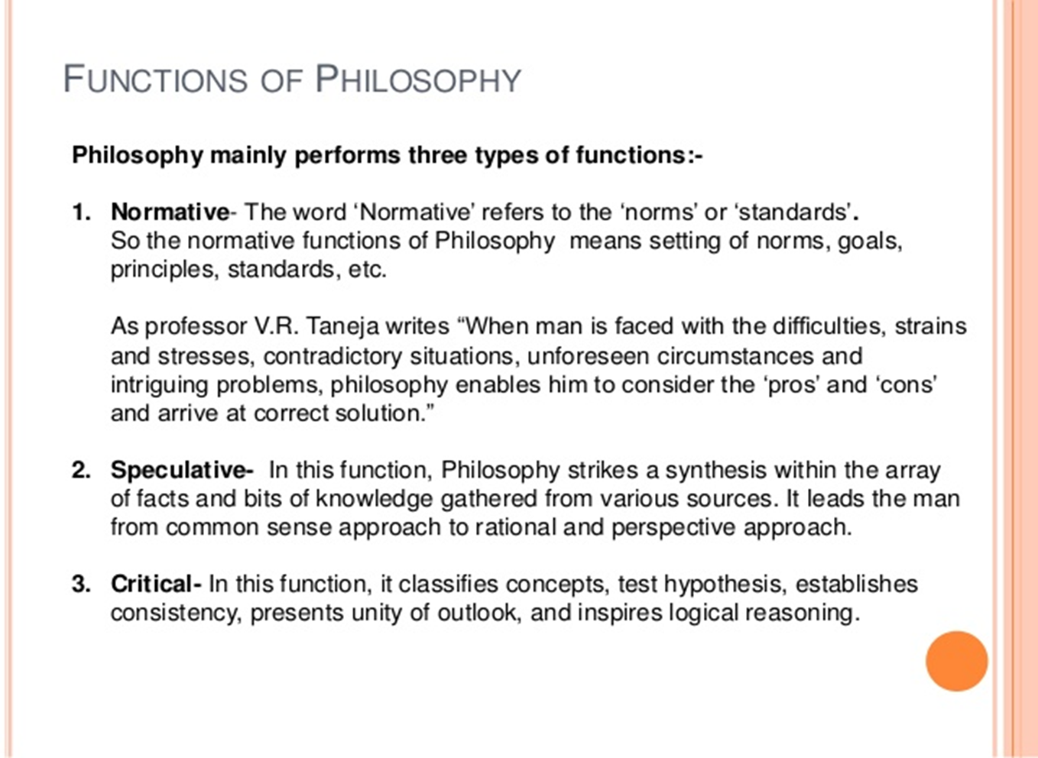
Functions of Philosophy

Slide 30
Normative function of philosophy
In philosophy, normative statements make claims about how things should or ought to be, how to value them, which things are good or bad, and which actions are right or wrong.
Normative statements and norms, as well as their meanings, are an integral part of human life.

Slide 31
In philosophy, normative theory aims to make moral judgements on events, focusing on preserving something they deem as morally good, or prevent a change for the worse.
Normative systems, i.e., sets of norms, have two main actions:
a) to evaluate human actions, and b) to guide people. The guidance and the evaluation based on a normative, be good or bad.

Slide 32
Normativity is the phenomenon in human societies of designating some actions or outcomes as good or desirable or permissible and others as bad or undesirable or impermissible. A norm in this normative sense means a standard for evaluating or making judgments about behaviour or outcomes.
There's no universally agreed upon distinction between "moral" and "ethical," but both terms fall within the realm of the normative.

Slide 33
Normative philosophy deals with "should" questions as opposed to "is" questions
In other words, the purpose of a normative question is to define or set the stage as to what are the possibilities or opinions in a given situation.
For example:—
“What is the unemployment rate in this country?” isn’t a normative question — it seeks to find out the actual matter. This is a factual question seeking a factual answer. It is a positive question — an objective question — one that can be answerable by yes/no or factual information.

Slide 34
Normative questions occur a lot in political and economic debates.
What basic healthcare is provided to all citizens by the government? is a positive, objective question — the answer is a list of actual services available.
What basic healthcare should be provided to all citizens by the government? is a normative question — it’s really a statement of opinion about the role of government in healthcare.

Slide 35
What is my debt level? is a positive question — answerable by calculations of your income vs. outgoings and liabilities.
What should be my debt level? is a normative question — it has to take into account a number of variables for your financial circumstances at this particular moment. Therefore it’s seeking a balanced estimation of your various components and perceptions of your situation right now. One accountant may say your debt should be 20% of assets yet another may say 40%, and there’s no way to say both are correct or incorrect because both are accounting opinions.

Slide 36
Speculative function
In the history of ideas and culture speculative philosophy denotes a broad range of philosophical approaches and traditions that normally cluster around metaphysics and systematic treatments of existence, consciousness and free will. In a sense all philosophy is speculative insofar as it deals with universal ideas.

Slide 37
Speculative Philosophy determines place of man in the world. In this all the philosophical assumptions and hypothesis are included which are related to life and world and which forms the basis of education.

Slide 38
The difference between analytic and speculative philosophy is on its emphasis. Analytic philosophy places heavy emphasis on logic and language, while speculative philosophy emphasizes on a systematic approach to reality.

Slide 39
Philosophy of education as speculative refers to that which allows individuals to look at the different elements of education from the whole perspective of man and examines each element.
Speculative philosophy limits ones vision of the future as each individuals have only a limited vision of what he speculates in the future.

Slide 40
Critical function
There are two general thinking skills in philosophy. These are critical and creative thinking. Critical thinking entails the ability to think rationally and clearly. Creativity is a matter of bringing new and useful ideas.

Slide 41
Philosophy students learn how to write clearly, and to read closely, with a critical eye; they are taught to spot bad reasoning, and how to avoid it in their writing and in their work. In this department, students can learn how to ask the questions well, and how we might begin to develop responses.

Slide 42
5 critical thinking skills
The key critical thinking skills are: analysis and interpretation, inference, explanation, self-regulation, open-mindedness, and problem-solving.

Slide 43
Critical Thinking is important in life. It helps you to think creatively. It keeps you from becoming narrow. Researcher Jane Qinjuan Zhang writes that critical thinking enables students to assess their learning styles, strengths and weaknesses, and allows them to take ownership of their education

Slide 44
Critical thinking is that mode of thinking — about any subject, content, or problem — in which the thinker improves the quality of his or her thinking by skill fully analysing, assessing, and reconstructing it. Critical thinking is self-directed, self-disciplined, self-monitored, and self-corrective thinking.

Slide 45
Philosophy of Education
Meaning :Philosophy of education is that branch of philosophy that addresses philosophical questions concerning the nature, aims, and problems of education. As a branch of practical philosophy, its practitioners look both inward to the parent discipline of philosophy and outward to educational practice, as well as to developmental psychology, cognitive science more generally, sociology, and other relevant disciplines.

Slide 46
RELATIONSHIP BETWEEN PHILOSOPHY & EDUCATION
Philosophy and education are closely inter-related and inter-dependent. Philosophy points out the ways and education follow it. Without philosophy education would be a blind effort and without education, philosophy would be crippled. Education is the process and philosophy is the product. All educational problems are questions of philosophy.

Slide 47
In the word of Ross, “philosophy and education are two side of same coin; the former is the contemplative side while the latter is the active side.
In other word we can say that the application of philosophical principle in the field of education to solve various educational issues is regarded as educational philosophy

Slide 48
Educational philosophy
Educational philosophy is that philosophy which provide answer to the educational issues of why to educate (aim), whom to educate (child), who to educate (teacher), where to educate (school), what to educate (curriculum), how to educate (methods), when to educate (motivation) and soon.

Slide 49
Spencer’s view: “True education is practicable to true philosophers”.
John Dewey says, “Philosophy is the theory of education in its most general phase”.
John Adams : Education is the dynamic side of philosophy.

Slide 50
Educational philosophy is the application of philosophical principle in the educational practices which direct the process of education towards the aims of human life. In short, educational philosophy relates philosophy of life through the medium of education.

Slide 51
DEPENDENCE OF EDUCATION ON PHILOSOPHY
Philosophy determines the real destination towards which education has to go:
Philosophy has always inspired educational theory as well as practice.
Philosophy is wisdom; education transmits that wisdom from one generation to the other.
Philosophy represents a system of thought; education embraces that thought in the content of instruction.

Slide 52
Philosophy embodies a way of life; education is the preparation for life.
Philosophy is the knowledge obtained by natural reason; education is the development of that reason and other powers of mind.
Every aspect of education has a philosophical base– aims, curriculum, methods, text books, discipline, teacher etc

Slide 53
DEPENDENCE OF PHILOSOPHY ON EDUCATION
The plant of education draws its nourishment from the soil of philosophy. Education is the dynamic side of philosophy.
Education is the best means for the propagation of philosophy. Philosophy gives ideals, values and principles; education works out those ideals, values and principles

Slide 54
Education is the best means for the propagation of philosophy. Education cannot even be imagined without philosophical principles ,likewise philosophical principles are lifeless without the help of education. Example- the introduction of the 10+2+3 system of education and craft education are the consequence of philosophical views.

Slide 55
OBJECTIVES OF STUDYING EDUCATIONAL PHILOSOPHY
1. To find out the solution for various educational issues.
2. The purpose of studying educational philosophy is to make education according to the need based life and society.
3. To determine the aim of human life, aim of survival.
4. To produce better citizen by fostering democratic attitude in behaviour.

Slide 56
5. To make teaching learning process more effective and attractive according to the need, interest and ability of child.
6. To discern the different philosophies and choose any one of them to lead a fruitful life in the society.
7. To expand our knowledge and experiences and implement them in the educational practices.
8. To bring out all round personality development in child and prepare him to stand\ on his own feet.

Slide 57
9. To make education flexible in order to achieve the goals of a country-national integration, international understanding and globalization.
10. To develop education as a powerful instrument to bring about social, cultural, political and economical change in society.

Slide 58
SCOPE OF EDUCATIONAL PHILOSOPHY
The scope of philosophy of education is concerned with the problems of education.
These problems mainly include –
• interpretation of human nature, the world and the universe and their relation with man,
• interpretation of aims and ideals of education,
• the relationship of various components of the system of education

Slide 59
• Relationship of education and various areas of national life [economic system, political order, social progress, cultural reconstructions etc.
• educational values,
• Theory of knowledge and its relationship to education.

Slide 60
The above mentioned problems constitute the scope of philosophy of education and explain
its nature.
Aims and Ideals of Education Philosophy:
They are character building, man making, harmonious human development, preparation for adult life, -development of citizenship, -utilization of leisure, training for civic life, training for international living, achieving social and national integration, -scientific and technological development, education for all, equalizing educational opportunities, strengthening democratic political order and human source
development.

Slide 61
b) Interpretation of Human Nature: - A philosophical picture of human nature is a result
of the synthesis of the facts borrowed from all the human science with the values discussed
in different normative sciences.
The philosophical picture, therefore, is broader as
compared to the picture of man drawn by biology, sociology, psychology, economics and
anthropology and other human science.

Slide 62
c) Educational Values: - Educational values are’ determined by philosophical values. Educational values propagated by different philosophers have been derived from their own world, view and their outlook on the purpose of human life.

Slide 63
d) Theory of Knowledge: - Education is related to knowledge. It is determined by the source,
limits, criteria and means of knowledge. The discussion of all these falls within the
jurisdiction of epistemology, one of the branches of philosophy, therefore, an important area of the functioning of philosophy of education is related to theory of knowledge.

Slide 64
Relationship of education and various components of the system of education: - One of the most important contributions of the philosophy of education is the provision of criteria for deciding the relationship of state and education, economic system and education, curriculum, school organization and management, discipline, teacher-pupil relationship, methods of teaching, textbooks etc.

Slide 65
Importance of educational philosophy
A] Determining the aspects of education:
Aims of education
Curriculum
Methods of teaching
Discipline
Teacher & Student
Administration

Slide 66
B] Harmonizing old and new traditions in the field of education. In the process of social development the old traditions become out dated for the people.
C]Providing the educational planners administrators and educators with the progressive vision to achieve educational development:-

Slide 67
D] Preparing the young generation to face the challenges of the modern time:- Society is not static; it changes its value, tradition, custom, culture etc. from time to time.

