Slide 1
MODERN PHILOSOPHY
The Modern period in Philosophy runs roughly from 1600 to 1800.
The Modern period covers the first attempts to solve the problems following the scientific revolution.
It moves from our ability to solve these problems to the skepticism of Hume and Kant.

Slide 2
Modern Philosophical tradition characterized by an emphasis on clarity ,argument and a respect for the natural sciences (often achieved via modern formal logic and analysis of language).

Slide 3
Vibrant period in Western European philosophy spanning the seventeenth and eighteenth centuries.
Most historians see the period as beginning with the 1641 publication, in Paris, of Rene Descartes' Meditationes de Prima Philosophiae (Meditations on First Philosophy), and ending with the work of the German philosopher Immanuel Kant, published in the 1780s.

Slide 4
They faced one of the greatest intellectual challenges in history: reconciling the tenets of traditional Aristotlean philosophy and with the radical scientific developments.
Established ways of thinking about the mind, body and God were directly threatened by a new mechanistic picture of the universe.

Slide 5
In response, the philosophers invented and refined a startling variety of views concerning humans' relation to the universe.

Slide 6
CHARECTERISTICS
Modern Philosophy is a universal knowledge characteristic because it embraces the whole, deals with existence completely, tries to understand the human being considered within its own essence and structure, and tries to ground the values ​​that exist everywhere.

Slide 7
Modern philosophers
Descartes,
Spinoza,
Locke,
Leibniz,
Berkeley,
Hume

Slide 8
Rene Descartes
The French philosopher Rene Descartes was a devout Catholic, a pioneering mathematician and one of the most influential philosophers in history.
His presentation of skeptical worries and the relation between the mind and body are still the starting points for many contemporary discussions.

Slide 9
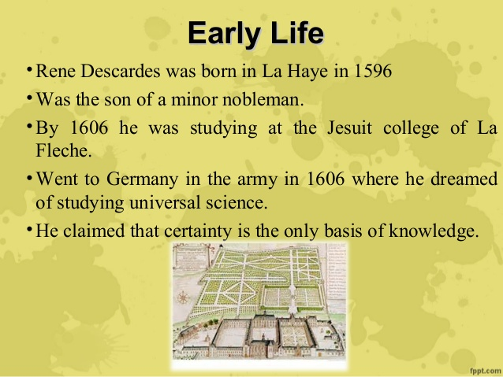

Slide 10
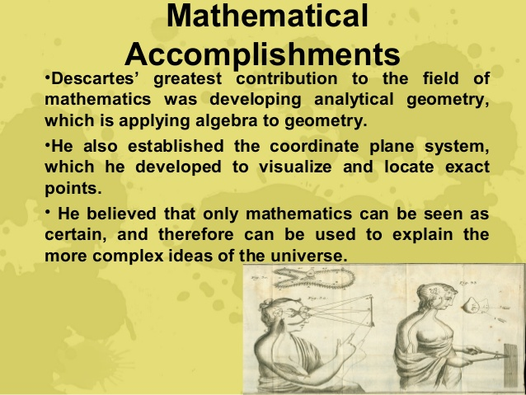

Slide 11
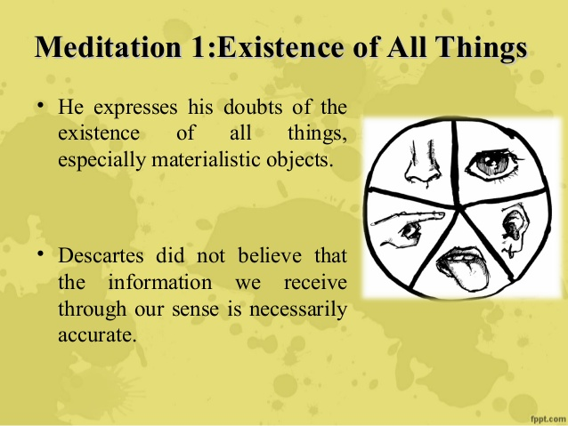

Slide 12
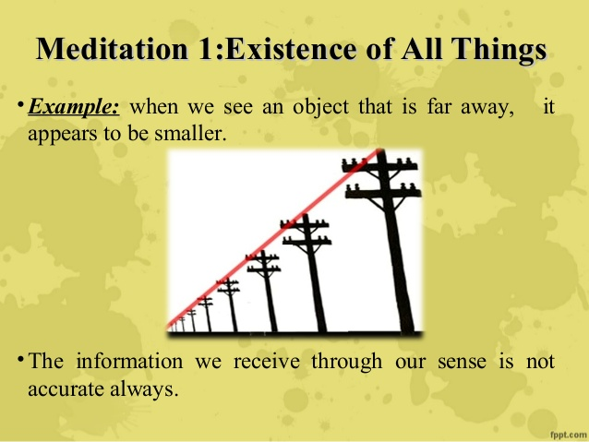

Slide 13
skepticism
Philosophical skepticism, ("inquiry") is a family of philosophical views that question the possibility of knowledge or certainty.
Philosophical skeptics are often classified into two general categories: Those who deny all possibility of knowledge,
And those who advocate for the suspension of judgement due to the inadequacy of evidence.

Slide 14
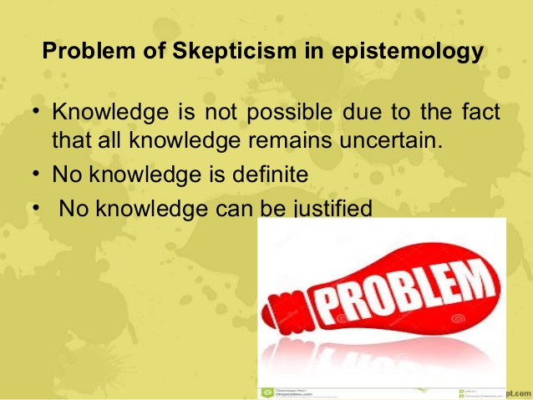

Slide 15
In everyday life, practically everyone is skeptical about some knowledge claims; but philosophical skeptics have doubted the possibility of any knowledge beyond that of the contents of directly felt experience.
The original Greek meaning of skeptikos was “an inquirer,” someone who was unsatisfied and still looking for truth.

Slide 16
Skeptics have challenged the adequacy or reliability of these claims by asking what principles they are based upon or what they actually establish.
They have questioned whether some such claims really are, as alleged, indubitable or necessarily true, and they have challenged the purported rational grounds of accepted assumptions.

Slide 17
Descartes considered three increasingly strong grounds for doubt that could serve in his project. The first was that his senses were capable of being deceived, and that many of his beliefs were based on the deliverences of his senses.
The second ground for doubt was the compatibility of all of his sensory experience with a deceptive dreaming experience, and the apparent impossibility of telling the difference.

Slide 18
Descartes presented his third and final ground for doubt: the possibility that he was being systematically deceived by an all-powerful being.

Slide 19
God
One of the things Descartes thought was least susceptible to even the strongest skeptical doubt was the presence in his mind of an idea of God as an infinite, perfect being. Descartes took the mere existence of this idea to provide the foundation for a proof of God's existence.
Descartes, the argument states that the idea of God has a necessary connection to the idea of existence.

Slide 20
Mind and body
Descartes argued that the mind and body must be distinct substances, and so must be capable of existing independently of each others (since it was produced by God). Descartes concluded that they must in fact be able to exist one without the other.

Slide 21
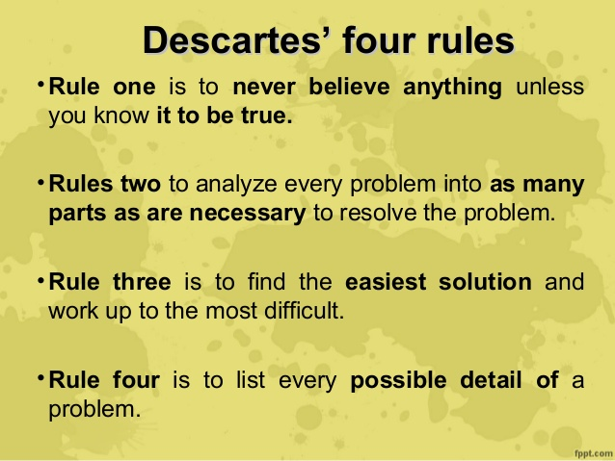

Slide 22
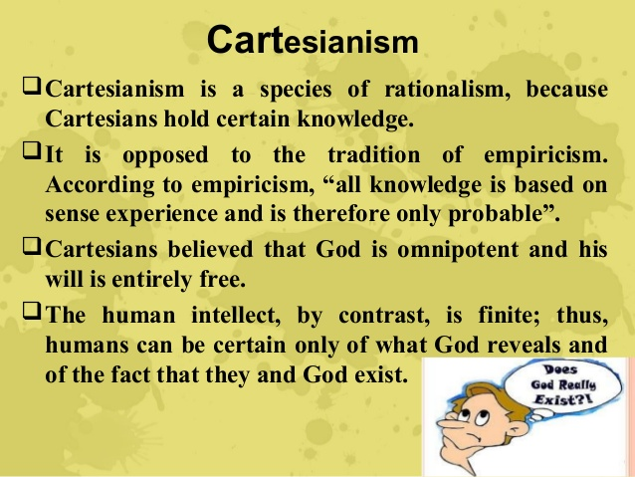

Slide 23
Spinoza
The Jewish philosopher Baruch Spinoza was regarded as one of the foremost experts on Descartes' philosophy.
He presented a highly systematic philosophy that departed radically from Descartes on many points.
His most important work was the Ethics

Slide 24
SKEPTICISM
Spinoza thought that our senses give us confused and inadequate knowledge of the world, and so generate doubt, but that ideas of reason were self-evident.
So for Spinoza, certain conclusions about the nature of the world could be reached simply by sustained application of intellectual ideas, beginning the idea of God.

Slide 25
GOD
Spinoza believed that there was only one substance. This substance was God.
All finite creatures were merely modifications of general properties of God. For instance, our minds are merely modifications of God's property (or 'attribute') of thought.

Slide 26
MIND AND BODY
Both the mind and body are modifications of God, according to Spinoza, yet they are modifications of two different attributes: thought and extension.
They bear a very close relation: the object of the mind just is the physical body. Because of this, the two are 'parallel'.

Slide 27
John Locke
The British philosopher John Locke published his monolithic Essay Concerning Human Understanding in 1689.
Locke is generally seen as the first real proponent of 'British Empiricism.'
Features of his work was empirical evidence over the abstract reasoning.
He developed a discipline of psychology.

Slide 28
Skepticism
He held that our senses did provide us with a weak sort of knowledge of the existence of external bodies, but did not see this as on par with the sort of knowledge we have of God's existence, or our own.
Locke asserted that, as finite beings, we should recognize that God had merely given us cognitive powers sufficient to our tasks on earth.

Slide 29
God
Locke denied that all humans have an innate idea of God, but he did believe that it was possible to demonstrate the existence of God merely on the basis of our own existence.
His reasoning was that the existence of finite, thinking beings requires some causal explanation, and that the only sort of being capable of producing those beings would be a thinking, eternal, maximally powerful being - i.e., God.

Slide 30
Mind and Body
Locke, following Descartes, was impressed by the new mathematical approach to physics, and believed that the only properties truly in bodies are the properties describable in geometry (specifically, extension and motion). He termed these as 'primary qualities.'

Slide 31
Locke would follow Descartes in claiming that minds must be distinct substances from bodies.
Locke did not believe that our understanding of the nature of minds and bodies was sufficient to establish that result.

Slide 32
Leibniz
The German philosopher Gottfried Wilhelm Leibniz was one of the intellectual powerhouses of his day, not only developing a highly systematic philosophy, but also making pioneering developments in nearly every academic discipline.

Slide 33
GOD
Leibniz, like Descartes, accepted a version of the ontological argument for God's existence. Yet he also put forth a much more original (and controversial) argument.
According to Leibniz, the best metaphysical picture of the universe was one in which infinitely many unextended, non-interacting, thinking substances existed in the universe.

Slide 34
The only possible explanation for such a universe, Leibniz claimed, was an all-powerful, all-knowing God who instituted such a pre-established harmony at creation.

Slide 35
According to Leibniz, God is best understood in terms of his infinite intellect and his will. God's intellect contains ideas of everything that is possible, so that God understands every possible way the world could be.

Slide 36
God's will, on the other hand, was characterized best by the 'principle of sufficient reason, according to which everything actual (i.e., everything created by God) had a reason for its existence.
Leibniz asserted that the only possible conclusion was that God had created the best of all possible world.

Slide 37
Mind and body
Leibniz believed that the universe must consist of substances, but that substances must be simple. All extended (physical) things, however, are capable of being broken down into parts, and so cannot be simple.
In light of this, Leibniz concluded that the universe can, at bottom, only consist of non-physical substances with no spatial dimensions whatsoever.

Slide 38
The only properties minds have, however, are perceptions, so that on Leibniz's picture, the universe is exhaustively constituted by minds and their perceptions. This is often described as a form of idealism.

Slide 39
Berkeley
George Berkeley was an Irish Bishop, theologian and philosopher who was both inspired by the philosophical advancements of Locke and Descartes. Berkeley was an idealist.
He held that ordinary objects are only collections of ideas, which are mind-dependent. Berkeley was an immaterialist. He held that there are no material substances. There are only finite mental substances and an infinite mental substance, namely, God.

Slide 40
Skepticism
Berkeley believed that the central cause of skepticism was the belief that we do not perceive objects directly, but only by means of ideas.
Objects that exist independently of our ideas, he thought, naturally led people to doubt the existence of God.

Slide 41
Mind and body
Berkeley shared Locke's view that all of our knowledge must be based in our sensory experience.
He also believed that all of our experience involves the perception of ideas.

Slide 42
It is a mistake to ask about how minds and bodies causally interact, unless this is a question about minds having ideas.
Berkeley believed that there was nothing mysterious about how minds could generate ideas (something we do every day in our imagination).

Slide 43
GOD
we can understand ideas to be generated by a mind, and more powerful minds generate better ideas.
Berkeley believed we could conclude that most of the ideas in our minds were created by some other, much more powerful mind - namely, God.

Slide 44
Hume
David Hume spent most of his life in his native Scotland, outside of several trips to France, where he enjoyed wild popularity.
His first and most substantial philosophical work was the Treatise of Human Nature (published in 1739 and 1740).

Slide 45
Hume was widely regarded as an atheist and as a radical skeptic.
Today he is regarded by many as one of the most sophisticated and insightful philosophers in history.

Slide 46
David Hume is famous for the elegance of his prose, for his radical empiricism, for his skepticism of religion, for his critical account of causation, for his naturalistic theory of mind, for his thesis that “reason is...the slave of the passions,” .

Slide 47
Hume tried to describe how the mind works in acquiring what is called knowledge. He concluded that there can be no knowledge of anything beyond experience.
Despite the enduring impact of his theory of knowledge, Hume seems to have considered himself chiefly as a moralist.

Slide 48
Hume conceived of philosophy as the inductive science of human nature, and he concluded that humans are creatures more of sensitive and practical sentiment.

Slide 49
Hume inherits from his predecessors several controversies about ethics and political philosophy.
One is a question of moral epistemology: how do human beings become aware of, or acquire knowledge or belief about, moral good and evil, right and wrong, duty and obligation.

Slide 50
skepticism
Perhaps Hume's most famous argument concerns a certain type of inference known today as 'inductive inference.‘
In an inductive inference, one draws some conclusion about some unknown fact (e.g., whether the sun will rise tomorrow) on the basis of known facts (e.g., that the sun has always risen in the past).

Slide 51
God
Hume was thoroughly unimpressed by a priori proofs for God's existence .
The last major item in Berkeley's ontology is God, a spirit, but an infinite one.
He has a novel and convincing argument for God's existence as the cause of our sensory ideas.

Slide 52
IMPORTANCE
Philosophy brings the important questions to the table and works towards an answer. It encourages us to think critically about the world; it is the foundation of all knowledge and when utilized properly, can provide us with huge benefits.”

Slide 53
Logical empiricism
Logical positivism, also called logical empiricism, a philosophical movement that arose in Vienna in the 1920s and was characterized by the view that scientific knowledge is the only kind of factual knowledge and that all traditional metaphysical doctrines are to be rejected as meaningless.

Slide 54
Logical positivism, later called logical empiricism, and both of which together are also known as neo-positivism, was a movement in Western philosophy whose central thesis was the verification principle.
It may help to understand the new style of viewing philosophy.

Slide 55
According to logical empiricism ,Philosophy should dismiss any statements or believes that were not verifiable or ,at least confirmable by observation or experiment (verification principle).
A principle only had meaning if it could logically verified, that were based on logic and scientific thoughts or based on observations of the natural world that is experiments.

Slide 56
Father of logical positivism
Alfred Jules Ayer (1910-89) was a philosopher and a leading English representative of Logical Positivism. He was responsible for introducing the doctrines of the movement as developed in the 1920s and 1930s by the Vienna Circle -group of philosophers and scientists.
Ayer’s philosophy was also influenced by empiricism of David Hume and the logic of Bertrand Russell.

Slide 57
After the end of the first World War, a group of mathematicians, scientists, and philosophers began meeting in Vienna to discuss the implications of recent developments in logic.

Slide 58
Under the leadership of Moritz Schlick, this informal gathering (the “Vienna Circle“) campaigned for a systematic development of human knowledge to logical and scientific foundations.
Because the resulting logical positivism allowed only for the use of logical tautologies and first-person observations from experience, it dismissed as nonsense the metaphysical and normative pretensions of the philosophical tradition.

Slide 59
This movement offered a powerful vision of the possibilities for modern knowledge.
It is a philosophical emphasis that regards all metaphysical issues particularly ,god ,values, and the question of the human soul,as meaning less.

Slide 60
Immanuel Kant had attempted a unification of rationalist tradition to British empiricism.
Logical empiricism examines and analyses the relationship between mathematical language and empirical propositions .
Here philosophy as an activity of clarifying and classifying language

Slide 61
John Locke modelled a human as ‘tabula rasa’ or ‘blank slate’ ,upon which experiences were written. For them experience was the key to knowledge .
Hume realised that reasoning ,such as cause and effect ,were not derivable from sense alone. Hume tried to solve the issues with analytic reasoning.

Slide 62
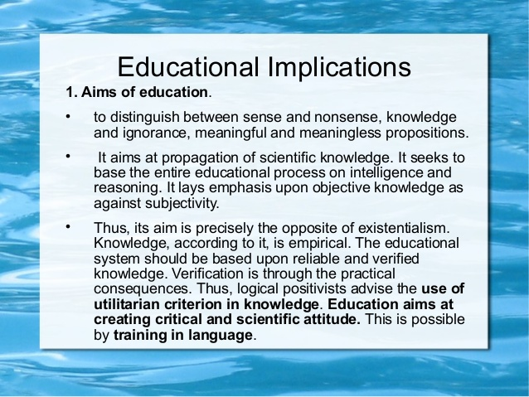

Slide 63
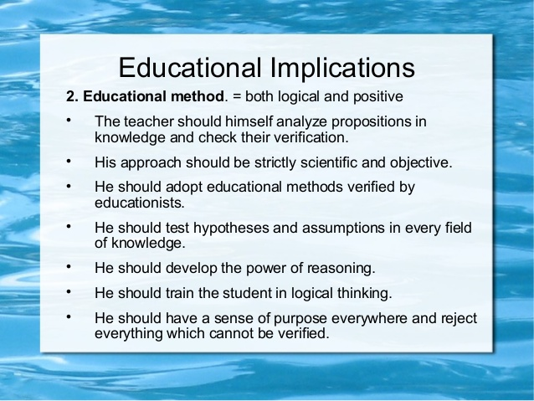

Slide 64
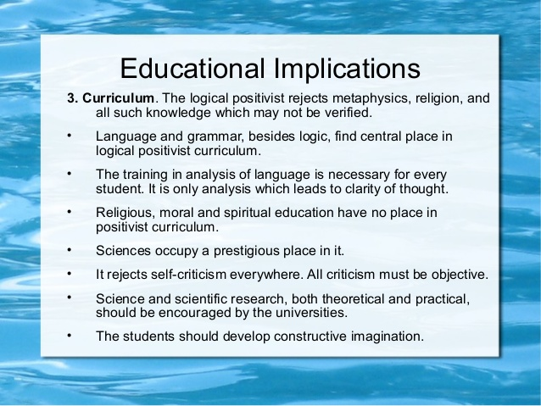

Slide 65
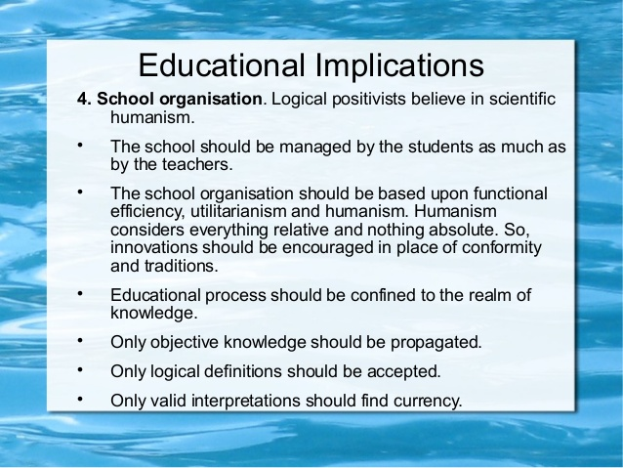

Slide 66
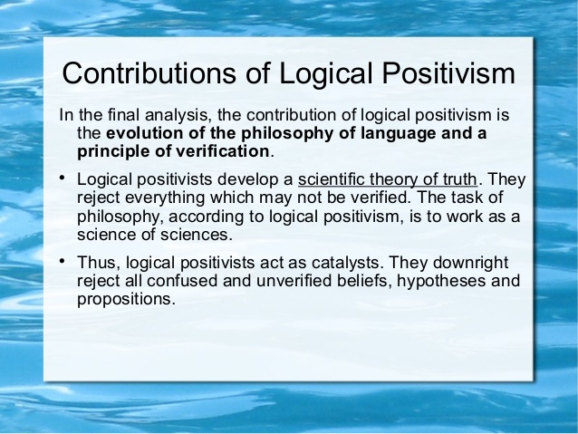

Slide 67
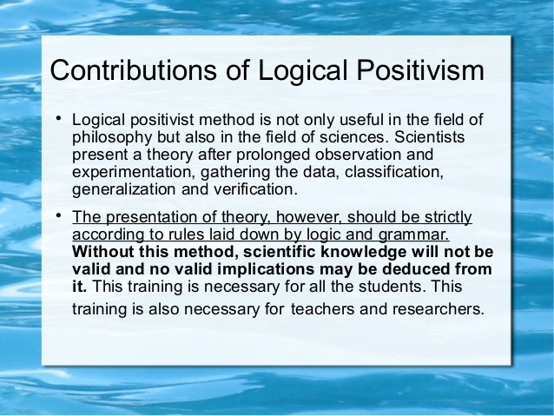

Slide 68
Logical Anaysis
A trend in modern analytic philosophy which maintains that the problem of philosophy is the logical analysis of the language of science using instruments of modern formal (mathematical) logic.
LA emerged as an important philosophy in the early 20th century and is still dominant in the English speaking world.

Slide 69
Analytic philosophy is a philosophical practice characterised by an emphasis on argumentative clarity and precision and a tendency to use or refer to , mathematics and the natural sciences.
Analytical philosophers , Rudolf Carnap, G. E Moore, Betrand Russel and Ludwig Wittigenstein etc.,

Slide 70
Logic (from the Greek "logos", which has a variety of meanings including word, thought, idea, argument, account, reason or principle) is the study of reasoning, or the study of the principles and criteria of valid inference and demonstration.
It attempts to distinguish good reasoning from bad reasoning.

Slide 71
Logical analysis is an instrument of interpretation and the systematic reconstruction of a theory that concerns the issues that are discussed.
Logical analysis attempts to resolve philosophical disputes by clarifying language.
logical analysis gave rise to the movement known as logical positivism.

Slide 72
The emergence and development of the philosophy of logical analysis was due to:
The increased interest in logical and methodological problems.
The intensified mathematization of science and to the development of methods of formalization.

Slide 73
However, the detailed investigation of logical problems in science was related by the philosophy of logical analysis to a positivist negation of the significance of philosophy as a world view.

Slide 74
The fundamental ideas of the philosophy of logical analysis were first formulated by B. Russell.
Russell advanced the thesis that any scientifically meaningful philosophical problem is essentially one of formal logic.
The ideas of the philosophy of logical analysis were also developed in L. Wittgenstein’s Tractatus logi-co-philosophicus and received their full expression in the logical positivism of the Vienna circle.

Slide 75
Beginning in the 1930’s, a number of other groups of philosophers and individual philosophers, such as the logical pragmatists W. Quine, N. Goodman, and A. Pap (USA), K. Popper (Great Britain) and T. Kotarbiński (Poland), became adherents of the philosophy of logical analysis.

Slide 76
Significance
Logical analysis is the branch of study that concerns questions about reference, predication, identity, truth, quantification, existence, entailment, modality, and necessity.
Philosophical logic is the application of formal logical techniques to philosophical problems.

Slide 77
Importance in life
In life ,when we are faced with a routine daily situation or a very difficult problem or issue to resolve, logic and reasoning are important to remember and be applied for the best or most desired results.
Logic is important because it influences every decision we make in our lives. Logical thinking allows us to learn and make decisions that will affect our lifestyle.

Slide 78
IMPORTANCE IN EDUCATION
We use logical reasoning to derive conclusions from the bits of information.
We use logical proofs to convince others of our conclusions.
Logic is essential for many STEM disciplines, especially computer science.
We know that calculus is important to physics, and we teach is at the high school level.

Slide 79
TYPES OF LOGIC
Philosophical logic.
Informal logic.
Formal logic.
Mathematical logic.
Logical form.
Semantics.
Inference.
Logical systems.

Slide 80
PRINCIPLES OF LOGIC
The three fundamental laws of logic:
(1) the law of contradiction,
(2) the law of excluded middle (or third), and
(3) the principle of identity.

Slide 81
DIFFERENCE BETWEEN LOGIC AND PHILOSOPHY
philosophy is love for wisdom, while logics is the study of the principles of reasoning. ... Philosophy uses logic in order to answer intellectual, ethical and even spiritual questions. Logic is the study of correct reasoning (basically). Philosophy is the study of all that is humanity and all that is the universe.

Slide 82
Pure Relativism
Relativism is sometimes identified as the thesis that all points of view are equally valid.
In ethics, this amounts to saying that all moralities are equally good; in epistemology it implies that all beliefs, or belief systems, are equally true.

Slide 83
Sophists are considered the founding fathers of relativism in Western philosophy.
Elements of relativism emerged among the Sophists in the 5th century BC
Relativism, roughly put, is the view that truth and falsity, right and wrong, standards of reasoning, and procedures of justification are products of differing conventions and frameworks of assessment.

Slide 84
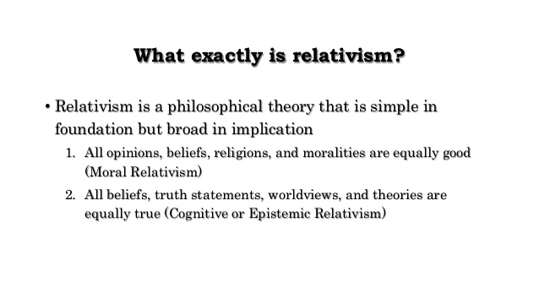

Slide 85
Positive relativism
Positive relativism is considered as a medium between two extremes of objectivism and subjectivism.
objectivism is considered as modernism and subjectivism is considered as post modernism.
It is a position that neither asserts nor denies an objective reality.

Slide 86
Positive Relativism
Positive Relativism
One has a better morals system, beliefs system, or truth claim
Provides solid logical grounds to prevent conflict and promote acceptance
The ultimate philosophical theory of tolerance Negative Relativism • No one has the Truth or the knowledge of what is Good

Slide 87
Modernism
Modernism is objective stressing on logic, rational thoughts and coherence
Modernists are strong believers in progress
It considers truth and values that are logically proved to be objective in nature

Slide 88
Post modernism
Post modernism is a science that is not logically constructed but socially constructed.
It is subjective and believes in coherence and indeterminacy.

Slide 89
Positive relativism relates two extremes of modernism and post modernism and evolves a harmonious synthesis is through the realities of experiences of people.
It is neither in favour nor against modernism and post modernism.

Slide 90
Subjective relativism
"Subjective relativism," then, as a philosophical position, declares that each person is his own authority on the moral life, and source of his own moral principles.
Holds the idea that each individual person decides what is right or wrong for themselves. A popular notion attached to subjective relativism is that "What's right for you may not be right for me."

