Slide 1
SECI KM MODEL/The Nonaka and Takeuchi KM Model
The Nonaka and Takeuchi KM model focuses on knowledge spirals that transforms tacit knowledge into explicit knowledge and back again as the basis for individual, group and organizational innovation and learning.
SECI model of knowledge dimensions (or the Nonaka-Takeuchi model) is a model of knowledge creation that explains how tacit and explicit knowledge are converted into organisational knowledge.

Slide 2
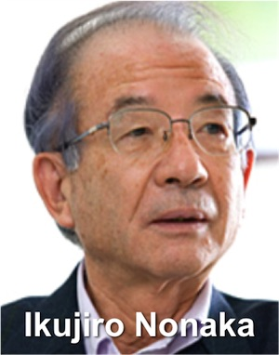
Ikujiro Nonaka has been described as the ‘Father of Knowledge Management’.
He takes a radical view –he goes to the route of how we acquire, create and share knowledge

Slide 3
Knowledge is an essential item in our daily activities to perform the works efficiently.
It is considered as the most important asset for every organization.
Knowledge management is a system of acquiring, capturing, sharing, storing, developing, capitalizing, disseminating, and utilizing knowledge efficiently in organizations.

Slide 4
The Nonaka and Takeuchi KM model is basically a two dimensional matrix depicting four possible scenarios of tacit and explicit knowledge interaction or conversion.
Nonaka and Takeuchi’s four modes of knowledge conversion;➢socialization, ➢externalization, ➢combination and ➢ internalization, create a dynamic process for organizational knowledge creation.

Slide 5
Socialization is a process of creating common tacit knowledge through shared experiences.
Externalization is a process of articulating tacit knowledge into explicit knowledge as concepts and/or diagrams.
Combination- is a process of assembling new and existing explicit knowledge into systemic knowledge, such as a new curriculum implementation plan and teaching methods.
Internalization is a process of embodying explicit knowledge into tacit, pedagogical knowledge such as having the “know-how” to teach.

Slide 6
Internal organizational knowledge flow can be obtained through mutual interaction and sharing by the organization’s members, thereby strengthening the organization and the teaching skills of individual members.

Slide 7
Nonaka and Takeuchi’s four modes conversion model can be applied in schools to explain how teachers share their tacit and explicit knowledge through Lesson Study.
Lesson study is a type of action research and professional development activity in which teachers collaborate to create effective lessons and examine their practice .

Slide 8
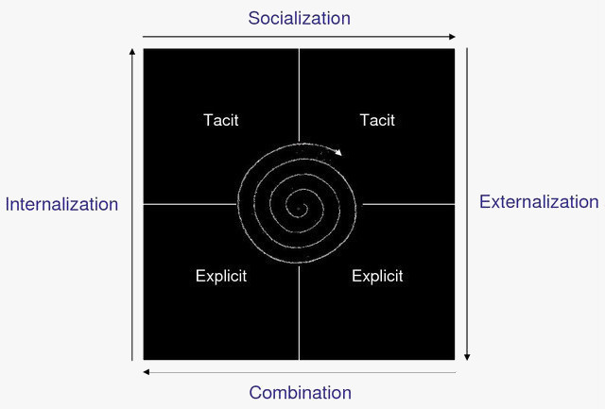
The SECI Model Knowledge Creation Spiral

Slide 9
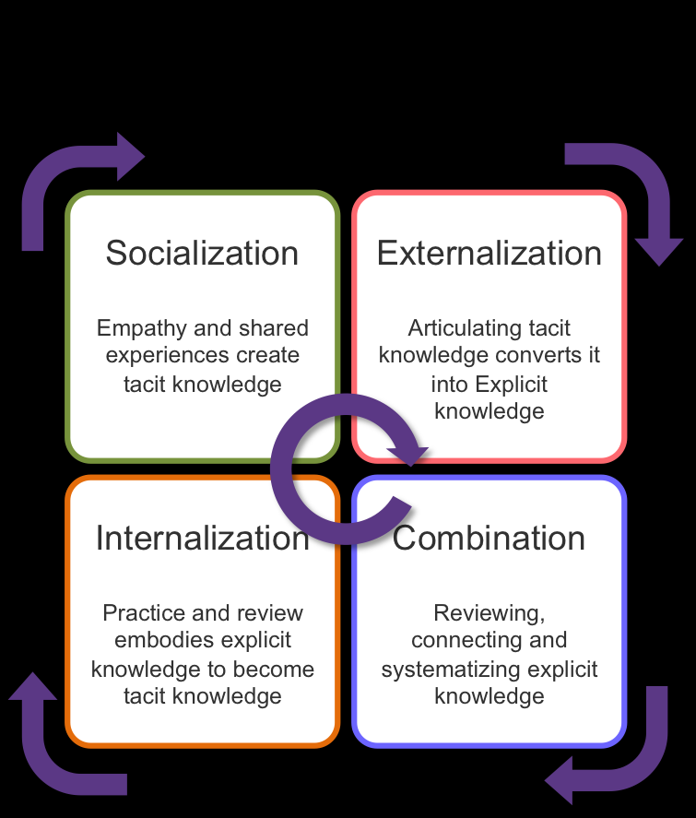
5555555555555555

Slide 10
Nonaka and Takeuchi start their cycle with social knowledge sharing to build tacit knowledge and move around to internalization of explicit knowledge to make it implicit, or tacit.
knowledge being shared, restarting the cycle (they originally drew it as a continuous spiral.
At each stage, knowledge is converted, and made more useful.

Slide 11
Socialization
The process that transfers tacit knowledge in one person to tacit knowledge in another person is
socialization.
It is experiential, active and a “living thing,” involving capturing knowledge by walking around and through direct interaction with customers and suppliers outside the organization and people inside the organization.
Socialization is primarily a process between individuals.

Slide 12
Externalization
The process for making tacit knowledge explicit is externalization. One case is the articulation of one’s own tacit knowledge - ideas or images in words, metaphors, analogies.
A second case is eliciting and translating the tacit knowledge of others - customer, experts for example - into a readily understandable form, e.g., explicit knowledge.
Dialogue is an important means for both.

Slide 13
combination
Once knowledge is explicit, it can be transferred as explicit knowledge through a process Nonaka calls combination.
Information technology is most helpful, because explicit knowledge can be conveyed in documents, email, data bases, as well as through meetings and briefings.

Slide 14
Internalization
Internalization is the process of understanding and absorbing explicit knowledge in to tacit knowledge held by the individual.
Knowledge in the tacit form is actionable by the owner. Internalization is largely experiential, in order to actualize concepts and methods, either through the actual doing or through simulations.

Slide 15
Advantages of the model
Appreciates the dynamic nature of knowledge and knowledge creation.
Provides a framework for management of the relevant processes.

Slide 16
The Boisot Information -Space KM Model
The Boisot KM model is based on the key concept of an "information good“ that differs from a physical asset.
Boisot distinguishes information from data by emphasizing that information is what an observer will extract from data as a function
of his or her expectations or prior knowledge. :

Slide 17
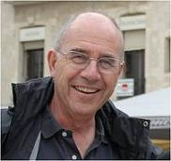
Max Henri Boisot was born on November 11, 1943 and died on September 7, 2011.
He was a British architect and management consultant who was professor of Strategic Management at the ESADE business school in Barcelona.
Max was known for his ideas about the information economy, the Information Space, social capital, and social learning theory.

Slide 18
Boisot (1998) proposes the following two key points:
The more easily data can be structured and converted into information, the more diffusible it becomes.
The less data that has been structured and converted into information, requires a shared context for its diffusion, the more diffusible it becomes (Dalkir, 2011, p.82).

Slide 19
Boisot's model can be visualized as three dimensional cube with the following dimensions:
i. from uncodified to codified,
ii. from concrete to abstract,
iii. from undiffused to diffused.

Slide 20
Boisot posits four different types of knowledge, which are the four main corners of the I-Space .
1. Common sense (cultural) knowledge is that which ‘everybody knows’. It is concrete, uncodified, and widely diffused.
2. Personal knowledge, such as biographical knowledge, is concrete but neither codified nor diffused.
3. Proprietary knowledge, such as patents and official secrets, is abstract and codified. But, it is not diffused. Here barriers to diffusion have to be set up.
4. Textbook (or Public) knowledge is abstract, codified, and diffused.

Slide 21
He proposes a Social Learning Cycle (SLC) that uses the I-Space to model the dynamic flow of knowledge through a series of six phases:
Scanning: insights are gained from generally available (diffused) data
Problem-Solving: problems are solved giving structure and coherence to these insights (knowledge becomes 'codified')
Abstraction: the newly codified insights are generalized to a wide range of situations (knowledge becomes more 'abstract')
Diffusion: the new insights are shared with a target population in a codified and abstract form (knowledge becomes 'diffused'

Slide 22
Absorption: the newly codified insights are applied to a variety of situations producing new learning experiences (knowledge is absorbed and produces learnt behaviour and so becomes 'uncodified', or 'tacit')
Impacting: abstract knowledge becomes embedded in concrete practices, for example in artifacts, rules or behaviour patterns (knowledge becomes 'concrete')

Slide 23
Knowledge is an essential item in our daily activities to perform the works efficiently. It is considered as the most important asset for every organization. Knowledge management is a system of acquiring, capturing, sharing, storing, developing, capitalizing, disseminating, and utilizing knowledge efficiently in organizations.

Slide 24
NATHANIEL LEE GAGE(1917-2008)
Gage was an American educational psychologist who made significant contributions to a scientific understanding of teaching.
Born in august first 1917 at New Jersy in America

Slide 25
Father of research in teaching field.
• Professor of Stanford graduate school of education and emeritus at university of education .
• A giant among educational researchers.
• Received E.L Thorndake award for career achievement in educational psychology.
• Elected to the National academy of education in 1979.

Slide 26
He began his career at Purdue university as an assistant professor.
• His important works is,” A Handbook of research on teaching”.
• In 1965 founded Centre for educational research at Stanford.
• In 1970 Gage received fellowship and served as a visiting professor

Slide 27
CONTRIBUTIONS
• He provided a scientific basis to the art of teaching.
• New definition to teaching as,”any activity from the part of one person intended to facilitate learning on the part of another”.
• So teaching is the act of facilitating learning.
• He paved a new way for discussion about science of teaching and the scientific basis of teaching

Slide 28
Published works are ,”A Conception of teaching(2008), Educational psychology”(1975)
•” The nature of evaluation process, The scientific basis of art of teaching, Instructors manual with test items(1984).”

Slide 29
According to Gage” teaching is properly done by Hunch, by Intuition, by Experience , by Ideology, what it also needs is a basis in scientific research in teaching “.
• Teaching as more of an “art than a science.”
• “Good teacher is not born ,They are built “.

Slide 30
A conception of teaching dedicates a chapter to each of the following important components:-
the evolution of a paradigm for the study of teaching ,a conception of the process of teaching ,a conception of the content of teaching ,a conception of students cognitive capabilities and motivations , a conception of class room management , and the integration of these conceptions.

Slide 31
Untill now , no theory of teaching has existed and “A conception of teaching “is a important and a great step forward, offering an important and original contribution to the literature.
• First chapter agenda; it consists of:
• The money raised for education
• The curricula developed

Slide 32
An Agenda
• The administrators ,supervisors and teachers trained .
• The parents and other citizens consulted.
• The teachers influence the students knowledge ,understanding ,appreciation and attitude in a desirable way.
• The nation require that their young people have frequent contact for long periods with adults, called teachers.

Slide 33
The desirability and possibility of a theory of teaching
• Education has a large number of discrete components ,each of which uses its own concepts and purposes .
Components are educational finance, educational architecture, educational personal ,curriculum ,assessment, classroom management, design technology etc .
Due to these complexities we need theory of teaching .

Slide 34
The evolution of paradigm for the study of teaching
• In research on teaching , the paradigm has evolved from the cumulative contribution of students of teaching in the period from 1890 to 1980s
• The evolution began with a paradigm implicit in the empirical research design used by Joseph Mayer Rice.
• Rice had studied the relationship between variables in two catagories that would later be called process and achievement(product).

Slide 35
In his study the process variable was the amount of time teachers devoted to teaching. • The achievement variable was the average score of the students on test.
• This relationship was later known as” process -product paradigm”.

Slide 36
A conception of the process of teaching
• The process of teaching explains-how teaching happen, what the students and teacher say, what the students experience as they see and hear the teacher.
• A conception of content of teaching
• Content derived from objectives of teaching
• Educational content involve societies culture which foster freedom and well being of the society, help to perform their economic roles and proper functioning of government.

Slide 37
A conception of the content of teaching
Teaching content is important.KayBentley explained some of its benefits: how it motivates learners by arousing their curiosity; and how it develops subject and language competence simultaneously, along with cultural awareness, and critical and creative skills.
Successfully motivating students to learn about subject content begins by activating their prior knowledge of the subject topic.

Slide 38
In the question-and-answer session, Kay offered advice on a number of subjects, including correcting students – make sure not to interrupt students with corrections, but wait until they’ve finished speaking, and then ask the class to help them out – and on dealing with parents’ high expectations.

Slide 39
Conception of students cognitive capabilities and motivation
• Cognitive capability includes-students intelligents and their prior knowledge.
• Cognitive capabilities called mental age
• Students often vary in their prior knowledge according to their interests previous schooling and random experience

Slide 40
A conception of classroom management
• Classroom management is a process of content transfer , students cognitive capabilities and students motivation .
• According to Berliner poverty as a major factor that troubles classroom management.
• The average achievement of students from low income group is substantially lower than that of middle class students.

