Slide 1
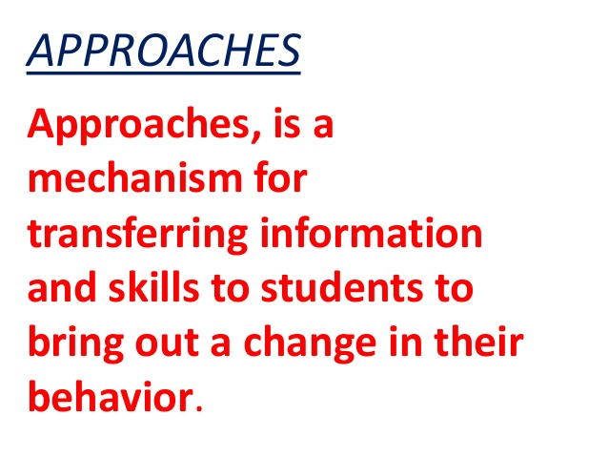

Slide 2
Multidisciplinary approach
An approach to curriculum integration which focuses primarily on the different disciplines and the diverse perspectives they bring to illustrate a topic, theme or issue.
A multidisciplinary curriculum is one in which the same topic is studied from the viewpoint of more than one discipline.

Slide 3
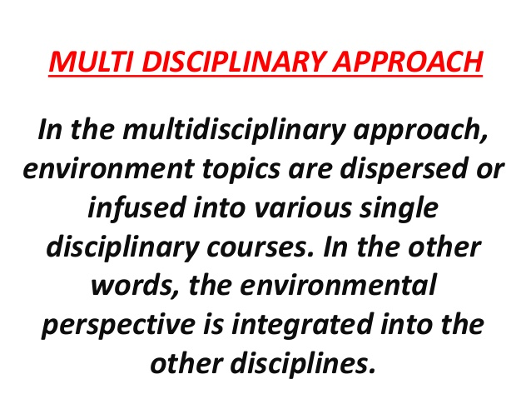

Slide 4
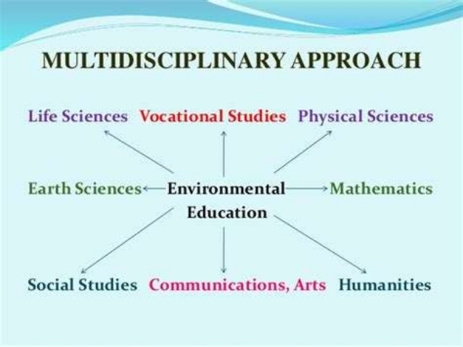

Slide 5
Holistic Approach
Holistic education is based on the premise that each person finds identity, meaning, and purpose in life through connections to the community, to the natural world, and to spiritual values such as compassion and peace.

Slide 6
The alarming environmental problems we are facing will require a more holistic view to education.
An inter-disciplinary approach and better linkages among the different school subjects, as well as a growing need for more thematic teaching.
The learners need a lot of specified and detailed knowledge provided by traditional subject studies.

Slide 7
Integrated approach
The integrated approach is one in which learners learn by doing in a learner centred environment in learner-interest contexts.
• It allows students to engage in purposeful, relevant learning.
An integrated curriculum implies learning that is synthesized across traditional subject areas and learning experiences that are designed to be mutually reinforcing. This approach develops the child’s ability to transfer their learning to other settings.

Slide 8
Integrated teaching and learning processes enable children to acquire and use basic skills in all the content areas and to develop positive attitudes for continued successful learning throughout the elementary grades.
curriculum for the primary grades includes reading, writing, listening, speaking,
literature, drama, social studies, math, science,
health, physical education, music, and visual arts.

Slide 9
Characteristics of an Integrated Curriculum
 Experiences to develop children’s attitudes, skills, and knowledge and to help them make connections across the curriculum
 Activities that provide for a range of abilities
 Activities that are both teacher-initiated and directed and child-initiated and directed
 Whole class, small group, and individual experiences
 Opportunities for critical and creative thinking
 Teacher, peer, and self-assessment
 Opportunities to experience learning as a meaningful whole

Slide 10
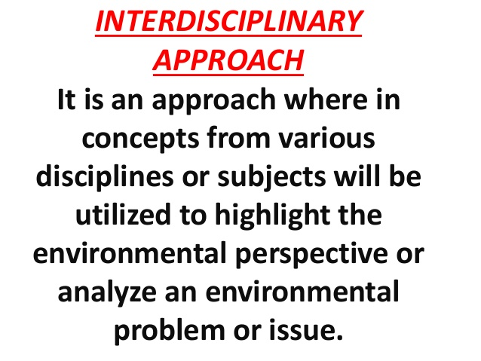

Slide 11
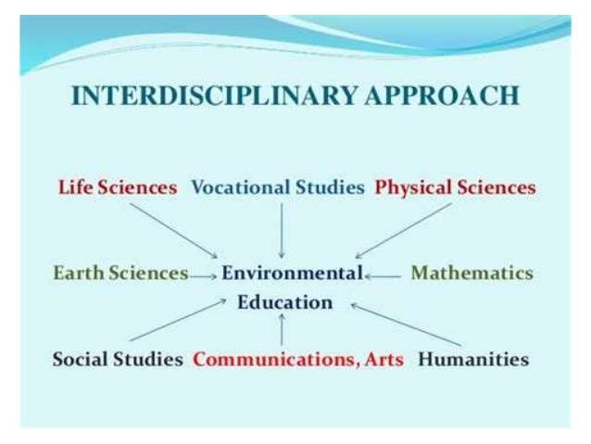

Slide 12
An interdisciplinary approach involves drawing appropriately from several disciplines to redefine problems outside of normal boundaries and reach solutions based on a new understanding of complex situations.

Slide 13
