Slide 1
Natural disasters
A natural disaster is a major adverse event resulting from natural processes of the Earth; examples are floods, hurricanes, tornadoes, volcanic eruptions, earthquakes, tsunamis, storms, and other geologic processes. A natural disaster can cause loss of life or damage property, and typically leaves some economic damage.

Slide 2
Geological disasters
Avalanches and landslides
A landslide is described as an outward and downward slope movement of an abundance of slope-forming materials including rock, soil, artificial, or even a combination of these things.
An avalanche (also called a snow slide) is an event that occurs when a cohesive slab of snow lying upon a weaker layer of snow fractures and slides down a steep slope.
During World War I, an estimated 40,000 to 80,000 soldiers died as a result of avalanches during the mountain campaign in the Alps at the Austrian-Italian front. Many of the avalanches were caused by artillery fire.

Slide 3
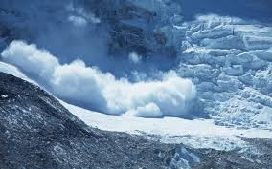
Avalanches

Slide 4
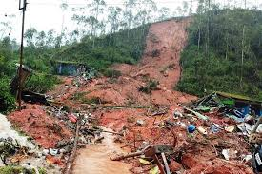
landslides

Slide 5
Earthquakes
An earthquake is the result of a sudden release of energy in the Earth's crust that creates seismic waves. At the Earth's surface, earthquakes manifest themselves by vibration, shaking, and sometimes displacement of the ground. Earthquakes are caused by slippage within geological faults. The underground point of origin of the earthquake is called the seismic focus.

Slide 6
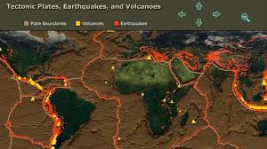
Earthquakes

Slide 7
The point directly above the focus on the surface is called the epicentre. Earthquakes by themselves rarely kill people or wild life, building collapse, fires, tsunamis (seismic sea waves) and volcanoes. Many of these could possibly be avoided by better construction, safety systems, early warning and planning.

Slide 8
Volcanic eruptions
Volcanoes can cause widespread destruction and consequent disaster in several ways .Lava may be produced during the eruption of a volcano, destroys many buildings, plants and animals due to its extreme heat.
volcanic ash, may form a cloud, and settle thickly in nearby locations. When mixed with water this forms a concrete-like material. In sufficient quantities, ash may cause roofs to collapse.

Slide 9
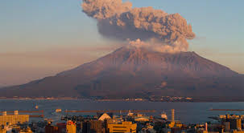
volcanos

Slide 10
The main killer of humans in the immediate surroundings of a volcanic eruption is the pyroclastic flows, which consist of a cloud of hot volcanic ash .
A lahar is a volcanic mudflow or landslide. The 1953 Tingyi disaster was caused by a lahar, as was the 1985 Amerco tragedy in which the town of Amerco was buried and an estimated 23,000 people were killed.

Slide 11
The main danger from a super volcano is the immense cloud of ash, which has a disastrous global effect on climate and temperature for many years.

Slide 12
Hydrological disasters
A violent, sudden and destructive change either in the quality of Earth's water or in the distribution or movement of water on land below the surface or in the atmosphere.
Floods
A flood is an overflow of water that 'submerges' land. Flooding may result from the volume of water within a body of water, such as a river or lake, which overflows, causing some of the water to escape its usual boundaries.

Slide 13
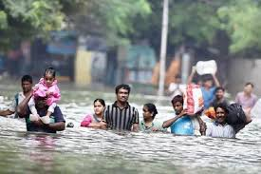
Floods

Slide 14
Tsunami
The word tsunami originated from Japanese: which means harbour wave, also known as a seismic sea wave or as a tidal wave, is a series of waves in a water body caused by the displacement of a large volume of water, generally in an ocean or a large lake.

Slide 15
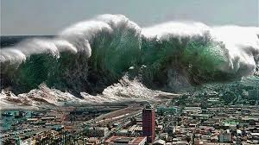
TSUNAMI

Slide 16
Tsunamis can be caused by undersea earthquakes such as the 2004 Boxing Day tsunami, or by landslides such as the one in 1958 at Latoya Bay, Alaska, or by volcanic eruptions such as the ancient eruption of Santorin.

Slide 17
Limbic eruptions
A limbic eruption occurs when a gas, usually CO2, suddenly erupts from deep lake water, posing the threat of suffocating wildlife, livestock and humans.
Such an eruption may also cause tsunamis in the lake as the rising gas displaces water. Scientists believe landslides, volcanic activity, or explosions can trigger such an eruption.

Slide 18
Meteorological disasters
Cyclonic storms-- Cyclone, tropical cyclone, hurricane, and typhoon are different names for the same phenomenon, which is a cyclonic storm system that forms over the oceans.
The determining factor on which term is used is based on where they originate. In the Atlantic and Northeast Pacific, the term "hurricane" is used; in the Northwest Pacific it is referred to as a "typhoon" and "cyclones" occur in the South Pacific and Indian Ocean.

Slide 19
The deadliest hurricane ever was the 1970 Bola cyclone; the deadliest Atlantic hurricane was the Great Hurricane of 1780 which devastated Martinique, St. Eustatius and Barbados. Another notable hurricane is Hurricane Katrina, which devastated the Gulf Coast of the United States in 2005.

Slide 20
Blizzards
Blizzards are severe winter storms characterized by heavy snow and strong winds. When high winds stir up snow that has already fallen, it is known as a ground blizzard. Blizzards can impact local economic activities, especially in regions where snowfall is rare. The Great Blizzard of 1888 affected the United States, when many tons of wheat crops were destroyed, and in Asia, 2008

Slide 21
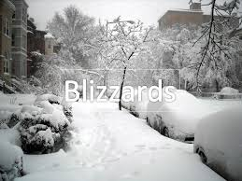
Blizzards

Slide 22
Hailstorms
Hailstorms are precipitation in the form of ice, with the ice not melting before it hits the ground.
Ice storms
An ice storm is a type of winter storm characterized by freezing rain.

Slide 23
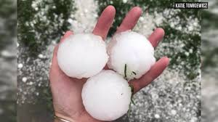
Hailstorm

Slide 24
Droughts
Drought is the unusual dryness of soil caused by levels of rainfall significantly below average over a prolonged period. Hot dry winds, shortage of water, high temperatures and consequent evaporation of moisture from the ground can also contribute to conditions of drought. Droughts result in crop failure and shortages of water.

Slide 25
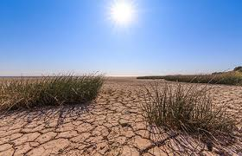
Droughts

Slide 26
Thunderstorms
Severe storms, dust clouds, and volcanic eruptions can generate lightning. Apart from the damage typically associated with storms, such as winds, hail, and flooding, the lightning itself can damage buildings, ignite fires and kill by direct contact.
Most lightning deaths occur in the poor countries of America and Asia, where lightning is common and adobe mud brick housing provides little protection.[

Slide 27
Tornadoes
A tornado is a violent and dangerous rotating column of air that is in contact with both the surface of the Earth and a cumulonimbus cloud, or the base of a cumulus cloud in rare cases. It is also referred to as a twister or a cyclone.

Slide 28
Wildfires
Wildfires are large fires which often start in wild land areas. Common causes include lightning and drought but wildfires may also be started by human negligence .They can spread to populated areas and can thus be a threat to humans and property, as well as wildlife.

Slide 29
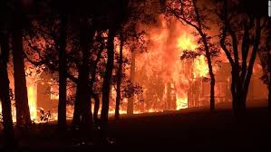
wildfire

