Slide 1
Trophic levels and Ecological Pyramids
Trophic Levels
Each successive level of nourishment as represented by the links of the food chain is known as a trophic level. The plant producers within an ecosystem constitute the first trophic level, the herbivores form the second trophic level, and the carnivores represent the third level. Additional links in the main food chain, and inside chains such as those formed by parasites constitute further trophic levels.

Slide 2
Ecological Pyramids
Ecological pyramids represent the trophic structure and also the trophic function of an ecosystem. In an ecological pyramid, the first trophic level forms the base and successive trophic levels the tiers which make up the apex. Ecological pyramids may be of three general type’s

Slide 3
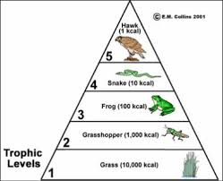
Trophic Levels

Slide 4
(1) Pyramid of numbers-
It represents the numerical relationship between different trophic levels of a food chain. In such a pyramid, the more abundant species form the base of pyramid and the less abundant species remain near the top. The pyramid of numbers can be best understood by taking lake or grassland as an example.

Slide 5
(2) Pyramid of Biomass
The biomass i.e. the living weight of the organisms of the food chain present at any time in an ecosystem forms t he pyramid of biomass. The pyramid of biomass indicates the decrease or the gradual reduction in biomass at each trophic level from base to apex.

Slide 6
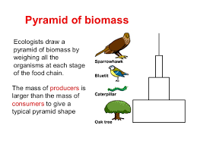
PYRAMID OF BIOMASS

Slide 7
(3) Pyramid of energy
(3) Pyramid of energy It indicates the total energy at each trophic level of the food chain. It also exhibits that at each trophic level loss of energy and material takes place . The production rate of energy at
different tropic levels of an ecosystem can be represented by the pyramid of energy. The base of such a pyramid is represented by the autotrophs i.e. green plants and the higher levels are represented by different herbivore and carnivore trophic levels.

Slide 8
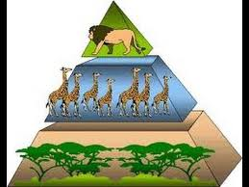
PYRAMID OF ENERGY

Slide 9
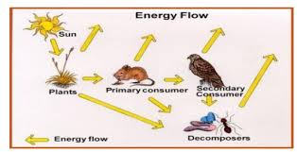

Slide 10
Energy Flow in an Ecosystem
The existence of living world depends upon the flow of energy and circulation of materials through the ecosystem. The energy is required for the performance of all the life activities. The source of this energy is sun. The solar energy enters the space in the form of light rays. Approximately 57 per-cent of solar energy is absorbed in the atmosphere and scattered in space. About 36 per-cents are expended in heating water and land and in evaporating water. Nearly 8 per cent of light energy strikes the plants, of which 80-85 per cent is absorbed, and only fifty per-cent of it is utilized in photosynthesis (Odum and Barrett, 2005).;Benson, 2000).

Slide 11
Four successive steps in the production process
1. Gross Primary Productivity- It is the total energy stored in the food materials synthesized by the green plants or total rate of photosynthesis including the organic matter used up in the respiration during “total photosynthesis or total assimilation.”

Slide 12
2. Net Primary Productivity-
It is the total gross productivity minus the energy used up in the metabolic process. In other words it is the rate of storage of organic matter in plants in excess of the organic matter utilized in respiration by the plants during the measurement period.

Slide 13
Importance
Net primary production (NPP) is the amount of carbon and energy that enters ecosystems. It provides the energy that drives all biotic processes, including the trophic webs that sustain animal populations and the activity of decomposer organisms that recycle the nutrients required to support primary production.

Slide 14
3. Net Community Productivity-
It is the rate of storage of organic matter used by heterotrophs during the period under consideration, usually the growing season of the year. This is primary production minus heterotrophic consumption.

Slide 15
Net community productivity
Net community productivity (NCP), defined as the difference between gross primary productivity (GPP) and community respiration (R), is an important indicator of the role of the biota in sequestering and exporting carbon.

Slide 16
4. Secondary Productivities-
The rates of energy storage at consumer levels are referred to as secondary productivities. There are three fundamental aspects of productivity: (1) standing crop (2) material removed and (3) production rate.

Slide 17
. Balance within the Ecosystem
Changes which occur in ecosystems over a geological time span are met by evolutionary changes resulting from natural selection. Those changes that occur naturally as a result of normal succession are met by changes in species makeup of the communities involved. The ecosystem always makes efficient use of the available energy within the limitations of the physical environment. Whether artificially or naturally caused, changes are met by the adjustment of the species present or creation and filling of new ecological niches by species which are new to the ecosystems.

Slide 18
Environmental issues
Global problems—
1.Global warming
2. Acid Rain
3.Depletion of ozone layer
4.Pollution-air and marine
5 Nuclear war

Slide 19
E--Issues
National Problems
1.Pollution—air, water, soil
2. Degradation of natural resources
3. conversion of agricultural land into industrial purposes.

