Slide 1
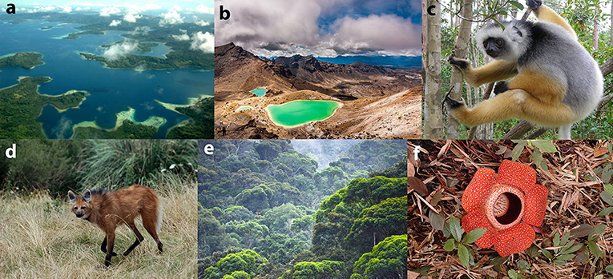
Biodiversity Hotspot/ecological hotspot

Slide 2
Hotspot/Ecological hotspot
The term ‘hot spot’ was introduced by N. Myers in 1988 for those geographical regions particularly rich in ‘endemic’, ‘rare’ and ‘threatened’ species found in relatively small areas but facing significant threats to habitat loss.
A biodiversity hotspot is a biogeographic region that is both a significant reservoir of biodiversity and is threatened with destruction.

Slide 3
Area of hot spot
Presently, there are 36 areas across the globe that qualify as hotspots. They represent 2.4% of the Earth’s land surface but support more than half of the world’s plant species as endemics — and nearly 43% of bird, mammal, reptile and amphibian species as endemics.

Slide 4
Criteria for determining hotspots
The area must contain at least 1,500 species of endemic vascular plants.
The area must have lost at least 70 per cent of its primary native vegetation.

Slide 5
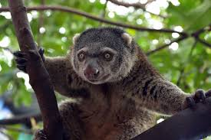
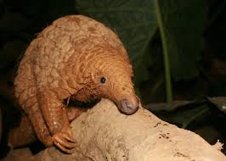
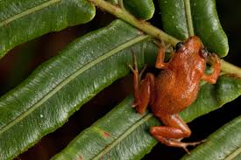
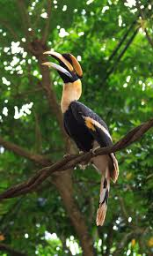

Slide 6
Ecological hotspots importance
Biodiversity underpins all life on Earth.
Without species, there would be no air to breathe, no food to eat, no water to drink.
There would be no human society at all.

Slide 7
Biodiversity Hotspots Across the World
The eight hottest hot spots in terms of the above factors are:
Madagascar
Philippines
Sundaland [South East Asia]
Brazil’s Atlantic Forest
Caribbean
Indo-Burma
The Western Ghats and Sri Lanka
Eastern Arc and Coastal Forests of Tanzania/Kenya

Slide 8
There are 4 biodiversity hot spots present in India.
The Eastern Himalayas [Arunachal Pradesh, Bhutan, Eastern Nepal]
Indo-Burma [Purvanchal Hills, Arakan Yoma, Eastern Bangladesh]
The Western Ghats
Sundalands: Includes Nicobar group of Islands

Slide 9
The leading causes
A biodiversity hotspot must have lost at least 70% of its habitat. Biodiversity hotspots now cover only 1.4% of the land on Earth, when they originally covered 12% of the land.
Factors, such as pollution, exploitation of land, invasive species, deforestation, and climate change are the leading causes of habitat loss and destruction.

Slide 10
The fact that these factors are widespread creates challenges for the species that manage to survive; and with an ever-changing climate and unpredictable circumstances, species that cannot resist the changing environment or move to a more suitable habitat will likely become extinct.

Slide 11
When we think about the future of biodiversity on Earth, we need to consider the role we play in climate change.
Some scientists predict that up to 54% of species are at risk of extinction due to climate change.
The consequences of climate change are extremely widespread, threatening even places untouched by humans.

Slide 12
Measures to protect our ecological hotspots
we can start by making small changes in our daily lives.
Taking action by recycling, picking up trash, being conservative with our water consumption, and limiting pollution by walking, biking, or taking public transportation are ways that we can help the environment.

Slide 13
IUCN Red List
Founded in 1964, the IUCN Red List also known as the Red Data List evaluates the biological species in the world which are at the risk of extinction.
IUCN aims to focus on the conservation of the world’s species to reduce the species extinction. More than 77,300 species have been assessed on the IUCN Red List.
According to the reports of 2019 as per the IUCN Red List, 41% of the amphibians and 33% of the coral reefs are in the threatened category.

Slide 14
The IUCN Red List can be divided into the following 9 categories:
Extinct (EX) – No known individuals remaining.
Extinct in the wild (EW) – Known only to survive in captivity, or as a naturalized population outside its historic range.
Critically endangered (CR) – Extremely high risk of extinction in the wild.
Endangered (EN) – High risk of extinction in the wild.

Slide 15
Vulnerable (VU) – High risk of endangerment in the wild.
Near threatened (NT) – Likely to become endangered shortly.
Least concern (LC) – Lowest risk. Does not qualify for a more at-risk category. Widespread and abundant taxa are included in this category.
Data deficient (DD) – Not enough data to assess its risk of extinction.
Not evaluated (NE) – Has not yet been evaluated against the criteria

Slide 16
Tiger Conservation in India
Since a large number of the tiger population in India is entering into the list of endangered species, the conservation of tigers has become a crucial point in India. One of the initiatives taken by the Government of India for the protection of the tigers is the ‘Project Tiger’. This project was launched in April 1973 and was administered by the National Tiger Conservation Authority.

Slide 17
The list of major threats to Tiger Population are:
Man- animal conflict
Hunting, poaching and illegal trade
Habitat and loss of prey species

Slide 18
Top 5 Endangered Species of India
Endangered Animal Species---& Plant Species
The Royal Bengal Tiger--- Ebony tree
The Great Asiatic Lion---- Indian Mallow
The Snow Leopard ----- Malabar Lily
The Pig Nosed Frog Assam -- Catkin Yew
The Pink Headed Duck--- Milkwort

