Slide 1
Curriculum planning
Curriculum planning refers to the creation of a curriculum. .. "curriculum is the subject matter taught to students or an arrangement of instructional materials.

Slide 2
It helps one plan the education process or procedure for a given period of time (a term, session, lesson period etc). ... Hence for a society to achieve its educational goals, it needs a curriculum that is functional and relevant to its needs.

Slide 3
Steps in Curriculum Planning
Establish a value base for the program.
Develop a conceptual framework.
Determine program goals.
Design the program.
Establish program assessment procedures.
Implement the program.

Slide 4
Curriculum principles
Curriculum principles are the values a school believes will give both their pupils and community the best chance of succeeding, and what they know to be right, given its context.

Slide 5


Slide 6
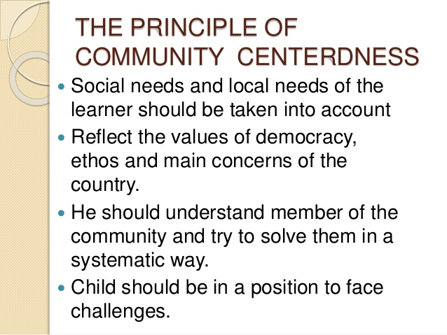

Slide 7


Slide 8
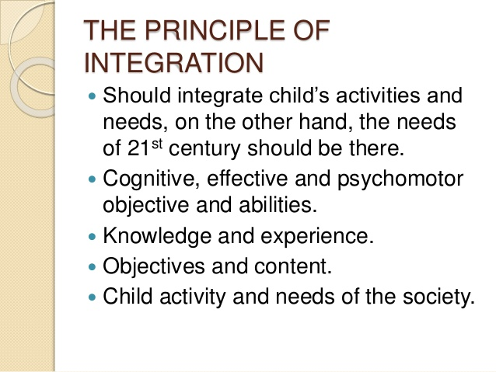

Slide 9


Slide 10


Slide 11


Slide 12


Slide 13


Slide 14


Slide 15


Slide 16
FACTORS FOR CURRICULUM CONSTRUCTION
From the ancient period to modem times, different factors have been influencing our education system. These factors may be philosophical, psychological, social, economical and environmental etc..

Slide 18
The philosophical aspects :
The various philosophical thoughts that influence curriculum are Idealism, Realism, Existentialism, Pragmatism, Essentialism and Deconstructionism
.The spirit and nature of the government of a particular state as well as the cultural and historical background is to be taken into consideration for the educational system of the country,

Slide 19
The form of government
The form of government - democratic, communistic or dictatorial - largely influences the shape of educational system prevailing in the country –
. While attempting to evaluate the principles of curriculum construction the democratic values of the country should take precedence over all other considerations

Slide 20
Democracy not only as a form of Government, but also as a way of life.... A healthy development of democratic trends will help softer the impact of this division into social, economic and cultural groups“
A communist country like U.S.S.R. has a different ideological and philosophical background. In U.S.S.R. greater emphasis has been placed on the demands of the national economy.

Slide 21
Commurist China has two broad objectives of its education i.e., political education and education for national reconstruction. The schools place primary importance on Education and National Development.

Slide 22
Cultural factor
culture binds the individual and society together and education helps culture to flourish.
Education in democratic India must be rooted in the cultural heritages of the land in terms of both the past and present
It is not possible for us to ignore the role of cultural aspect in educational system

Slide 23
Religious aspects
In the ancient age, education was dominated by religion
Religious education was treated as the touchstone for religious knowledge.
The Vedas constituted the texts for higher education in ancient India.
Buddhist religion formed an essential part of academic discipline

Slide 24
The basic objective of moslem religious education was to instruct boys in the fundamental aspects of the Qoran which a mohammedan was expected to know for performances of religious rites.

Slide 25
Caste system :
Four main castes - Brahman,Kshatriya, Vaishya and Sudra.
The brahmin by virtue of his social superiority had been given priority to acquire higher education but at the same time Kshatriya and the Vaisya were also eligible for studentship.
The Sudra's education was restricted to animal husbandry, hand work and handicrafts, music, dancing, instrument playing
etc.

Slide 26
From the above discussion, it is clear that caste system had a great role in our ancient Indian education system.
Birth and occupations were the main factors on the basis of which was determined what type of education .

Slide 27
Geographical factor :
To discuss the geographical factor, the economic nature of the country, its regions, climate, natural resources, production etc. should not be ignored
If the country is agricultural, its education system should place emphasis on agricultural education because the economics of the country is essentially based on the natural resources

Slide 28
An industrialised country demands a different types of education which would help the country to develop more engineers and technological experts.
If the country possesses extensive mineral resources, the education system will place an emphasis on mining education in order to develop the economy of the country. A coastal country will teach how to utilise the sea resources properly.

Slide 29
Climate :
The factors such as the structure of the school system, the school buildings and equipments, the means and transport used by the pupil; all these factors are determined by the climate of the country
For eg :In a -temperate climate, the pupils get easy incentive to acquire their lessons.

Slide 30
Economic factor (Production and vocation

