Slide 1
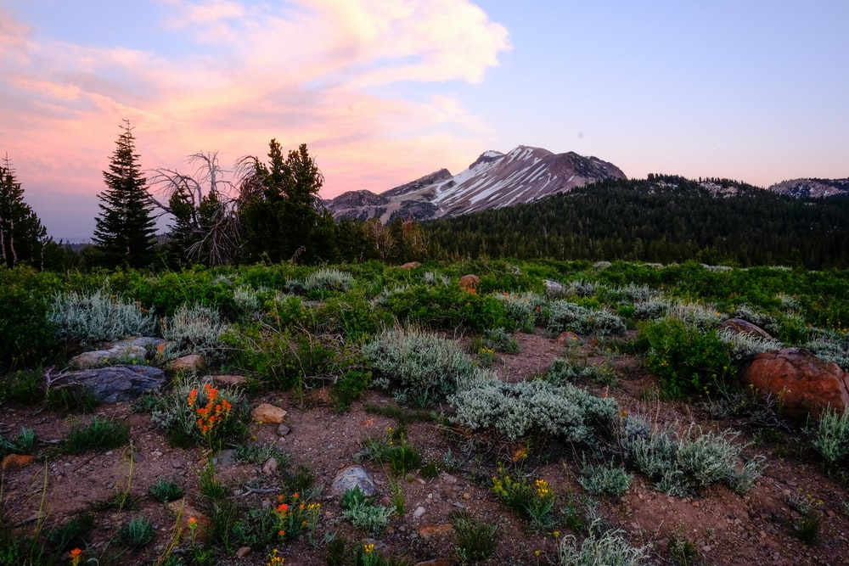
Ecology & Eco system
Meaning of Ecology: Ecology is concerned with the study of interrelationships between organisms and their environments. Two distinct components of environment can be identified: Abiotic (nonliving or nonorganic, sometime called the physical environment) and Biotic (living or organic).

Slide 2
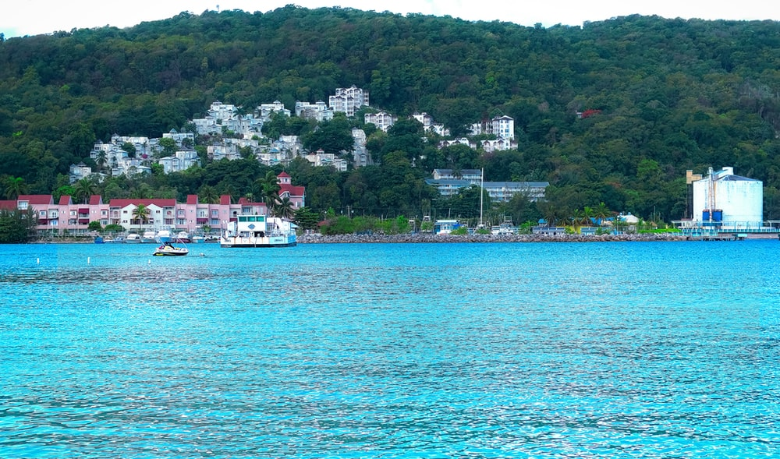
Eco system
The term ‘ecosystem’ was proposed by a British ecologist A.G. Tansley in the year 1935. The ecosystem represents the basic functional unit of ecology which comprises of the biotic communities mutually related with their non living or abiotic environment. Thus a biotic community and its abiotic environment together represent an ecosystem.

Slide 3
Principle Steps and Components in a Self-Sufficient Ecosystem
(1) Reception of energy;
(2) Manufacture of organic food by producers;
(3) Consumption of organic material by consumers;
(4) Decomposition into inorganic compounds and
(5) Transformation of these compounds into suitable compounds for the nutrition of the producers.

Slide 4
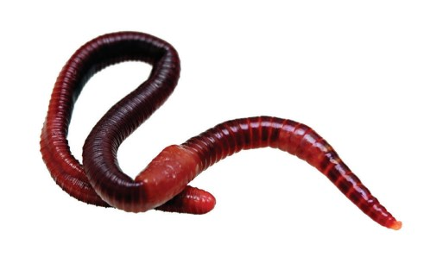
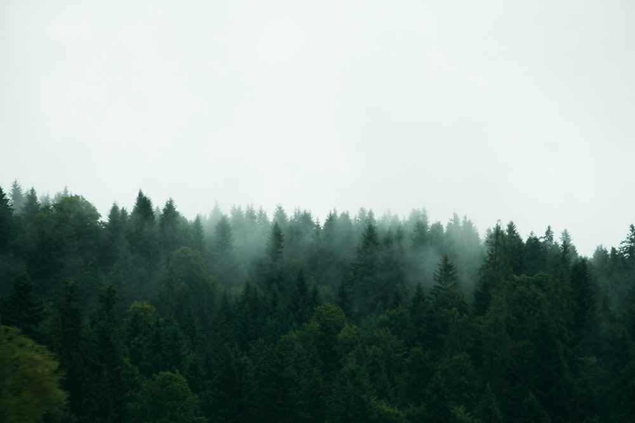
Odum (1968) has divided an ecosystem into two components:
1. Autotrophic component: It consists of green plants which bring about the fixation of solar energy (sunlight) and synthesis of organic compounds (carbohydrates) from simple inorganic substances.
2. Heterotrophic component: It consists of the decomposers (micro-organisms such as bacteria and fungi) are concerned with the utilization, rearrangement and degradation of complex food substances.

Slide 5
Structural point of view, the ecosystem divided into four
(i) Abiotic substances
(ii) Producers
(iii)Composers
(iv) Decomposers

Slide 6
1 Abiotic substances or nonliving
Which are, water, carbon dioxide, oxygen, nitrogen, calcium, phosphate etc. and their compounds such as nitrates, carbonates, phosphates etc.
Which are, free in nature, compounds dissolved in water, in the soil,recycled by the action of micro-organisms on the dead bodies of plants and animals.

Slide 7
Producers or autotrophic members of the ecosystem
producers may be represented by the small microscopic plants (the phytoplankton) and algae or the rooted or large floating plants generally growing in shallow water only. The phytoplankton are distributed throughout the pond and as deep as light could penetrate the water. . The grasses are found in the grassland, trees in the forest, floating plants in pond water and lakes.

Slide 8
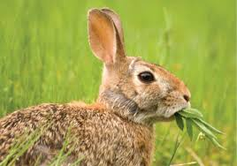
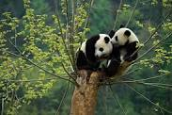
3 Consumers or Heterotrophic organisms
The herbivores are the primary consumers in the ecosystem. These solely feed upon vegetation or plants. A deer or rabbit is a primary consumer in a forest and a rat in the gardens. Protozoans, Crustaceans and mollusks are the primary consumers of the pond or lake or sea and feed upon the floating algae. Insects, rodents and ruminants are the major herbivores of terrestrial environment.

Slide 9
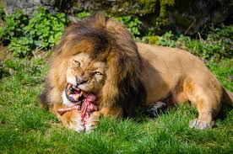
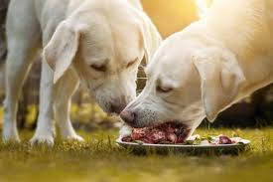
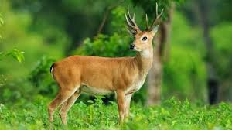
SECONDARY CONSUMERS
Secondary consumers-The primary carnivores or the omnivorous animals( wolves, dogs, cats, foxes, etc.)
Tertiary consumers-secondary carnivores or the animals which feed upon the carnivorous animals
, lions which feed upon the wolves, cattle, deer, etc. are the secondary carnivores.

Slide 10
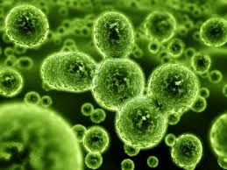
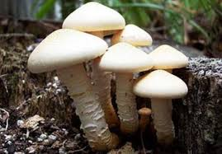
4 Decomposers
Micro-organisms (bacteria and moulds) are decomposers of the ecosystem.
These feed upon dead decaying living organisms (both plants and animals) and break them into simpler compounds.

Slide 11
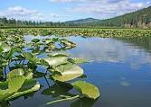
Nomenclature of Ecosystems
The terrestrial ecosystems -cropland ecosystem, grassland ecosystem, forest ecosystem and desert ecosystem
Fresh water ecosystems - pond ecosystems, lake ecosystems and river ecosystems etc.
marine ecosystem-largest and most uniform system

Slide 12
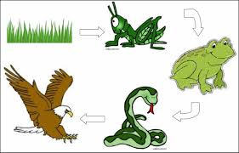
. Food Chain
Different organisms of an ecosystem i.e. plants and animals are linked together by their nutritional requirements. A food chain can, therefore, be defined as a group of organisms in which there is a transfer of food energy through a series of repeated eating and being eaten (Egerton, 2007).

Slide 13
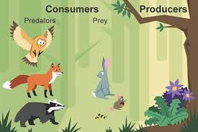
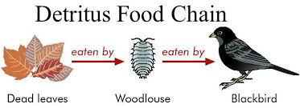
Various types of food chain
The predator food chain
Parasitic food chain
Saprophytic food chain:

Slide 14
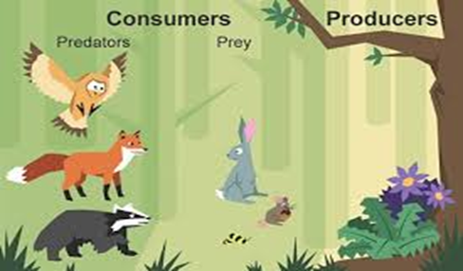
The predator food chain
The predator food chain starts with herbivores (the plant base) and goes from smaller to larger predators, i.e it includes herbivores as the primary consumers (second trophic level) and predators as the secondary and tertiary consumers, but the size of the predator increases at each level in the food chain.

Slide 15
Parasitic food chain
The parasitic food chain also starts with the herbivores but food energy passes from larger to smaller organisms. Therefore, the lager animals are the host and the small animals which fulfill their nutritional requirement from the host are described as parasites.

Slide 16
Saprophytic food chain:
The saprophytic food chain exhibits transfer of energy from dead organic matter of decaying animal and plant bodies to microorganisms.

Slide 17
. Food Web
Interlocking pattern of several food chains is known as food web.
food chains are not isolated sequences but are interconnected with one another.
Food web may be defined as the relationship in which a predator eats several types of food and every kind of food is eaten by many different organisms and is the outcome of the interaction between different types of food chains (Egerton, 2007; Orlove,1980).).

