Slide 1
13-Selection and organisation of learning experiences

Slide 2
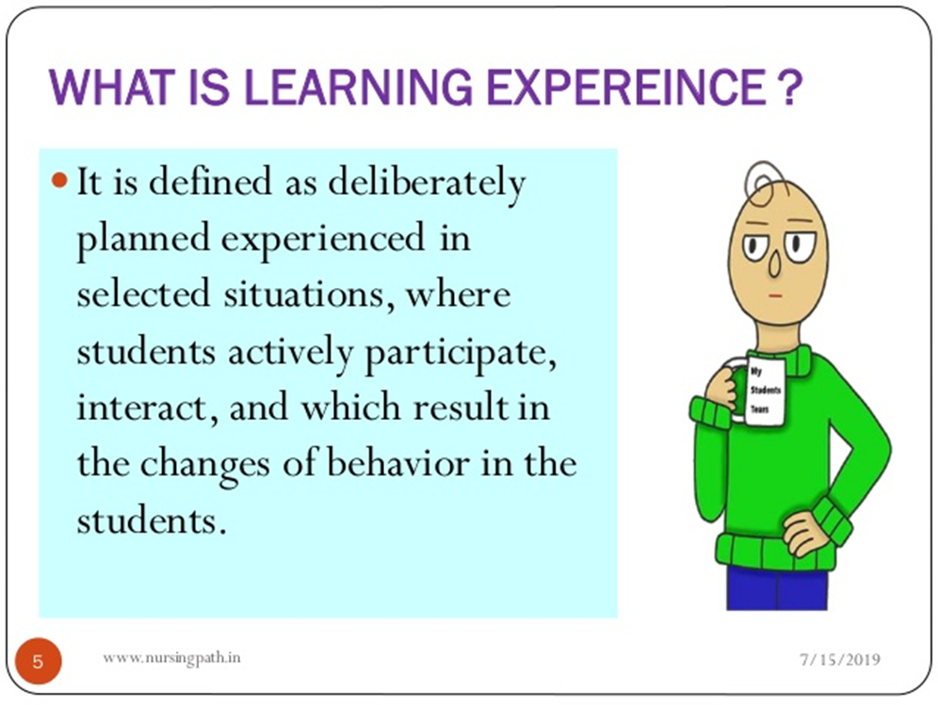

Slide 3
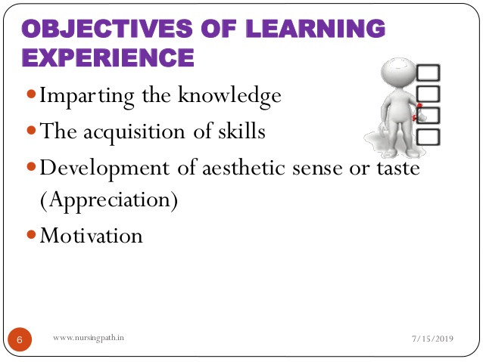

Slide 4
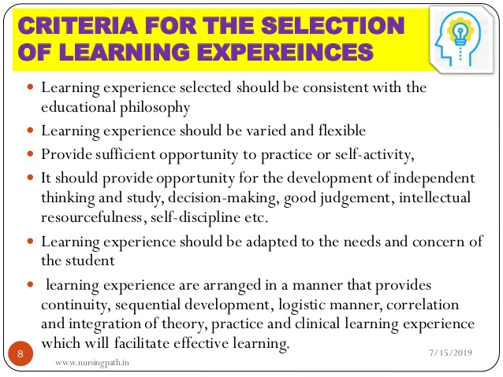

Slide 5
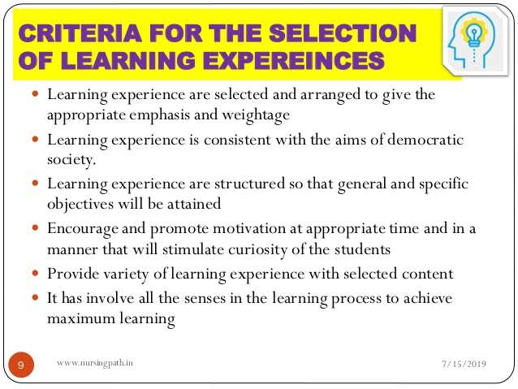

Slide 6
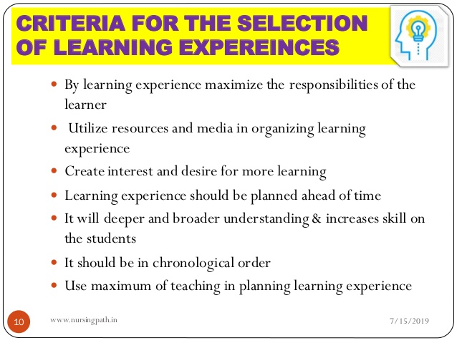

Slide 7
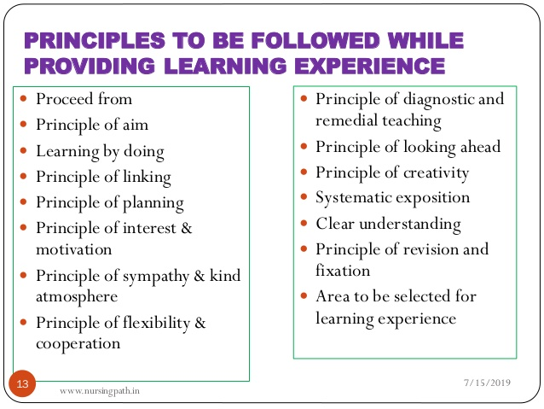

Slide 8
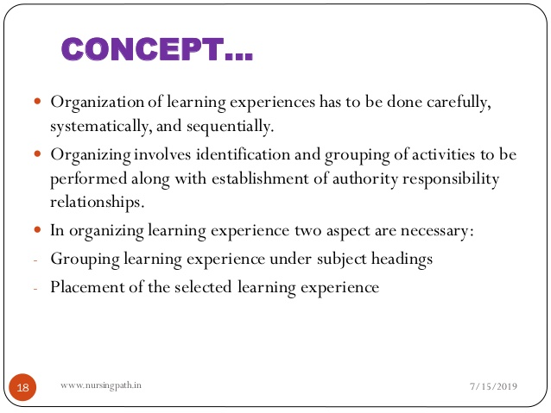
ORGANISATION OF LEARNING EXOERIANCES

Slide 9
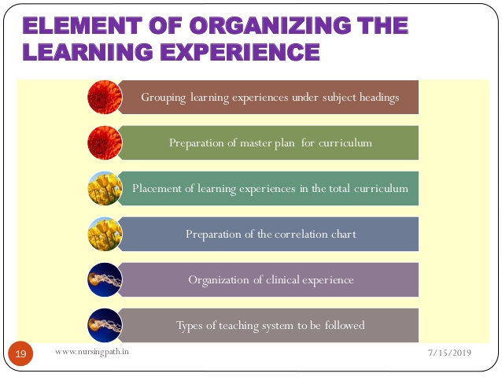

Slide 10
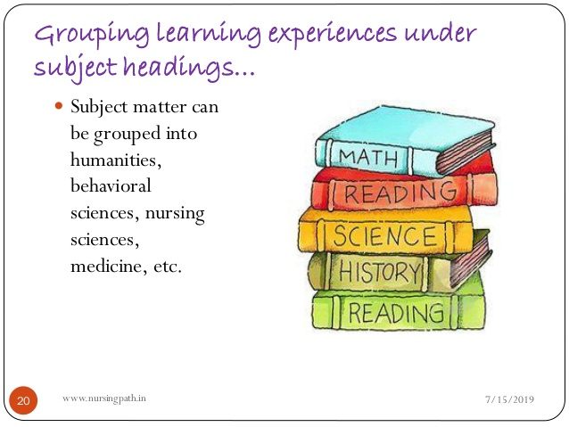

Slide 11
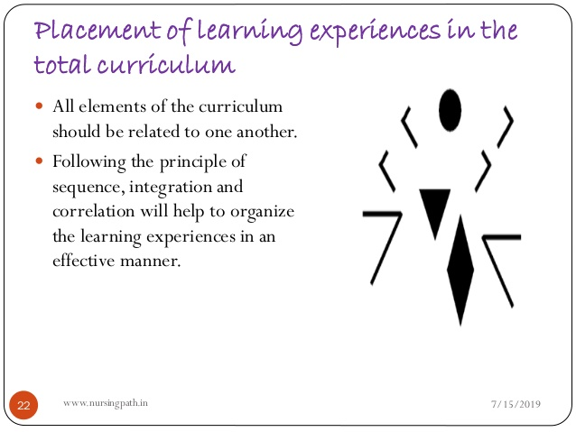

Slide 12
15--Curriculum implementation
Curriculum implementation entails putting into practice the officially prescribed courses of study, syllabuses and subjects.
The process involves helping the learner acquire knowledge or experience.
It is important to note that curriculum implementation cannot take place without the learner

Slide 13
Implementation takes place as the learner acquires the planned or intended experiences, knowledge, skills, ideas and attitudes that are aimed at enabling the same learner to function effectively in a society

Slide 14
Curriculum implementation refers to how the planned or officially designed course of study is translated by the teacher into syllabuses, schemes of work and lessons to be delivered to students.

Slide 15
Factors that Influence Curriculum Implementation
▪ Curriculum Implementation Influence on Teachers
▪ Curriculum Implementation Influence on Learners
▪ Curriculum Implementation Influence by Resource
Materials and Facilities
▪ Curriculum Implementation Influence on Interest of
Groups
▪ Curriculum Implementation Influence on the School
Environment

Slide 16
Curriculum Implementation Influence due to Culture and Ideology
▪ Curriculum Implementation Influence through Instructional Supervision
▪ Curriculum Implementation Influence by Assessment .

Slide 17
The Teacher
Role of teacher in curriculum implementation as an autonomous one.
Teacher select and decide what to teach from the prescribed syllabus or curriculum.
Implementation takes place through the
interaction of the learner and the planned learning opportunities, the role and influence of the teacher in the process is indisputable.

Slide 18
The Learners
Learners are also a critical element in curriculum implementation. While teachers are the arbiters of the classroom practice, the learners hold the key to what is actually transmitted and adopted from the official
curriculum.

Slide 19
The School Environment
One other factor that influences curriculum implementation concerns the particular circumstances of each school.
Schools located in rich socio-economic environments and those that have adequate human and material resources can implement the curriculum to an extent that would be difficult or impossible for schools in poor economic environments.

