Slide 2
Curriculum Theory
The three models of curriculum described in the article are curriculum as product, curriculum as process, and curriculum as praxis.

Slide 3
Curriculum as a product
Curriculum as a product there were certain skills to master and facts to know. Knowledge was seen as something similar to a product that is manufactured.
There was a series of steps leading to the product, and curriculum could be designed accordingly. The steps were:

Slide 4
Step 1: Diagnosis of need
Step 2: Formulation of objectives
Step 3: Selection of content
Step 4: Organization of content

Slide 5
step 5: Selection of learning experiences
Step 6: Organization of learning experiences
Step 7: Determination of what to evaluate, and the ways and means of doing it.

Slide 6
Here are some of the problems with the product orientation:
Students are generally left out of the picture.
The objectives are not clear.
Students are not be able to solve unanticipated problems that arise.

Slide 7
Curriculum as process sees curriculum as what actually happens in the classroom and what things are done to prepare.
The process model is driven by general principles and focuses on meaning-making.

Slide 8
Some possible drawbacks or problems include an issue for those who want “some greater degree of uniformity in what is taught, a lack of attention towards context, and dependency on the quality of teachers.

Slide 9
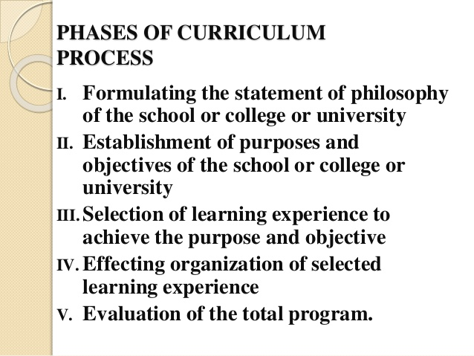

Slide 10
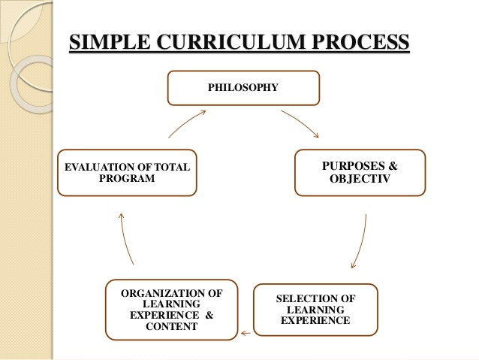

Slide 11
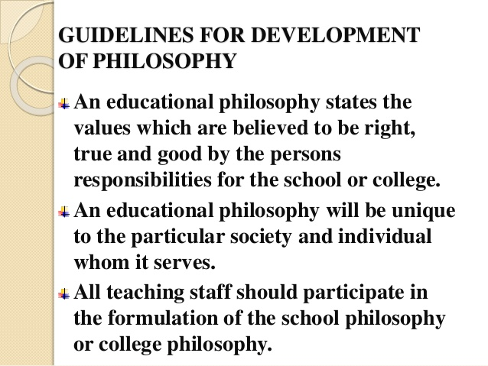

Slide 19
Curriculum as a praxis
Praxis is the process by which a theory, lesson, or skill is enacted, embodied, or realized. "Praxis" may also refer to the act of engaging, applying, exercising, realizing, or practicing ideas.
Praxis is used by educators to describe a recurring passage through a cyclical process of experiential learning .

Slide 20
Curriculum as Praxis
Scott and Marshall (2009) refer to praxis as "a philosophical term referring to human action on the natural and social world".
First, the notion of curriculum as praxis holds that practice should not focus exclusively on individuals alone or the group alone, but pays careful attention to the way in which individuals and the group create understandings and practices, as well as meaning making.

Slide 21
For example, explore the experiences of different cultural and racial groups in society, as well as focus on individual attitudes.

Slide 22
Second, we could be looking for a commitment expressed in action to the exploration of educators' values and their practice. Are they, for example, able to say in a coherent way what they think makes for human well-being and link this with their practice?

Slide 23
Third, we could expect practitioners committed to praxis to be exploring their practice with their peers.
In other words, their beliefs and values would be reflected in the work they do.

Slide 24
Praxis may be described as a form of critical thinking and comprises the combination of reflection and action. Praxis can be viewed as a progression of cognitive and physical actions:
Taking the action
Considering the impacts of the action
Analysing the results of the action by reflecting upon it

Slide 25
Altering and revising conceptions and planning following reflection
Implementing these plans in further actions
This creates a cycle which can be viewed in terms of educational settings, learners and educational facilitators.

