Slide 1
Curriculum development
Curriculum development is defined as planned, purposeful, progressive, and systematic process in order to create positive improvements in the educational system. Every time there are changes or developments happening around the world, the school curricula are affected.

Slide 2
The curriculum development process systematically organizes what will be taught, who will be taught, and how it will be taught. Each component affects and interacts with other components.

Slide 3
Issues in curriculum development- centralised v/s decentralised
Centralized curricula tend to be more structured and orderly
It ensure uniformity and a standard approach to teaching and learning.
The decentralized curricula tend to be more appropriate to students' local needs and often ensure better ownership of the course by teachers.

Slide 4
Centralization and decentralization apply to all essential education sector functions including planning and plan implementation monitoring, budget and financial management, personnel management, academic management, and provision of infrastructure including procurement.

Slide 5
Planning and Plan Implementation and Monitoring
Central government retains the function of national policy setting and national planning, including long-term and medium-term planning, annual action plans and linked to annual budgeting which is undertaken at sub-national level.

Slide 6
Strategic planning functions are the responsibility of regional or provincial entities. For education levels considered strategic, school mapping remains a centralized function while responsibilities have been devolved to lower tiers of government for primary education.

Slide 7
As decentralization proceeds, increasingly information come from certain monitoring and evaluation systems grow in education sectors all over the world sometimes reversing some of the potential benefits of decentralization through increased bureaucratization and control.

Slide 8
Budget and Financial Management
Budget preparation and allocation, expenditure management and monitoring are often a shared responsibility between central and decentralized levels of government.
The Ministry of Education is not involved in the budget allocation process.
The largest share (80 percent and more) of the total public recurrent budget for education is executed through the budgets of local level governments.

Slide 9
Education financing is already much more decentralized than other areas of government activity
Granting resource allocation and budget execution autonomy to local level governments makes achieving of national education targets difficult.

Slide 10
The annual incremental increases in the education budgets have been shifted to local level authorities .

Slide 11
Personnel Management
The decision power on key personnel management functions, in particular the distribution of posts, remains the central government’s most decisive instrument to orient national plan implementation and influence local planning decisions.

Slide 12
Academic Management
Government retains central control over the contents of learning and standards through the curriculum.
Decentralization of academic management functions is limited to extra-curricular activities with local contents, flexibility with timetables to implement a prescribed core curriculum, authorization to select reading materials

Slide 13
Learning performance assessment policies, including national examination systems and standardized entry requirements into higher levels of education, act as strong centralizing elements even in systems with a high level of school autonomy.

Slide 14
Provision of Infrastructure
Functions associated with infrastructure planning, financing, maintenance have been largely decentralized to lower levels of government and local communities. They concern primarily capital expenditure.

Slide 15
A centralized curriculum may allow better access to a wide pool of expertise but be less sensitive to local needs.
The decentralized curricula tend to be more appropriate to students’ local needs and often ensure better ownership of the course by teachers.
Decentralization can allow for a variety of approaches to design and delivery and enable comparisons of the strengths and weaknesses of each.

Slide 16
Diversified Teacher Competencies
Competencies are the skills and knowledge that enable a teacher to be successful.
To maximize student learning, teachers must have expertise in a wide-ranging array of competencies in a complex environment where hundreds of critical decisions are required each day.

Slide 17
The transformational power of an effective teacher many of us have experienced. Intuitively, the link between teaching and student academic achievement may seem obvious.
Four classes of competencies :-
Instructional delivery
Classroom management
Formative assessment
Personal competencies (soft skills).

Slide 18
Better learning happens in a dynamic setting in which teachers offer explicit active instruction , control over content and pace of instruction to students .

Slide 19
The following are hallmarks of an explicit approach for teachers:
Teacher selects the learning area to be taught.
Teacher sets criteria for success.
Teacher informs students of criteria ahead of the lesson.
Teacher demonstrates to the students successful use of the knowledge/skills through modelling.
Teacher evaluates student acquisition.
Teacher provides remedial opportunities for acquiring the knowledge/skills, if necessary.
Teacher provides closure at the end of the lesson.

Slide 20
ISSUES
A common complaint of an explicit instruction approach is that it does not offer sufficient opportunities for students to build on acquired knowledge/skills in creative and novel ways that help them to assimilate the material.

Slide 21
In order to effectively engage with students from diverse backgrounds, teachers require the relevant knowledge and understanding, attitudes, values, skills and dispositions.
Their efficacy also depends on their awareness of their own perspectives, assumptions and biases, and their ability to empathise with students from different backgrounds.
Competent teaching treats diversity as an asset and a source of growth, rather than a hindrance to performance.

Slide 22
Teachers also need a high level of professionalism to select and modify methods that will meet the needs of diverse student populations; to critically evaluate the representation of diversity in teaching materials; and to systematically reflect on the impact of their own practice.
professional autonomy and latitude, which empower teachers to take charge of developing their pedagogical competency

Slide 23
Problems of curriculum load
Any attempt to raise educational standards simply by adding more and more content may lead to the problem of curriculum load.
The problem has been discussed extensively by several committees, with several recommendations on reducing the academic burden on the students.
The problem has grown more acute with the passing time and increased competition.

Slide 24
The most common being behaviour problems and academic under achievement.
Children attending pre- schools carrying a bag full of books and notebooks.
Both the child and the teacher have lost the ‘joy of learning’.
stress in the children

Slide 25
Beneficiaries and functionary of curriculum
One of the main objectives of curriculum development is to assist the beneficiaries to become active and productive group members and leaders.
Participation of functionary and beneficiaries in curriculum leads to the satisfaction of basic human needs and a meaningful participation leads to economic and social change.

Slide 26
For the proper curriculum development many kinds of expertise are needed.
The educators should be knowledgeable about recent changes in subject matter and also learning theories.
To encourage group promoters and other supporting staff to adjust their standard training to meet the need of the rural poor.

Slide 27
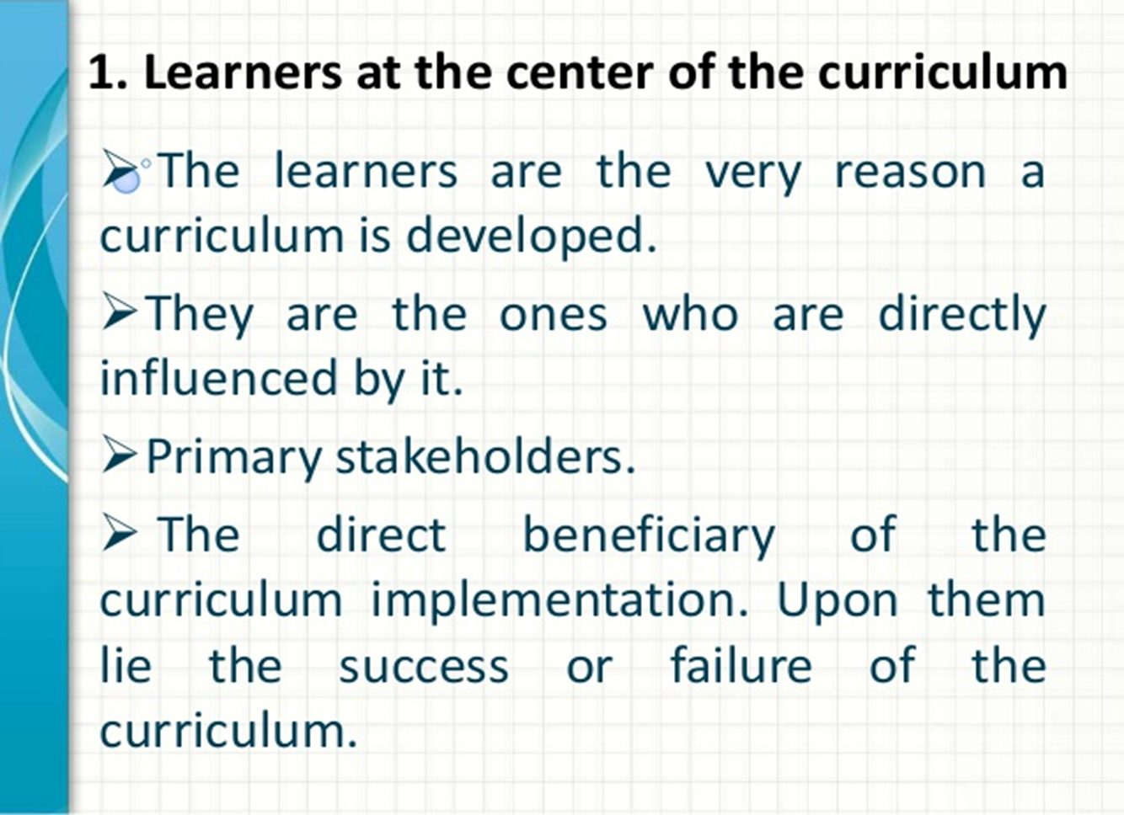

Slide 28
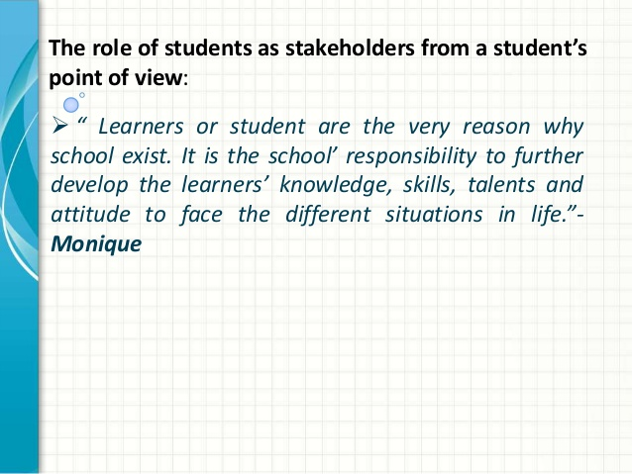

Slide 29
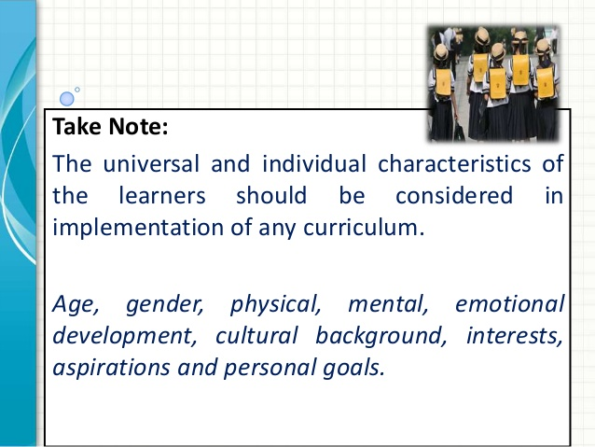

Slide 30
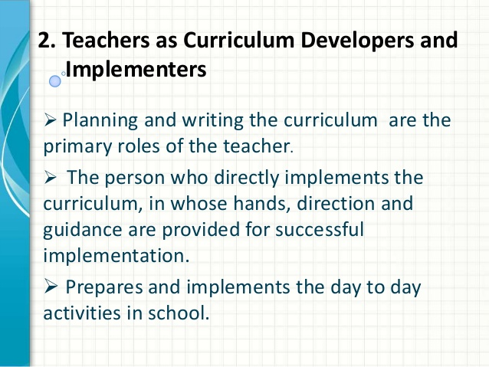

Slide 31
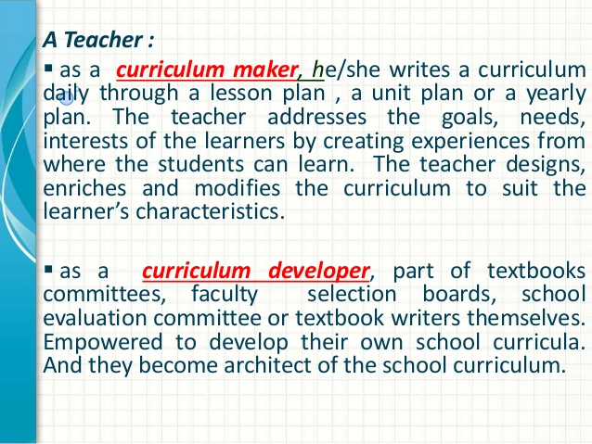

Slide 32
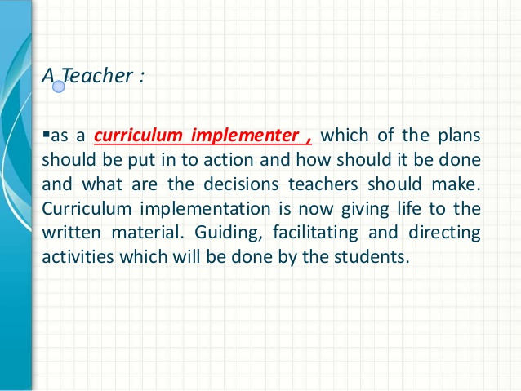

Slide 33
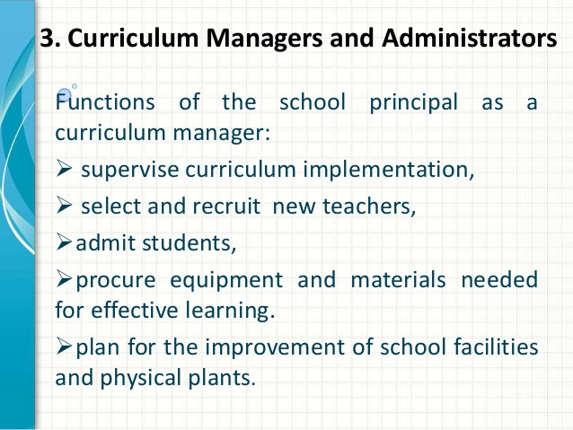

Slide 34
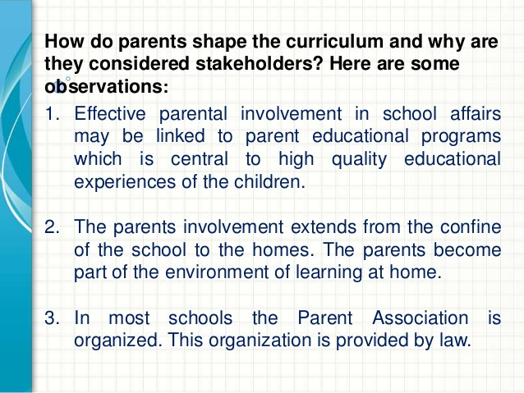

Slide 35
