Slide 1
MODELS OF CURRICULUM DEVELOPMENT
Way of planning curricula to optimize students' learning and to allow them to increase their output.
A plan for structuring the learning environment and coordinating the elements of personnel, materials, and equipment.
A complex unity of parts organized to serve a common function.
The actual engineering and construction of the curriculum is the development of curriculum.

Slide 2
The success of our educational endeavours rests on careful planning, without which disorder and chaos will result.
The need to plan effective curricula cannot be denied. From such curriculum plans a model for curriculum development will emerge.

Slide 3
For the construction of a curriculum thought has to be given to goals, content, learning
experiences, methods and evaluation.
Curricular approaches also focus on different aspects like subject matter, learners and society.
Hence there are various ways to define curriculum-development for which several models can be developed.

Slide 4
Most models can be classified as either technical or scientific models and non-technical or non-scientific .
subject matter approaches adopt the scientific or technical model to curriculum development

Slide 5
Advocates of learner-centred and problem centred designs formulate non-technical or non-scientific curriculum designs.

Slide 6
Technical-Scientific Models .
According to this point of view, "Curriculum development.. is basically a plan for structuring the environment to coordinate in an orderly manner the elements of time, space. materials, equipment and personnel."

Slide 7
To optimize students' learning and to allow them to increase their output.
A plan for structuring the learning environment and coordinating the elements of personnel, materials, and equipment.
A complex unity of parts organized to serve a common function.

Slide 8
Technical-Scientific model.
Taba's Model
Hilda Taba believed that teachers should create specific teaching-learning situations for their students.
They should adopt an inductive approach to teaching i.e. from - specific to general rather than the traditional deductive approach.

Slide 9
Tabs's grassroots model has seven steps.
Diagnosis of needs - Identify needs of the students for whom curriculum is to be planned.
Formulation of Objectives - Specify the objectives by which needs will be fulfilled
Selection of Content - Select subject matter based on objectives and determine validity of the chosen content.

Slide 10
Organisation of content - Arrange the content in a particular sequence keeping in mind the maturity of learners, academic achievement, interests etc.
Selection of learning experiences - Facilitate interaction of learners with content through appropriate instructional methodology.

Slide 11
Organization of learning activities - The learning activities be organized in a sequence depending both on content sequence and learner
Evaluation - To assess the achievement of learning objectives, evaluation procedures need to be devised.

Slide 12
weaknesses are as follows:
The model has employed the concept of participatory democracy to a highly technical, complex and specialized process, and this will not guarantee effective curricula.

Slide 13
Teachers haven’t the time and expertise to engage in such extensive curricular activities. (Hunkins and Omstein, 1988.)

Slide 14
RALF TYLOR MODEL
Fundamental Questions in Developing Curriculum
What educational purposes should the school seek
to attain?
What educational experiences can be provided that
are likely to attain these purposes?
How can these educational experiences be
effectively organized?
How can we determine whether and to what extent
these purposes are being attained?

Slide 15
Tylor’s Curriculum Development Model
Behavioural Model published by Ralph Tyler in 1949.
Tyler model is deductive; it proceed from the general (e.g., examining the needs of society) to the specific (e.g., specifying instructional objectives).
Furthermore, the model is linear; it involve a certain order or sequence of steps from beginning to end.

Slide 16
The model is prescriptive; it suggest what ought to be done and what is done by many curriculum developers.
It is more “society centred.” This model positioned the school curriculum as a tool for improving community life. Therefore, the needs and problems of the social-issue is the source of the main curriculum.

Slide 17
There are three forms of resources that can be used to formulate the purpose of education, i.e. individuals (children as students), contemporary life, and expert consideration of field of study.
There are four fundamental things that are considered to develop a curriculum, which is the purpose of education who wants to be achieved, learning experience to achieve the goals, learning organizing experiences, and evaluation.

Slide 18
Objectives of the Learning Experience
Studies of contemporary life provided information for learning objectives.
He defines the learning objectives in terms of knowledge, communication skills, social and ethical perspective, quantitative and analytical skills, and taxonomy.

Slide 19
Educational objectives originate from three sources: studies of society, studies of learners, and subject-matter specialists.
These data systematically collected and analysed form the basis of initial objectives to be tested for their attainability and their efforts in real curriculum situations.

Slide 20
Defining learning experience.
The term “learning experience” refers to the interaction between the learner and the external conditions in the environment to which he can react.
A learning experience is to some degree a function of the perceptions, interests, and previous experiences of the student.

Slide 21
Principles
Principles in determining student learning experiences, which are:
(a) students experience must be appropriate to the goals you want to achieve,
(b) each learning experience must satisfy the students,
(c) each design of student learning experience should involve students, and
(d) in one learning experience, students can reach different objectives.

Slide 22
organizing of learning activities for attaining the defined objectives.
Three major criteria are required in building organized learning experiences: Continuity, sequence, and integration.
Students need concrete experiences to which the readings are meaningfully connected.

Slide 23
The principle of continuity means that the learning experience given should have continuity and it is needed to learning experience in advance.
The principle of sequence means learning experience given in class five should be different with learning experiences in the next class.

Slide 24
The principle of integration means that the learning experience provided to students must have a function and useful to obtain learning experience in other sectors.
For example, learning experience in Arabic language must be able to get help learning experience in the field of other studies.

Slide 25
Evaluation and Assessment of the Learning Experiences
curriculum evaluation is the process of matching initial expectations in the form of behavioural objectives with outcomes achieved by the learner.
There are two functions of evaluation.
First, the evaluation used to obtain data on the educational goals achievement by the students (called the summative function).
Second, the evaluation used to measure the effectiveness of the learning process (called the formative function).

Slide 26
Tyler asserts, “The process of evaluation is essentially the process of determining to what extent the educational objectives are actually being realized by the program of curriculum and instruction”.
Tyler believes that all evaluation must be guided by a purpose and be sensitive to the uniqueness of the individual being assessed.

Slide 27
Tyler states, “Education is a process of changing the behaviour patterns of people” . He values the individual learner.

Slide 28
The Saylor ,Alexander and Lewis Model
Galen Saylor ,William Alexander and Lewis (1974) viewed curriculum development as consisting of four steps.
curriculum is “a plan for providing sets of learning opportunities to achieve broad educational goals and related specific objectives for an identifiable population served by a single school centre”.

Slide 29
Goals, Objectives and Domains
Each major goal represents a curriculum domain and they advocate 4 major goals or domains: personal development, human relations, continued learning skills and specialisation.
The goals, objectives and domains are selected after careful consideration of several external variables such as findings from educational research, views of community groups and others.

Slide 30
Curriculum Designing:
Curriculum be designed along the lines of academic disciplines, or according to student needs and interests .
Curriculum Implementation:
Based on the design of the curriculum plan teachers would specify instructional objectives and then select relevant teaching methods and strategies to achieve the desired learning outcomes among students in the classroom.

Slide 31
Evaluation:
Evaluation should involve the total educational programme of the school and the curriculum plan, the effectiveness of instruction and the achievement of students.
Through the evaluation process, can determine whether or nor the goals and the objectives of instruction have been met.

Slide 32
Non-scientific model to curriculum
A minority of educators support a non-scientific approach to curriculum development, which is seen as personal, subjective, transactional, and aesthetic, and focuses on the learner .
Supporters of non-scientific models see learning as a holistic process rather than as segmented subject.

Slide 33
Features:
Stress the subjective, personal, aesthetic, heuristic, and transactional.
Stress the learner through activity-oriented approaches to teaching and learning.
Curriculum evolves rather than being planned.
The persons most involved with the curriculum (learners).
Focuses on individual's self-perceptions and personal preferences, their own assessments of self-needs, and their attempts at self-integration.

Slide 34
Glatthorn's - Non scientific model
Glatthorn's model is an example of a linear and rational curriculum development model.
The model recognizes the importance of using multiple sources in developing curriculum standards.
The use of benchmarks to improve, refine, and validate curriculum standards is an equally good practice in curriculum development.

Slide 35
Glatthorn Intended for developing curriculum standards for any discipline from basic education to higher education.
Develop standards.
1. Using multiple sources.
2. By eliminating and combining.
3. Secure teacher input.
4. Essential Standards and Enrichment Standards

Slide 36
Develop benchmarks.
1. Content emphases
.2. Identify standards.
3. By taskforce or by teachers.
4. Initial draft of benchmarks.
Develop final products.
1. Scope and sequence chart.
2. Decide on guide content.
3. Analyse into learning objectives

Slide 37
Glatthorn's model is an example of a linear and rational curriculum development model.
The model recognizes the importance of using multiple sources in developing curriculum standards.
The use of benchmarks to improve, refine, and validate curriculum standards is an equally good practice in curriculum development.
Its relevance and applicability in any educational institution in developing curriculum standards for various courses.

Slide 38
Weinstein and Fantini model
Gerald Weinstein and Mario Fantini (1970) link socio-psychological factors with cognition, so learners can deal with their problems and concerns.
For this reason, authors consider their model a “curriculum of affect.”
The model stresses to identify the learners demographic details and their concerns.

Slide 39
The teacher attempts to develop student-centred strategies for instruction to meet learners’ concerns and organize contents rather than on the demands of subject matter.

Slide 40
They further emphasizes that the content should be organized according to the learners: life experiences, their attitudes and feelings, and the social context in which they live.
Teaching procedures should be developed for learning skills, content, and organizing ideas.
Teaching procedures should match the learning styles on their common characteristics and concerns.
Finally, the teacher evaluates the outcomes of the
curriculum: cognitive and affective objectives.

Slide 41
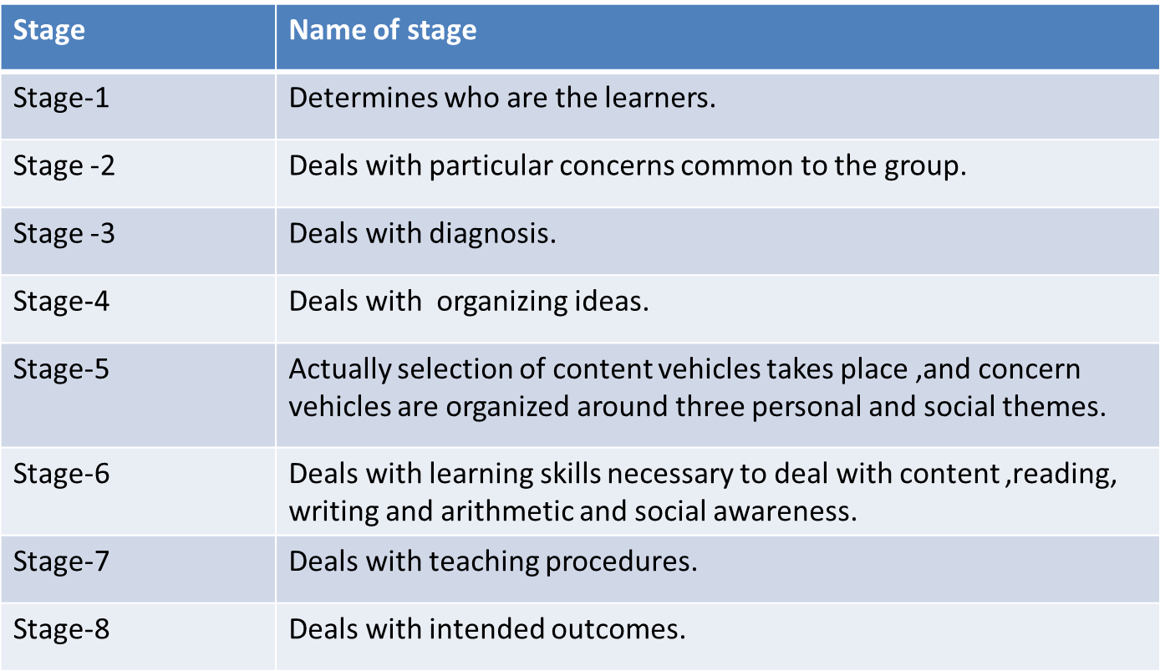

Slide 42
Doll
Doll (1993) provides a more complete view and argues for the construction of a postmodernist curriculum, which contains several elements:
Teachers and learners can develop their own curriculum through continuous interaction.
The curriculum needs to enhance self-organisation by being rich in diversity, problamatics and heuristics, and a classroom atmosphere, which encourage exploration.

Slide 43
Curriculum theories are based on the simple, stable and cognitive vision of teaching, education is the stable, closed and equilibrated system.
Education is a process composed of the interaction of multiple elements.

Slide 44
The curriculum has to empower both the teachers and the learners, thus creating an environment where they can engage in constructive dialogues.
The curriculum should encourage interpretation, rather than explanation of knowledge.

Slide 45
The curriculum should adopt developmental planning, which allows for greater flexibility and modification.
Evaluation will be an interactive process, in which feedback is provided to the learner.
Communities’ support is required to help the
learner through constructive critiques.

Slide 46
Four criteria to check the quality of a postmodernist curriculum.
They are richness, recursion, relationships and rigor.
Richness is about the interactive nature of the curriculum, which allows teachers and learners to interact and develop the richness that is appropriate to the context.

Slide 47
Recursion is about the interactive nature between the learner and the knowledge. The
learner is always reflecting the knowledge.
Relationships are about interactions in two dimensions. One is ‘pedagogical relationships’, which emphasises interactions among the curriculum structure.
The other is ‘cultural relationships’, which focuses on the interactions among the
curriculum with the local as well as global context.

Slide 48
Rigor deals with the continuous interactions among concepts and theories. The attitude towards curriculum is one that constantly entails rigorous exploration and interpretation.

Slide 49
Doll argue that power needs to be redistributed from the planners at the ‘top’ to the teachers and students at the ‘bottom’.
This resonates with the concepts of decentralisation and empowerment in the management discipline.
Doll’s model is a manifestation that power needs to lie in the hands of teachers and learners.

Slide 50
Humanistic Curriculum
A curriculum based on intercultural education that allows for the plurality of society to ensure a balance between pluralism and universal values.
A humanistic curriculum is also a curriculum
that works for the common good and nation good.
The humanistic approach engages social skills, feelings, intellect, artistic skills, practical skills, and more as part of their education.

Slide 51
Carl Rogers has been called the "Father of
Humanistic Psychology" and devoted much of
his efforts toward applying the results of his
psychological research to learner -centred
teaching where empathy, caring about
students, and genuineness on the part of the
learning facilitator were found to be the key
traits of the most effective teacher.

Slide 52
Characteristics
The learner as human being has prime
significance for the Humanistic Curriculum.
Aims at development and realization of
complete human personality of the student.
The humanistic curriculum does not take
student as subservient to society, history or
philosophy but as a complete entity.

Slide 53
education succeeds in development of needs,
interests, and aptitudes of every individual,
The students will willingly and intelligently cooperate
with one another for common good.
This will ensure a free and universal society with
shared interests rather than conflicting ones.
Thus humanists stress on individual freedom and
democratic rights to form global community.

Slide 54
The education is good for a person is also
best for the well being of the nation.
The individual learner is not regarded as a
passive or at least easily managed recipient of input
She/he is the choosing or self-selecting organism.

Slide 55
Self-understanding, self-actualization, and
fostering the emotional and physical well
being as well as the intellectual skills necessary for independent judgment become the immediate concern of the Humanistic Curriculum.
To the humanists, the goals of education are
related to the ideals of personal growth, integrity, and autonomy.

Slide 56
Healthier attitudes towards self, peers, and
learning are among their expectations.
curriculum for consciousness are the important types of humanistic curriculum.
Socrates, Plato, Aristotle, Locke, Rousseaue,
Kant, and Pestalozzi are some of the great
humanists of the world history.

Slide 57
Humanistic teacher
The humanist teacher is a facilitator, not a
disseminator, of knowledge.
Participatory and discovery methods would be favoured instead of traditional didacticism (every thing the teacher says).
As well as the child's academic needs the
humanistic teacher is concerned with the child's
affective (or emotional) needs.
Feeling and thinking are very much inter linked. Feeling
positive about oneself facilitates learning.

Slide 58
Much of a humanist teacher's effort would be put into developing a child's self-esteem.
It would be important for children to feel good about themselves (high self-esteem), and to feel that they can set and achieve appropriate goals (high self-efficacy).
This form of education is known as child- centred and is typified by the child taking responsibility.

Slide 59
Reinforcement such as praise, and punishment in the form of negative criticism both praise and blame are rejected by the humanists.
• Children can become addicted to praise, and
put much effort into receiving praise from their teachers.
.

Slide 60
Psychological basis of humanistic curriculum
• Humanistic education is an approach to education based on the work of humanistic psychologists, most notably Abraham Maslow and Carl Rogers.
• Carl Rogers has been devoted much of his efforts toward applying the results of his psychological research to Learner -centred teaching where empathy, caring about students, and genuineness on the part of the learning facilitator were found to be the key traits of the most effective teachers.

Slide 61
Curricula focused solely on academics is incomplete, and that it is the responsibility of teachers to address the needs of the whole child, including social and emotional learning.

