Slide 1
unit 15-Life Skills Education in Schools
Activities like critical thinking, creative art & craft work, decision-making, problem-solving, an ability to collaborate & communicate along with a sense of responsibility towards personal as well as society at large, to contribute good citizenship comes under Life Skill.
schools provide their students basic mental, social & physical skills to make them ready for leading a better after-school life.

Slide 2
Importance of Life Skills
Bring positive effects in the life of an individual.
Essential to gain success not only for a healthy society but also for successful individuals.
Helps children to build a stronger foundation for a thriving future on the academic as well as at the professional front.
To cope up with the increasing pace and change of present-day life, students need to learn life skills.
Introduction to skill training at a young age will by all means give the student an opportunity to explore various options and accordingly, narrow down on a vocation of his/her liking.

Slide 3
Life skills help adolescents to transit successfully from childhood to adulthood by healthy development of social and emotional skills.
It helps in the development of social competence and problem solving skills, which in turn help adolescents to form their own identity.
It helps to weigh pros and cons of the situation, hence, act as a mediator to problem behaviour.
It promotes positive social, norms that an impact the adolescent health services, schools and family.

Slide 4
Life skills
communication skills (verbal and written)
commercial awareness
attitude towards work
lifelong learning
self-management
teamwork
problem solving
initiative

Slide 5
self-motivation
adaptability
stress management
creativity
interpersonal sensitivity
technology/it skills

Slide 6
Benefits
1. Encourages them to take responsibility for what they do, instead of shifting blames.
2. Build confidence both in speaking skills, for group collaboration & cooperation with joint effort and participation.
3. Analyze various alternatives, make decisions and understand why they make certain specific decisions outside the classroom.
4. Develop a greater sense of self-awareness, feeling of mindfulness and an appreciation for other people.

Slide 7
5. The capacity to self-manage, tackle issues while understanding individual responsibilities.
6. Readiness and flexibility to various jobs in adaptable workplaces.
7. Help them develop self-confidence & higher self-esteem.
8. Give them a voice in their group, community, society & at schools.

Slide 8
9. Enable them to make a positive contribution by developing experience & expertise within them.
10. Prepare them for upcoming challenges, difficult situations as well as opportunities in their later life.

Slide 9
Various ways to carry out skill development at school level:
Skill development courses must be provided in the secondary stage of schooling
Many more courses in fields such as Hospitality ,Tourism, Handicraft, Healthcare, Textiles, Photography, IT, Retail, Banking, Insurance can be added that would interest students to learn.

Slide 10
A student opts for healthcare , he could learn to be a blood-collection expert and later can add further courses to become full-fledged pathology technician or nurse.
The pedagogy has to be practical; learning can be enhanced through field visits, e-learning, industry driven projects, digital or video inputs and so on.

Slide 11
Factors that prevent skill development of students:
Emphasis on bookish knowledge.
The curricula do not cover components of employable skills nor is there any option to introduce students to different vocations.
The Indian education system does not consider the component of skilling in its curriculum.
Different boards that follow different systems/curriculum. The two major reasons of skill shortage are lack of faculty and facility.

Slide 12
Professional management skills
Management skills can be defined as certain attributes or abilities that an executive should possess in order to fullfill specific tasks in an organization.
Management skills enables you to manage others effectively.
Managers who can motivate their employees are true assets to their company.
Hiring managers look for leaders who can spot employees' strengths and encourage them to develop their skill sets.

Slide 13
The managers avoiding crisis situations and promptly solving problems when they occur.
Management skills can be developed through learning and practical experience as a manager.
The skills help the manager to relate with their fellow co-workers and know how to deal well with their subordinates, which allows for the easy flow of activities in the organization.

Slide 14
MANAGEMENT SKILLS
Motivation
Problem solving
Professionalism
Communication
Technical skills
Innovation

Slide 15
MOTIVATION:
Empowering employees to take ownership of projects
Creating an energetic and highly motivated workplace
Showing proper appreciation for employee accomplishments
Supporting co-workers who are under stress
Providing rewards and incentives for outstanding performance

Slide 16
Problem solving
Demonstrating resourcefulness in the face of a problem
Anticipating potential issues before they arise
Identifying factors contributing to problems
Interpreting critical industry data
Troubleshooting quickly and efficiently

Slide 17
Professionalism
Providing exceptional customer service with a professional attitude
Identifying diplomatic solutions to workplace issues
Exhibiting strong moral values
Showing initiative
Attending professional development seminars

Slide 18
Communication
Drafting clear and concise training materials
Maintaining open lines of communication with co-workers
Negotiating successfully to resolve employee disputes
Encouraging communication among reticent employees
Leading efficient meetings that are both productive and sensitive to time constraints

Slide 19
Technical skill
Providing customer support Handling data security
Generating reports and drafting presentations with Microsoft Office
Managing website content, social media accounts, or marketing campaigns
Offering technical support to employees and/or customers

Slide 20
Innovation
Developing innovative solutions for customers' needs
Identifying key shortcomings in manufacturing and drafting solutions to boost production
Constructing research models to test new product ideas
Generating fresh ideas for timely marketing campaigns
Redesigning systems for increased productivity or functionality

Slide 21
Management skills are important for many reasons.
They position you to act as an effective leader and problem-solver in so many situations.

Slide 22
UNIT 16-Role of teachers and PTA in curriculum development
Teachers with their knowledge , experience and competencies are central to any curriculum improvement effort.
They are responsible for introducing the curriculum in the classroom and outside the classroom as well.
In order to create strong curriculum teachers must play an integral role in every step of the process.

Slide 23
The teacher should consider carefully the order in which learning targets should be learnt.
With the pre-requisite skills of the children known, the teacher can then design learning materials to help them achieve the target skills.

Slide 24
The most common role a teacher plays in the classroom is to teach knowledge to children.
Teachers teach in many ways including lectures, small group activities and hands-on learning activities. Creating Classroom Environment.
Teachers also play an important role in the classroom when it comes to the environment.

Slide 25
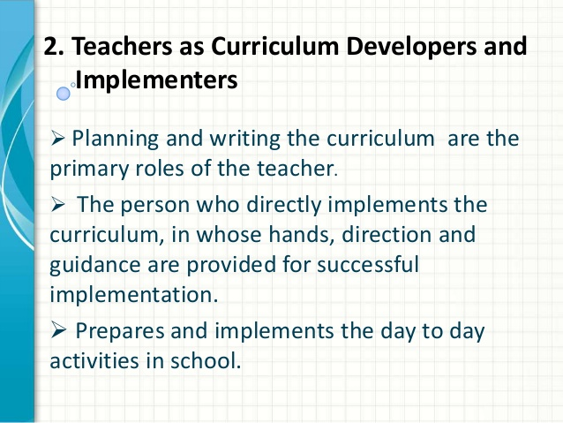

Slide 26
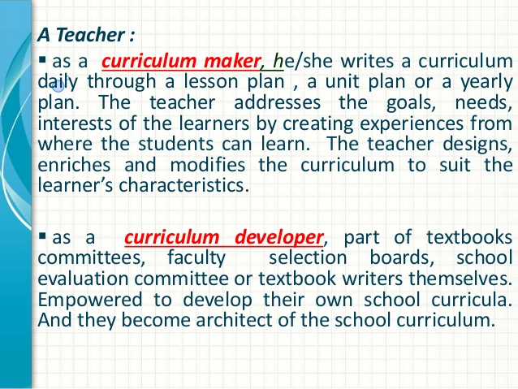

Slide 27
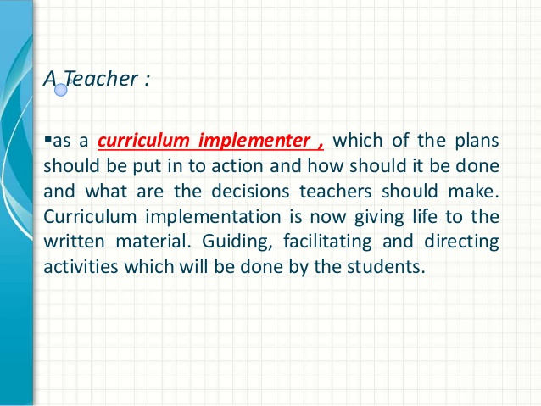

Slide 28
Role of PTA
PTA serves as a channel of communication between the school and the community.
They advise on educational needs as perceived by the parents and promote quality teaching and learning.
PTA formulates school policies towards the achievement of the school objectives.

Slide 29
The PTA is not a body for collective bargaining or a grievance redrassal forum.
A proactive PTA gives appropriate feedback to the school management through the Principal, regarding the functioning of the school.
Parents should provide resources, monitor their wards, and volunteer in school events; develop good relationship with principals and teachers; keep school well informed about homework, curriculum problems, child development; and attend school events.

Slide 30
1, PTA helping teachers to understand family needs;
2) Communication that allows for two-way, open communication between the school and home;
3) Volunteering that recognizes parents’ talents and contributions both in and for the school;
4) Learning at home strategies that engage the family with their children’s school work;
5) Decision making that includes parents as key stakeholders in making decisions that will impact student learning.

Slide 31
Collaborating with the community to create mutual benefit by sharing resources and contributing to both school and community goals.
The PTA can also provide a powerful mediating function, providing a neutral forum for resolving conflicts that sometimes occur in schools around controversial issues.

