Slide 1
social science education
Module Two: Componential Convergence in Social Science (15 hours)
5. Geo-political understanding about Society, Critical geo-political inquiry, Geo-political Economy.

Slide 2
GEO POLITICS
A method of studying foreign policy to understand, explain and predict international political behaviour through geographical variables.
These include area studies, climate, topography, demography, natural resources, and applied science of the region being evaluated.

Slide 3
The word geopolitics was originally coined by the Swedish political scientist Rudolf Kjellén about the turn of the 20th century, and its use spread throughout Europe in the period between World Wars I and II (1918–39) and came into worldwide use during the latter.
Geopolitics has been widely employed as a loose synonym for international politics.

Slide 4
Definition of geopolitics
1: a study of the influence of such factors as geography, economics, and demography on the politics and especially the foreign policy of a state
2: a governmental policy guided by geopolitics
3: a combination of political and geographic factors relating to something (such as a state or particular resources)
the geopolitics of oil

Slide 5
Geopolitics focuses on political power linked to geographic space. In particular, territorial waters and land territory in correlation with diplomatic history. Topics of geopolitics include relations between the interests of international political actors focused within an area, a space, or a geographical element, relations which create a geopolitical system.
Critical geopolitics deconstructs classical geopolitical theories, by showing their political/ideological functions for great powers

Slide 6
According to Christopher Gogwilt and other researchers, the term is currently being used to describe a broad spectrum of concepts, in a general sense used as "a synonym for international political relations", but more specifically "to imply the global structure of such relations“.

Slide 7
Focused on the impact on world politics of the new technologies of the Industrial Revolution.
Geopoliticians sought to understand how the new industrial capabilities of transportation, communication, and destruction—most notably railroads, steamships, airplanes, telegraphy, and explosives—interacting with the largest-scale geographic features of the Earth would shape the character, number, and location of viable security units in the emerging global international system.

Slide 8
Mahan’s historical analysis of the rise of the British Empire was the starting point for the geopolitical debate.
The control of sea routes was decisive because of the superior mobility of the oceanic sailing vessel over animal-powered land transport, Mahan claimed that there was a tendency for maritime trade and colonial possessions to be controlled by one well-positioned maritime state

Slide 9
The emergence of the airplane led some geopoliticians (e.g., Giulio Douhet) to downplay the role of both naval and land power in favour of air superiority. During World War II some even predicted that technological developments would render naval power obsolete.

Slide 10
The popularity of geopolitical theory declined after World War II, both because of its association with Nazi German and imperial Japanese aggression and because the emergence of nuclear explosives and ballistic missiles reduced the significance of geographical factors in the global strategic balance of power.

Slide 11
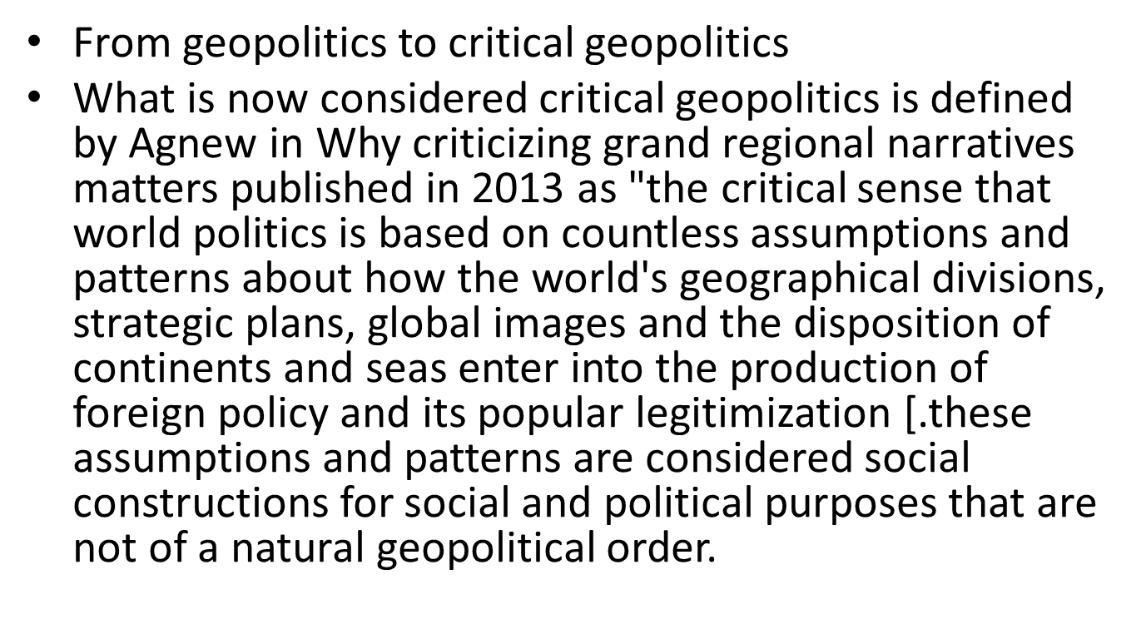

Slide 12
The ideas is a critical view on the discourses conducted in geopolitics. The classical geopolitics of the early 20th century is only one specific example of a geographical mask that hides imperialism or hegemony behind a "naturalized" causality.
Agnew analyzes for the most part the emergence of critical political geography in the United States, but it is not the only one where the term "geopolitics" is reintroduced and used.

Slide 13
FEATURES
The basic concept behind critical geopolitics is that intellectuals of statecraft construct ideas about places; these ideas have influence and reinforce their political behaviours and policy choices, and these ideas affect how people process their own notions of places and politics.

Slide 14
Critical geopolitics is a post-structural approach which insists that rather than being an a political influence on international politics, as conventional accounts of geopolitics would argue, geographical relationships and entities are specific to historical and cultural circumstances.

Slide 15
The meaning of geography can be made to change so that there is a politics to the use of geographical concepts in arguments about international relations. Following Foucault, critical geopolitics analyzes discourses of geography in international relations theory and practice to examine the power relations supported by such representations.

Slide 16
Various attempts have been made to apply the critical geopolitics approach to the analysis of political speeches and policy documents, popular culture, and to go beyond the approach’s origins in textual analysis to provide a critical account of geopolitics which understood the inscription of international politics in the body.

Slide 17
Critical geopolitics questions the way that geographical knowledge about places and spatial strategies and processes is put together and explained. In this sense, “critical” does not mean an outright rejection of something. Instead, it indicates an approach that examines underlying assumptions.

Slide 18
Geopolitical Economy
Geopolitical Economy examines the significance and nature of free trade agreements (FTAs), the primary policy tool through which modern nations seek access to international markets and promote economic growth.
Geopolitical Economy also looks at Korean FTAs through the lens of development strategy.

Slide 19
Geoeconomics
The term includes two aspects: on the one hand, the use of politics means to achieve economic goals.
This comprises the traditional measures of foreign trade policy such as trade and investment agreements, state foreign trade promotion such as export credit insurance, chambers abroad, and delegation trips, but also increasingly governmental interference in securing raw materials.
The use of economic means to achieve political goals: control of markets, trade surpluses and currency reserves, strategic investments, economic sanctions.

Slide 20
Definition of geo-economics
1: the combination of economic and geographic factors relating to international trade
2: a governmental policy guided by Geo-economics
It is understood as the use of economic tools to advance geopolitical objectives.

Slide 21
Geo-economics as the interplay of international economics, geopolitics and strategy.
Geoeconomics entered the lexicon in 1990 with an article by Edward Luttwak, which argued that following the Cold War, the importance of military power was giving way to geoeconomic power.

Slide 22
One reason the term is more commonly used now is the rise of China, which is increasingly using economic tools to project power.
Two other factors are also relevant: the revival of state capitalism and state-owned enterprises means that states have more economic resources at their disposal; and the deep integration of global trade links and financial markets has made Geoeconomic tools more powerful.

Slide 23
6-Social adaptation and Community living – EconomicRestructuring and Living Standards - Values andCulture.
Social adaptation is considered one of the important issues directly linked to human behavior, which is in turn a reaction of an individual trying to achieve harmonization of his motives and needs on one hand, and the requirements of the environment and the different circumstances in the other hand; so he cares about the positive actions that brings satisfaction and leads to more social acceptance, and therefore the ability to adapt in different life situations.

Slide 24
The adaptation process occurs as an interaction between the individual and the surrounding environment in order to satisfy his motives and incentives, which must include a changing process in behaviour to fit the surrounding environment changes, and also must include the feedback behavioural and psychological responses that can adjust his behavior for responding to these changes (Ahmad, 1996).

Slide 25
There are three different types of adaptations
Behavioural - responses made by an organism that help it to survive/reproduce.
Physiological - a body process that helps an organism to survive/reproduce.
Structural - a feature of an organism's body that helps it to survive/reproduce.

Slide 26
Most animals are well adapted to their biotic and abiotic conditions due to behavioural, physiological or structural adaptations that increase their chances of survival and reproduction.
An adaptation is a characteristic of an organism that improves its chances of surviving and/or reproducing.
Organisms are generally well adapted to the abiotic and biotic conditions of the environment in which they live.
An organism’s adaptations are a result of the genes the organism inherits from its parents.

Slide 27
Meanings in different sciences
Psychology “The process that surrounds the unceasing interaction between Man and the dynamic world in which he evolves Equilibration and interacts”.
Sociology Despite intertwined roots with biology, sociology seldom uses the concept of adaptation, preferring the terms Integration acculturation, deviance or even socialization. Nevertheless, the concept of adaptation exists by social adaptation, Socialization which dwells on changes in the individual at the origin of the development of aptitudes, to integrate and acquire Acculturation the feeling of belonging to a group”

Slide 28
Social support will enable them to adapt to the environment better, and a combination of adaptability and social support will have a more positive impact on life satisfaction.
Adaptability from within and social support from others are both important to happiness. Modern society has a rapid rhythm and changes quickly.

Slide 29
Adaptation problem
One widespread argument against the efficacy of subjective well-being as a measure of well-being is the adaptation problem as formulated by Sen and Nussbaum: the phenomenon that people may adapt to deprivation and find satisfaction or happiness in objectively bad circumstances.

Slide 30
Adaptation to climate change is a relatively new and complex challenge – monitoring and evaluation of adaptive capacity and adaptation actions must be carried out with a view to learning, rather than purely assessing the success or failure of an intervention.

Slide 31
Economic restructuring- Living Standards - Values and Culture.
Economic restructuring is used to indicate changes in the constituent parts of an economy in a very general sense.
It is usually used to refer to the phenomenon of urban areas shifting from a manufacturing to a service sector economic base.

Slide 32
Economic restructuring is the process in which economies move from a blue-collar industrial base, especially around heavy industry and factories, into more of a white-collar service sector.
This process is typical in most major American cities, which has produced a thinner middle class and more menial jobs.

Slide 33
Urban areas shifting from a manufacturing to a service sector economic base.
Productive capacities and competitiveness of cities and regions.
This transformation has affected demographics including income distribution, employment, and social hierarchy; institutional arrangements including the growth of the corporate complex, specialized producer services, capital mobility, informal economy, nonstandard work, and public outlays; as well as geographic spacing including the rise of world cities, spatial mismatch, and metropolitan growth differentials.

Slide 34
Demographic impact
Loss of manufacturing jobs and growth of services.
Widening of the social hierarchy occurs where high-level, high-income, salaried professional jobs expands in the service industries alongside a greater incidence of low-wage, low-skilled jobs, usually filled by immigrants and minorities.

Slide 35
Increasing concentration of poverty
Social forms such as the underclass, informal economy, and entrepreneurial immigrant communities
The declining manufacturing sector leaves behind strained blue-collared workers who endure chronic unemployment, economic insecurity, and stagnation due to the global economy's capital flight.
More women enter the labour force usually in the service sector.[

Slide 36
The low-skilled, low-income population faces the loss of opportunities, full participation in society, lack of access in labour market and school, weak position in housing markets, limited political participation, and restricted social-cultural integration.
High-skilled, high-income professionals enjoy social inclusion with modern amenities, conveniences, social participation, and full access to public resources.

Slide 37
The declines in education, health care, and social services and the dearth of jobs
Children become prisoners of home relying on television and other outlets for companionship. Contemporary urban environments restricts the opportunities for children to forge and negotiate peer culture or acquire necessary social skills.

Slide 38
7-ECHO-HABITATION
An Eco-house (or Eco-home) is an environmentally low-impact home designed and built using materials and technology that reduces its carbon footprint and lowers its energy needs.
Eco-homes are measured in multiple ways meeting sustainability needs such as water conversation, reducing wastes through reusing and recycling materials, controlling pollution to stop global warming, energy generation and conservations, and decreasing CO2 emissions.

Slide 39
Eco-friendly house
With the world facing climate change and global warming issues, more and more people are now supporting the creation of sustainable spaces, which are environmentally more sensitive and ecologically less harmful and polluting. Building eco-friendly homes is a step in this direction.
An eco-friendly or a green home is an environmentally low-impact house, exquisitely designed and built using materials and technology that reduces carbon footprint and requires less energy consumption.

Slide 40
An Eco-house could include some or all of the following:
Higher than normal levels of thermal insulation
Better than normal air-tightness
Good levels of daylight
Passive solar orientation — glazing oriented south for light and heat
Thermal mass to absorb that solar heat
Minimum north-facing glazing — to reduce heat loss

Slide 41
Heating from renewable resources (such as solar, heat pump or biomass)
Photovoltaic panels, small wind turbine or electricity from a ‘green’ supplier
Natural materials — avoidance of PVC and other plastics
Rainwater harvesting
Grey-water collection
Composting toil

Slide 42
Glass that has two or three layers with a vacuum in between to prevent heat loss;
Solar panels or wind turbines
Geothermal heating and growing plants on the roof to regulate temperature, quieten the house, and to produce oxygen
A vegetable patch outside the house for some food

Slide 43
How to convert your existing home into an eco-friendly home?
Switch to CFL and LED bulbs and tube lights, as these are more energy-efficient.
Install smart sensors for lights, which could be adjusted as per one’s requirement.
Unplug appliances when you are not using them.
Make provision for natural light to come in. Use light-coloured curtains, to make the most of available sunlight.

Slide 44
Grow indoor plants which act as natural air filters. You can also opt for plants that absorb pollutants from rugs, furniture and other equipment.
If you have a terrace or a backyard, nurture a small garden, as it helps in reducing soil erosion. You can also compost kitchen leftovers such as tea leaves, eggshells and vegetable skin, as they are great sources of manure.

Slide 45
Install a rainwater harvesting system, to save water and use it for other purposes such as cleaning or watering the garden.
Use low-consumption faucets and shower heads, to conserve water.

Slide 46
, and population related issues.
The recent explosive population growth, and the poverty of so many people, is a root cause of much of the environmental crisis.
Directly or indirectly, large population increases result in extensive deforestation, expanding deserts, land degradation by erosion, shortages of water, change in regional and global climate, endangerment and extinction of species, and other great environmental problems.

Slide 47
scarcity issues
Two kinds of natural resources can be distinguished. A non-renewable resource is present in a finite quantity.
As these resources are extracted from the environment, in a process referred to as mining, their stocks are inexorably diminished and so are available in increasingly smaller quantities for future generations.
Non-renewable resources include metals and fossil fuels such as petroleum and coal.

Slide 48
Renewable resource can regenerate after harvesting, and if managed suitably, can provide a supply that is sustainable forever.,
The ability of the resource to regenerate cannot be compromised by excessive harvesting or inappropriate management practices.
Renewable resources include fresh water, the biomass of trees and agricultural plants and livestock, and hunted animals such as fish and deer.

