Slide 1
Variables

Slide 2
Variables
Variables are those attributes of objects, events, things and beings which can be measured.
Variables are conditions or characteristics that the experimenter manipulates, control or observes.
They can take different quantitative values.

Slide 3
Variables…..
A variable is a measurable characteristic that varies.
It may change from group to group, person to person and within one person over time.
Intelligence, anxiety, aptitude, income, education, etc. are examples of variables commonly employed in psychology, sociology and education.
Kerlinger defines “variable as a property that takes on different values”.

Slide 4
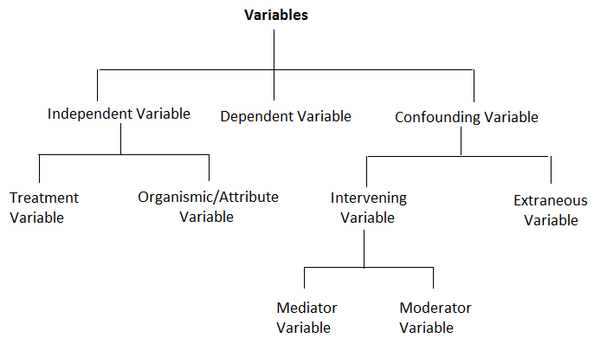
Different types of variables

Slide 5
Independent variable
The independent variable is the conditions or characteristics that the experimenter manipulates or control in his or her attempt to ascertain their relation ship to observed phenomena.
The values of these variables are independent of participant’s behaviour.
Independent variable is also known as stimulus variable or input variable.

Slide 6
Independent variable.......
In educational research, it may be a particular teaching method, a type of teaching material, a reward, or a period of exposure to a particular condition.
It is the cause for change.
An independent variable is the variable on the basis of which prediction about dependent variable is made. Therefore an independent variable is also known as predictor variable, Cause variable, antecedent variable etc.

Slide 7
Independent variable.......
There are two types of an independent variable
Treatment variables: These variables are those factors that the experimenter manipulates and to which the researcher assigns subjects.
Organismic / attribute Variable: These are variables whose characteristics cannot be altered by the experimenter. Eg: age, sex etc.

Slide 8
Characteristics of independent variable
It can cause change in other variable
Independent variable is always interested only in how it affect another variable, not in what it affects it.

Slide 9
Dependent Variable
They are the conditions or characteristics that appear, disappear or change as the experimenter introduces, removes or changes IV Eg: test scores, the number of errors etc.
The variations in the dependent variable depend on the variations in the independent variable.
Dependent variable is also called effect variable, response variable, outcome variable and criterion variable.

Slide 10
Dependent Variable.......
Dependent Variable is called criterion variable because on the basis of the effectiveness of independent variable/ experimental variable is established or studied.
Therefore there is a cause effect relationship between independent and dependent variable.

Slide 11
Confounding Variable
Confounding Variables are those aspects of a study or sample that might influence the dependent variable and whose effect may be confused with the effects of independent variable.
Researcher cannot easily measure or control confounding variable because their effects cannot be easily separated.

Slide 12
Confounding Variable..........
There are two types of confounding variables:
intervening variable
extraneous variable.

Slide 13
Intervening Variable
These variables comes in between independent and dependent variable and they intervene the effect of independent variable, i.e., between cause and effect.
These variables cannot be controlled or measured directly.
Eg: motivation, tiredness, boredom etc.
We cannot measure directly how much they affect the dependent variable.

Slide 14
There are two types of intervening variable
Mediator variable:
variables which tend to influence independent variable which intern influence dependent variable.
Job satisfaction interest in job Job satisfaction

Slide 15
There are two types of intervening variable........
2. Moderator variable:
which tend to have a direct relationship with one part of the sample.
Nature of job Job satisfaction
Gender

Slide 16
Extraneous variable
Extraneous variables are those uncontrolled variables that may have a significant influence upon the result of the study.
Extraneous variables can be defined as any variable other than the independent variable that could cause a change in the dependent variable.
Eg: family history, education of parents etc.
Extraneous variable are dangerous and will affect the validity of the study. It is impossible to eliminate all extraneous variables. But a sound experimental design helps the researcher to neutralise their influence.

Slide 17
Methods of controlling extraneous variables
Removing the variable: Some variables between the subjects may be eliminated by selecting cases with uniform characteristics.
Eg: using only female subjects, removes sex as a variable but there by reduces the generalisation from the study to only females.
Matching cases: This involves selecting pairs or set of individuals with identical and nearby identical characteristics and assigning one of them to experimental group and other to the control group.

Slide 18
Methods of controlling extraneous variables.......
Analysis of covariance: Statistical method of controlling or eliminating the extraneous or unwanted variable. This method is more precise than other methods.
Randomisation: Based on the theory of probability it involves pure chance of selection and assignment of subjects to experimental and control group. This is the most effective method of eliminating systematic bias and minimizing the effect of extraneous variables.

Slide 19
Methods of controlling extraneous variables.......
Balancing cases: Assigning subjects to experimental and control group in such a way that their means and variance are nearby equal to one another. Here the researcher has to decide how much departure from equality can be tolerated without loss of satisfactory control.

