Slide 1
Hull’s Systematic Behavioural Theory/ Drive Reduction Theory

Slide 2
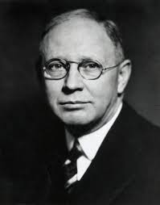
Born- 24/May 1884- NewYork
Died 10/May/1952
Nationality- American
Field- Psychology

