Slide 1
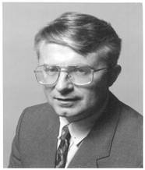
David Paul Ausubel

Slide 2
Ausubel’s
Meaningful Reception Learning
David Paul Ausubel - American psychologist
Ausubel believed that understanding concepts, principles, and ideas are achieved through deductive reasoning.
The most important single factor influencing learning is what the learner already knows.
Developed an interesting theory of meaningful learning and advance organizers.

Slide 3
Meaningful Reception Learning
contracts to rote learning or blind memorization
Alternative form for acquisition of knowledge
Different from discovery learning

Slide 4
Construction of knowledge begins with our observation and recognition of events and objects through concepts we already have.
We learn by constructing a network of concepts and adding to them
stresses the importance of reception rather than discovery learning

Slide 5
Ausebel’s theory focuses on meaningful learning. - to learn meaningfully, individuals must relate new knowledge to relevant concepts they already know.
- New knowledge must interact with the learner’s knowledge structure.

Slide 6
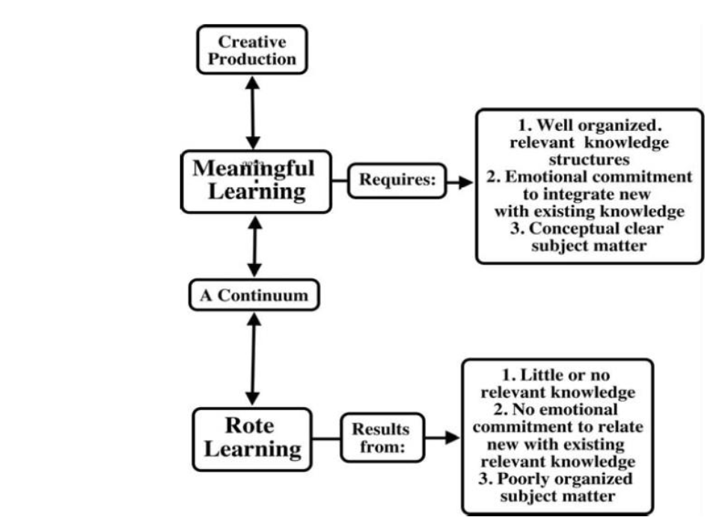

Slide 7
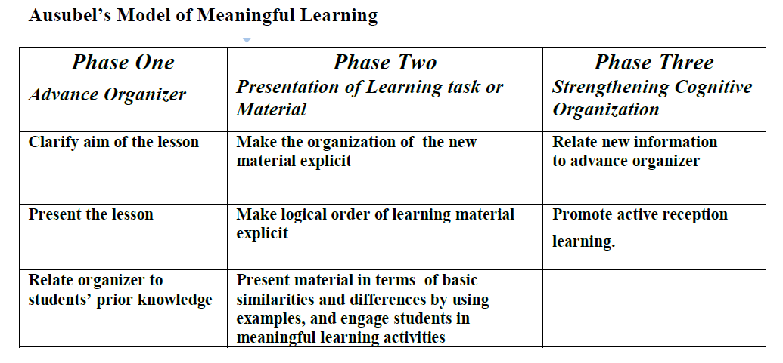

Slide 8
Ausubel ‘s theory
Knowledge structure appropriate for stage of development
Subject matter and stage of development determine goals
Intrinsic motivation
No stimulus required
Cognitivist theory
Holistic approach

Slide 9
Environment and heredity equally significant
Subject provides its own structures and procedures for learning
Student centred
Provide organized opportunities for insight to occur Deductive Thinking process

Slide 10
Characteristics of Expository Teaching
More interaction between teacher and student
Makes greater use of examples- drawings, diagrams, or pictures…
It is deductive
It is sequential

Slide 11
ADVANCED ORGANISERS
Introductory statements of high level concepts that are broad enough to encompass the information that will follow.
The main purpose is to explain, integrate and interrelate, the material in the learning task with previously learned material
Verbal statements presented at the beginning of a lesson that preview and structure the new material and link to the existing knowledge.

Slide 12
It could be a –Definition
- Analogy
- Generalization
- A paragraph form
Conceptual bridge between new and old learning material
They are introductory ideas of a general nature
Broad enough to cover all information to be learnt.
Give information about upcoming lessons or help to remember and use information already have

Slide 13
Two types of ADVANCED ORGANISERS
Expository Organizer: Provide broad generalization within which number of sub classes are presented.
eg:- Intelligent tests-IQ tests, purpose, use etc:

Slide 14
2. Comparative Organizer: it is designed to integrate new concepts with similar concepts found in the cognitive structure.
eg: 5 x 6 = 6 x 5
but division is not like this
believe and deceive

Slide 15
Purposes of ADVANCED ORGANISERS
Direct attention to what is important in the upcoming material
Highlight relationship among ideas that will be presented
Remind the facts that already know

Slide 16
Meaningful verbal Learning
Acquisition of ideas that are linked to other ideas
Interaction between new (subsumed) and more inclusive or generalized concept learned (subsumer)- SUBSUMPTION

Slide 17
TWO TYPES OF SUBSUMPTION
1. Derivative subsumption : new information is derived from exisiting one. (assimilation)
2. Correlative subsumption : new information requires that the existing structure be modified them subsumption take place (accomodation)

Slide 18
Principles of Meaningful verbal Learning
1). Progressive Differentiation: Most inclusive concepts are presented first then to specific
eg: class – sub class
2). Integrative Reconciliation: cross linkages are formed and new inter relationships established between concepts in the cognitive structure
eg: fish- dolphin- mammals

Slide 19
3). Superordinate Learning: New concepts are constructed that pulls together and integrates large domains of knowledge that are previously recognized as intimately related.
eg: Fish – Cartilaginous Skelton- Different fishes already know

Slide 20
4). Combinatorial Learning: New idea is derived from another idea that is of same level in the hierarchy.
Related branch
Learning by analogy or comparison
      Eg: Pollination and Fertilization

Slide 21
Educational Implications
Teaching of Large content matter with lasting retention
Importance of teacher’s role
New knowledge connect effectively with past knowledge
New knowledge become anchors of future knowledge
Advanced organizers

Slide 22
Curriculum construction: Progressive Differentiation and Integrative Reconciliation
Use of example and analogies
Listening ability, Attention capacity etc: increases

