Slide 1
LEARNING
Change in behaviour of the individual brought about by experience.
Modification of behaviour for the attainment of specific goals.
Learning = organism x environment
All changes and modifications in the behaviour of the individual during his lifetime.
Provides a key to the structure of our personality & behaviour.

Slide 2
Definitions of learning
Gates – “ Learning is the modification of behaviour through experience”
Henry P. Smith – “ Learning is the acquisition of new behaviour or the strengthening or weakening of old behaviour as a result of experience”
Crow & Crow – “ Learning is the acquisition of habits, knowledge and attitudes”
Gardner Murphy – “ The term learning covers every modification in behaviour to meet environmental requirements”

Slide 3
Skinner – “Learning is a process of progressive behaviour adaptation”.
In short,
learning – any relatively permanent change in behaviour which occurs as a result of experience or practice”.
This definition has 3 important elements. -Change in behaviour
-through experience/practice
- relatively permanent

Slide 4
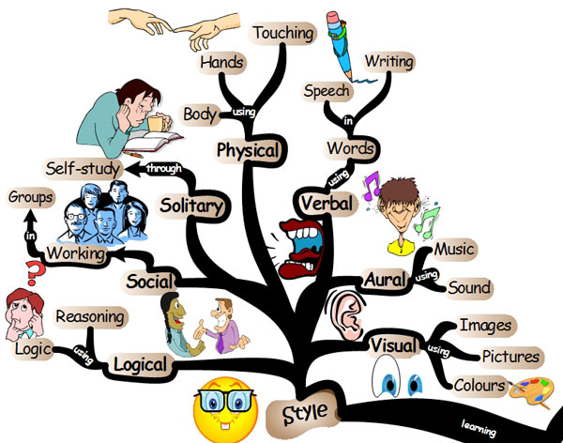

Slide 5
Purpose of learning
Acquisition of knowledge ( Cognitive)
Acquisition of attitudes & ideals (Affective)
Acquisition of skills ( Psychomotor)

Slide 6
Nature of learning
Process not a product.
change in behaviour-involves all those experiences and training.
through practice and experience.
Process of progressive adjustment and adaptation to changing physical as well as social environment.
relatively durable or permanent.
Universal process

Slide 7
Acquisition of habits, knowledge & attitudes.
Process of development.
Both formal & informal process.
Learning is adjustment.
Requires maturation as pre-requisite.
All learning is goal directed or purposive.
Involves reconstruction of experiences
Is transferable from one situation to another
Continuous life long process

Slide 8
Learning does not necessarily imply improvement and development in right direction
Helps in bringing desirable changes in behaviour
Helps in attaining teaching-learning objectives
Helps in realization of life goals
Comprehensive process.

Slide 9
Outcomes of learning
Bringing desirable changes in behaviour
Attainment of teaching – learning objectives
Attainment of proper growth & development
Attainment of balanced personality
Proper adjustment
Realizing the goals of life

Slide 10
Various Aspects of Learning
The various aspects of the process of learning are:
Needs
Readiness
Situation
Interaction

Slide 11
NEEDS Learning begins with the need of the learner. When the need of a learner is strong, he sets definite goal for achievement
This makes learning more concrete.

Slide 12
Readiness A normal child develops readiness to learn, say, reading or writing at a certain age. Children differ in readiness from one another

Slide 13
Situation The learning situations like the home & school provides opportunity for learning.
Special learning situations are also provided by the teacher .

Slide 14
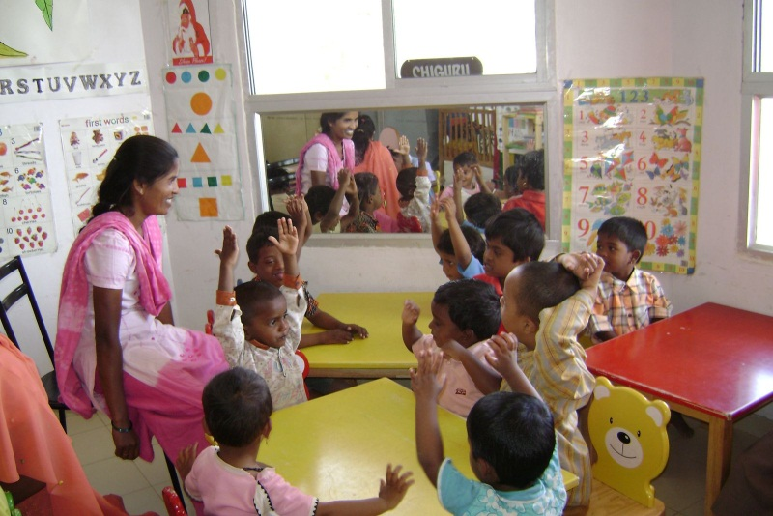
Home
School

Slide 15
Interaction It is the process of responding to a situation and getting feedback from it – satisfaction of the needs.

Slide 16
Learning curve
Graphical representation of how learning takes place in a particular situation.
It is a record of child’s improvement.
In graph,
X axis -- Time interval /Practice
Y axis -- Amount of learning

Slide 17
Types of learning curve
There are different types of learning curve
based on :-
a) The nature of the learner
b) The nature of the task
c) The learning conditions
d) The time available

Slide 18
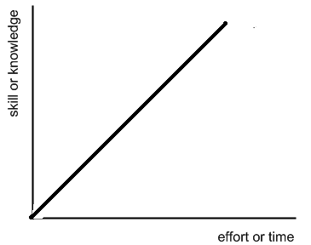
Straight line Curve Curve which shows a constant or uniform rate of progress in learning

Slide 19
2. Convex Curve
Negatively accelerated curve
Shows rapid initial improvement in learning that slows down with time.
Convex curves are seen,
When the task is simple
The learner has previous practice on a similar task

Slide 20
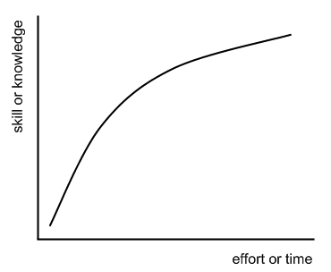

Slide 21
3. Concave Curve
Positively accelerated curve
Shows slow initial improvement in learning that increases with time ultimately leading to the mastery over the learning material.
Concave curves are seen,
When the task is new or difficult
The learner has no pervious experience with similar task

Slide 22
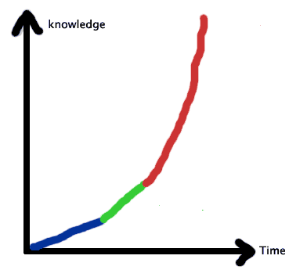

Slide 23
4. Mixed Curve/ Concave – Convex / S - Curve
S – shaped curve – combination of a concave and convex curve depending on rapid or slow initial success followed by a reverse condition in learning.

Slide 24
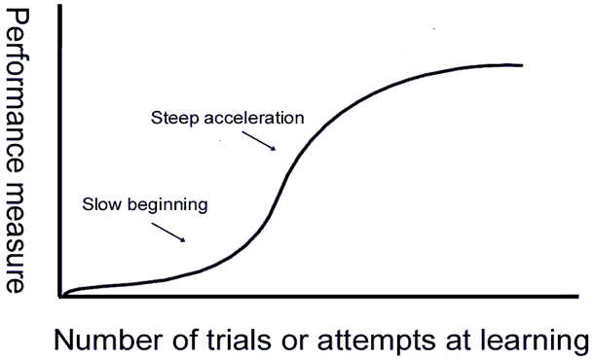

Slide 25
Learning Plateau
Stationary stage where apparently no progress in learning is recorded.
When such a stage is reached, a learning curve takes the form of a straight line and become parallel to the X axis
A period of no progress in a learning curve.
“ A long flat stretch in the learning curve, a long period of almost no improvement, is called a plateau, provided it is followed by more improvement” – Woodworth and Marquis.

Slide 26
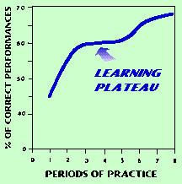

Slide 27
Causes of Learning Plateau
Poor or faulty method of learning.
Physical as well as mental fatigue.
Lack of proper motivation or loss of interest.
Too much difficulty and complexity of the task.
Conflict of previous learning with new learning.
Transition from a lower level to higher level.
Poor and unfavorable environment and working condition.

Slide 28
8. Mental or physical illness of the learner.
9. Distraction or lack of proper attention.
10. Satisfaction of the learner with moderate achievement.
11. Applying a new method.

Slide 29
Elimination of Plateaus
Adopt efficient methods of teaching
Acquaint children with the goals of the work
Arrange learning experiences according to the increasing level of difficulty
Avoid introducing new material in a hurried manner
Use appropriate audio visual aids
Provide incentives to arouse and maintain motivation
Eliminate the distracting factors
Help children to select appropriate method of his learning
Encourage the learner to stop the task for a short while & start again.

Slide 30
Educational Implications/ Uses of Learning Curves
Helps the teacher to acquaint with the individual differences in learning among his students.
To improve the method of teaching.
Helps the teacher to select appropriate teaching aids.
Helps the teacher to maintain a proper account of the regular progress of his students.

Slide 31
Helps the teacher to compare the progress of the students in the class.
Helps the teacher to understand the emotional life and personality characteristics of the learner.
Help the students to acquaint themselves with their own progress and provides opportunity for self-appraisal.

Slide 32
Learning Theories: Behaviourism
Emphasizes the role of environmental stimuli in learning.
Focus on observable responses.
Learning through S-R connection is the primary concern.
Stimulus – an event / object that activates behaviour
Response – observable reaction to a stimulus
Classical conditioning (pavlov), Trial & error learning(Thorndike), Hull’ theory &operant conditioning(skinner) – behaviourist theories

Slide 33
Cognitivism
Learning is an active mental process of acquiring, remembering and using knowledge
Learning – acquisition of knowledge
Focus on individual and differences in cognition
Theories- Gestalt view of learning, Meaningful Verbal Learning by Ausubel & Purposive behaviourism by Tolman

Slide 34
3. Constructivism
Learner construct his own understanding and knowledge , through experiencing things and reflecting on those experiences
Eg: Piaget’s theory, Bruner’s theory – Discovery Learning
Vygotsky ( Social constructivism)

