Slide 1
TPACK
Technological Pedagogical Content Knowledge (TPACK) is a framework to understand and describe the kinds of knowledge needed by a teacher for effective pedagogical practice in a technology enhanced learning environment.
The idea of pedagogical content knowledge (PCK) was first described by Lee Shulman (Shulman 1986) and TPACK builds on those core ideas through the inclusion of technology.

Slide 2
Technology knowledge (TK)
Technology knowledge refers to an understanding of the way that technologies are used in a specific content domain.
For example, for physics teachers, it is an understanding of the range of technologies that physicists use in science and industry.
Within the context of technology integration in schools, it appears to most often refer to digital technologies such as laptops, the Internet, and software applications.
TK does however go beyond digital literacy to having knowledge of how to change the purpose of existing technologies (e.g. wikis) so that they can be used in a technology enhanced

Slide 3
Content knowledge (CK)
Content knowledge may be defined as “a thorough grounding in college-level subject matter” or “command of the subject” (American Council on Education, 1999).
It may also include knowledge of concepts, theories, conceptual frameworks as well as knowledge about accepted ways of developing knowledge (Shulman, 1986).

Slide 4
Pedagogical knowledge (PK)
Pedagogical knowledge includes generic knowledge about how students learn, teaching approaches, methods of assessment and knowledge of different theories about learning (Harris et al., 2009; Shulman, 1986).
This knowledge alone is necessary but insufficient for teaching purposes. In addition a teacher requires content knowledge.

Slide 5
Pedagogical content knowledge (PCK)
Pedagogical content knowledge is knowledge about how to combine pedagogy and content effectively (Shulman, 1986).
This is knowledge about how to make a subject understandable to learners.
Archambault and Crippen (2009) report that PCK includes knowledge of what makes a subject difficult or easy to learn, as well as knowledge of common misconceptions and likely preconceptions students bring with them to the classroom.

Slide 6
Technological Content Knowledge (TCK)
Technological content knowledge refers to knowledge about how technology may be used to provide new ways of teaching content(Niess, 2005).
For example, digital animation makes it possible for students to conceptualize how electrons are shared between atoms when chemical compounds are formed.

Slide 7
Technological Pedagogical Knowledge (TPK)
Technological pedagogical knowledge refers to the affordances and constraints of technology as an enabler of different teaching approaches (Mishra & Koehler, 2006).
For example online collaboration tools may facilitate social learning for geographically separated learners.

Slide 8
Technological Pedagogical Content Knowledge (TPCK)
Technological pedagogical content knowledge refers to the knowledge and understanding of the interplay between CK, PK and TK when using technology for teaching and learning (Schmidt, Thompson, Koehler, Shin, & Mishra, 2009).
It includes an understanding of the complexity of relationships between students, teachers, content, practices and technologies (Archambault & Crippen, 2009).

Slide 9
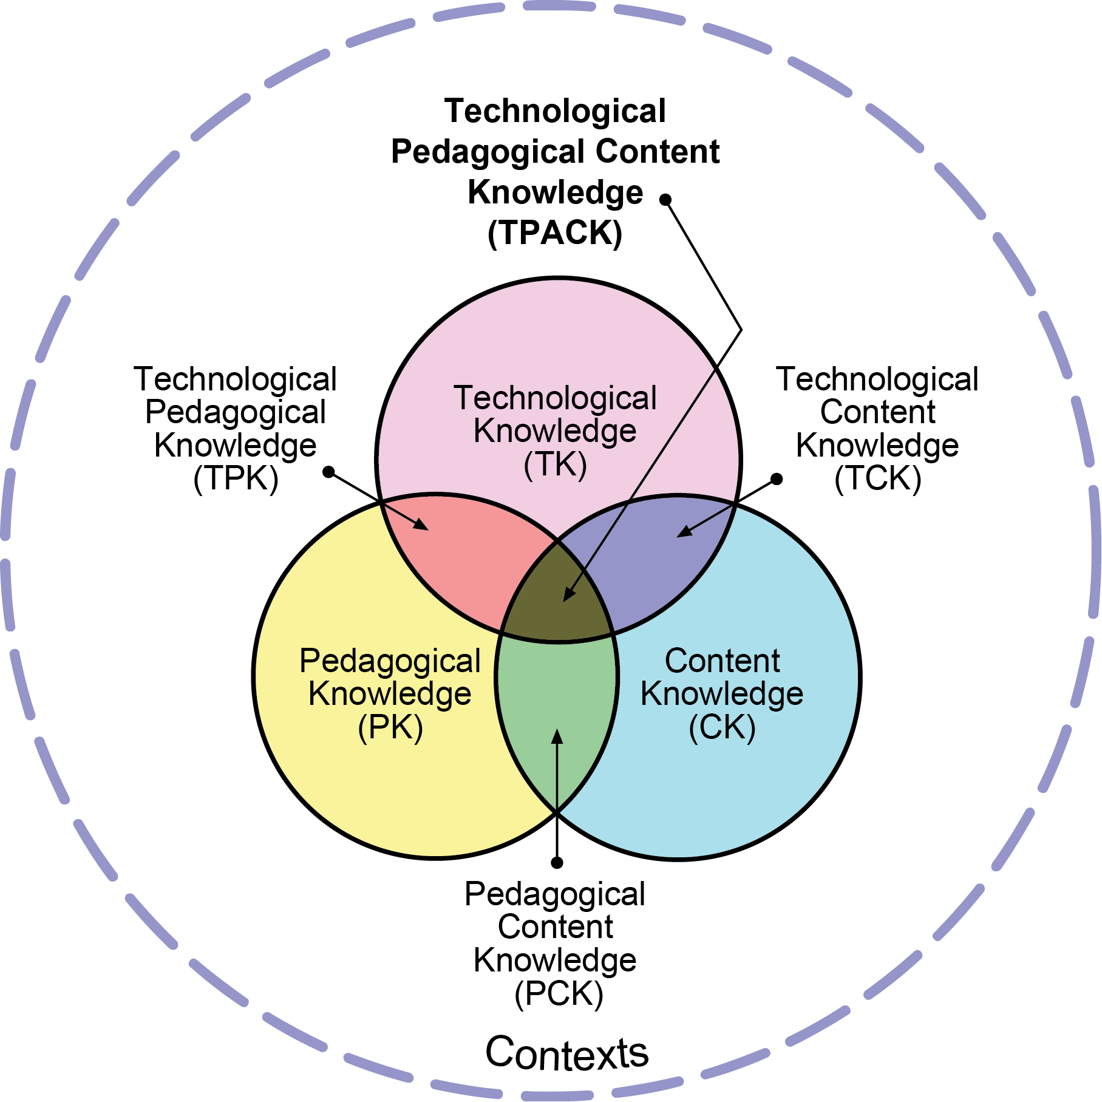

Slide 10
Technological Pedagogical Content Knowledge (TPACK) attempts to identify the nature of knowledge required by teachers for technology integration in their teaching, while addressing the complex, multifaceted and situated nature of teacher knowledge

Slide 11
Content Knowledge (CK)
“Teachers’ knowledge about the subject matter to be learned or taught. The content to be covered in middle school science or history is different from the content to be covered in an undergraduate course on art appreciation or a graduate seminar on astrophysics…
As Shulman (1986) noted, this knowledge would include knowledge of concepts, theories, ideas, organizational frameworks, knowledge of evidence and proof, as well as established practices and approaches toward developing such knowledge” (Koehler & Mishra, 2009).

Slide 12
Pedagogical Knowledge (PK)
“Teachers’ deep knowledge about the processes and practices or methods of teaching and learning. They encompass, among other things, overall educational purposes, values, and aims.
This generic form of knowledge applies to understanding how students learn, general classroom management skills, lesson planning, and student assessment.” (Koehler & Mishra, 2009).

Slide 13
Technology Knowledge (TK)
Knowledge about certain ways of thinking about, and working with technology, tools and resources. and working with technology can apply to all technology tools and resources.
This includes understanding information technology broadly enough to apply it productively at work and in everyday life, being able to recognize when information technology can assist or impede the achievement of a goal, and being able continually adapt to changes in information technology (Koehler & Mishra, 2009).

Slide 14
Pedagogical Content Knowledge (PCK)
“Consistent with and similar to Shulman’s idea of knowledge of pedagogy that is applicable to the teaching of specific content.
Central to Shulman’s conceptualization of PCK is the notion of the transformation of the subject matter for teaching. Specifically, according to Shulman (1986), this transformation occurs as the teacher interprets the subject matter, finds multiple ways to represent it, and adapts and tailors the instructional materials to alternative conceptions and students’ prior knowledge.
PCK covers the core business of teaching, learning, curriculum, assessment and reporting, such as the conditions that promote learning and the links among curriculum, assessment, and pedagogy” (Koehler & Mishra, 2009).

Slide 15
Technological Content Knowledge (TCK)
“An understanding of the manner in which technology and content influence and constrain one another. Teachers need to master more than the subject matter they teach; they must also have a deep understanding of the manner in which the subject matter (or the kinds of representations that can be constructed) can be changed by the application of particular technologies.
Teachers need to understand which specific technologies are best suited for addressing subject-matter learning in their domains and how the content dictates or perhaps even changes the technology—or vice versa” (Koehler & Mishra, 2009).

Slide 16
Technological Pedagogical Knowledge (TPK)
“An understanding of how teaching and learning can change when particular technologies are used in particular ways.
This includes knowing the pedagogical affordances and constraints of a range of technological tools as they relate to disciplinarily and developmentally appropriate pedagogical designs and strategies” (Koehler & Mishra, 2009).

Slide 17
Technological Pedagogical Content Knowledge (TPACK)
“Underlying truly meaningful and deeply skilled teaching with technology, TPACK is different from knowledge of all three concepts individually.
Instead, TPACK is the basis of effective teaching with technology, requiring an understanding of the representation of concepts using technologies; pedagogical techniques that use technologies in constructive ways to teach content; knowledge of what makes concepts difficult or easy to learn and how technology can help redress some of the problems that students face; knowledge of students’ prior knowledge and theories of epistemology; and knowledge of how technologies can be used to build on existing knowledge to develop new epistemologies or strengthen old ones” (Koehler & Mishra, 2009).

Slide 18
Teacher as a Techno Pedagogue
The term “pedagogue” is derived from two Greek words pais, paidos meaning boy and agogos meaning guide which together connotes a teacher.
Thus pedagogic implies the science of teaching.
By pedagogic analysis we mean a logical and systematic breakup of the curriculum from the point of view of a pedagogue [teacher] for the purpose of its effective transaction.

Slide 19
Techno pedagogy is a key deciding factor in while an educational media product is a successful or not.
Literally ‘pedagogy’ refers to art, the art skill handcrafting, derived from the Latin texere [to weave or fabricate].Here techno is a qualifier; it intersects or crosses the meaning of ‘pedagogy’ with its own.
Techno pedagogy refers to the techniques of the craft of teaching into the learning environment itself.
It requires conscious recognition of the mediated learning environment in order to maximize the ease and clarity in the transmission of information.

Slide 20
Technology in professional development is a complex issue.
Technology helps higher education to overcome previous outreach barriers, particularly in reaching students in remote location.
Because technologies are continually changing, the instability of technology, as well as the unfired nature of the knowledge required in using them, places in additional demands on faculty to keep up with constant stream of new technologies

Slide 21
Technology is a broad and constantly changing skill- set required of faculty and selecting the appropriate techno pedagogical strategies to effectively engage students in the content is a separate skill- set.
Media literacy influence students’ development and developing a critical analysis of media consumption is an important skill for students. Pedagogy and e- learning co- constructive pedagogies together.
The dynamics of classrooms change when e- learning is a part of regular learning environment.

Slide 22
The technological pedagogical content knowledge is a collaboratively developed frame work of scholars and researchers seeking to conceptualize and clarity the competencies that evolve from the inter section between pedagogy and technology.
Pedagogical content knowledge was first described by Leeshulman [1986] and TPACK builds on core ideas through the inclusion of technology.
Technological content knowledge refers to knowledge about how technology may be used to provide new ways of teaching content.

Slide 23
Content knowledge is a is a teacher’s knowledge about the subject matter to be learned for taught.
It defines as “a through grounding in college level subject matter or comment of the subject.” It may also include knowledge or concepts, theories conceptual frames as well as knowledge about accepted ways of developing knowledge.
Knowledge of content is critical importance for teachers.
As ideas organizational frame works, knowledge of evidence and proof as well as established practices and approaches towards developing such knowledge.

Slide 24
Pedagogical knowledge is deep knowledge about processes and practices or methods of teaching and learning.
They encompass, among other things, overall educational purpose, values and aims, this generic form of knowledge applies to understanding how students learn, general classroom management skills, and lesson planning and student’s assessment.
It includes knowledge about techniques or methods used in the classroom.

Slide 25
A teacher with deep pedagogical knowledge understands how students construct knowledge and acquire skills and how they develop habits of mind and positive dispositions toward learning.
Pedagogical knowledge requires an understanding of cognitive and developmental theories of knowledge and how they are play to students in the classrooms.

Slide 26
Technological knowledge is always in a state of flux. Thus defining it is difficult.
Technology knowledge is the basis of effective teaching with technology. Requiring and understanding of the representation of concepts using technologies; pedagogical techniques that use technologies in constructive ways to teach content; knowledge of what makes concepts difficult or easy to learn and how technology can help redress some of the problems that students face; knowledge of students prior knowledge and theories of epistemologies or strengthen old ones.

Slide 27
TPACK is an emergent form of knowledge that goes beyond all ‘core’ components [content, pedagogy and technology]. Technological pedagogical content knowledge is an understanding that emerges from interactions among content, pedagogy and technology knowledge.
Underlying truly meaningful and deeply skilled teaching with technology, TPACK is different from all there concepts individually. It is the basis of effective teaching with technology.

Slide 28
CONCLUSION
Technology in the classroom is becoming more and more predominant.
Students prefer technology because they believe that makes learning more interesting and fun.
Subjects that students deem challenging or boring can become more interesting with virtual lessons, through a video or when using a tablet.
Using technology in the classroom would help prepare them for the digital future. Technology occupies an important place.

